Slide 1
CGMS-MOROCCO STATUS
El Hairech T., Balaghi R., De Witt A., Van Der Wijngaart R.

Slide 2
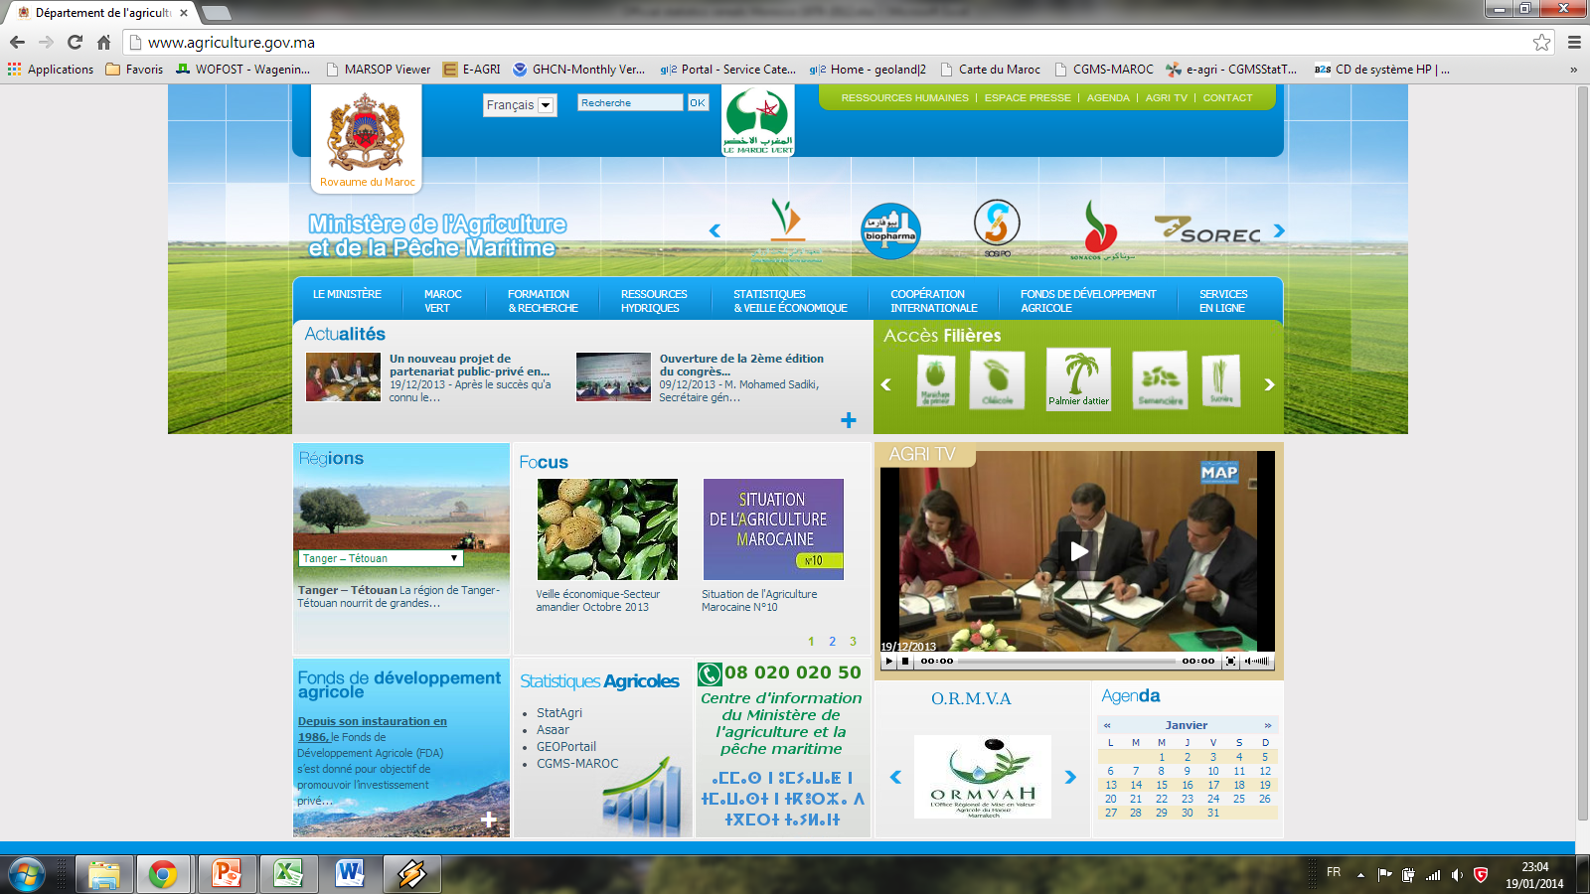

Slide 3
CGMS-MOROCCO :IT Infrastructure
NRT Processing and feeding the web wiewer
Weather data integration and calculation, Climate data interpolation, WOFOST simulation , Agregation and CST
CGMS-MA oracle 11 g R2 Server
WWW.CGMS-MAROC.MA/CGMS-MA

Slide 4
CGMS-MOROCCO : INPUTS
LEVEL 1
RT and HISTORIC DAILY RAW MET DATA FROM DMN NETWORK ( 43 stations)
RT and HISTORIC DAILY RADIATION and PET CALCULATIONS
LEVEL 2
FINE SCALE SOIL MAP FROM INRA
CROP PARAMETERS FOR SOFT AND DURUM WHEAT
LEVEL 3
SPOT/MODIS NDVI AND MDP FROM 2000 UP TO LAST DECADE
REGULAR INTERPOLATION GRID OF ABOUT 9 KM COVERING ALL MOROCCO
WATER BALANCE INITIALIZATION STRATEGY FOR WOFOST SIMULATIONS
« Glcrop V2 » CROP MASK
4 NUTS LEVEL: DISTIRICT, PROVINCE, AEZ AND NATIONAL
YIELD AND AREA STATISTICS FROM DSS

Slide 5
CGMS-MOROCCO : OUTPUTS
LEVEL 1: RT AND HISTORIC INTERPOLATED GRID OF DAILY CLIMATE VARIABLES FROM 01/01/1987 UP TO DATE
LEVEL 2: WOFOST OUTPUTS AT EMU LEVEL AND AGGREGATED AT DISTRICT LEVEL FROM 1988 UP THE LAST DEKADE
POTENTIAL AND WL Variables
LEVEL 3: LINEAR REGRESSION AND SIMILARITY ANALYSIS FOR YIELD FORECASTING :
Rainfall
Temperatures: Tmax and Tmin
Wind Speed
PET: E0, ES0, ET0
Radiation
DEVELOPMENT_STAGE
RELATIVE_SOIL_MOISTURE
TOTAL_WATER_CONSUMPTION
TOTAL_WATER_REQUIREMENT
FSM
FSMUR
LEAVES_DIED_BY_COLD
RUNOFF
SOIL_EVAPORATION
LOSS_TO_SUBSOIL
CUMULATED AND AGGREGATED RAINFALL
CUMULATED AND AGGREGATED NDVI
CUMULATED AND AGGREGATED WOFOST OUTPUTS

Slide 6
CGMS-MOROCCO : perspectives
WEATHER DATA
Adding more than 100 new stations in CGMS-MA@Level1 database
Exploring the added value of climate seasonal forecasting

Slide 7
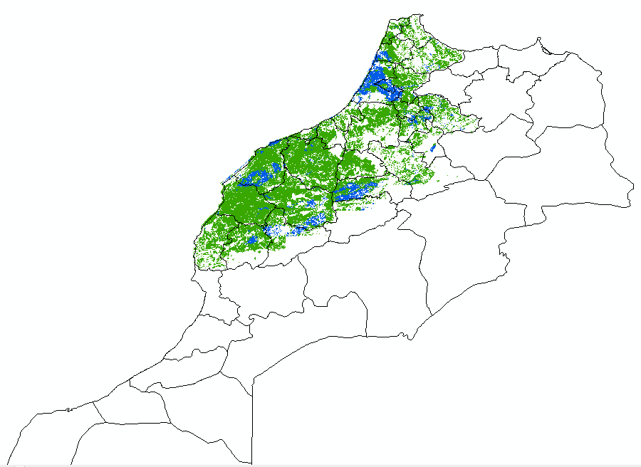
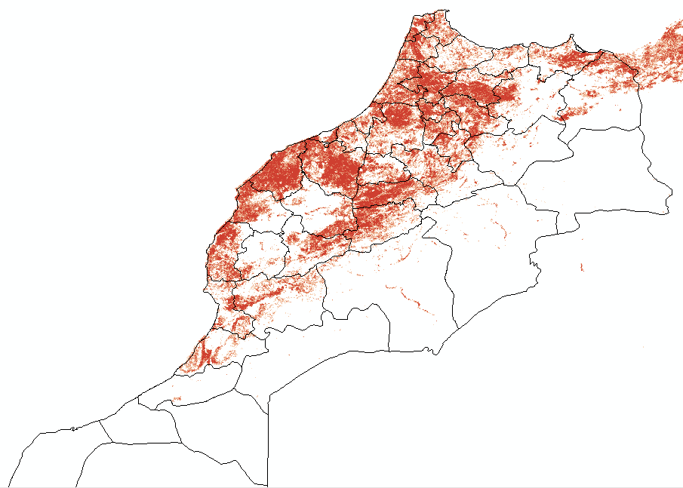
CGMS-MOROCCO : perspectives
CROP GROWTH MODELING
Updating the GLcropV2 mask by the more detailed DSS mask
Adapting BIOMA Platform: ( New rules for sowing date, Cropsyst outputs, disease modelling ….)
DSS Crop mask
GLcropV2
Irrigated
Rainfed

Slide 8
شكرا
謝謝您
Thank you

