Slide 1

E-AGRI: DRSRS ROLE INTEREST AND EXPERTISE
Charles Situma
Nairobi , Kenya
Charles.situma@yahoo.com

Slide 2
Department of Resource Surveys and Remote Sensing (DRSRS)
www.drsrs.go.ke

Slide 3
DRSRS
Mission: Provision of Geo-Spatial data for decision-making in National development
Vision: a leading national focal centre of excellence in matters of Geo-Spatial science for rapid decision-making
Mandate:
Collection, storage, archiving, analysis, updating and dissemination of geo-spatial information on natural resources.
The data collected is processed and integrated leading to informed decision-making preparation of development plans and formulation of sector policies.

Slide 4
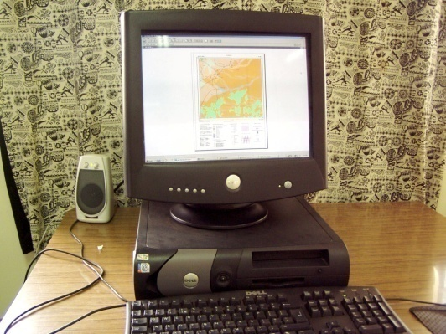
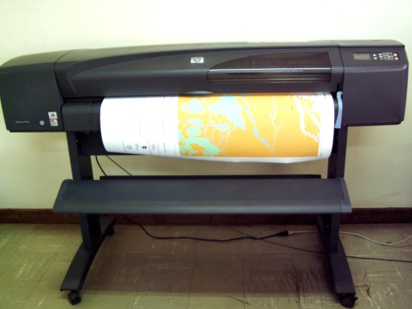
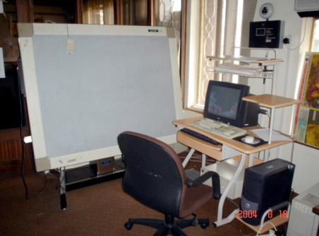
DRSRS Capabilities
Institution capacities
Hard/Soft-wares
Over 40 state-of-the-Art h/ware
ArcGIS
Geovis
GPS
ILWIS
ERDAS
IDRISI
3 twin engine aircraft, have modern navigation system for precise aerial survey & aerial photography
4

Slide 5
Maize and wheat are the main staple food in Kenya accounting for over 80 percent of total cereals used at a household level
Rice is the third most consumed cereal
Each year the Food Steering Committee (FSC) of the Office of State, Special Programmes require information on Area, Yield and Production of these cereals

Slide 6
60’s
Spatial Population Distribution
70’s
80’s
90’s

Slide 7
Changes in population demography (1948-2009)

Slide 8
INTEREST IN E-AGRI
Crop area stratification
Estimation of area crop using vertical aerial photography
Determination of crop yield per hectare
Computation of crop production
Computation of consumption

Slide 9
Users of maize and wheat crop data
Aerial
Photos
Satellite
Images
NDVI
Crop
Area
Crop
Yield
Crop
Prod
Min of Agriculture
Min of State -FSC
Universities/Research
Bureau of Statistics
FEWSNET
RCMRD
NGOs
Private Firms
Individuals

Slide 10
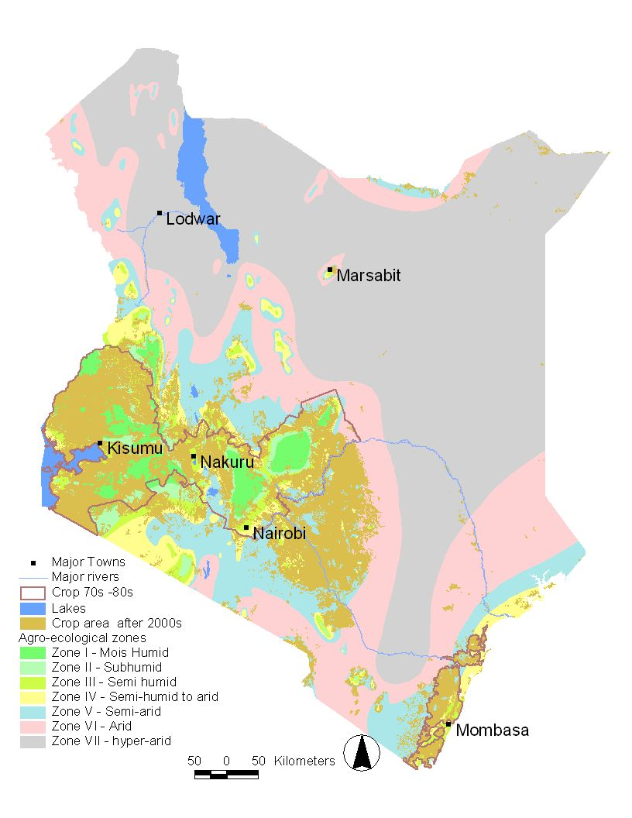
Agriculture expansion between 1990’s and 2000’s
Population of Kenya in 2009 census = 38,610,097 people
20 % of Kenya support crop cultivation significant to the economy
Kenya requires approx 31 - 34 million bags of maize and 9 -11 million bags of wheat annually
Balance in food deficit met by substantial quantities of rice, potatoes and pulses produced locally and also from imports

Slide 11
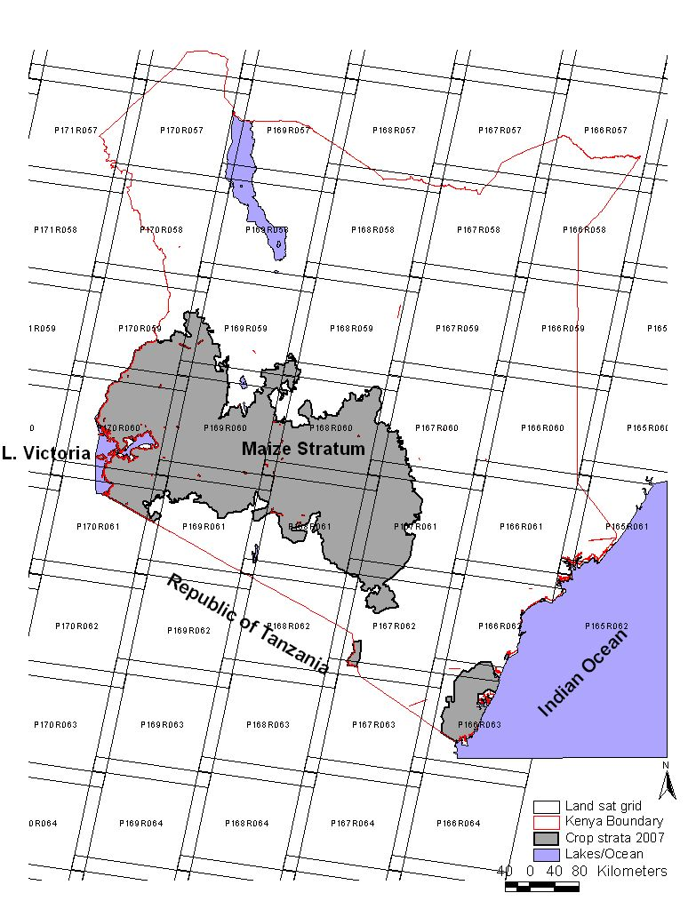
Satellite Data for Determination of Crop Strata
16 Landsat satellite scenes cover agricultural area
Cost: free for Landsat
Cost: Aster = US D 1,520
Economical
Poor accuracy

Slide 12
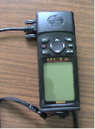

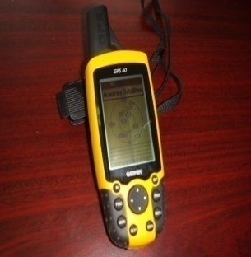
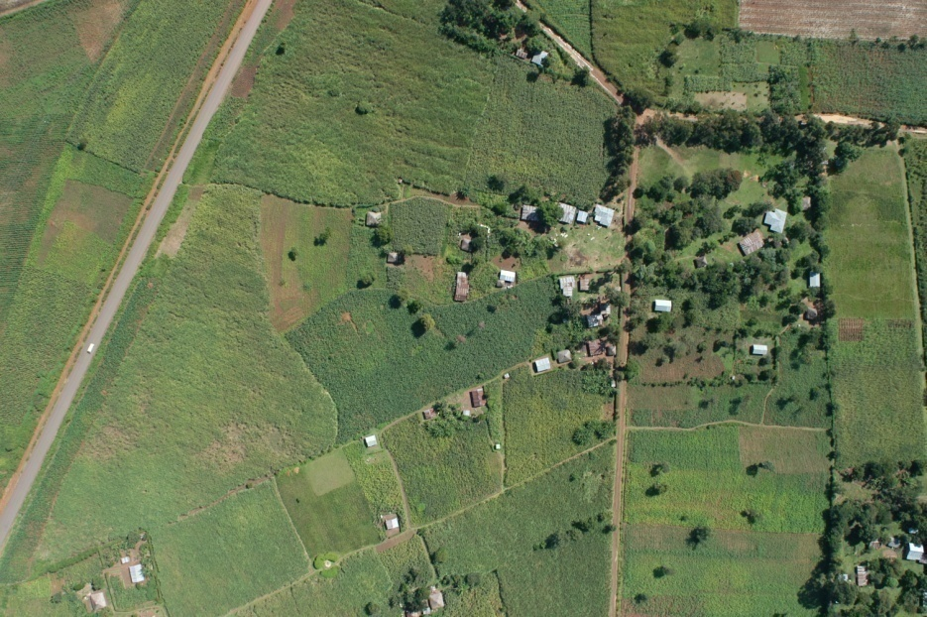
METHODS: ESTIMATION AREA
Aircraft:
High winged twin or single engine (P68 or Cessna )
Flying height of 1600 ft
Camera:
A 35 mm camera, 20 mm wide-angle lens
GPS:
Set to UTM WGS 84 datum or Geographic
Photographs:
Vertical
Scale is approx. fixed

Slide 13
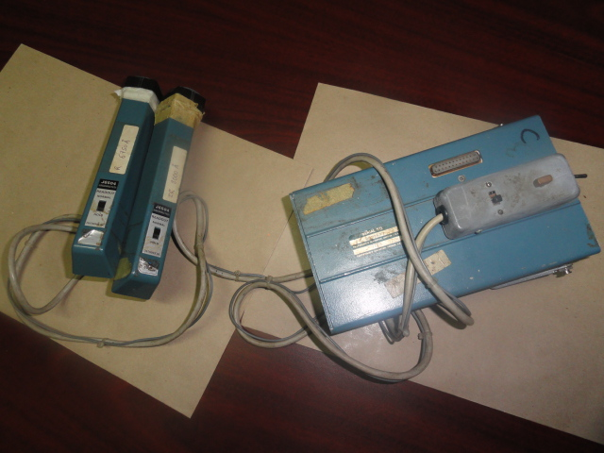
METHODS: DETERMINATION OF CROP YIELD
Tektronix J16 digital radiometer
Applies Remote Sensing Techniques a ratio of near-infrared and red band reflectance (NIR-VIS)/(NIR+VIS) is a surrogate for primary production
Tussled maize
NIR -700 - 1300nm
VIS - 400 - 700nm

Slide 14
Relationship between Yield and ratio of R/IR –Embu District in 1984

Slide 15
Regression in Maize yield vs Production in selected districts 2004-07

Slide 16
Trends in maize yield

Slide 17
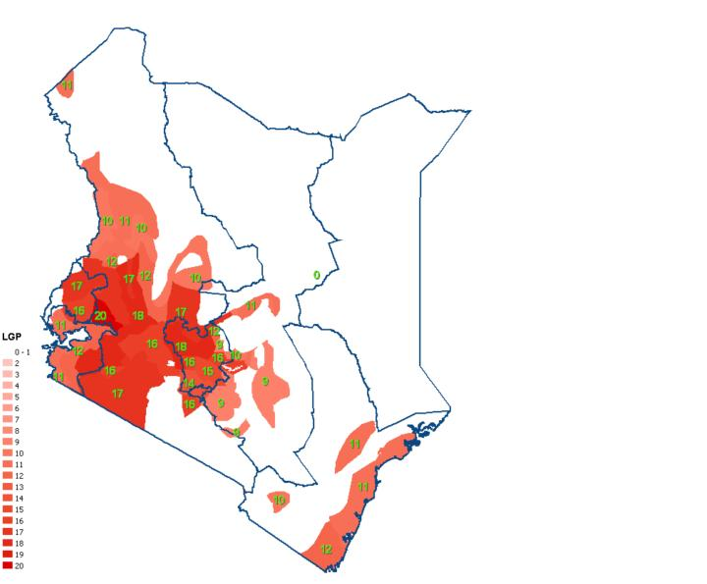
Collateral Information
Crop calendar
LGP
Seasonal progression of rainfall pattern
Agronomic practices
Soil moisture
ETP
Crop growth model
Source: MoA, 2004

Slide 18
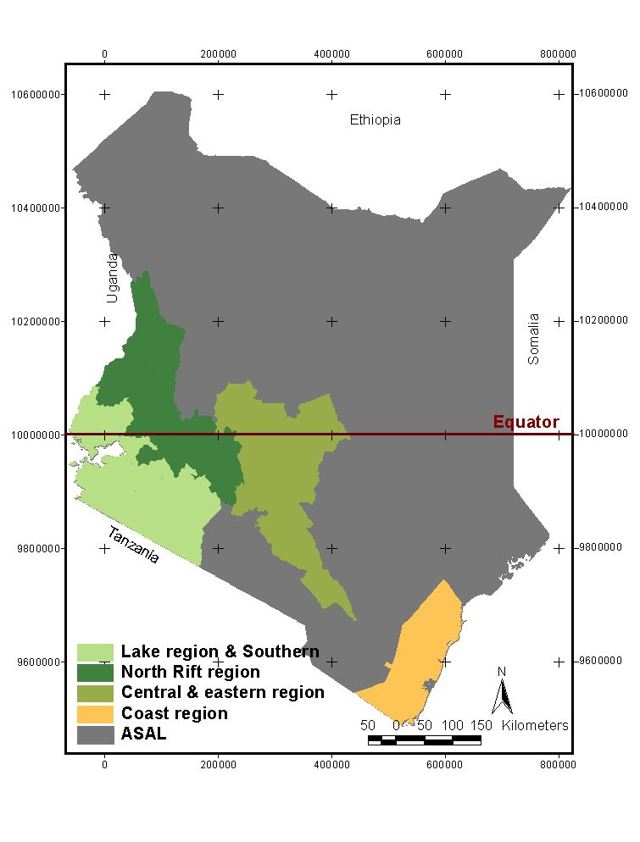
Crop calendar Cont’d
Long rains maize planting begin in Feb - March,
harvesting in July-Aug
Long rains maize planting begin in March - April, harvesting in September -Dec
Long rains maize planting begin in March, harvesting in July-Aug
Long rains maize planting begin in March, harvesting in June-July
Lake Region & Southern | North Rift/Western | Central & Eastern | Coast
BOMET | BUNGOMA | EMBU | KILIFI
BONDO | KEIYO | KIAMBU | KWALE
BURET | KERICHO | KIRINYAGA | MALINDI
BUSIA | KOIBATEK | LAIKIPIA
BUTERE/MUMIAS | LUGARI | MACHAKOS
GUCHA | MARAKWET | MAKUENI
HOMA BAY | MT ELGON | MARAGUA
KAKAMEGA | NAKURU | MBEERE
KISII CENTRAL | NANDI | MERU CENTRAL
KISUMU | NYANDARUA | MERU NORTH
KURIA | TRANS NZOIA | MERU SOUTH
MIGORI | UASIN GISHU | MURANGA
NAROK | WEST POKOT | NYERI
NYAMIRA |  | THARAKA
NYANDO |  | THIKA
RACHUONYO
SIAYA
SUBA
TESO
TRANS MARA
VIHIGA

Slide 19
Agronomic Factors
Factors
Land preparation (mechanized, traditional
Type of seed (certified, traditional)
Planting pattern (broadcast etc)
Seed spacing
Fertilizer used (compost, etc)
etc
Largescale farmers
Range from 10 ha – 50 ha
Small scale farmers
Range from 2 ha – 12 ha
Small scale farmers
Range from 1 ha – 5 ha

Slide 20
Anomalies
Kajiado district, 2008
Isiolo district, 2008
Anomalies

Slide 21
Crop Production
Production = Area * Yield

Slide 22
Maize consumption/Production 1985-2010
Average consumption rate being 98 Kg per person per year (FEWSNET, 1997)
Source: DRSRS Database 1985-2010)

Slide 23
Wheat
Average consumption rate of wheat being 27 Kg per person per year (FEWSNET, 1997)
Source: DRSRS Technical 2004-2007

Slide 24
Recommendations
Need to increase in crop yield since area appear crop appear to remain relatively constant year after year
Need to increase field checks to improve the Confusion Connotation matrix or error matrix
The Government should continue sponsoring crop monitoring and assessment programme since it has proved reliable
Research on use of satellite imagery for area estimation of crop in comparison to aerial use of photography
Continuously review regression relationship between yield and spectrometric ratio of RED/INRA-RED in each AEZ
Increase and enhance collateral information sources

Slide 25
End
Thank you

