Slide 1
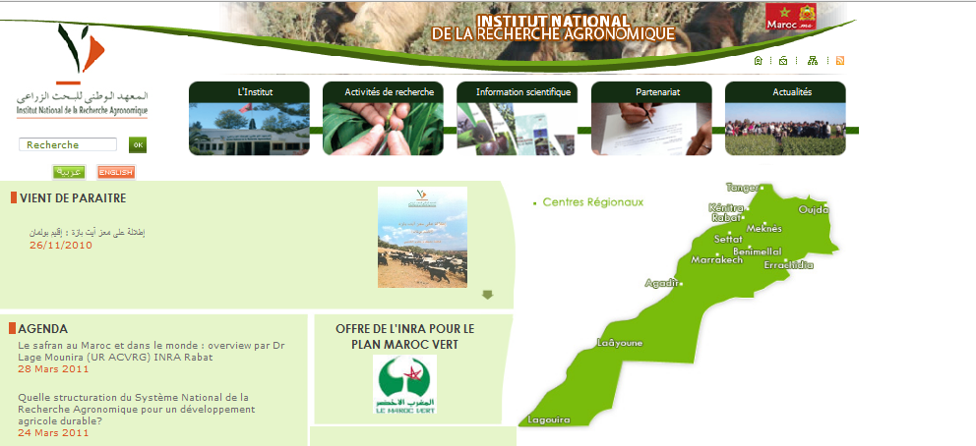
Introduction to INRA - Morocco
Riad BALAGHI
National Institute for Agricultural Research – Morocco
www.inra.org.ma

Slide 2
INRA - Morocco
The National Agricultural Research Institute of Morocco (INRA-Morocco) is a publicly-owned establishment with a moral entity and financial autonomy.
INRA- Morocco has the mandate for applied crop and livestock research at national level.
INRA- Morocco is the major agricultural research institution in Morocco.
Funding for research comes mainly from the government.

Slide 3
INRA - Morocco
INRA-Morocco headquarters are in Rabat.
It has eight scientific departments (environment and natural resources, plant breeding and resources, plant protection, agronomy and machinery, livestock, food technology, socio-economics and R&D) supervising all research and R&D projects.

Slide 4
INRA - Morocco
Currently (2008), INRA-Morocco has about 1259 employees, including 191 researchers working in various scientific areas (crops, breeding, land management, livestock, food technology, etc.), except forestry and fisheries.
Other activities cover technology transfer (through its extension Services), and education (support to graduate student’s thesis, lectures at several universities, etc.).

Slide 5
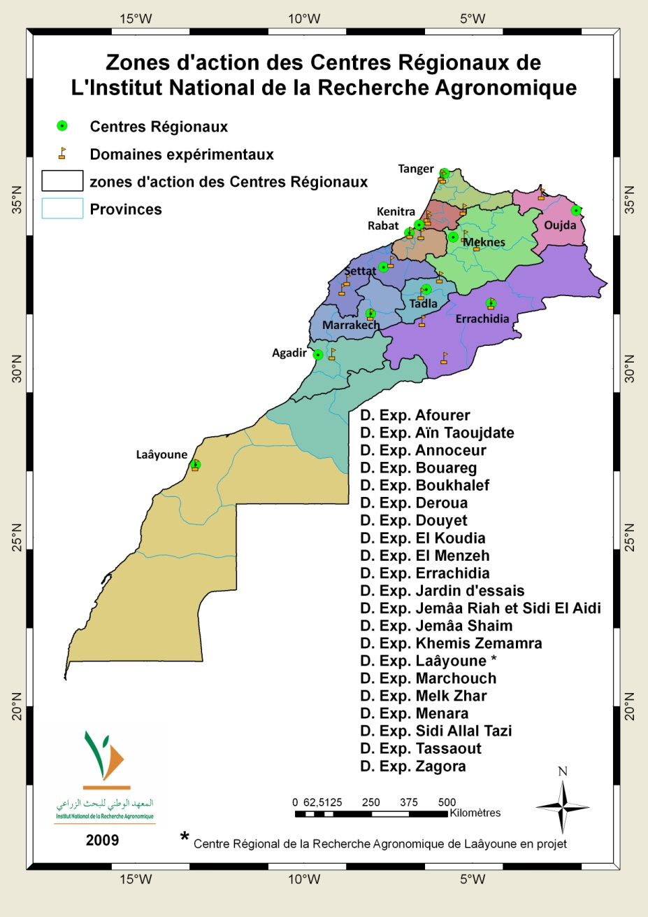
INRA - Morocco
INRA-Morocco has 10 regional centres and 23 experimental stations located in almost all agro-ecological zones of the country.

Slide 6
INRA - Morocco
INRA has published the agro-climatic maps of Morocco and land suitability maps for almost all the agricultural areas of Morocco.
INRA has the broadest national experience in the field of crop yield forecasting for the major crops in Morocco.
INRA has one of the unique experiences in climate change impacts on crop productivity.

Slide 7
Strategic research programs at INRA
Characterization and conservation of natural resources (water, soil and agro-biodiversity) ;
Crop and animal breeding ;
Development of technological packages to increase productivity and improve quality of agricultural products;
Valorization of agricultural products ;
Socio-economic impact studies ;
Research & developement, and technology transfert.

Slide 8
Soil conservation – No till system

Slide 9
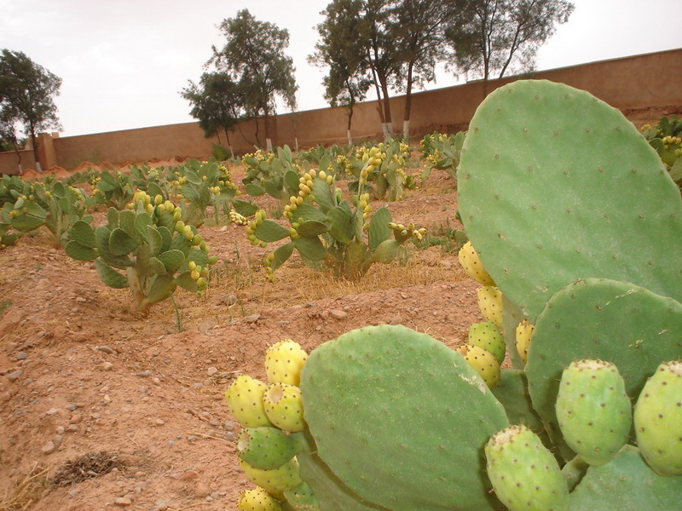
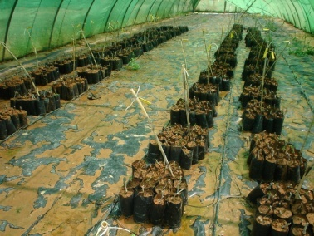
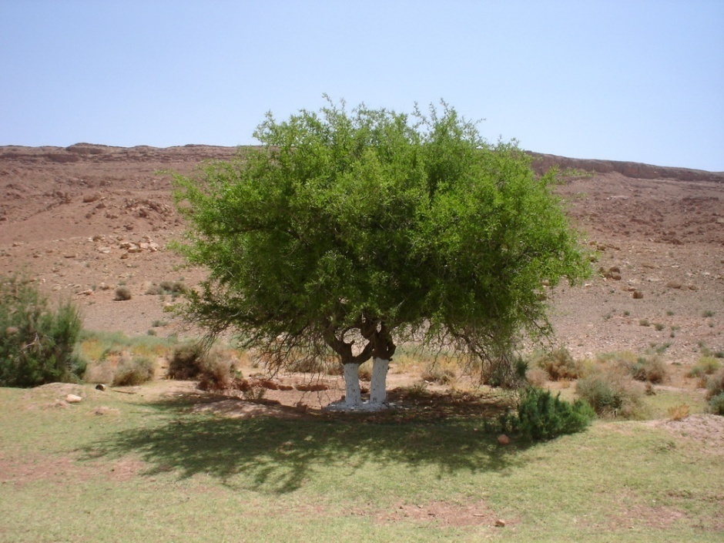
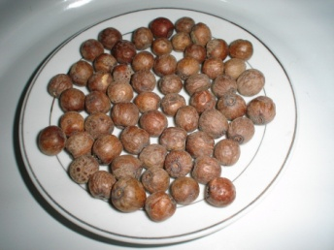
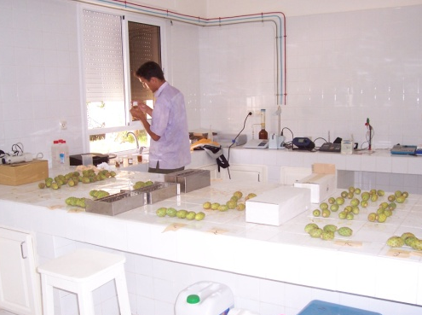
Agro-biodiversity
Opuntia ficus indica (L.)

Slide 10
Agro-biodiversity

Slide 11
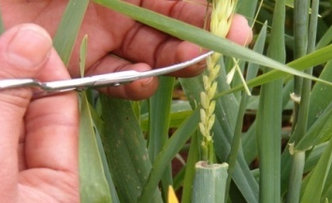
Crop breeding
Drought and diseases resistant varieties
INRA - Morocco, 2009
Notes:
11

Slide 12
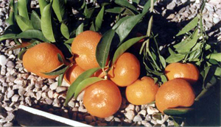
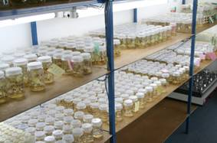
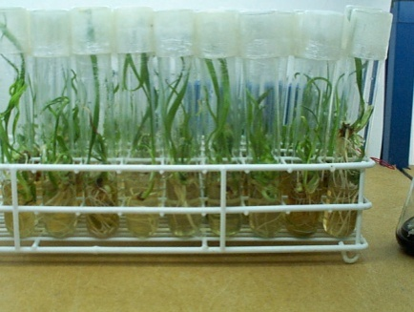
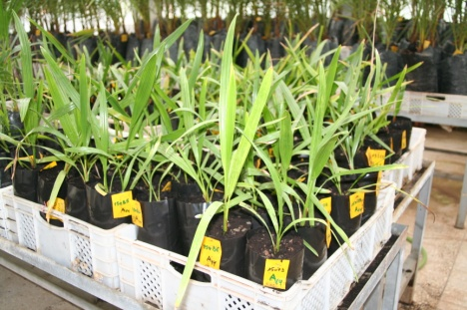
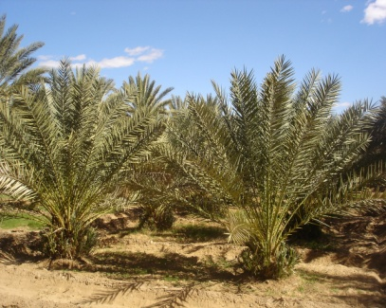
Technologies for agricultural green water management
Crop breeding
Drought and diseases resistant varieties
INRA - Morocco, 2009
A world wide date palm achievement : resistance to Bayoud. 120 000 Najda seedlings released
Notes:
12

Slide 13
Agro-climatic characterization - LGP

Slide 14
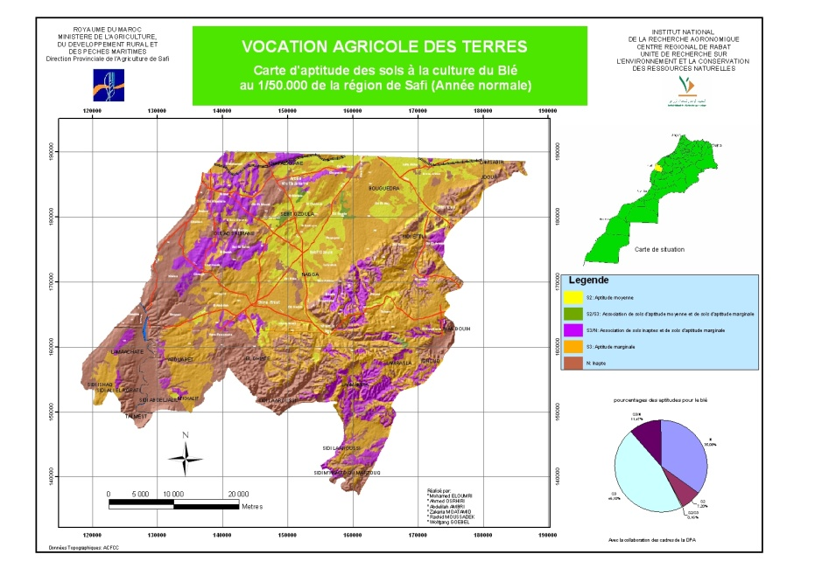
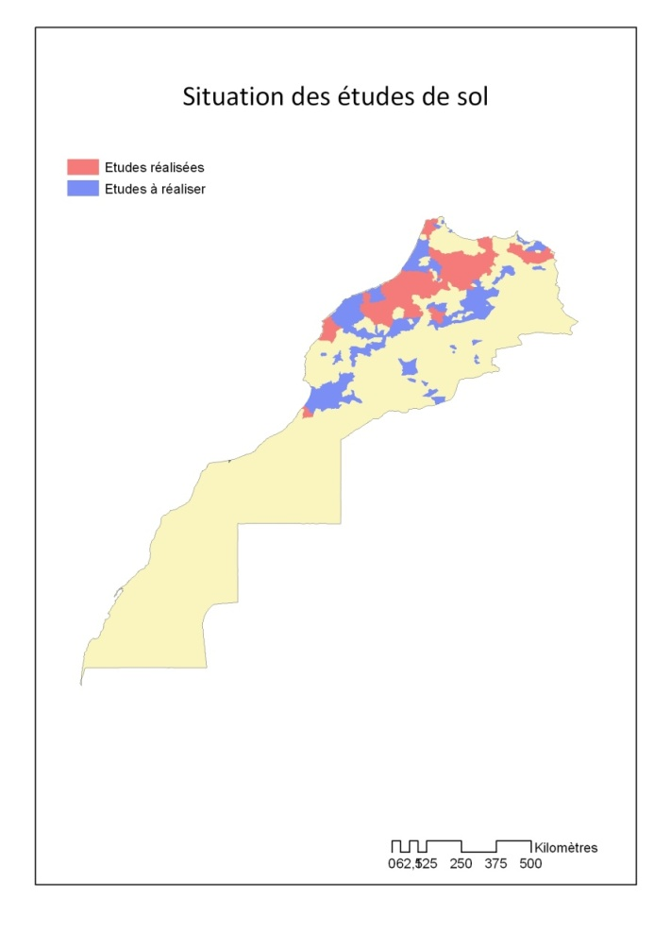
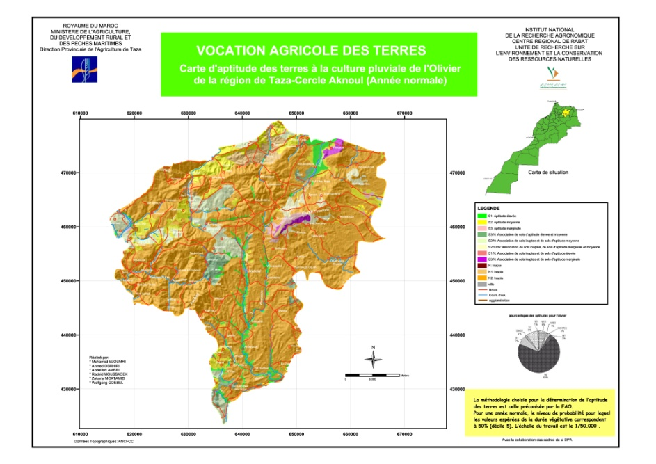
Land suitability maps
Maps for ≈ 6 million hectares

Slide 15
Climate change vs. Land suitability

Slide 16
Agro-climatic characterization
Climatic characterization
Crop forecasting
National wheat yield vs. Rainfall in Morocco
Rainfall Probabilities in Morocco
http://mars.jrc.it/mars/content/download/1436/8124/file/MoBul09_03_English.pdf

Slide 17
Crop Growth Monitoring System - Morocco
http://marsstat.jrc.it/gaia/frameview.phtml

Slide 18
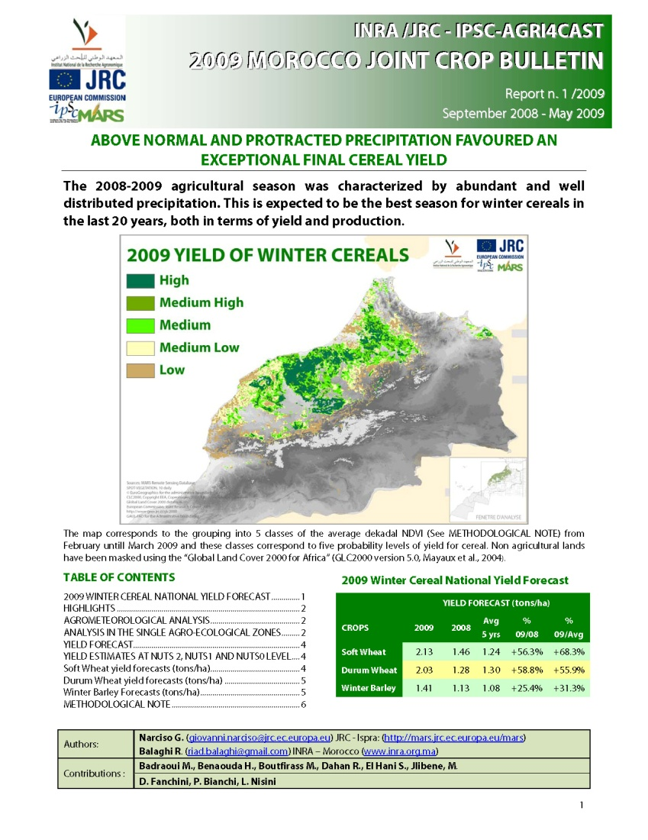
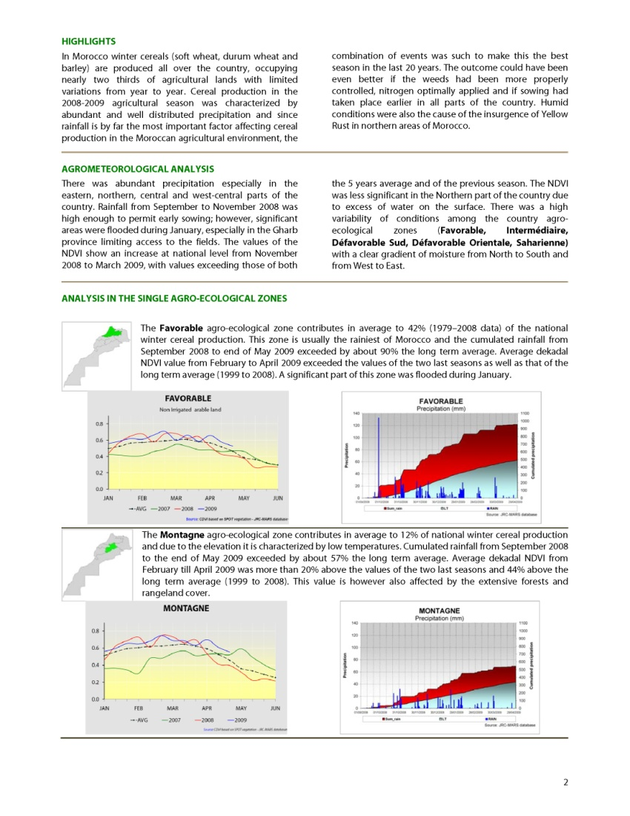
Crop Growth Monitoring System - Morocco
http://mars.jrc.it/mars/Bulletins-Publications

Slide 19
INRA - Morocco
Thank you

