Slide 1



Crop monitoring as an E-agriculture tool in developing countries (E-AGRI)
FP7 STREP Project (GA 270351)

Slide 2
E-AGRI (content)
  Background (what)
  Objectives (how far)
Study areas (where)
Partnership (who)
State of the art (how)
Structure and Planning

Slide 3
E-AGRI :Background
Agriculture: one of the principal shares of EU’s competency (60 over 130 billion EUR ):
Within 27 member states: to implement its CAP
Global market: to strengthen the competitive position of European agriculture
How to feed 7 billion people (food security)
How to deal with surging agricultural commodity prices (trade)

Slide 4
E-AGRI:
General objectives
Transfer and adaptation of European agricultural monitoring technology in developing countries (DEMONSTRATION)
Establishing networks of users on the crop monitoring technology (DISSEMINATION)
Providing the feedback and improvement for European expertise and know-how ( ADDED VALUES for EU)
Creating synergy with other European crop monitoring actions (MARS-Food, GMFS…) (MORE COLLABORATION)

Slide 5
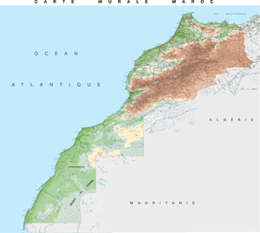
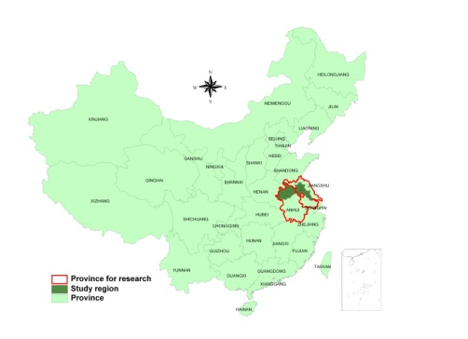
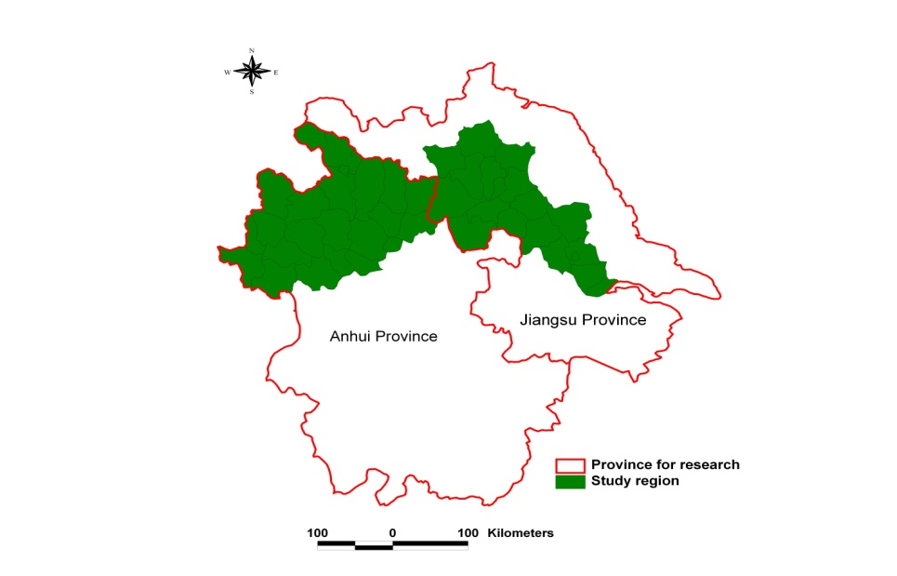
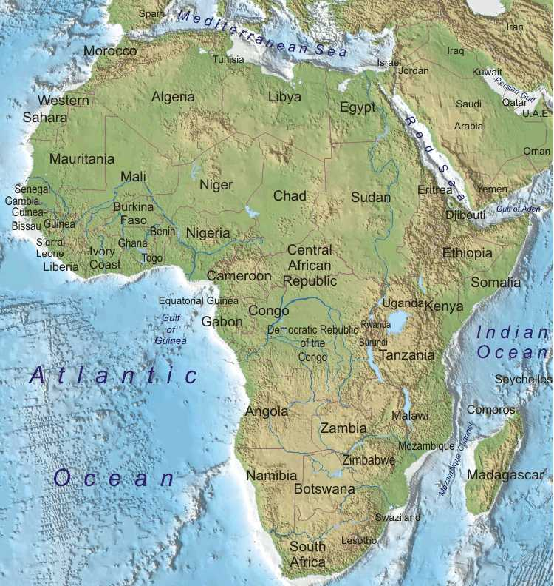
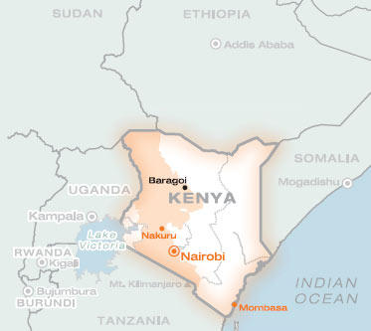
E-AGRI: 3 study areas
HuaiBei (Anhui ) and Jianghuai (Jiangsu) Plains
Morocco
Jianghuai Plain
Kenya
Huaibei Plain

Slide 6
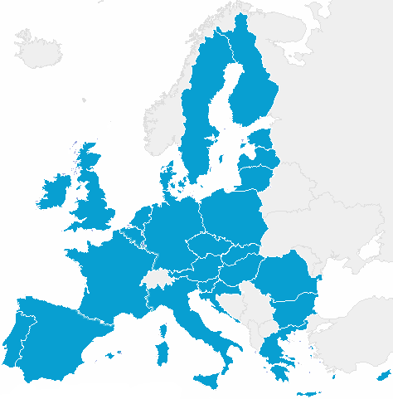
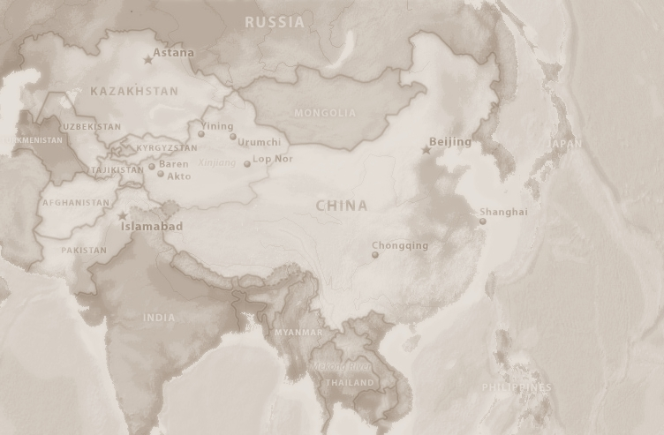






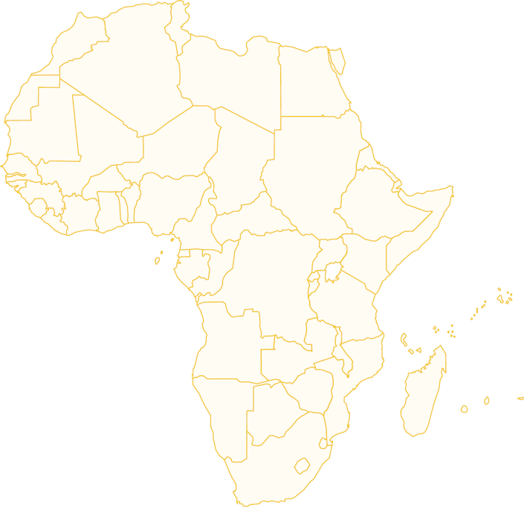

E-AGRI: 9 partner organizations
Alterra
(NL)
JRC
(EC)
CAAS
(CN)
VITO
(BE)
AIFER
(CN)
JAAS
(CN)
Univ. Milan
(IT)
INRA
(MO)
MEMR
(KE)

Slide 7

Approaches from 3 different angles
Yield estimates
(t/ha)
Agro-meteorological modelling
Assimilation by remote sensing
Acreage
(ha)
Remote sensing
Total production
(t or Mio t)

Slide 8
E-AGRI:
Specific objectives
Anhui (AIFER)
Morocco (INRA)
Implementing CGMS approach targeting wheat (Alterra)
Monitoring Using BioMA approach (UMI& JRC)
Wheat yield estimation Using RS for
Acreage assessment
Statistic Integration (Alterra)
Capacity building (Kenya) and international networking (VITO & DRSRS)
targeting wheat in Morocco (INRA)
targeting rice in Jiangsu (JAAS)
Anhui (VITO & AIFER)
Morocco (INRA & VITO)
Anhui (CAAS &VITO)
Morocco (INRA&CAAS)

Slide 9
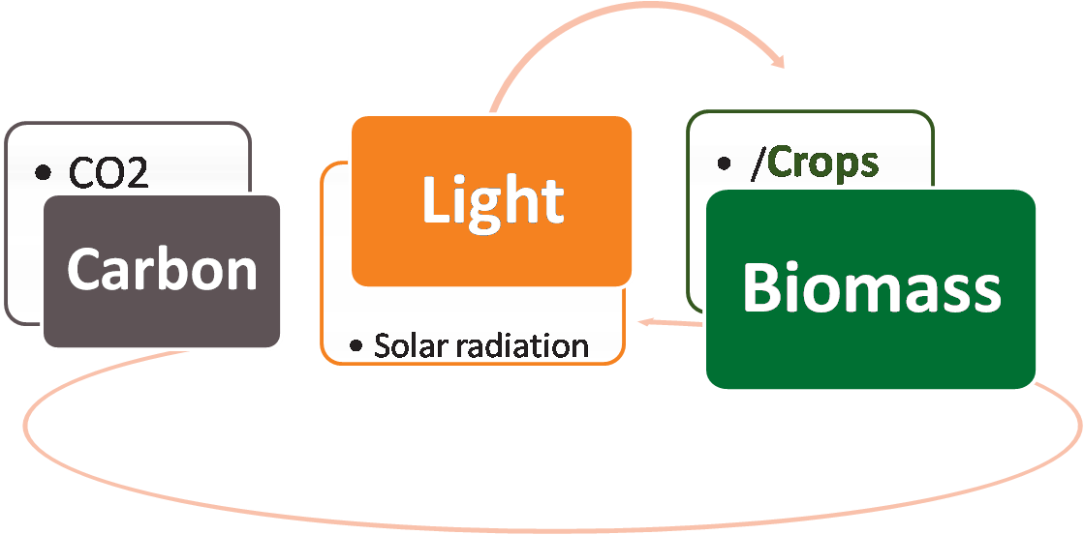
Methodology: Yield estimation:
Agro-meteorological modelling - CGMS
Meteorological products
Level 1
Meteo data:
Tem., Rad.
Crop calendar, phenology
Soil data
Agro-
meteorological products
Level 2
RS
tech
Stat
Statistical databank
Yield estimates
Level 3

Slide 10
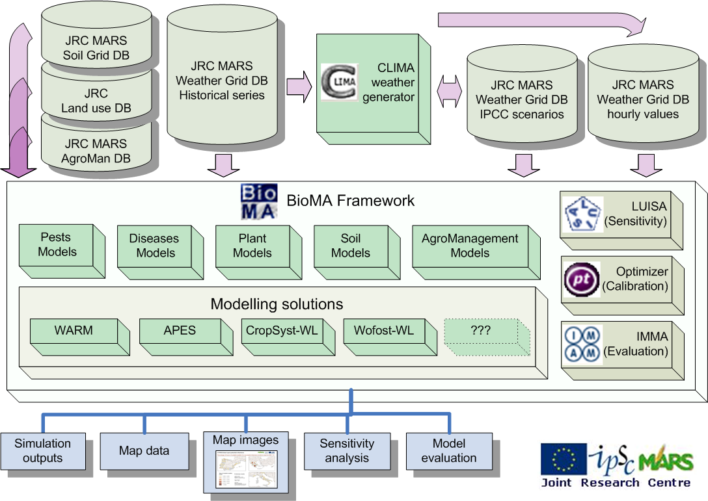
Methodology: Yield estimation:
Agro-meteorological modelling - BioMA

Slide 11

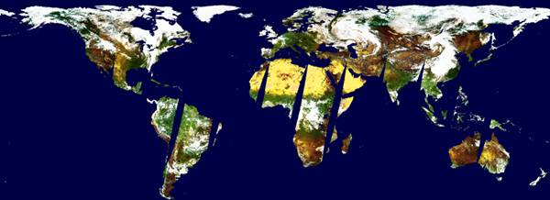
Methodology: Yield estimation
Remote sensing – LoRes Imagery
Prodict P (Segment)
S1 (Daily synthesis)
SPOT-VEGETATION
S10 (Ten daily synthesis)
Spatial: Global, 1km resolution
Time series: Since 1998
Production: VITO-CTIV

Slide 12
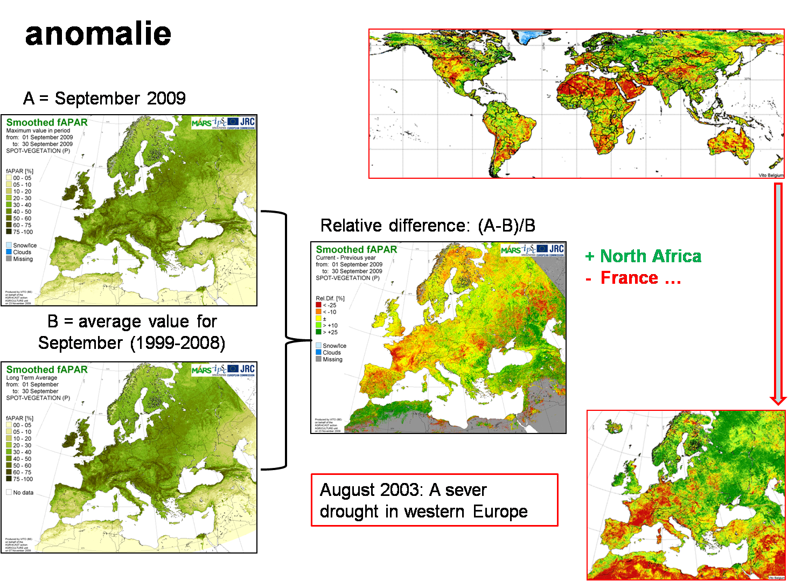
Methodology: Yield estimation
Remote sensing - yield indicators

Slide 13
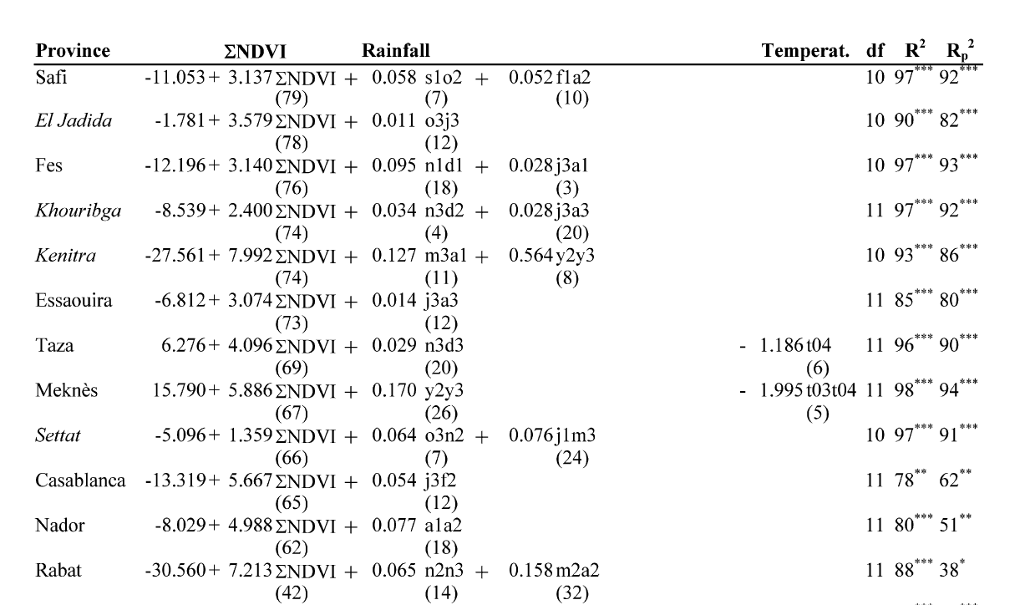
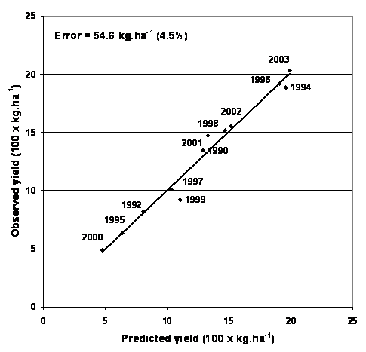
Methodology: Yield estimation
Using RS vegetation indicators
Wheat (Morocco) – using vegetation indicators

Slide 14
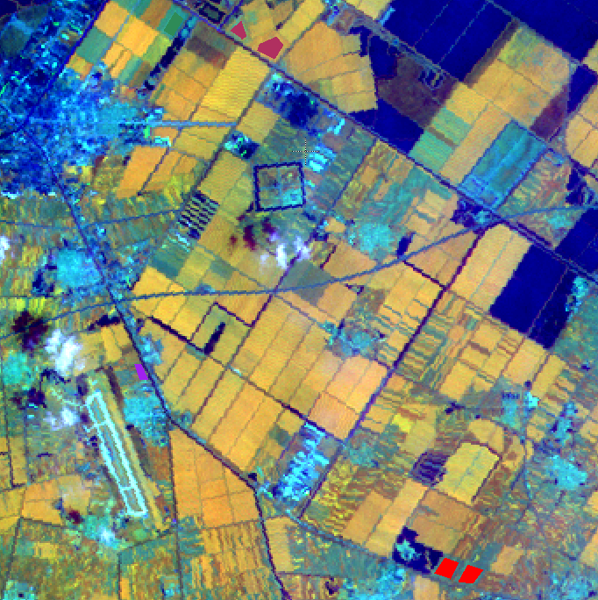
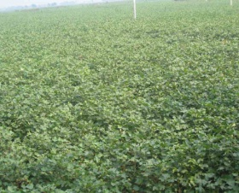
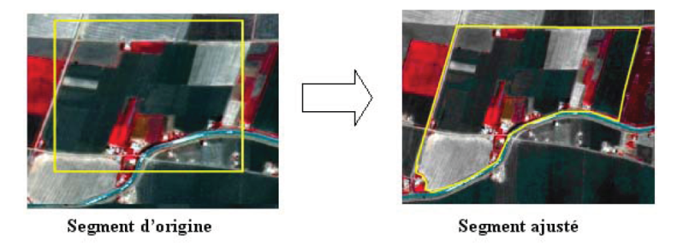
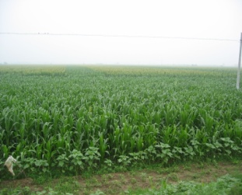
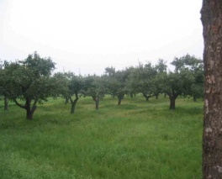
Methodology: Area estimation
Ground surveys + Remote sensing
Estimation by classification of satellite images
Stratified Area Frame Sampling
Estimators = ground data + classification data of satellite images

Slide 15
Methodology: Area estimation
COUNTY | FUYUAN | TON-JIANG | SUIBIN | FUJIN | RAOHE | YOUYI | TOTAL
SOYBEAN | 23.90 | 33.17 | 36.53 | 39.96 | 17.79 | 17.77 | 28.85
MAIZE | 0.75 | 1.44 | 5.07 | 0.90 | 0.83 | 0.00 | 1.22
WHEAT | 1.83 | 3.36 | 2.66 | 4.45 | 3.26 | 15.41 | 3.50
MELON | 1.03 | 1.69 | 1.22 | 5.77 | 0.53 | 3.42 | 3.00
POTATO | 0.00 | 0.00 | 0.00 | 0.00 | 0.00 | 0.00 | 0.00
RICE | 17.77 | 28.24 | 29.04 | 32.39 | 27.77 | 58.08 | 28.18
WETLAND | 48.45 | 19.60 | 2.83 | 9.24 | 13.82 | 1.14 | 19.21
WATER | 0.00 | 0.52 | 5.31 | 0.01 | 0.00 | 0.00 | 0.93
GRASS | 0.62 | 0.52 | 0.03 | 0.35 | 1.16 | 0.00 | 0.53
POPLAR | 0.30 | 0.67 | 0.13 | 1.03 | 1.74 | 0.24 | 0.88
DECI. FOR. | 1.19 | 6.18 | 1.70 | 1.47 | 20.98 | 0.01 | 6.71
PINE | 0.01 | 0.13 | 0.28 | 0.14 | 0.12 | 0.00 | 0.15
CONI. FOR. | 2.48 | 0.54 | 1.51 | 0.81 | 9.99 | 0.08 | 2.73
URB open | 0.56 | 1.18 | 2.39 | 1.32 | 0.53 | 0.22 | 1.15
URB+SOIL | 0.38 | 0.79 | 6.09 | 1.03 | 0.84 | 1.72 | 1.43
URB dense | 0.71 | 1.96 | 5.20 | 1.14 | 0.62 | 1.89 | 1.54
TOTAL % | 100.00 | 100.00 | 100.00 | 100.00 | 100.00 | 100.00 | 100.00
km² - CLAS | 1040 | 5357 | 1010 | 6337 | 3703 | 155
km² - CTY | 6238 | 6074 | 3332 | 8068 | 6338 | 1663
km² % | 17 | 88 | 30 | 79 | 58 | 9

Slide 16
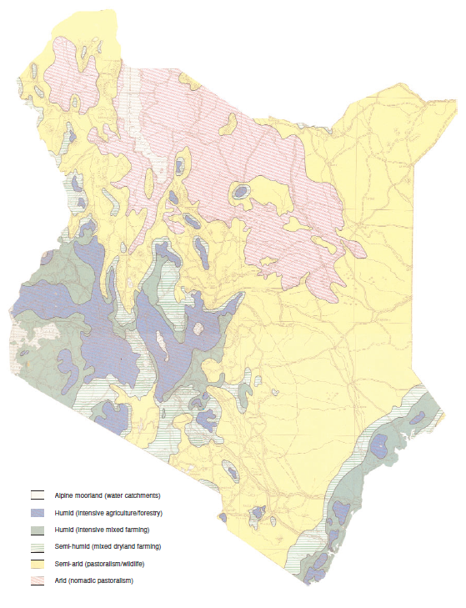
E-AGRI: Capacity building in Kenya
Capacity building for a third developing country: Kenya
In collaboration with other projects

Slide 17
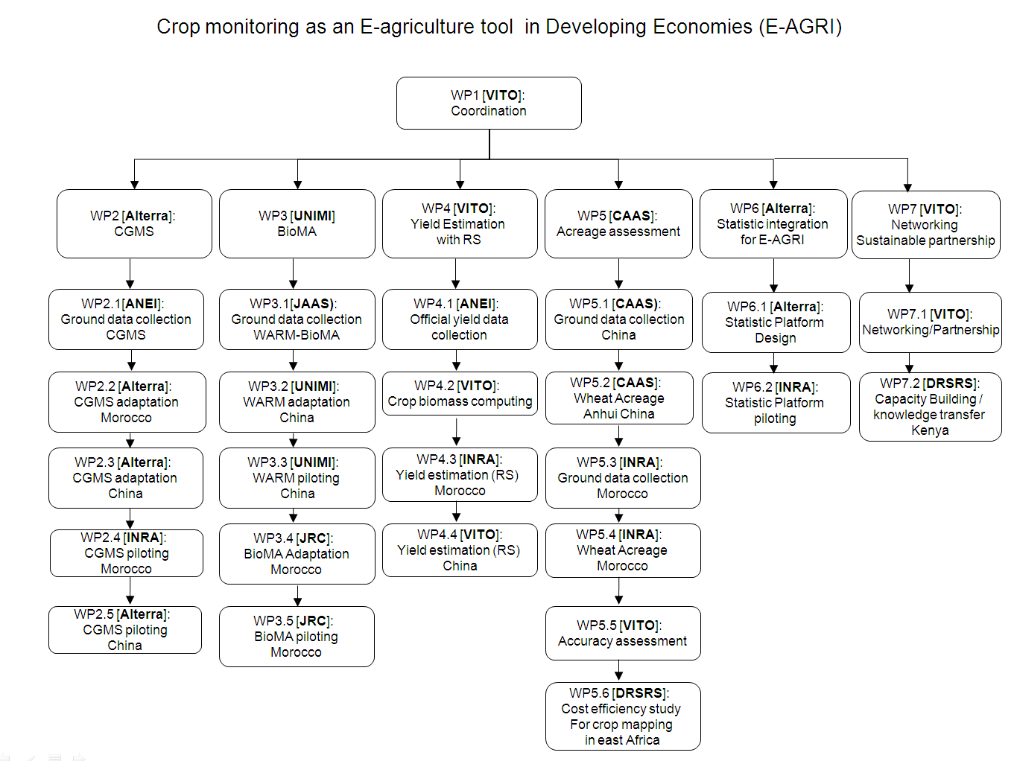
E-AGRI:
Project structure

Slide 18
E-AGRI:
Project Planning

Slide 19
E-AGRI:
The first deliverables
Deliverable. no. | Deliverable name | Delivery date
D23.1 | Usability reports for application of WOFOST for Anhui | 6
D31.1 | Ground data collection Report (BioMA: Jiangsu and Morocco) | 6
D34.1 | Synthetic report containing (i) groups of cultivars morphologically and physiologically similar, (ii) criteria for their identification (iii) the spatial distributed sensitivity analysis for wheat simulation (BioMA models) | 6
D44.1 | Databases on wheat yield for Anhui and Morocco | 6
D22.1 | Usability reports on CGMS application for Morocco | 9
D21.3 | Regional statistic databases (Anhui and Morocco) | 12
D22.2: | Strategy report on CGMS adaptation for Morocco | 12
D23.2 | Strategy report on CGMS adaptation for Anhui, China | 12
D32.1 | Report on the spatially distributed sensitivity analyses for rice simulation (BioMA models) | 12

Slide 20
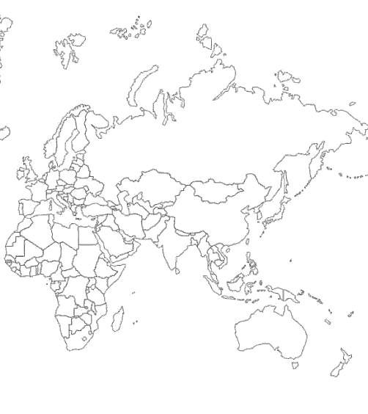

E-AGRI:
approaches and networking

Slide 21
A fruitful Collaboration
Grazie
Merci
Bedankt
شكرا
谢谢
asante

