Slide 1
RS based crop forecasting in Morocco
Riad BALAGHI
National Institute for Agricultural Research – Morocco
www.inra.org.ma

Slide 2
Key features of agriculture in Morocco
Moroccan agriculture is strongly dependent on rainfall (Avg. 340mm), as rainfed areas represent 85% of agricultural lands (7.9 millions hectares) ;
Most of lands are arid to semi-arid from which 75% are rangelands, 13% forests and 8% are cultivated ;
Rural population represents 45% of the total population.

Slide 3
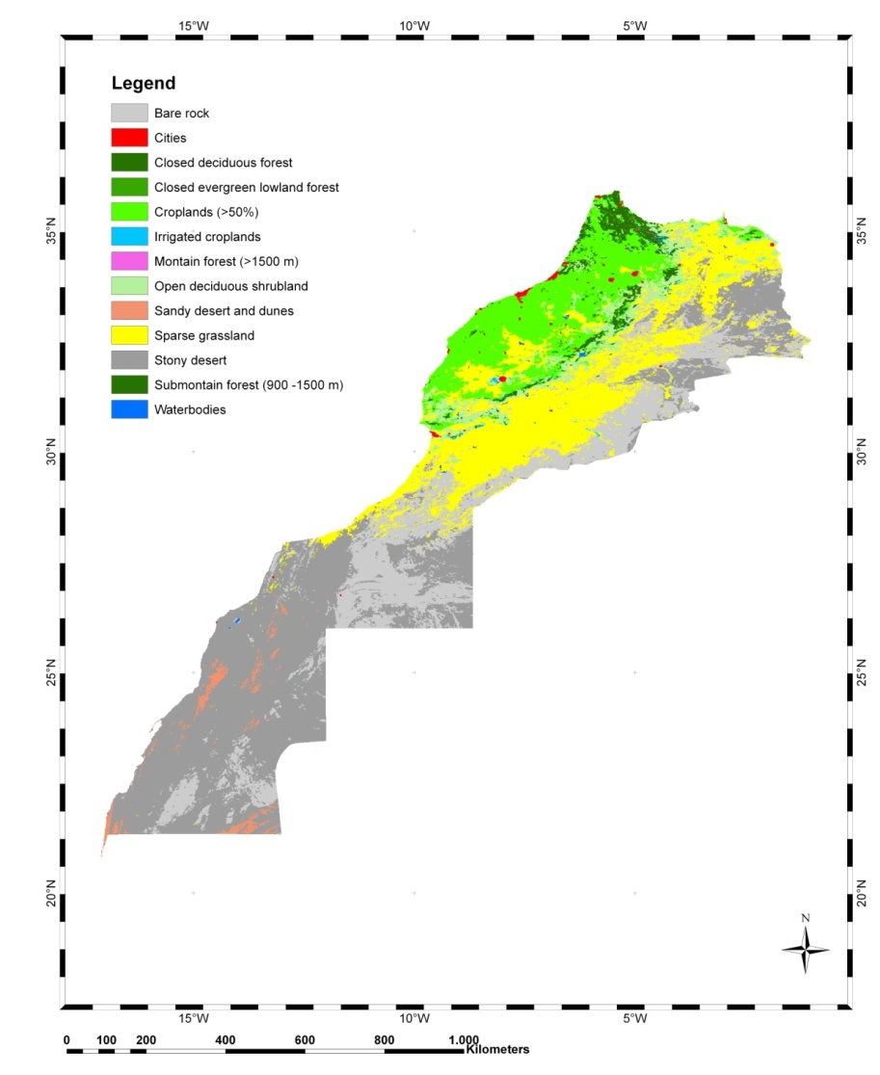
Key features of agriculture in Morocco
Morocco is a semi arid country with limited agricultural areas
Morocco is located in the northwest corner of Africa, bordered by the Mediterranean Sea and the Atlantic Ocean on the north and west, by Algeria on the east, and by Mauritania on the south. Its total land area is 710850 km² and includes several zones, among which are agricultural plains and river valleys, plateaus, and mountain chains. Most of lands are arid to semi-arid from which 75% are rangelands, 13% forests and 8% are cultivated. Morocco has a Mediterranean climate characterized by a dry and hot summer (4 to 6 months) and a short and cold winter in elevations.

Slide 4
Food security in Morocco
Increasing risk
Instability of crop production resulting from low and fluctuating rainfall and limited irrigation capacities

Slide 5
Food security in Morocco
Data source : FAOSTAT

Slide 6
Food security in Morocco
Cereals: Technological trend
Data source : DPAE

Slide 7
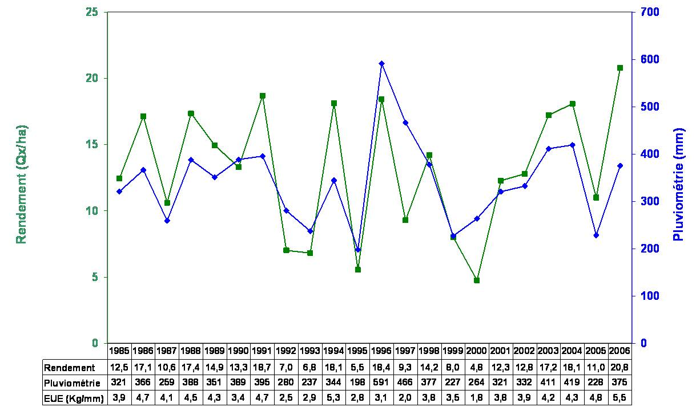
Wheat yield vs. rainfall
Data source: DMN & DPAE

Slide 8
Statistical approach using weather predictors
Correlation between rainfall and cereal yields in Morocco at national level (Balaghi & Jlibene, 2009)

Slide 9
Cereals: Yield vs. Cumulated Rainfall
Soft wheat
Durum wheat
(data from 1988 to 2008)
Barley
Balaghi et al. 2010
Data source : DMN

Slide 10
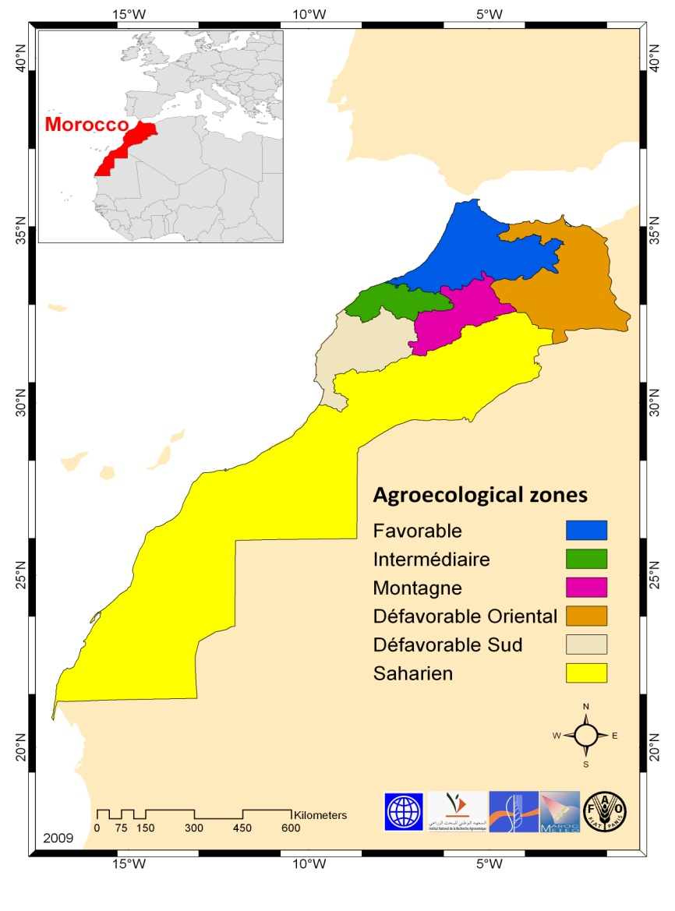
Cereals: Yield vs. Cumulated Rainfall
Balaghi et al. 2010
Data source : DMN

Slide 11
NDVI based yield forecasts
What do we need ?
Good and long time crop statistics ;
Good and long time NDVI series (NOAA, SPOT, MODIS, etc.);
Accurate crop mask (GLC2000, CLC, Globcover, etc.) ;
Good local expertise ;
Good RS expertise (ΣNDVI, Median NDVI, Slope of NDVI, etc.).

Slide 12
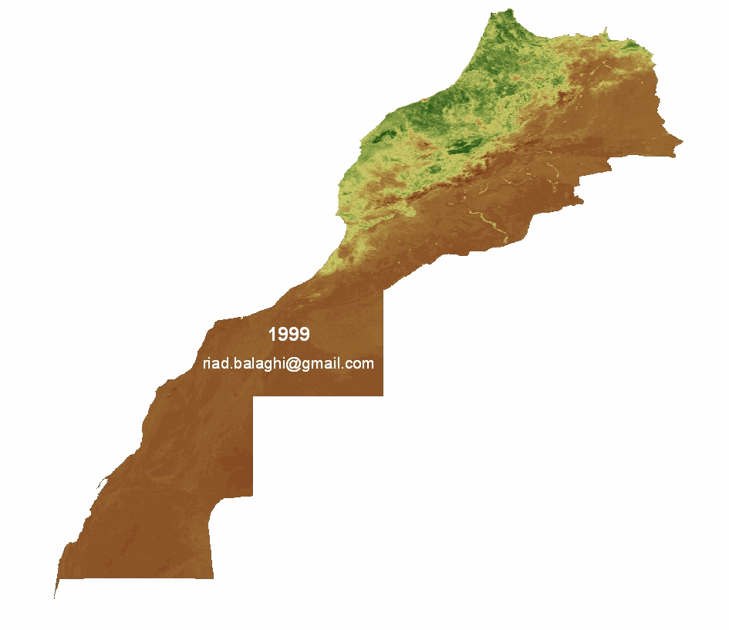
NDVI in Morocco
Cumulated NDVI (February – March)

Slide 13
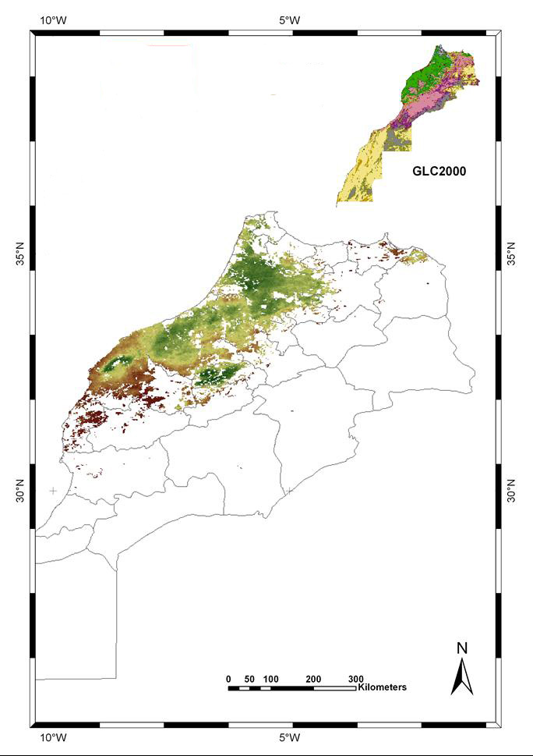
NDVI for agricultural areas

Slide 14
NDVI vs. Rainfall in Morocco
ΣNDVI_{Feb-Apr} is the accumulation of the NDVI values for the period of February until April and ΣRAIN_{Sept-May} is the sum of the rains over the cropping season (from September until May). Data from 1999 to 2006, for 25 stations.
(Jlibene & Balaghi, 2007; not published)

Slide 15
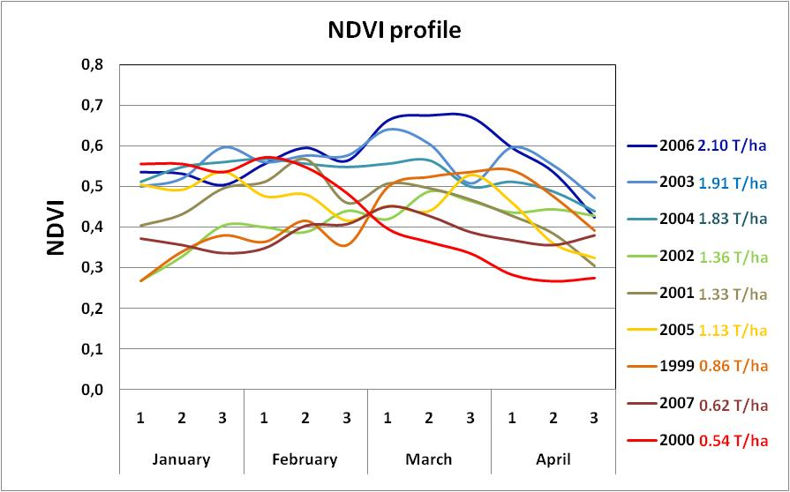
Cereals: Yield vs. Cumulated NDVI
Balaghi 2010
Data source : VITO

Slide 16
Cereals: Yield vs. Cumulated NDVI
Soft wheat
Durum wheat
(data from 1988 to 2008)
Barley
Balaghi et al. 2010
Data source : VITO

Slide 17
Cereals: NDVI based forecasting
Data from 1999 to 2004
Erreur in prédiction %
Balaghi et al. 2010
Data source : VITO

Slide 18
Crop forecasting : combination of methods
2008-09 cropping season
Rendements
Espèce | 1996+PT* | Pluviométrie | NDVI | Moyenne
Blé tendre | 24.5 | 21.8 | 19.9 | 22.1
Blé dur | 22.8 | 20.3 | 18.5 | 20.5
Orge | 15.7 | 15.6 | 12.8 | 14.7
Productions
Espèce | 1996+PT* | Pluviométrie | NDVI | Moyenne
Blé tendre | 49.0 | 43.6 | 39.8 | 44.1
Blé dur | 20.5 | 18.3 | 16.7 | 18.5
Orge | 34.5 | 34.3 | 28.2 | 32.3
Total | 104.2 | 96.2 | 84.6 | 95.0

Slide 19
CONCULUSION
NDVI based cereal forecasting is relatively easy in Morocco, at national level, because :
Morocco is a semi arid country ;
Most of the agricultural areas are rainfed ;
Cereals are the dominating crops ;
Quite good crop statistics for the main crops.
Cereals forecasting could be improved :
Through an improved crop mask ?
Cereal forecasting at sub national level needs :
The use of cumulated rainfall at explanatory variable ;
The use of weather - crop modelling

Slide 20
CONCULUSION
Many ways to forecast agricultural yields
Combination of methods is the appropriate way to reduce errors
Long term good quality crop and weather statistics are essentials
Good local expertise is needed
Good agronomic and statistical skills
Computer, GIS and remote sensing should be available

Slide 21
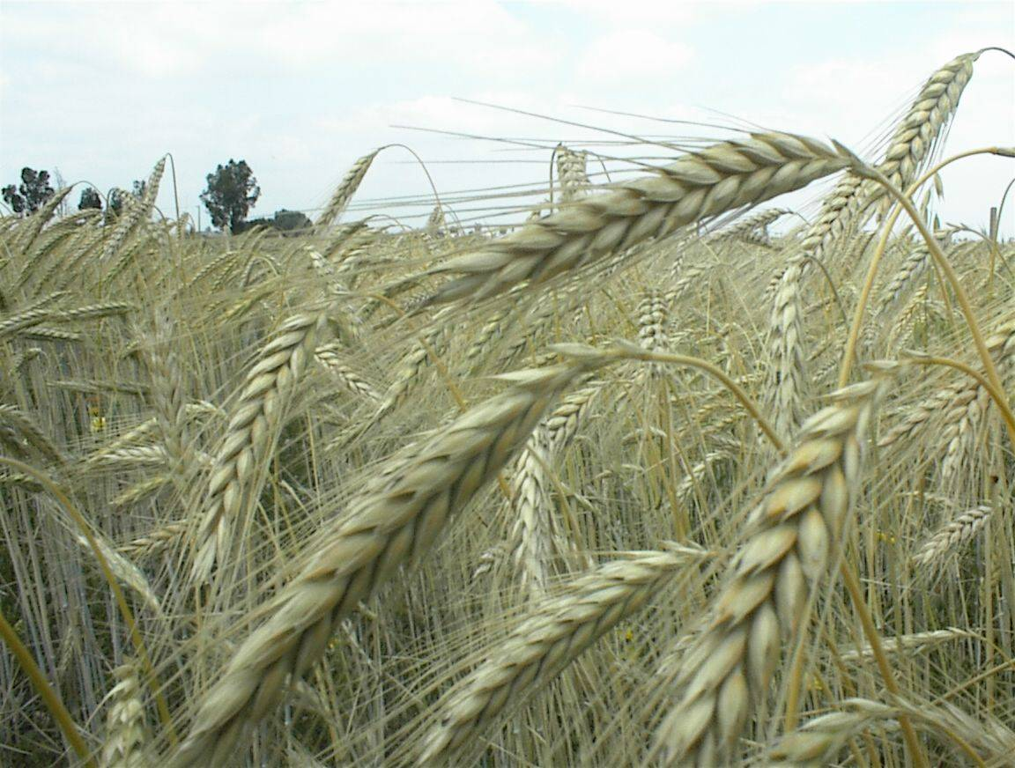
Thank you

