Slide 1




FP7 STREP Project (GA 270351)
1st Progress Meeting (2011-11-23)
Crop monitoring as an E-agriculture tool in developing countries (E-AGRI)
Overview and Management

Slide 2
E-AGRI: objectives
Objective of DEMONSTRATION :Transfer and adaptation of European agricultural monitoring technology in 3 developing countries.
Objective of DISSEMINATION: Establishing networks of users on the crop monitoring technology across three continents in the world (Europe , Africa and Asia (China))
Objective of providing ADDED VALUES for EU: Feedback and improvement for European expertise and know-how ( ADDED VALUES for EU)
Objective of COLLABORATION: Creating synergy with other European crop monitoring actions (MARS-Stat-Food, GMFS…)

Slide 3
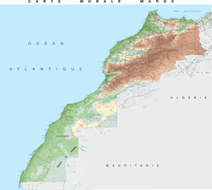
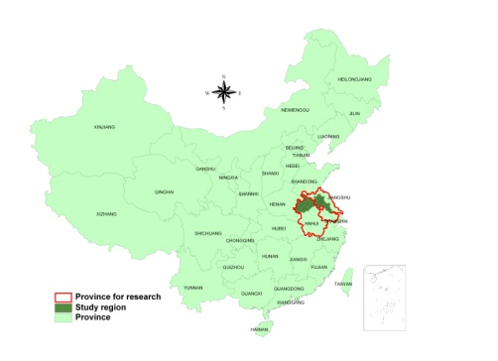
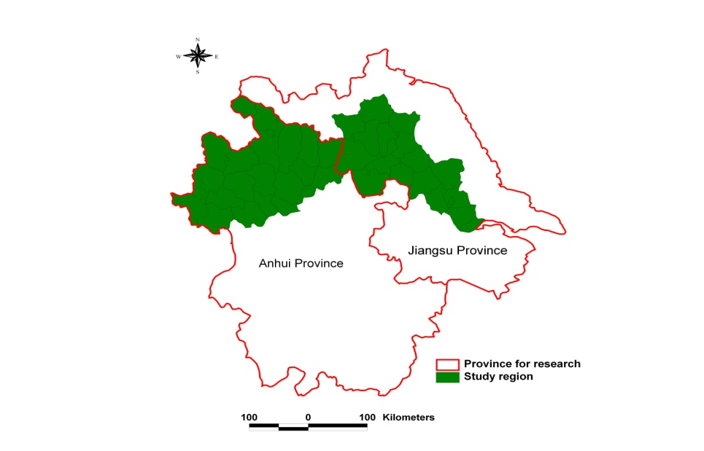
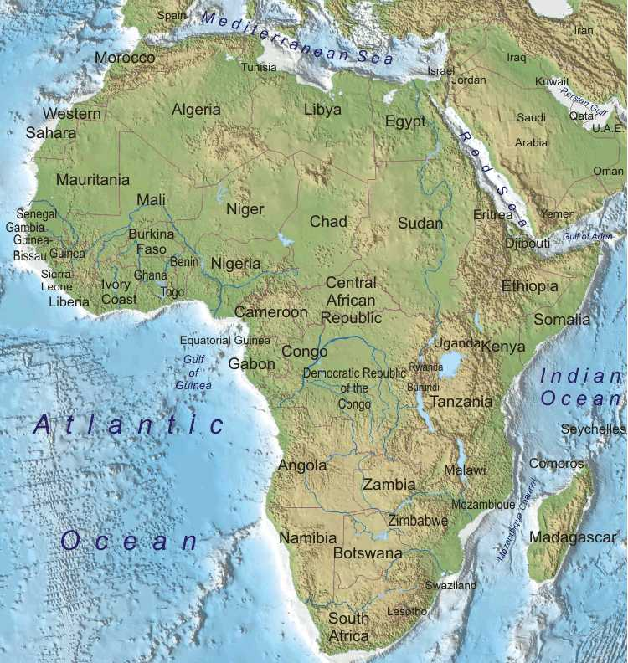
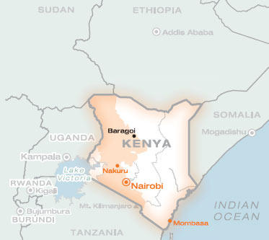
E-AGRI: 3 study areas
HuaiBei (Anhui ) and Jianghuai (Jiangsu) Plains
Morocco
Jianghuai Plain
Kenya
Huaibei Plain

Slide 4
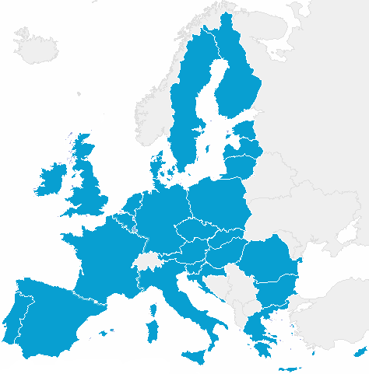
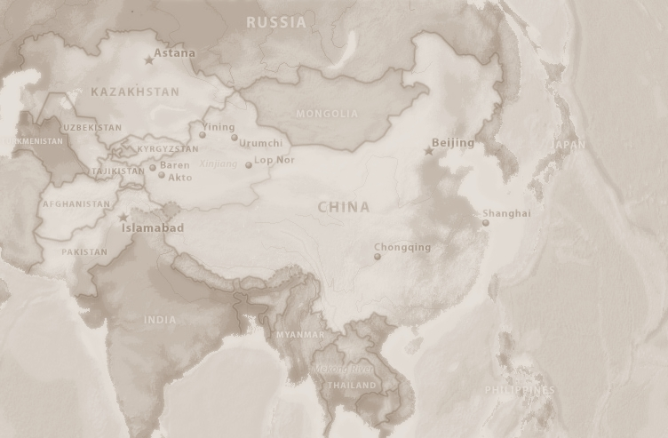






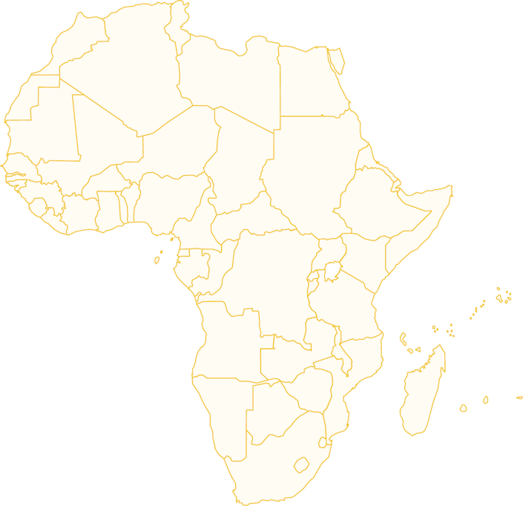

E-AGRI: 9 partner organizations
Alterra
(NL)
JRC
(EC)
CAAS
(CN)
VITO
(BE)
AIFER
(CN)
JAAS
(CN)
Univ. Milan
(IT)
INRA
(MO)
MEMR
(KE)

Slide 5

Approaches from 3 different angles
Yield estimates
(t/ha)
Agro-meteorological modelling
Assimilation by remote sensing
Acreage
(ha)
Area Sampling
Remote sensing
Total production
(t or Mio t)

Slide 6
E-AGRI:
Specific objectives
Anhui (AIFER)
Morocco (INRA)
Implementing CGMS approach targeting wheat (Alterra)
Monitoring Using BioMA approach (UMI& JRC)
Wheat yield estimation Using RS for
Acreage assessment
Statistic Integration (Alterra)
Capacity building (Kenya) and international networking (VITO & DRSRS)
targeting wheat in Morocco (INRA)
targeting rice in Jiangsu (JAAS)
Anhui (VITO & AIFER)
Morocco (INRA & VITO)
Anhui (CAAS &VITO)
Morocco (INRA&CAAS)

Slide 7
Methodology: Yield estimation:
Agro-meteorological modelling - CGMS
 | Actors partners | Ground data | Research | Main Output Deliverables | Dissemination
CGMS | SDLO (NL) INRA (MO) AIFER (CN) | Crop calendar Crop mask Meteo INRA (MO) AIFER (CN) | Identifying local crop growth drivers Adapted crop parameters Meteo data interpolation | Regional statistic databases Adapted CGMS models | Training workshop Piloting demo.

Slide 8
Methodology: Yield estimation:
Agro-meteorological modelling - BioMA
 | Actors partners | Ground data | research | Main Output Deliverables | dissemination
BioMA | UMI JRC INRA JAAS | Crop calendre; Phenological parameters of cultivars Wheat (MO) Rice (Jiangsu, China) | Spatially distribited sensitivity analysis; Calibration of rice /wheat parameters | Database for model parameters Multi-model platforms for rice/wheat simulation User guide for local crop monitoring application | Training workshop Pilot demo (field and regional scales)

Slide 9
Methodology: Yield estimation:
Yield forecasting using remote sensing
 | Actors partners | Ground data | Research | Main Output Deliverables | Dissemination
Yield forecast using RS | VITO INRA AIFER | Official Statistics vegetation indicators (NDVI, DMP) | Best indictors or combination of indicators for assimilating the cereal yields in the target regions. Different analytic appoaches (similarity analysis) | Best regression models for forecasting the cereal yields in two regions (Morocco) and Huaibei Plain). | Training Worshop Exchange of experts Bulltins

Slide 10
Methodology: Yield estimation:
Statistic Tool-box
 | Actors partners | Ground data | Research | Main Output Deliverables | Dissemination
Statistical integration for E-Agriculture service | SDLO INRA | Official Statistics | time trend analyses, (multiple) regression analyses and scenario analyses Efficiency of models relative to the trend only Hypothesis testing for determining significance of results | Statistic toolbox | Demo Workshop Training sessions

Slide 11
Methodology: Yield estimation:
Crop Area Estimation
 | Actors partners | Ground data | Research | Main Output Deliverables | Dissemination
Area estimation using smapling technique and RS | CAAS VITO AIFER INRA | Official Statistics Ground samples | Most accurate statistic models for each target region. The most cost-efficient way in sampling and using remote sensing estimators. | Field sample databases Validation with official statisticas | Training Workshop

Slide 12
Capacity building in Kenya
 | Actors partners | Ground data | Research | Main Output Deliverables | Dissemination
Networking and capacity building – targeted country: Kenya | MEMR VITO INRA JRC |  | Applicability of yield estimation using RS indicators Improving area estimation approach | Feasability and capacity building reports | Networking and exchange with experts from Morocco and China

Slide 13
E-AGRI Project Management
Activities | Deliverables | Networking
Kock-Off Meeting Rabat workshop (WP4 Yield RS) Hefei workshop (WP2 CGMS) Meeting with new Project Officer Ardiel CABRERA Web dissemination and sharing Coordination activities: Organising deliverables and justification of delays Organising the collection of data Consultation, understanding and peace-making CA | Meeting Minutes Workshop Minutes Action list Workshop Minutes Actions list Web site: FTP site: MOSS site | Contacts with other organizations outside of the consortium Communication with the EU delegation in Beijing; inviting head of INFOSO section Frank Greco; and the head of AGRI section Hans Christian Beaumond http://www.e-agri.info ftp://cvbftp.vgt.vito.be https://sites.vito.be/sites/egari

Slide 14
E-AGRI: Consortum Agreement (CA)
VITO made a final version of CA on May 2011.
Alterra, CAAS, JAAS, AIFER counter signed
JRC sent remarks in September 2011.
Now with the objections made by JRC, VITO has to make a new round, send a new version and to be counter-signed by every partner again.

Slide 15
E-AGRI Project Management
Deliverables | Deliverable name | date | Status
D23.1 | Usability reports for application of WOFOST for Anhui | 6 | Delay
D31.1 | Ground data collection Report (BioMA: Jiangsu and Morocco) | 6 | OK
D34.1 | Synthetic report containing (i) groups of cultivars morphologically and physiologically similar, (ii) criteria for their identification (iii) the spatial distributed sensitivity analysis for wheat simulation (BioMA models) | 6 | OK
D41.1 | Databases on wheat yield for Anhui and Morocco | 6 | OK
D22.1 | Usability reports on CGMS application for Morocco | 9 | ?
D21.3 | Regional statistic databases (Anhui and Morocco) | 12
D22.2: | Strategy report on CGMS adaptation for Morocco | 12
D23.2 | Strategy report on CGMS adaptation for Anhui, China | 12
D32.1 | Report on the spatially distributed sensitivity analyses for rice simulation (BioMA models) | 12

Slide 16
E-AGRI:
Project Planning

Slide 17
E-AGRI:
1st Progress Meeting Agenda
9.00 – 9.15 Welcome address
O. Léo (MARS Head of Unit)
and/or S. Niemeyer (AGRI4CAST Action Leader)
9.15 - 10.00 Presentation of the new project Officer Presentation of E-AGRI partners and E-AGRI project
Status of the project management
Agenda of the meeting
Q. Dong (VITO/ project coordinator)
10.30 -12:30 Progress of 4 main WP’s (Results and achievements)
Per WP/team :
15 min presentation of results
15 min for question/ discussion on results
(Allard, Roberto, Riad, Zhongxin)
12:30 - 13:45 Lunch
13:45 – 16:00 Discussion on further actions:
activities till the end of the first year project (Feb. 2012)
Deliverables (till month 12)
Interim Report (timing)
16:00 -17:00 Consortium agreement?
Action List and next events /Meetings

Slide 18
A fruitful Collaboration
Grazie
Merci
Bedankt
شكرا
谢谢
asante

