Slide 1








Work Package 3
BioMA multi-model monitoring
Roberto Confalonieri, Simone Bregaglio, Giovanni Cappelli, Marta Carpani, Wang Zhiming, Li Bingbai, Qiu Lin, Mohamed El Aydam, Stefan Niemeyer, Riad Balaghi, Mohammed Jlibene, Nasserlehaq Nsarellah
University of Milan, Department of Plant Production, CASSANDRA modelling team
Jiangsu Academy of Agricultural Sciences
European Commission Joint Research Centre, IES, AGRI4CAST
INRA Morocco,
roberto.confalonieri@unimi.it
E-AGRI WP3 – First progress meeting - Ispra, November 23, 2011

Slide 2
WP 3 tasks description
Task 3.1: Ground data collection for BioMA
Task 3.2: Adaptation of BioMA for multi-model rice monitoring in China
Task 3.3: BioMA piloting for multi-model rice monitoring and yield forecasting in JIANGHUAI Plain, China
Task 3.4: Adaptation of BioMA for multi-model wheat monitoring in Morocco
Task 3.5: BioMA piloting for multi-model wheat monitoring and yield forecasting in Morocco
E-AGRI WP3 – First progress meeting - Ispra, November 23, 2011
Rice, China
Wheat, Morocco
Task 3.1
BioMA adaptation
Task 3.2
Task 3.4
BioMA piloting
Task 3.3
Task 3.5

Slide 3
Task 3.1 description
Task leader: JAAS; partners: JAAS, INRA
Activity 3.1.1: Identification of the group of cultivars to be calibrated for the BioMA crop models (WARM, CropSyst, WOFOST)
Activity 3.1.2: Identification of measurable key variables and parameters needed for a robust calibration of the BioMA models
Activity 3.1.3: Collection of data (i) for each group of cultivar [3.1.1], (ii) for suitable variables [3.1.2], (iii) for different combinations site × year
Activity 3.1.4: Development of a database for the parameterization and calibration activities according to specifications provided by Task 3.2
E-AGRI WP3 – First progress meeting - Ispra, November 23, 2011
Rice, China
Wheat, Morocco
Task 3.1
BioMA adaptation
Task 3.2
Task 3.4
BioMA piloting
Task 3.3
Task 3.5

Slide 4
Task 3.1 deliverables
Task leader: JAAS; partners: JAAS, INRA
D31.1 Report on “Ground data collection for calibrating BioMA models”
  D31.1.A (rice in Jiangsu) delivered by JAAS
  D31.1.B (wheat in Morocco) delivered by INRA
E-AGRI WP3 – First progress meeting - Ispra, November 23, 2011

Slide 5
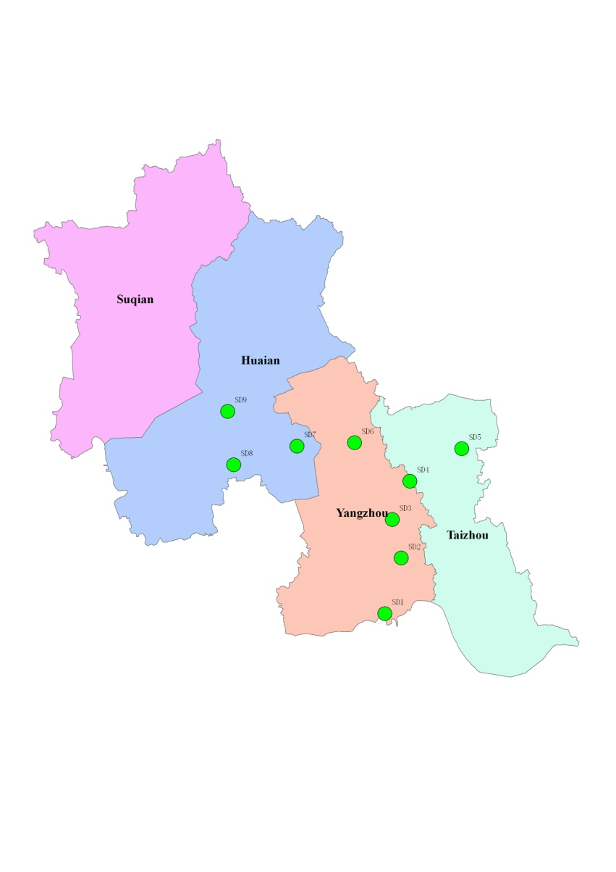
Task 3.1 deliverables
Task leader: JAAS; partners: JAAS, INRA
JAAS: Experimental sites in 2011
E-AGRI WP3 – First progress meeting - Ispra, November 23, 2011
 | Location | GPS information
SD1 | Shatou, Hanjiang, Yangzhou | 32 16 57.9N 119 33 50.1E
SD2 | Yiling, Jiangdu, Yangzhou | 32 30 39.0N 119 41 33.4E
SD3 | Fanchuan, Jiangdu, Yangzhou | 32 40 55.2N 119 40 37.5E
SD4 | Lincheng, Xinghua, Taizhou | 32 50 02.1N 119 47 53.2E
SD5 | Changrong, Xinghua, Taizhou | 32 56 28.6N 120 05 51.4E
SD6 | Xiaji, Baoying, Yangzhou | 33 02 07.4N 119 32 16.0E
SD7 | Tugou, Jinhu, Huaian | 33 03 27.5N 119 13 53.4E
SD8 | Dailou, Jinhu, Huaian | 33 00 57.7N 118 53 01.9E
SD9 | Zhuba, Hongze, Huaian | 33 14 58.4N 118 53 28.6E
Distribution of sample sites

Slide 6
Task 3.1 deliverables
Task leader: JAAS; partners: JAAS, INRA
JAAS: Measured variables and supporting information
  Complete soil characterization (physical and chemical)
  4 different groups of varieties
  Different planting strategies (direct sowing – transplanting)
  Complete determination of phenological stages
  Plant height
  Leaves emission
  Green LAI
  Plant density
  Above ground biomass
  Yield structure
  Information on features of the genotypes grown during the experiments
E-AGRI WP3 – First progress meeting - Ispra, November 23, 2011

Slide 7
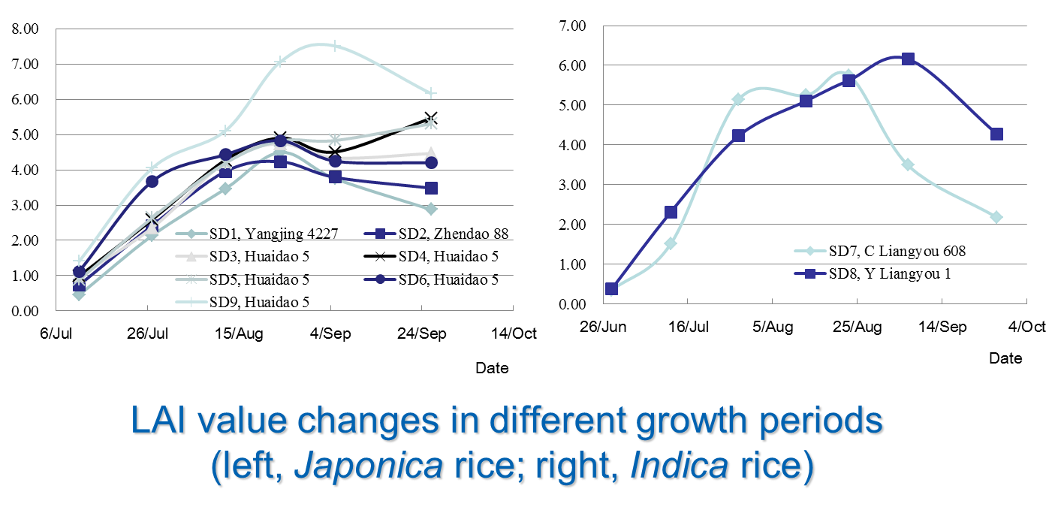
Task 3.1 deliverables
Task leader: JAAS; partners: JAAS, INRA
JAAS: Some of the data provided
E-AGRI WP3 – First progress meeting - Ispra, November 23, 2011

Slide 8
Tasks 3.2 & 3.4 description
Task leaders: UNIMI, JRC; partners: UNIMI, JRC
Activity 3.2(4).1: Spatially distributed sensitivity analysis of the BioMA models to identify the most relevant parameters
Activity 3.2(4).2: Parameters calibration for each model and group of cultivars
Activity 3.2(4).3: Evaluation of the BioMA models for field-scale simulations for each group of cultivars
Activity 3.2(4).4: Evaluation of the BioMA models for large-area simulations using official yield statistics
E-AGRI WP3 – First progress meeting - Ispra, November 23, 2011
Rice, China
Wheat, Morocco
Task 3.1
BioMA adaptation
Task 3.2
Task 3.4
BioMA piloting
Task 3.3
Task 3.5

Slide 9
Task 3.4 deliverables
Task leader: JRC; partners: UNIMI, INRA
D34.1 Report on “Group of wheat varieties and spatially distributed sensitivity analysis of WOFOST and CropSyst for wheat in Morocco”
Delivered.
A paper on the spatially distributed sensitivity analysis has been completed and it is under internal review. We think we will be able to send it within the next 2 weeks.
E-AGRI WP3 – First progress meeting - Ispra, November 23, 2011

Slide 10
Task 3.4 deliverables
Task leader: JRC; partners: UNIMI, INRA
Criteria used to define the groups of cultivars for which different sets of model parameters will be developed:
durum/soft wheat
difference in thermal requirements
difference in the degree of tolerance to water stress
productivity
E-AGRI WP3 – First progress meeting - Ispra, November 23, 2011

Slide 11
Task 3.4 deliverables
Task leader: JRC; partners: UNIMI, INRA
Groups of
wheat
cultivars
for which
parameters
sets
will be
calibrated
E-AGRI WP3 – First progress meeting - Ispra, November 23, 2011

Slide 12
Task 3.4 deliverables
Task leader: JRC; partners: UNIMI, INRA
Multi-year, spatially distributed Monte Carlo based sensitivity analysis of WOFOST and CropSyst for what in Morocco (almost 16 million simulations)
  Weather data and sowing dates from the CGMS database at 25 × 25 km spatial resolution
  Wheat “is” grown in 333 cells
  5-year simulations to avoid results affected by year-specific conditions
  Many simulations to be carried out. So, a 2-step procedure was used:
    Morris method to screen parameters (parsimonious)
    Sobol’ method on the screened parameters to quantify the amount of output variance explained by the different parameters
E-AGRI WP3 – First progress meeting - Ispra, November 23, 2011

Slide 13
Task 3.4 deliverables
Task leader: JRC; partners: UNIMI, INRA
WOFOST results
Selected after Morris:
AMAXTB000
CVO
EFFTB10
TMPFTB14
TMPFTB23
FRTB000
Q10
CVL
EFFTB30
SLATB035
E-AGRI WP3 – First progress meeting - Ispra, November 23, 2011

Slide 14
Task 3.4 deliverables
Task leader: JRC; partners: UNIMI, INRA
CropSyst results
Selected after Morris:
RUE
BTR
Topt
Kc
SLA
k
E-AGRI WP3 – First progress meeting - Ispra, November 23, 2011

Slide 15
Task 3.4 deliverables
Task leader: JRC; partners: UNIMI, INRA
It is probably the first time a multi-year, multi-model spatially distributed sensitivity analysis is carried out using advanced Monte Carlo based techniques to analyse the relationships between model structure and environmental driving forces.
This analysis provides rigorous elements to face with the need for parameterizations able to account for the heterogeneity of the conditions explored, in turns reflecting on the spatial distribution of different cultivars.
This results, coupled with information on groups of varieties and their spatial distribution, will support the calibration of the 4 parameters sets for each crop and for each model.
Results are also useful to support breeders activities, since they underlined the highest relevance of parameters (crop features) involved with photosynthesis compared to those involved, e.g., with leaf area evolution (contrarily to studies carried out in other regions).
E-AGRI WP3 – First progress meeting - Ispra, November 23, 2011

Slide 16
Task 3.4 deliverables
Task leader: JRC; partners: UNIMI, INRA
Considerations on these first months:
  The work carried out is a high quality one. According to my knowledge, nobody carried out such a preliminary analysis for calibrating models to be run on large areas
  We had some “communication problems”…
  we are surely able to do better on this point
  We are going to send a paper on part of the work (SA)
  A paper has been accepted on a study preliminary to spatially distributed sensitivity analysis, with E-AGRI contribution mentioned in the acknowledgement:
  Confalonieri, R., Bregaglio, S., Acutis, M., 2011. Quantifying plasticity in simulation models. Ecological Modelling, in press.
E-AGRI WP3 – First progress meeting - Ispra, November 23, 2011

Slide 17
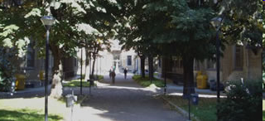

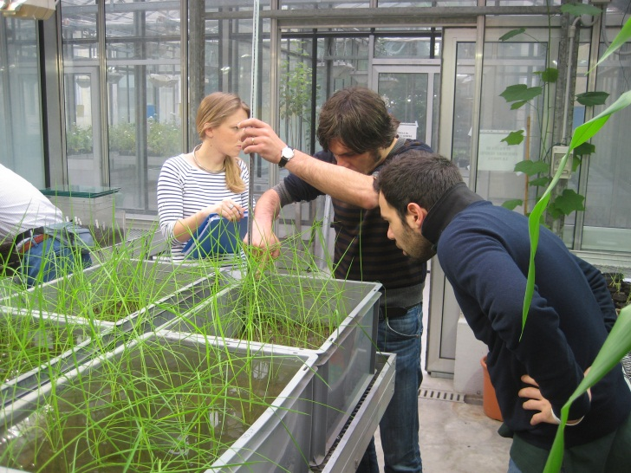
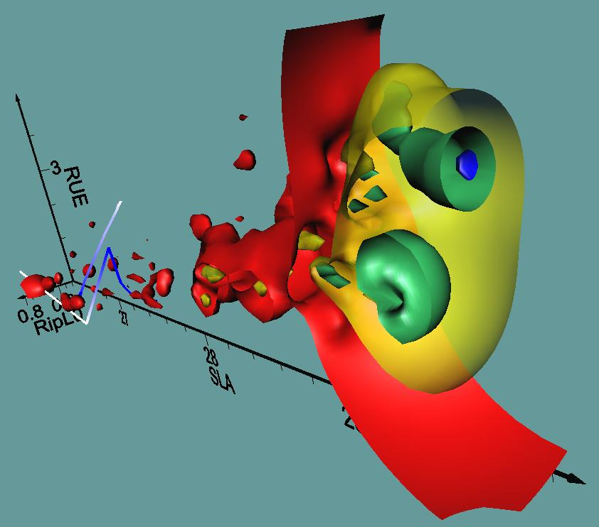

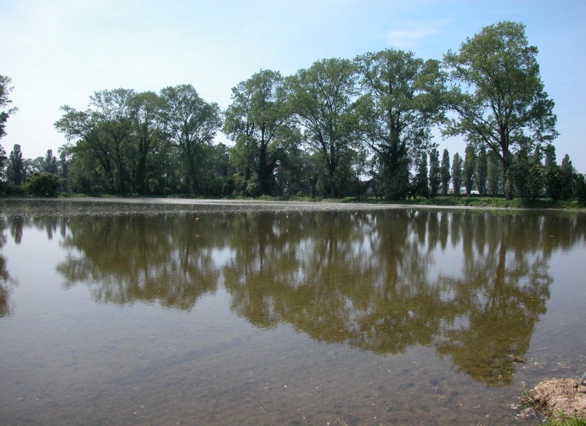
Many thanks for your attention
E-AGRI-WP3

