Slide 1
E-Agri Progress meeting
Ispra, November 23th 2011
WP 31.1 : Ground data collection for BioMA (Morocco)
Leading institution : UNIMI
Months: 1-30
Mohammed Jlibene, Nasserlehaq Nsarellah, Riad Balaghi
(INRA – Morocco)

Slide 2
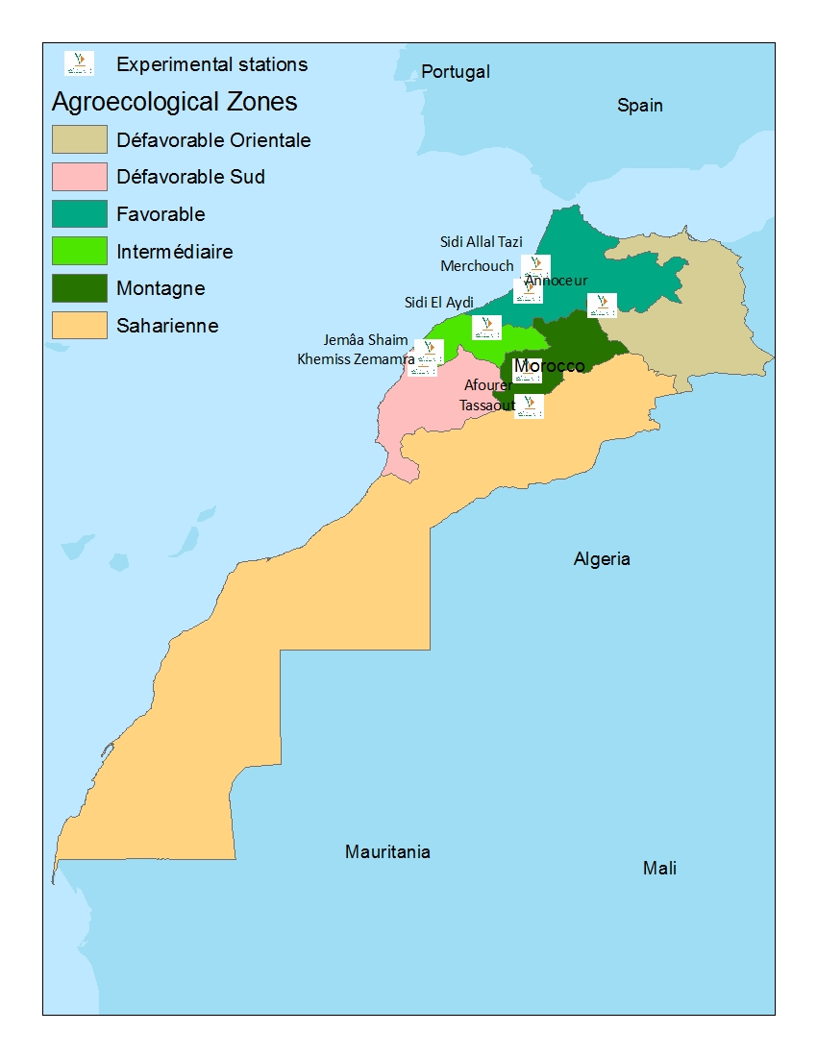
Location of field experimental trials

Slide 3
Location of field experimental trials
INRA Experimental Station | Coordinates |  | Agroecological zone | Major stresses
 | Latitude | Longitude
Afourer | 32.217 | -6.500 | Irrigated | Rusts, terminal heat
Annoceur | 33.667 | -4.850 | Mountain | Cold, drought, Hessian fly, rusts
Jemaa Shaim | 32.350 | -8.850 | Semi arid | Drought, Hessian fly, Leaf rust
Khemiss Zmamra | 32.633 | -8.700 | Semi arid | Drought, Hessian fly, Leaf rust
Marchouch | 33.987 | -6.496 | Favourable | Rusts, septoria, Hessian fly, drought
Sidi Allal Tazi | 34.520 | -6.324 | Favourable | Septoria, rusts, Hessian fly
Sidi El Aydi | 33.167 | -7.400 | Intermediate | Drought, Hessian fly, rusts
Tassaout | 31.420 | -6.467 | Irrigated | Rusts, terminal heat

Slide 4
Collected parameters for BioMA calibration
Species | Period | Nb years | Nb locations | Nb of varieties | Nb of trials | Parameters
Soft wheat | 2001 to 2004 | 4 | 4 | 4 | 136 | Sowing Emergence Tillering Heading Maturity Height Yield
Durum wheat | 2002 to 2005 | 4 | 6 | 24 | 1728 | Tillering Heading Maturity Height Yield

Slide 5
Collected parameters for BioMA calibration
Characteristics of soft wheat cultivars used for BioMA calibration
Cultivar | Year of release | Earliness | Productivity | Adaptation | Resistance to diseases and insects Hessian fly | Sensitivity to Yellow rust | Sensitivity to Septoria
Achtar | 1985 | Medium late | High | High | Susceptible | Susceptible | Medium
Kanz | 1985 | Early | Medium | Intermediate | Intermediate | Intermediate | Resistant
Mehdia | 1987 | Medium early | Medium | Intermediate | Susceptible | Intermediate | Medium
Massira | 1992 | Medium early | Medium | Intermediate | Resistant | Susceptible | Resistant
Arrehane | 1997 | Early | High | High | Resistant | Resistant | Resistant

Slide 6
Collected parameters for BioMA calibration
Twenty four durum wheat varieties were used, among the varieties released by INRA. These varieties are :
Marzak, RGL0095, Isly, Sarif, O.Rabia, Amjad, Ourgh, Tarek, Sebou, Tomouh, Marjana, RGN0027, Yasmine, Jawhar, Massa, Anouar and Karim which are suitable for the Northern and Western parts of Morocco, longer season, cooler winter and more favorable rain. These area may have Hessian fly (according to the years) they often have Septoria, leaf rust, root rot and fisarium head blight.
Irden, Nassira, Telset, Amria, Chaoui, Marouane (INRA1804, INRA1805, INRA1806, INRA1807, INRA1808, INRA1809) which are suitable for Southern and or Eastern parts of Morocco, which are warmer, shorter season, more atmospheric water demand, and possibly with less rain. These areas have problems mainly with Hessian fly and dryland root rot, in wet years they have problems with septoria, leaf rust and and fusarium head blight and root rot.

Slide 7
Collected parameters for BioMA calibration
Criteria used to split these varieties in two groups, are by priority :
Yield in the multiyear multisite experiment. Which is influenced by:
Plant phenology (earliness in heading flowering maturity etc) ,
Plant morphology (height, tillers number)
Plant phisiology (tolerance to drought)
Resistance to Hessian fly
Tolerance to root rot.

Slide 8
شكرا
謝謝您
Thank you

