Slide 1
Rice ground data collection in Jiangsu, China
Wang Zhiming, Li Bingbai, Qiu Lin
Institute of Agricultural Economy and Information,
Jiangsu Academy of Agricultural Sciences

Slide 2
Outline
General situation of Jiangsu
Rice production in Jiangsu
Fundamental data collection
Records of growth periods and fertilizer
Results of data observation
Field pictures presentation

Slide 3
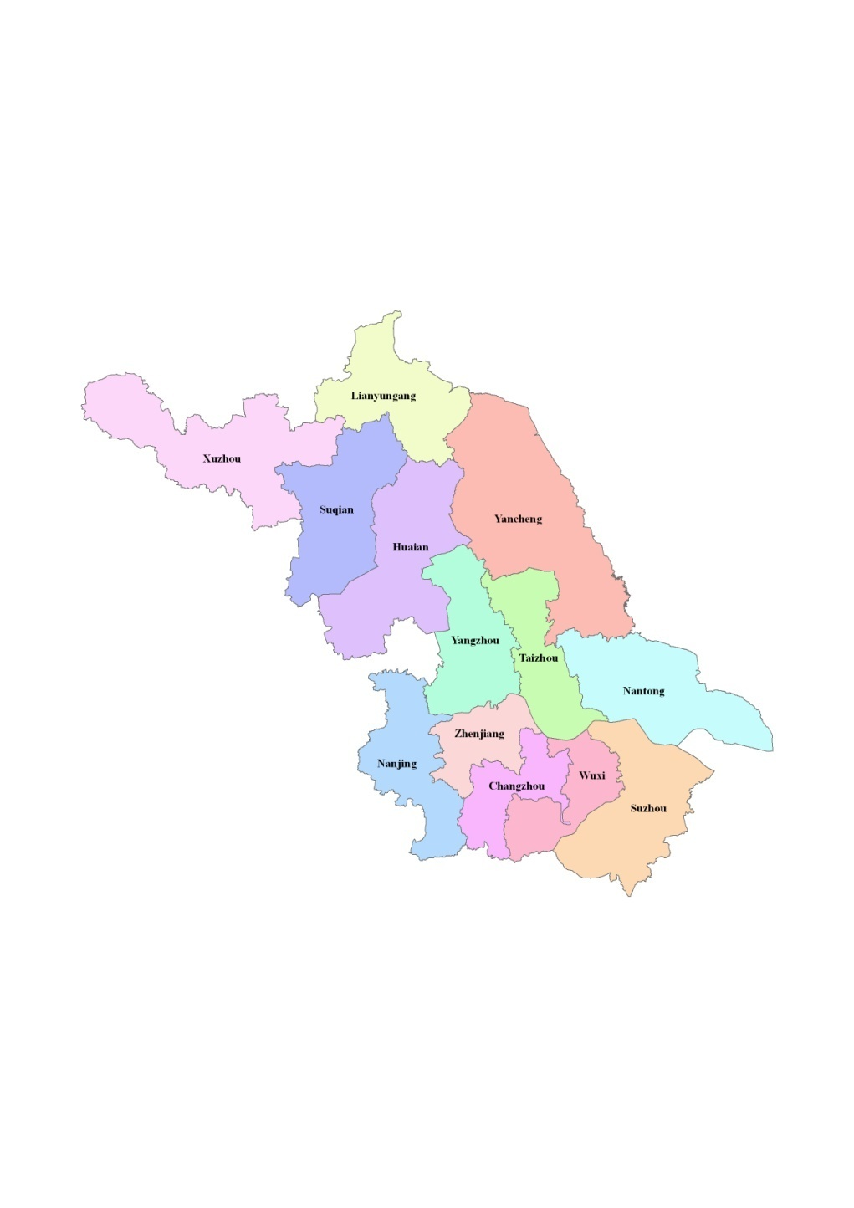
General Situation of Jiangsu
Location: Southeast of China
Lat./Lon.: 30º46’N—35º07’N,
116º22’E—121º55’E
Area: 102.6 thousand km²
Regions: 13
Population: about 78.66 million
Main crop types: rice, wheat, rapeseed, maize,
cotton, soybean
Map of Jiangsu

Slide 4
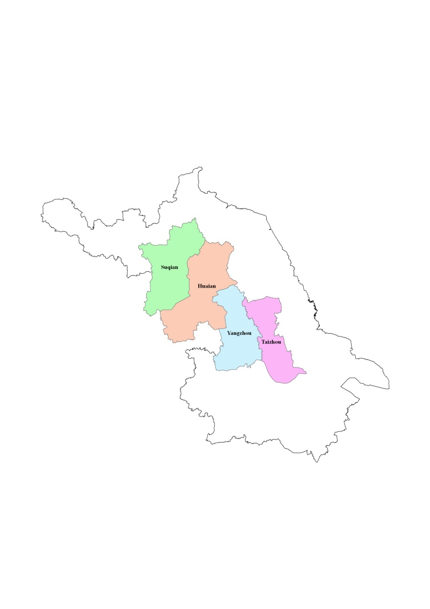
Rice production in Jiangsu
 | Area (k ha) |  |  |  | Yield (kg/ha)
 | Rice | Indica | Japonica | Others | Rice | Indica | Japonica
Jiangsu | 2232.50 | 1800.57 | 370.72 | 61.21 | 7937 | 8051 | 7355
Huaian | 281.22 | 183.50 | 93.26 | 4.46 | 8174 | 8323 | 7747
Yangzhou | 203.98 | 169.36 | 28.03 | 6.59 | 7973 | 8198 | 6814
Taizhou | 204.40 | 191.11 | 7.29 | 6.00 | 8871 | 8887 | 8886
Suqian | 205.64 | 107.71 | 90.13 | 7.80 | 7801 | 7771 | 7815
Land area in 4 study regions accounts for 30.3% of that in the whole province. Rice area in 4 study regions account s for 40.1% of that in the whole province. Indica and Japonica areas in the same regions account for 36.2% and 59.0% of those in Jiangsu, respectively.

Slide 5
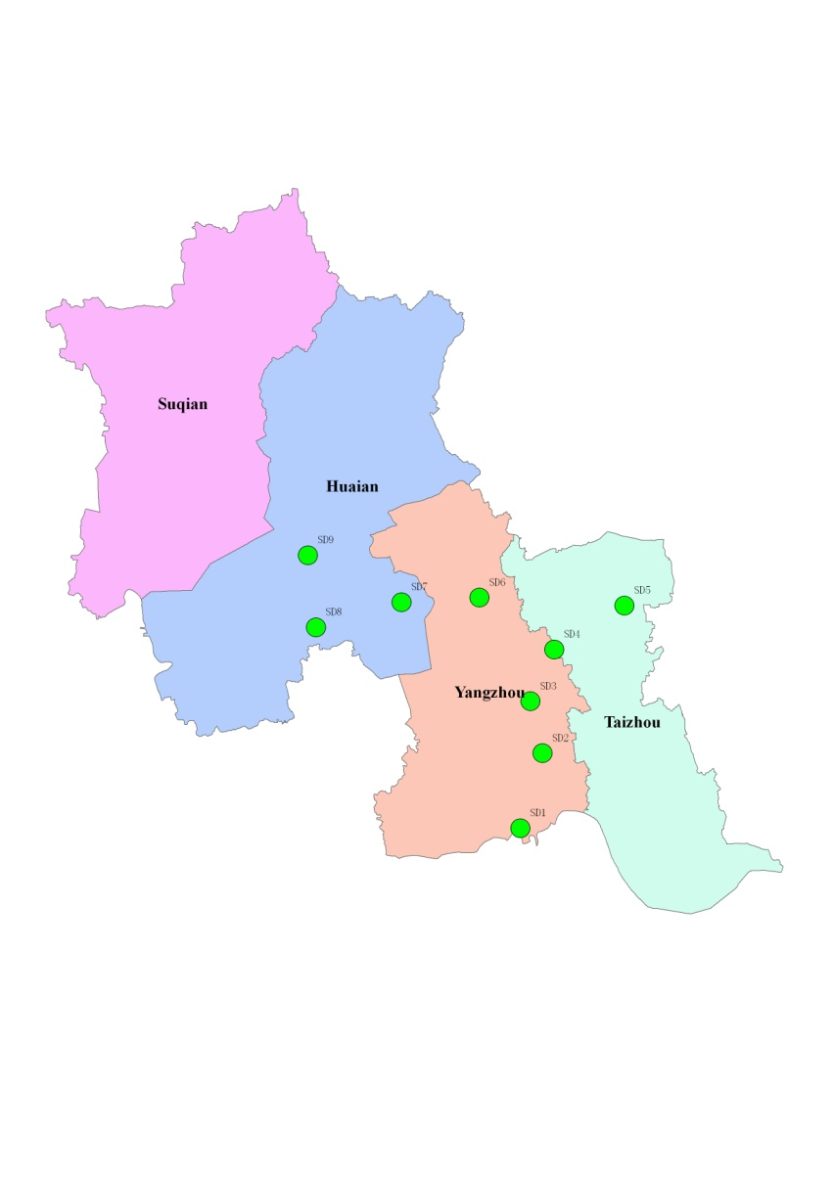
Location and GPS information of sample sites
 | Location | GPS information
SD1 | Shatou, Hanjiang, Yangzhou | 32 16 57.9N 119 33 50.1E
SD2 | Yiling, Jiangdu, Yangzhou | 32 30 39.0N 119 41 33.4E
SD3 | Fanchuan, Jiangdu, Yangzhou | 32 40 55.2N 119 40 37.5E
SD4 | Lincheng, Xinghua, Taizhou | 32 50 02.1N 119 47 53.2E
SD5 | Changrong, Xinghua, Taizhou | 32 56 28.6N 120 05 51.4E
SD6 | Xiaji, Baoying, Yangzhou | 33 02 07.4N 119 32 16.0E
SD7 | Tugou, Jinhu, Huaian | 33 03 27.5N 119 13 53.4E
SD8 | Dailou, Jinhu, Huaian | 33 00 57.7N 118 53 01.9E
SD9 | Zhuba, Hongze, Huaian | 33 14 58.4N 118 53 28.6E
Distribution of sample sites

Slide 6
Results of soil analysis
 | pH | Organic Matter | Total Nitrogen | Available N | Available P | Available K | Soil texture
 |  | (g.kg-1) | (g.kg-1) | (mg.kg⁻¹) | (mg.kg⁻¹) | (mg.kg⁻¹)
SD1 | 6.7 | 26.58 | 1.83 | 166.3 | 22.9 | 63.4 | clay loam
SD2 | 6.7 | 26.9 | 1.84 | 170.1 | 12.3 | 19.3 | clay loam
SD3 | 6.6 | 21.05 | 1.31 | 139.9 | 19.7 | 39.4 | clay loam
SD4 | 6.5 | 25.77 | 1.69 | 186.4 | 17.5 | 43.4 | clay loam
SD5 | 6.7 | 24.04 | 1.46 | 166.3 | 8.6 | 67.4 | clay loam
SD6 | 6.8 | 19.75 | 1.24 | 141.8 | 14.8 | 93.5 | loamy clay
SD7 | 6.8 | 21.18 | 1.32 | 166.7 | 8.9 | 113.5 | loamy clay
SD8 | 6.8 | 21.1 | 1.45 | 166.3 | 27.1 | 69.4 | loamy clay
SD9 | 6.7 | 17.73 | 1.28 | 139.9 | 24.2 | 77.5 | loamy clay
*Soil sample depth is from 0 to 20 cm.

Slide 7
Rice varieties, types and cultivation methods
 | Rice variety | Rice type | Cultivation method
SD1 | Yangjing 4227 | Early-maturing Japonica rice | Mechanical transplanting
SD2 | Zhendao 88 | Medium-maturing Japonica rice | Direct broadcasting
SD3 | Huaidao 5 | Late-maturing Japonica rice | Direct broadcasting
SD4 | Huaidao 5 | Late-maturing Japonica rice | Direct broadcasting
SD5 | Huaidao 5 | Late-maturing Japonica rice | Direct broadcasting
SD6 | Huaidao 5 | Late-maturing Japonica rice | Direct broadcasting
SD7 | C Liangyou 608 | Late-maturing Indica rice | Artificial transplanting
SD8 | Y Liangyou 1 | Late-maturing Indica rice | Artificial transplanting
SD9 | Huaidao 5 | Late-maturing Japonica rice | Mechanical transplanting

Slide 8
Introduction of rice varieties
Yangjing 4227
Breeding organization:Lixiahe Institute of Agricultural Sciences
Sources of variety: Yangjing 7057 × Huangye 9520
Characteristics: Plant height can reach 95-100 cm. Its panicle can reach 3~3.3 million/ha, and each panicle owns about 120 grains. 1000-grain weight is about 28 g, and its potential yield can reach about 10.5 t/ha. Yangjing 4227 is featured by thick stems, high yield, lodging resistance, stripe disease resistance, strong tillering ability. Rice quality indicators are as follows: milled rice rate, 67.4%; chalky grain rate, 7.0%; chalkiness, 0.4%; gel consistency, 86 mm; amylose content, 15.8%.

Slide 9
Introduction of rice varieties
Zhendao 88
Breeding organization: Zhenjiang Institute of Agricultural Sciences
Sources of variety: Moonのlight × Wuxiangjing 1
Characteristics: Plant height can reach about 95 cm. Its panicle can reach 3.3~3.75 million/ha, and each panicle owns about 110~120 grains with a seed setting rate of more than 90%. 1000-grain weight is about 27 g, and its potential yield can reach about 10.5 t/ha. Zhendao 88 is featured by compact plant type, short flag leaves, small leaf angle, slight thick-color leaves, easy shattering, and suitable for manual and mechanical threshing. Rice quality indicators are as follows: milled rice rate, 74.4%; ratio of length to width, 1.73; gel consistency, 86 mm; amylose content, 17.35%; protein content, 9.39%.

Slide 10
Introduction of rice varieties
Huaidao 5
Breeding organization: Huaiyin Institute of Agricultural Sciences
Sources of variety: 7208 × Wuyujing 3
Characteristics: Plant height can reach 93 cm. Its panicle can reach 3.3 million/ha, and each panicle owns about 110 grains with a seed setting rate of more than 92.5%. 1000-grain weight is about 28 g, and its potential yield can reach about 11.25 t/ha. Huaidao 5 is featured by compact plant type, coordinate grain structure, moderate tillering ability, better lodging resistance, bacterial blight resistance, and difficult threshing. Rice quality indicators are as follows: milled rice rate, 60.3%; chalky grain rate, 34%; chalkiness, 3.3%; gel consistency, 79 mm.

Slide 11
Introduction of rice varieties
C Liangyou 608
Breeding organization: Hunan Longping Seed Industry Co., Ltd.
Sources of variety: C815S×R608
Characteristics: Plant height can reach 110.8 cm. Its panicle can reach about 2.55 million/ha, and each panicle owns about 171 grains with a seed setting rate of more than 80.7%. 1000-grain weight is about 27.1 g, and its potential yield can reach about 10.5 t/ha. C Liangyou 608 is featured by compact plant type, and upright leaves. Rice quality indicators are as follows: milled rice rate, 57.0%; ratio of length to width, 2.8; chalky grain rate, 39%; chalkiness, 9.2%; gel consistency, 79 mm; amylose content, 14.5%.

Slide 12
Introduction of rice varieties
Y Liangyou 1
Breeding organization: Hunan Hybrid Rice Research Center
Sources of variety: Y58S×9311
Characteristics: Plant height can reach 120.7 cm. Its panicle can reach 2.5 million/ha, and each panicle owns about 164 grains with a seed setting rate of more than 81.0%. 1000-grain weight is about 26.6 g, and its potential yield can reach about 9.75 t/ha. Y Liangyou 1 is featured by compact plant type, and upright leaves. Rice quality indicators are as follows: milled rice rate, 66.9%; ratio of length to width, 3.2; chalky grain rate, 33%; chalkiness, 4.7%; gel consistency, 54 mm; amylose content, 16.0%.

Slide 13
Observation of rice growth periods
 | Sowing date | Emergence date | Transplanting date | Booting date | Heading date | Flowering date | Physiological maturity date
SD1 | 26-May | 30-May | 22-Jun | 24-Aug | 1-Sep | 3-Sep | 21-Oct
SD2 | 9-Jun | 14-Jun | — | 23-Aug | 30-Aug | 1-Sep | 17-Oct
SD3 | 12-Jun | 19-Jun | — | 28-Aug | 5-Sep | 7-Sep | 20-Oct
SD4 | 12-Jun | 19-Jun | — | 25-Aug | 2-Sep | 4-Sep | 20-Oct
SD5 | 11-Jun | 18-Jun | — | 25-Aug | 2-Sep | 4-Sep | 20-Oct
SD6 | 13-Jun | 20-Jun | — | 25-Aug | 2-Sep | 4-Sep | 21-Oct
SD7 | 10-May | 15-May | 13-Jun | 13-Aug | 20-Aug | 22-Aug | 10-Oct
SD8 | 5-May | 10-May | 13-Jun | 17-Aug | 24-Aug | 26-Aug | 12-Oct
SD9 | 20-May | 26-May | 20-Jun | 22-Aug | 30-Aug | 1-Sep | 21-Oct

Slide 14
Records of Basal fertilizer
 | Fertilization date | Fertilizer type | Fertilizer amount (kg.ha⁻¹)
SD1 | 27-Jun | Urea (N, 46%) | 150
SD2 | 9-Jun | Compound fertilizer (N-P2O5-K2O, 15-15-15) | 337.5
SD3 | 10-Jun | Compound fertilizer (N-P2O5-K2O, 15-15-15) | 375
SD4 | 12-Jun | Compound fertilizer (N-P2O5-K2O, 15-15-15) | 375
SD5 | 11-Jun | Compound fertilizer (N-P2O5-K2O, 15-15-15) | 375
SD6 | 13-Jun | Compound fertilizer (N-P2O5-K2O, 15-15-15) | 375
SD7 | 13-Jun | Compound fertilizer (N-P2O5-K2O, 15-15-15) | 525
SD8 | 13-Jun | Compound fertilizer (N-P2O5-K2O, 15-15-15) | 375
SD9 | 18-Jun | Compound fertilizer (N-P2O5-K2O, 15-15-15) | 375

Slide 15
Records of dressing fertilizer (1)
 | Fertilization date | Fertilizer type | Fertilizer amount (kg.ha⁻¹)
SD1 | 3-Jul | Specialized fertilizer for rice | 300
 | 8-Jul | Urea (N,46%) | 225
 | 10-Aug | Urea (N,46%) | 150
SD2 | 9-Jul | Urea (N,46%) | 262.5
 | 2-Aug | Urea (N,46%) | 375
SD3 | 9-Jul | Urea (N,46%) | 300
 | 5-Aug | Urea (N,46%) | 300
SD4 | 5-Jul | Urea (N,46%) | 187.5
 | 5-Aug | Urea (N,46%) | 375

Slide 16
Records of dressing fertilizer (2)
 | Fertilization date | Fertilizer type | Fertilizer amount (kg.ha⁻¹)
SD5 | 3-Jul | Urea (N,46%) | 150
 | 20-Jul | Urea (N,46%) | 150
 | 6-Aug | Urea (N,46%) | 375
SD6 | 5-Jul | Urea (N,46%) | 337.5
 | 21-Jul | Compound fertilizer (N-P2O5-K2O, 15-15-15) | 375
SD7 | 12-Jul | Compound fertilizer (N-P2O5-K2O, 15-15-15) | 75
SD8 | 28-Jun | Urea (N,46%) | 150
SD9 | 28-Jun | Urea (N,46%) | 150
 | 21-Jul | Urea (N,46%) | 375
 | 8-Aug | Compound fertilizer (N-P2O5-K2O, 15-15-15) | 225

Slide 17
Plant heights of Indica rice in different growth periods

Slide 18
Plant heights of Japonica rice in different growth periods

Slide 19
Leaf age changes (left, Indica rice; right, Japonica rice )
The last leaf had completely open on Aug. 24 (Indica rices) and on Aug.12 (Japonica rices), hereafter leaf age would not be observed.

Slide 20
LAI value changes in different growth periods (left, Indica rice; right, Japonica rice)
Generally, LAI values rose faster in the early stage, and reached their peaks in late August or early September, and then fell down.

Slide 21
Plant densities of Indica (left) and Japonica (right) rice in different growth periods
Plant densities increased rapidly within one month after sowing or transplant-ing due to tillering, reached their peaks on July 12, then slowed down due to survival competition, and remained stable after September 5. Generally, plant densities of Indica rice were higher than those of Japonica rice, and plant densities of direct broadcasting rice were higher than those of transplanting rice except SD9.

Slide 22
Aboveground biomass changes of Indica (left) and Japonica (right) rice in different growth periods

Slide 23
Yield structures of different rice varieties
 |  | Ear Density | Ear length | Grain no. per ear | Seed-setting rate | 1000-grain weight | Theoretical yield
 |  | (*10⁶ ha⁻¹) | (cm) |  | (%) | (g) | (t.ha⁻¹)
Indica | SD1, Yangjing 4227 | 2.64 | 15.1 | 103 | 94.5 | 31.06 | 8.01
 | SD2, Zhendao 88 | 3.33 | 13.8 | 88 | 96.1 | 29.44 | 8.29
 | SD3, Huaidao 5 | 3.57 | 13.8 | 92 | 90.9 | 27.42 | 8.18
 | SD4, Huaidao 5 | 3.63 | 15.5 | 99 | 95.6 | 28.99 | 9.99
 | SD5, Huaidao 5 | 3.77 | 15.2 | 94 | 96.6 | 27.26 | 9.33
 | SD6, Huaidao 5 | 3.44 | 13.8 | 98 | 95.6 | 28.94 | 9.35
 | SD9, Huaidao 5 | 3.95 | 15.3 | 100 | 91.2 | 28.27 | 10.22
Japonica | SD7, C Liangyou 608 | 2.47 | 24.9 | 179 | 79.7 | 26.57 | 9.33
 | SD8, Y Liangyou 1 | 2.49 | 22.9 | 162 | 81.5 | 26.26 | 8.65

Slide 24
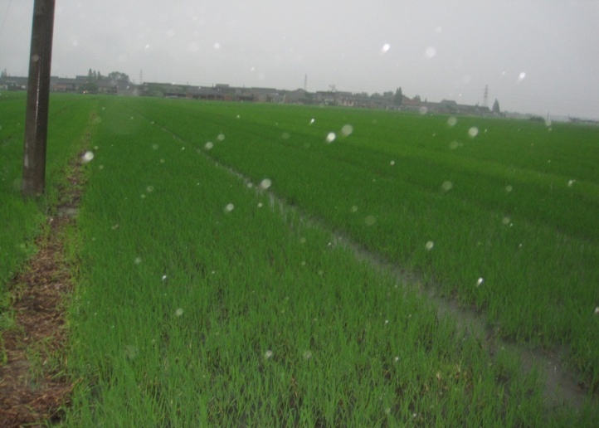
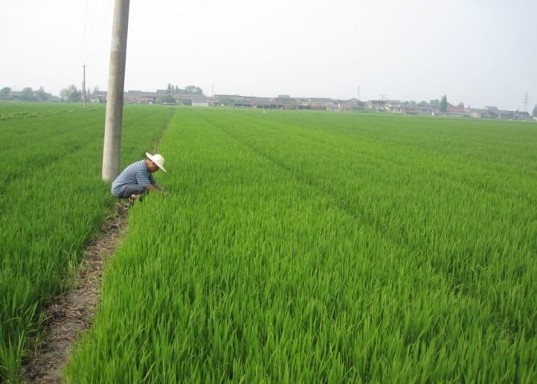
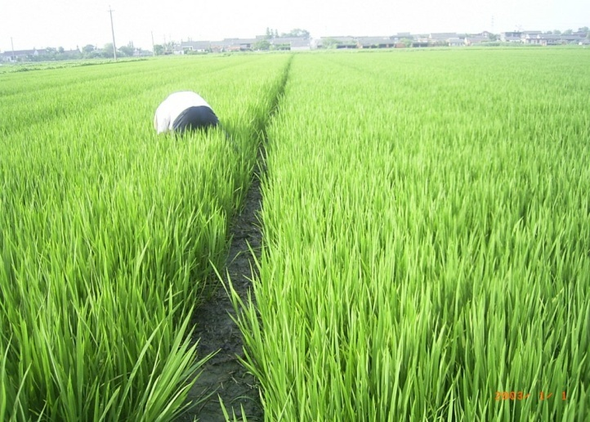
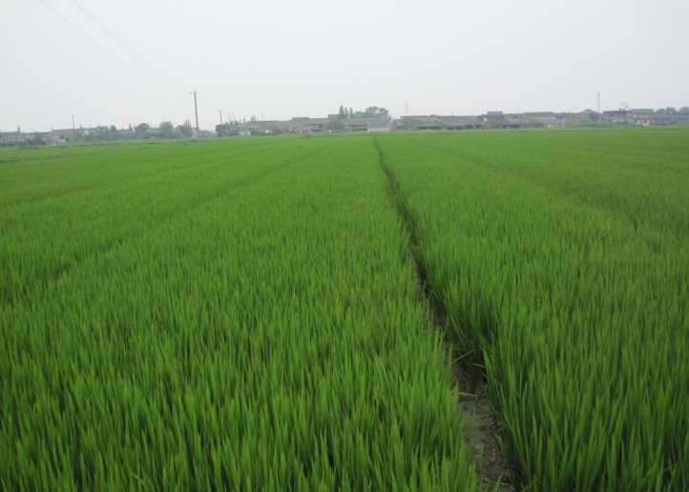
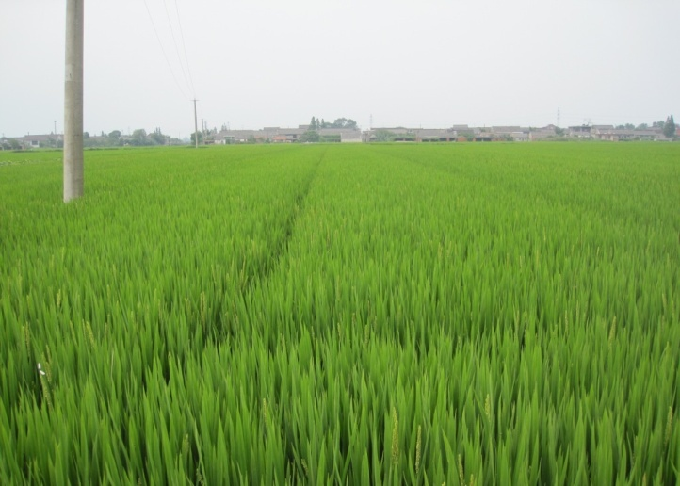
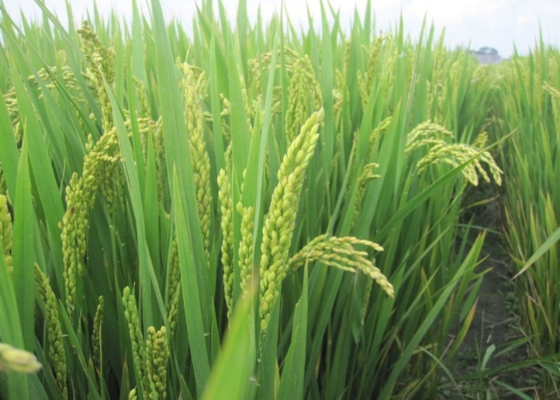
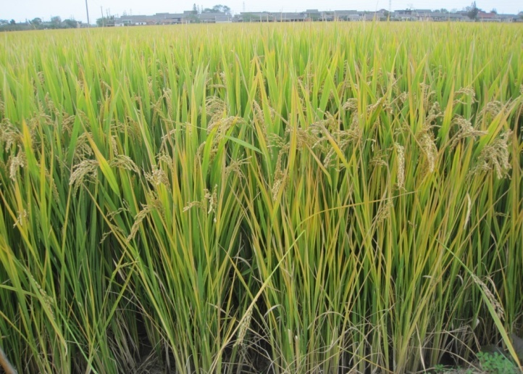
Picture series of Huaidao 5 (SD5, direct broadcasting Indica rice, Changrong, Xinghua)
June 27
July 11
July 27
Aug. 12
Aug. 23
Sep. 5
Sep. 26
Oct. 21

Slide 25
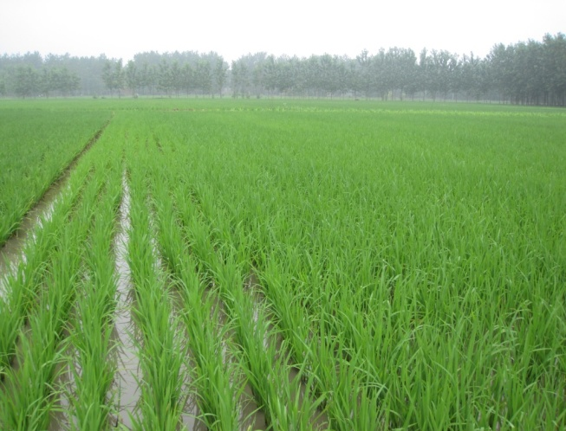
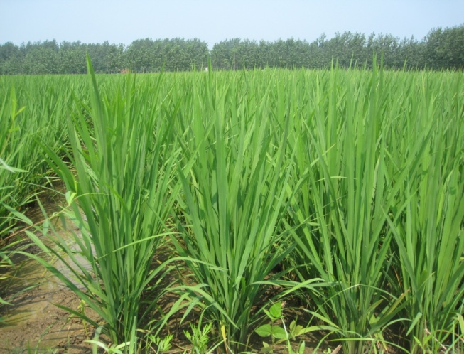
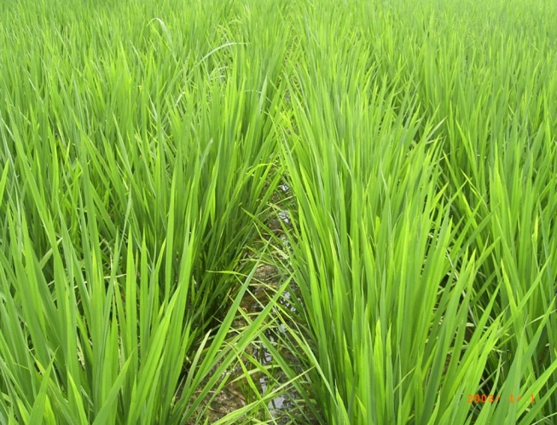
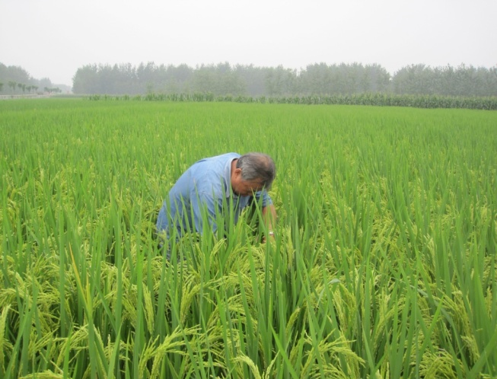
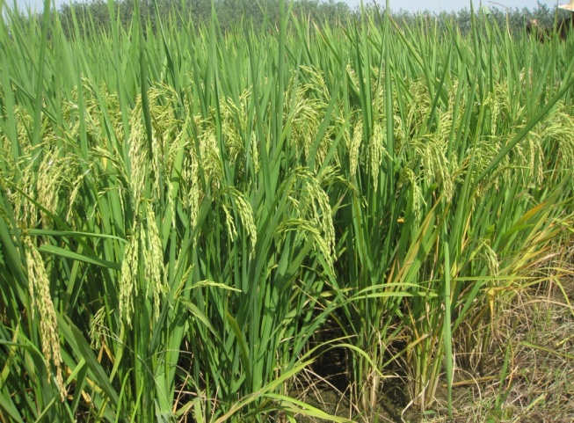
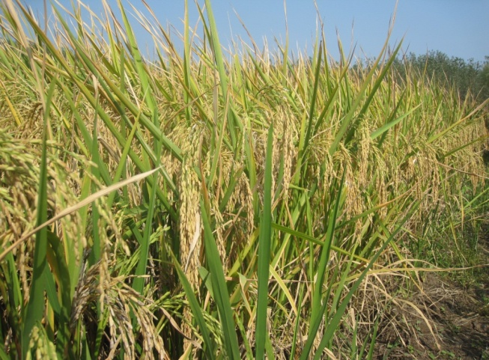
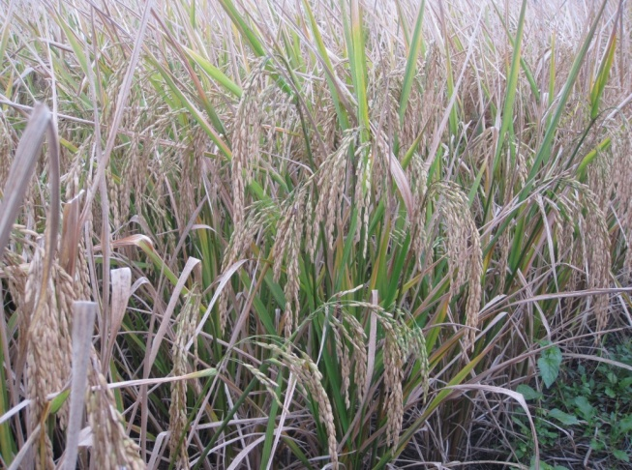
Picture series of C Liangyou 608 (SD7, artificial transplanting Japonica rice, Tugou, Jinhu)
June 28
July 12
July 28
Aug. 13
Aug. 23
Sep. 6
Sep. 27
Oct. 12
Prof. Li Bingbai

Slide 26
Thanks for your attention !

