Slide 1

E-Agri Progress meeting
Ispra, November 23th 2011
WP 4 : Yield Estimation with Remote Sensing
Leading institution : VITO
Months : 1-36
Eerens H. (VITO - Belgium)
Balaghi R., Jlibene M., (INRA - Morocco)
Tahiri (DSS - Morocco)
Aydam M. (JRC - Italie)

Slide 2
Work Packages
WP41: Official statistic data collection (Months: 1-6)
  WP41.1: Databases on wheat yield for Morocco and China (Done)
WP42: Crop biomass (wheat) derived from remote sensing (Months: 9-36)
  WP42.1: Databases of bio-physical variables NDVI, fAPAR, DMP (Done)
  WP42.2: RUM databases at county, district or province levels (Done)
WP43: Yield estimation for wheat based on remote sensing in Morocco (Months: 11-36)
  WP43.1: Database containing NDVI or DMP and wheat statistics (Done)
  WP43.2: Empirical models to forecast wheat yield from NDVI, at both national and provincial levels (Done at national level)
WP44: Wheat Yield estimation based on remote sensing for HUAIBEI Plain (Months: 11-36)
  WP44.1: Wheat yield prediction models for each of seven districts on the HUAIBEI plain (Done)

Slide 3
WP41: Official statistic data collection
Morocco:
  Official statistics : historical area and production data
  At province level (smallest available unit): 40 provinces
  For soft wheat, durum wheat and barley
  From 1978-79 to 2009-2010 cropping season
  Shapefiles of provinces
  All data available in Excel and GIS format
China:
  Official statistics: historical area and production data
  China : at district level (Huaibei, Bozhou, Suzhou, Bengbu, Fuyang and Huainan)
  For wheat and maize
  From 2000 to 2009
  Shapefile od districts
  All data available in Excel format

Slide 4
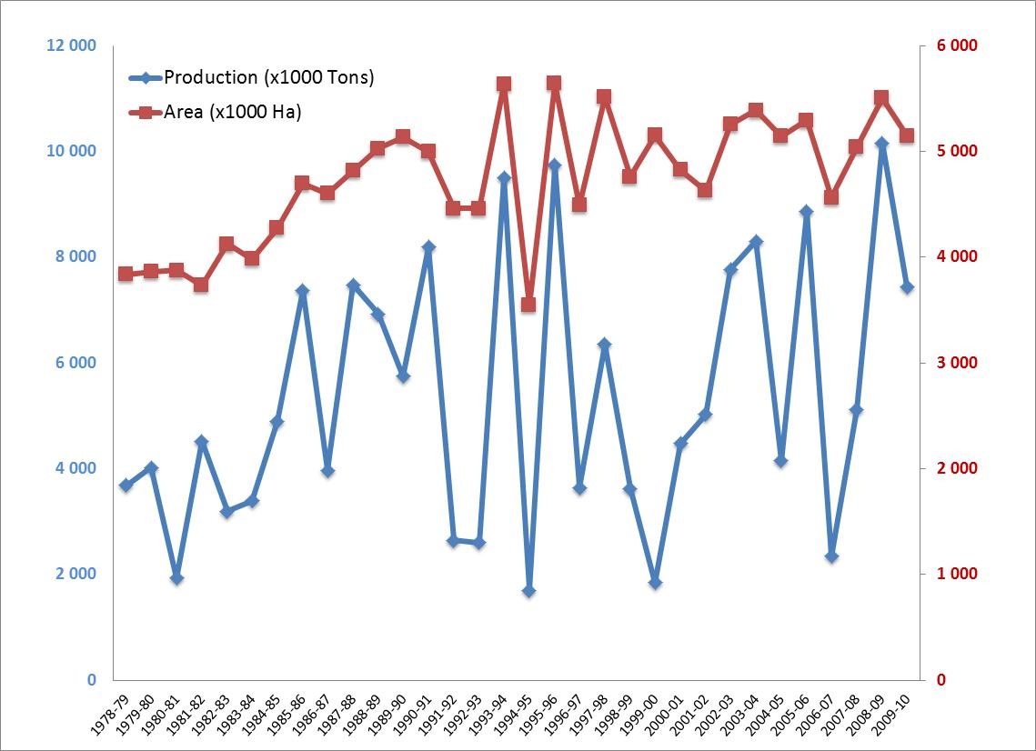
WP41: Official statistic data collection
Inter-annual variation of cereals production and area in Morocco at national level (Data source: Direction of Strategy and Statistics of the Ministry of Agriculture).

Slide 5
WP41: Official statistic data collection
Provinces of Morocco with their average cereal production (x1000 tons) (1990-2010; Data source: Direction of Strategy and Statistics of the Ministry of Agriculture).

Slide 6
WP42: Crop biomass (wheat) derived from remote sensing
SPOT – VEGETATION images extracted from global VITO archive.
Ten-daily series : (3 per month, 36 per year), ranging from 1999-dekad 1 until 2009-dekad 24). In total 396 dekads.
Five variables:
  Non-smoothed i-NDVI and a-fAPAR
  Smoothed k-NDVI and b-fAPAR (all cloudy and missing observations were detected and replaced with more logical, interpolated values).
  y-DMP: Dry Matter Productivity from smoothed b-fAPAR and European Centre for Medium-Range Weather Forecasts (ECMWF) meteodata.

Slide 7
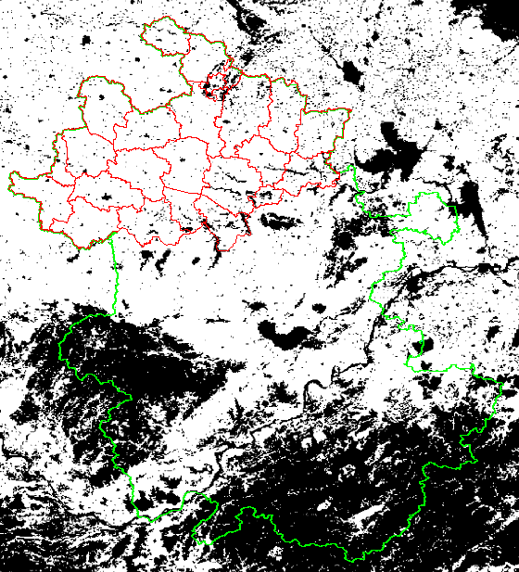
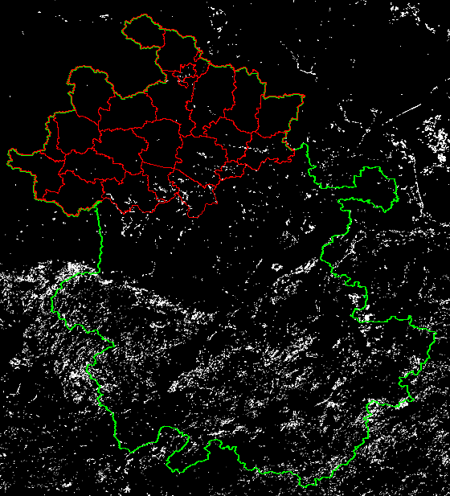
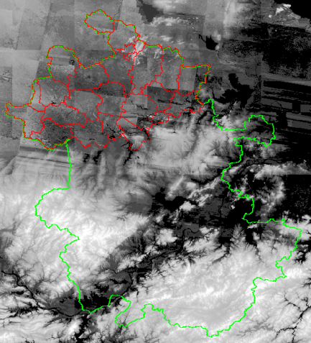
WP42: Crop biomass (wheat) derived from remote sensing
Cropmask (JRC-MARSOP project) applied to SPOT Images, derived from the 300m-resolution Land Use map GlobCover-v2.2, but JRC adapted/corrected it in many ways.
Huabei in China : cropland is predominant, while grassland is rather exceptional

Slide 8
WP42: Crop biomass (wheat) derived from remote sensing
Example : k-NDVI in Huaibei district
 | January |  |  | February |  |  | March |  |  | April |  |  | … | … | … | November |  |  | December |  |  | Wheat yield
 | 1 | 2 | 3 | 1 | 2 | 3 | 1 | 2 | 3 | 1 | 2 | 3 | … | … | … | 1 | 2 | 3 | 1 | 2 | 3
1999 | 0,302 | 0,328 | 0,357 | 0,394 | 0,453 | 0,395 | 0,383 | 0,396 | 0,449 | 0,544 | 0,562 | 0,56 | … | … | … | 0,252 | 0,221 | 0,215 | 0,206 | 0,21 | 0,219
2000 | 0,196 | 0,177 | 0,155 | 0,151 | 0,156 | 0,21 | 0,265 | 0,358 | 0,482 | 0,562 | 0,617 | 0,592 | … | … | … | 0,258 | 0,216 | 0,202 | 0,188 | 0,187 | 0,193 | 3,6945
2001 | 0,142 | 0,125 | 0,135 | 0,16 | 0,221 | 0,249 | 0,299 | 0,339 | 0,409 | 0,495 | 0,536 | 0,524 | … | … | … | 0,267 | 0,281 | 0,305 | 0,325 | 0,356 | 0,417 | 5,2690
2002 | 0,41 | 0,42 | 0,443 | 0,467 | 0,524 | 0,59 | 0,628 | 0,65 | 0,678 | 0,703 | 0,722 | 0,657 | … | … | … | 0,263 | 0,274 | 0,297 | 0,307 | 0,289 | 0,291 | 4,6574
2003 | 0,31 | 0,316 | 0,341 | 0,363 | 0,385 | 0,413 | 0,474 | 0,55 | 0,624 | 0,682 | 0,704 | 0,713 | … | … | … | 0,217 | 0,213 | 0,243 | 0,247 | 0,261 | 0,257 | 4,2794
2004 | 0,257 | 0,265 | 0,281 | 0,302 | 0,344 | 0,441 | 0,552 | 0,591 | 0,655 | 0,707 | 0,726 | 0,702 | … | … | … | 0,248 | 0,303 | 0,348 | 0,394 | 0,405 | 0,412 | 5,3774
2005 | 0,42 | 0,385 | 0,374 | 0,38 | 0,416 | 0,453 | 0,484 | 0,538 | 0,609 | 0,672 | 0,721 | 0,716 | … | … | … | 0,255 | 0,317 | 0,396 | 0,422 | 0,408 | 0,379 | 5,3295
2006 | 0,356 | 0,324 | 0,334 | 0,386 | 0,433 | 0,489 | 0,557 | 0,61 | 0,659 | 0,709 | 0,686 | 0,656 | … | … | … | 0,309 | 0,349 | 0,364 | 0,389 | 0,415 | 0,423 | 6,0515
2007 | 0,42 | 0,396 | 0,392 | 0,42 | 0,498 | 0,567 | 0,619 | 0,66 | 0,685 | 0,717 | 0,736 | 0,742 | … | … | … | 0,277 | 0,318 | 0,367 | 0,377 | 0,403 | 0,446 | 5,8683
2008 | 0,49 | 0,473 | 0,455 | 0,439 | 0,453 | 0,5 | 0,59 | 0,664 | 0,702 | 0,723 | 0,738 | 0,741 | … | … | … | 0,35 | 0,453 | 0,489 | 0,497 | 0,489 | 0,484 | 6,4350
2009 | 0,495 | 0,457 | 0,459 | 0,49 | 0,476 | 0,503 | 0,543 | 0,636 | 0,676 | 0,721 | 0,733 | 0,735 | … | … | … | 0,322 | 0,278 | 0,272 | 0,282 | 0,298 | 0,321 | 6,3967

Slide 9
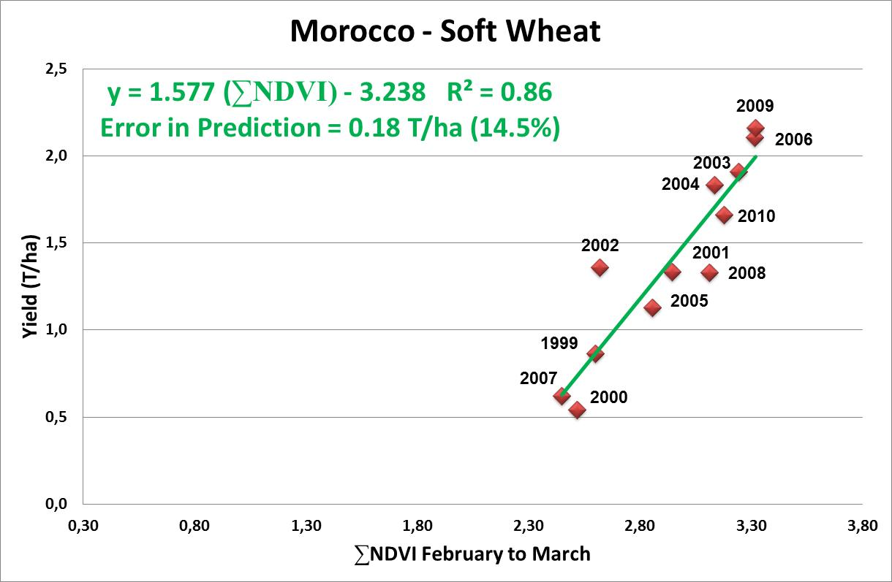
WP43: Yield estimation for wheat based on remote sensing in Morocco
NDVI of croplands is a strong indicator of cereal yields at national as well as at agro-ecological zone levels.
The relationship between cereal yields and cumulated NDVI (from February to March) is linear for soft wheat, durum and barley.

Slide 10
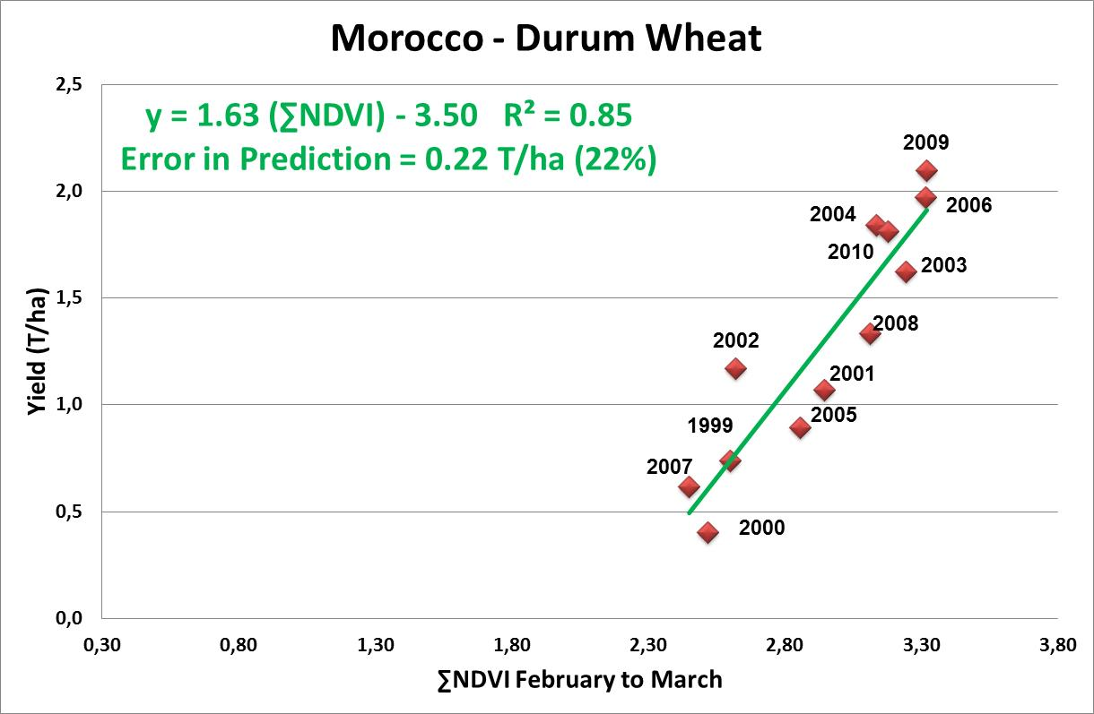
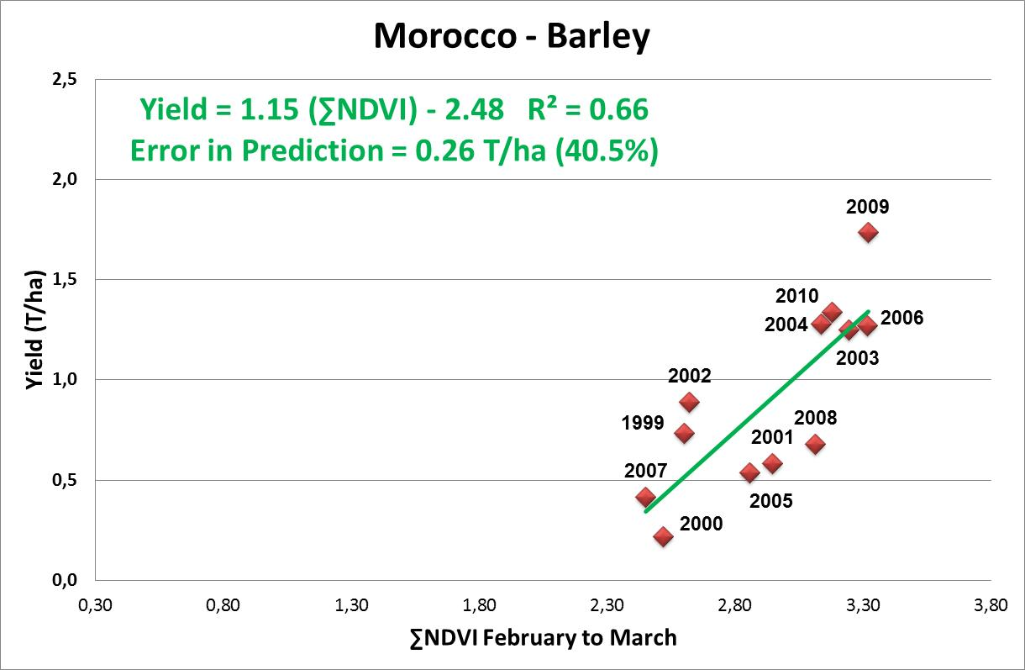
WP43: Yield estimation for wheat based on remote sensing in Morocco
The correlation between barley yields and ΣNDVI (from February to March) is lower ;
Prediction error is relatively low, for soft wheat and durum wheat, except for barley.

Slide 11
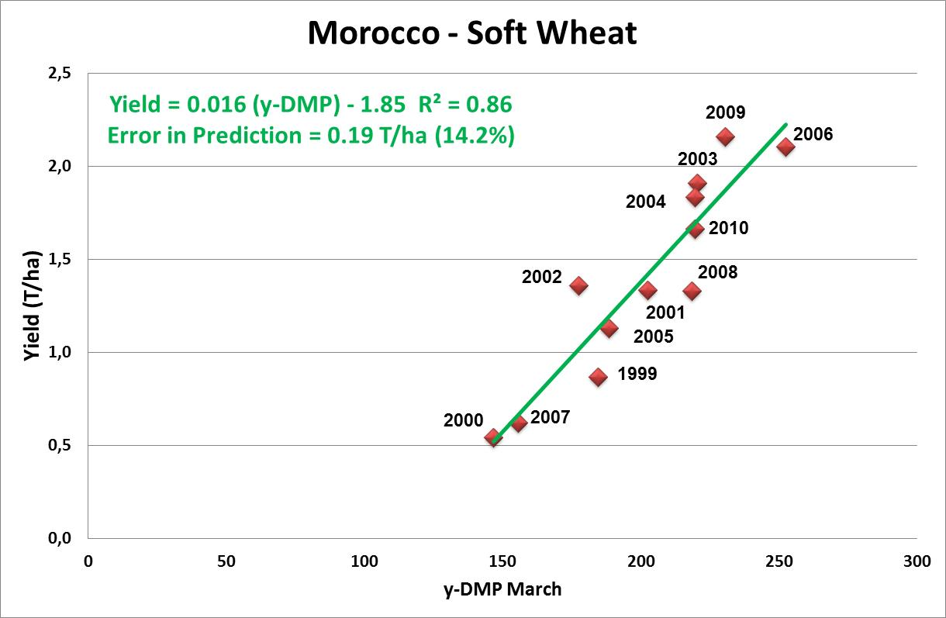
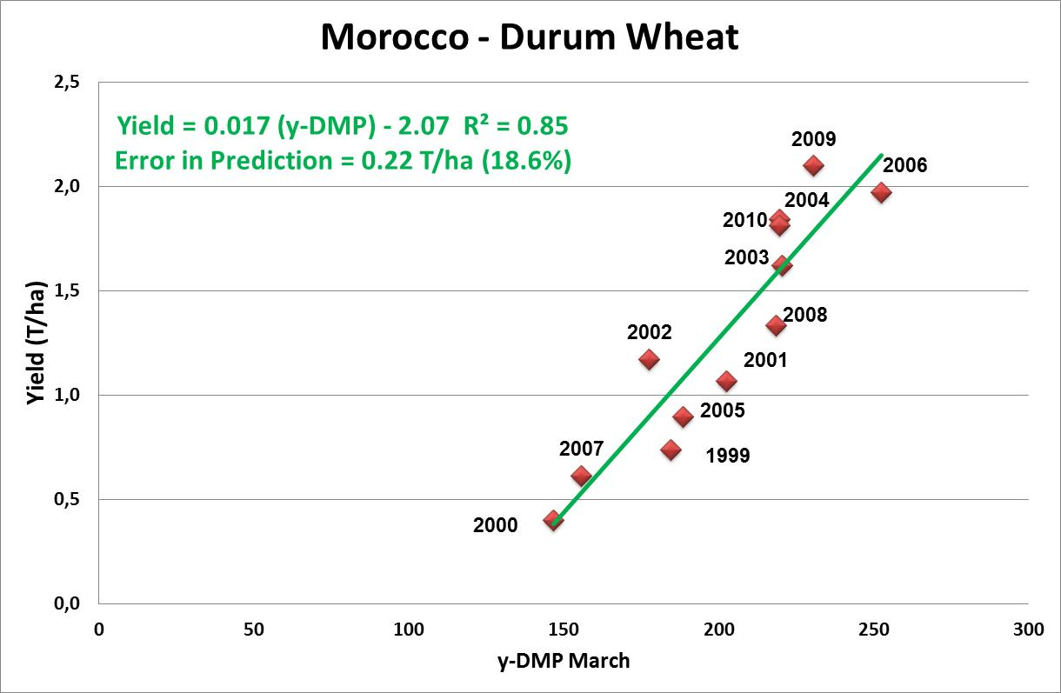
WP43: Yield estimation for wheat based on remote sensing in Morocco
ΣY-DMP (from February to March) is a better indicator than ΣNDVI for cereal yields ;
The relationship between cereal yields and ΣY-DMP (from February to March) is linear for soft wheat, durum and barley.

Slide 12
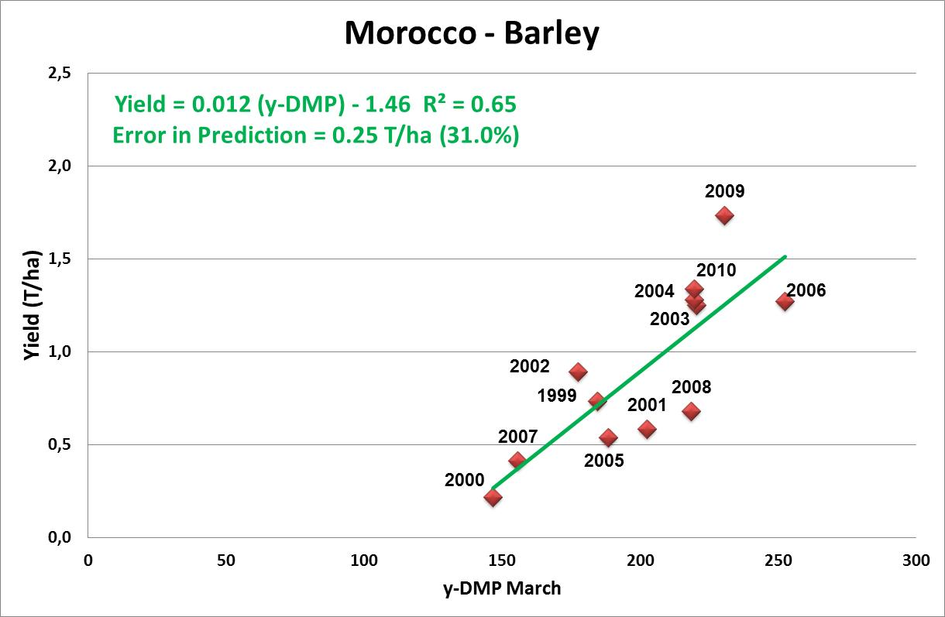
WP43: Yield estimation for wheat based on remote sensing in Morocco
Prediction error is lower for ΣY-DMP than for ΣNDVI , for soft wheat, durum wheat and barley.

Slide 13
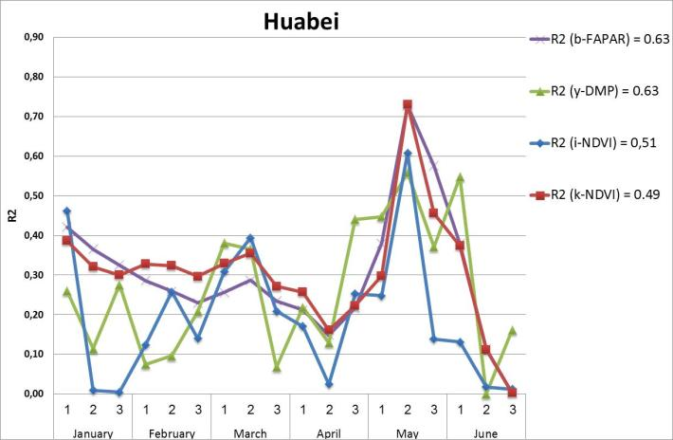
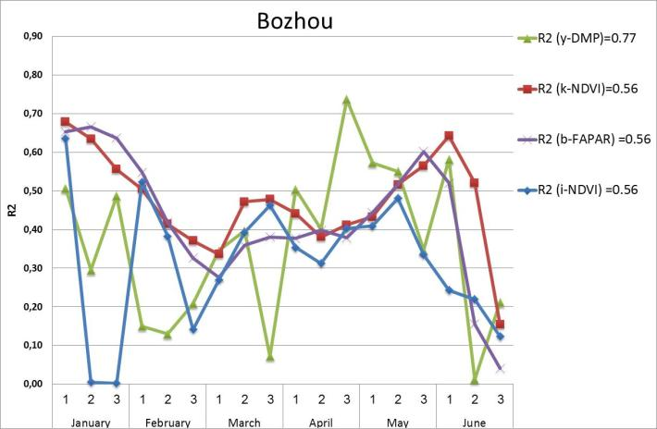
WP44: Wheat Yield estimation based on remote sensing for HUAIBEI Plain
Good correlations between Remte sensing indicators (b-FAPAR, y-DMP, i-NDVI and k-NDVI) and wheat yields in the 6 disctricts of Anhui ;
Best correlations obtained with y-DMP ;
Most consistant correlations with k-NDVI,

Slide 14
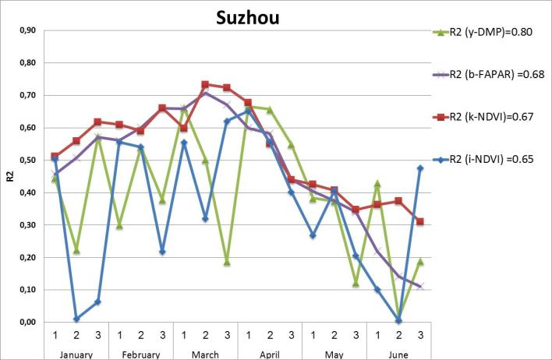
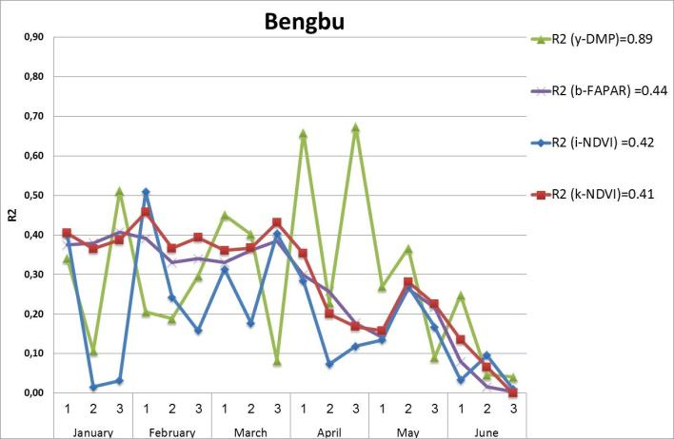
WP44: Wheat Yield estimation based on remote sensing for HUAIBEI Plain
Best correlations obtained in Suzhou and Bengbu districts for all indicators.

Slide 15
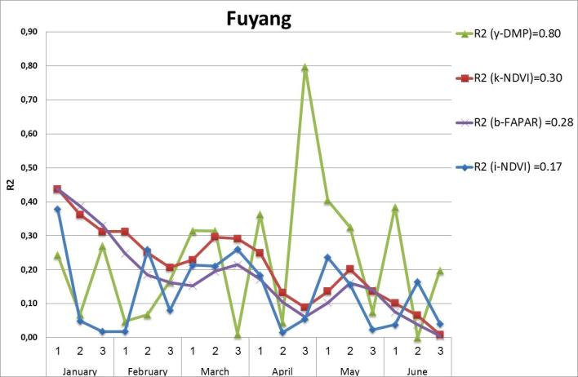
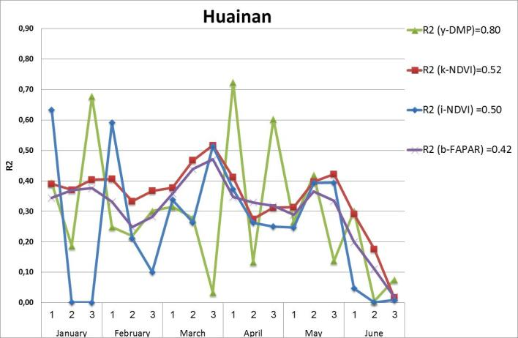
WP44: Wheat Yield estimation based on remote sensing for HUAIBEI Plain
Only y-DMP is well correlated to wheat yields in Fuyang and Huainan districts.

Slide 16
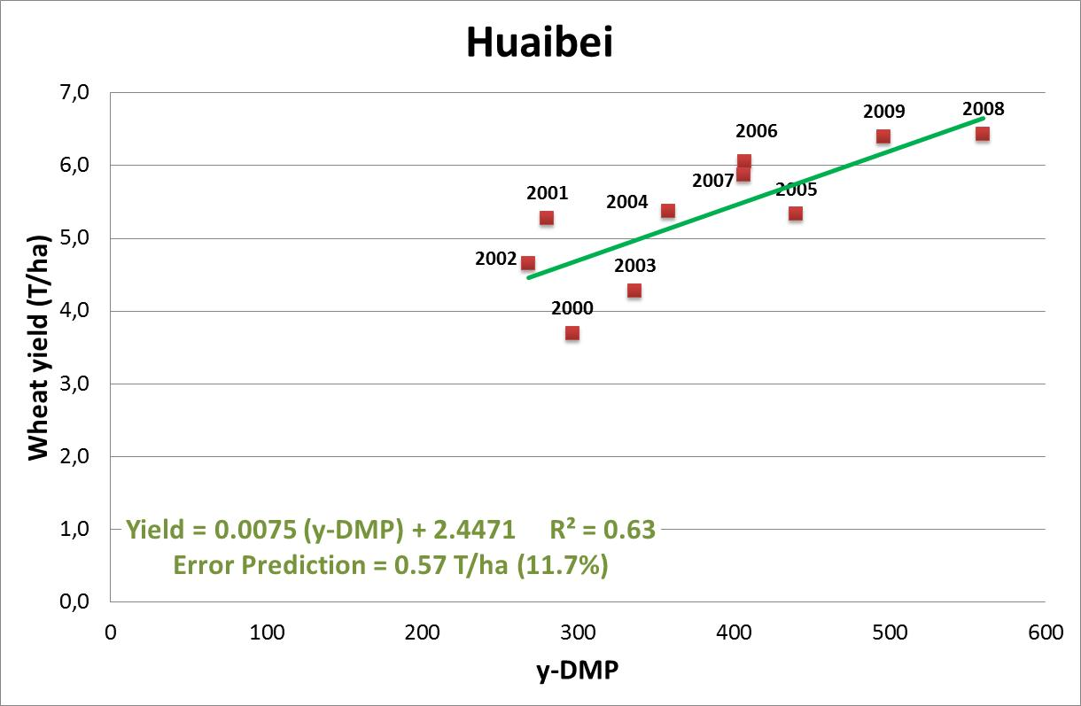
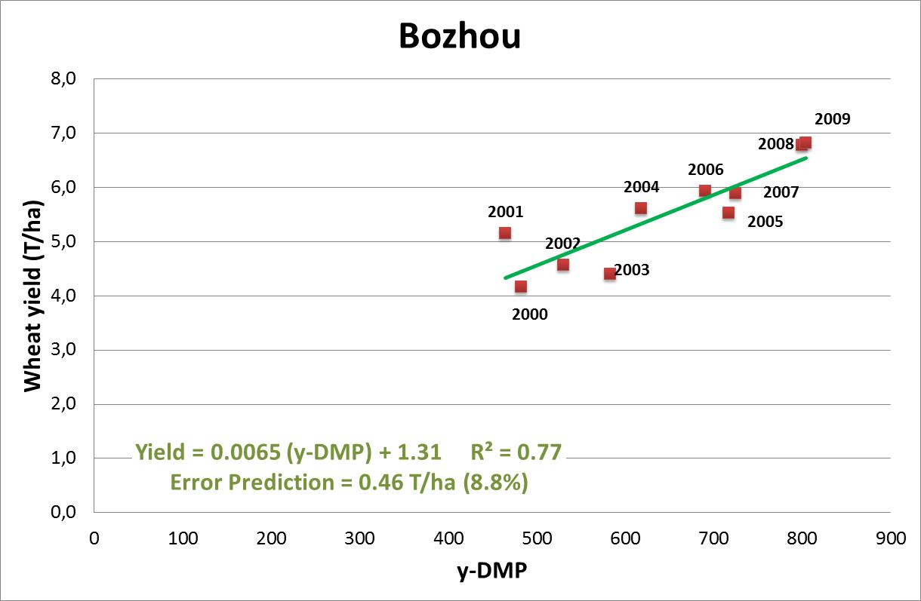
WP44: Wheat Yield estimation based on remote sensing for HUAIBEI Plain
Regression : Wheat yield = a * (y-DMP) + b
Good wheat yield prediction in the 6 districts, using y-DMP ;
Prediction error ranges from 8.4 to 11.7%.
Σ(y-DMP) : 3rd dekad April – 1st dekad June
Σ(y-DMP) : 1st dekad April – 1st dekad June

Slide 17
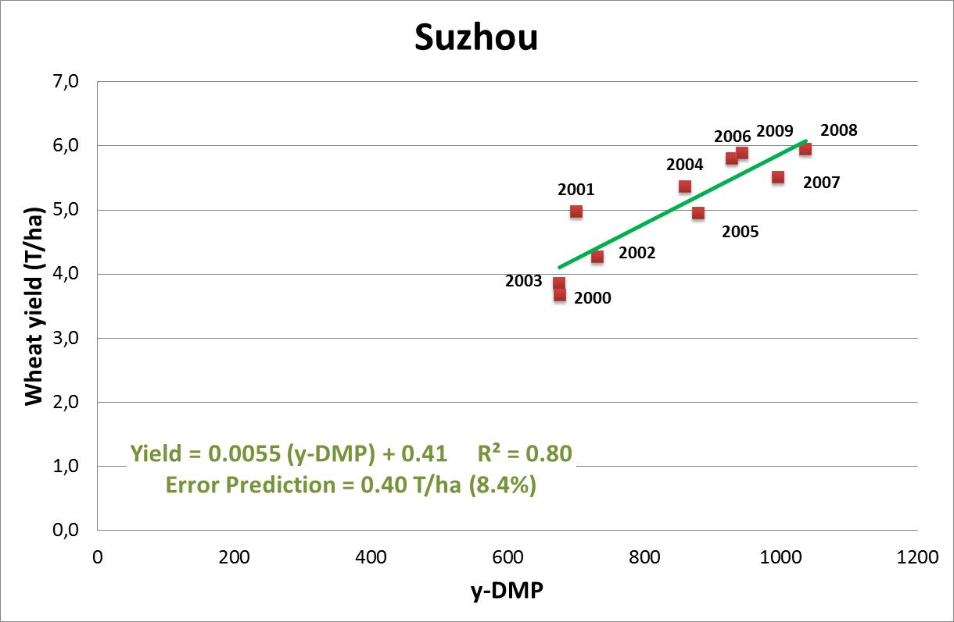
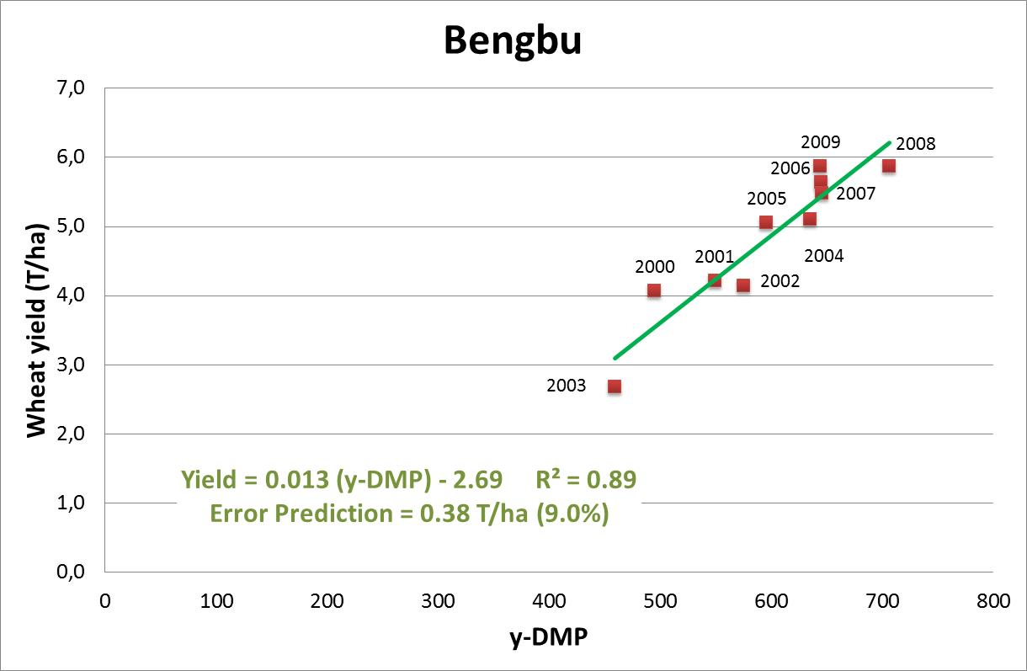
WP44: Wheat Yield estimation based on remote sensing for HUAIBEI Plain
Σ(y-DMP) : 2d dekad February – 2d dekad May
Σ(y-DMP) : 1st dekad March – 3rd dekad April

Slide 18
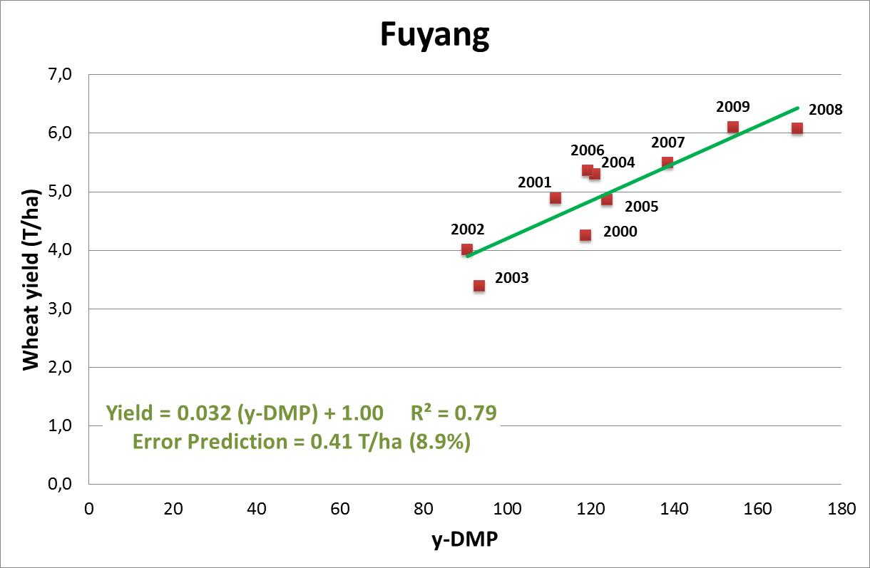
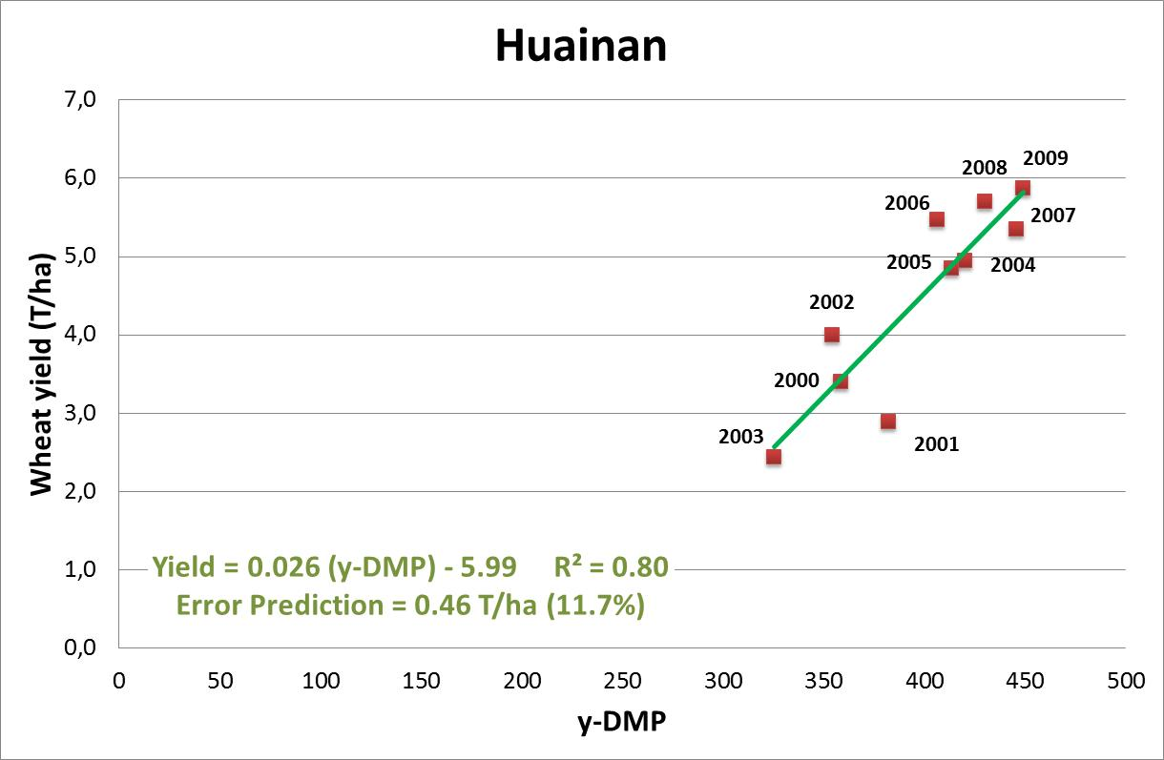
WP44: Wheat Yield estimation based on remote sensing for HUAIBEI Plain
y-DMP : 3rd dekad April
Σ(y-DMP) : 1st dekad April– 3rd dekad April

Slide 19
شكرا
謝謝您
Thank you

