Slide 1
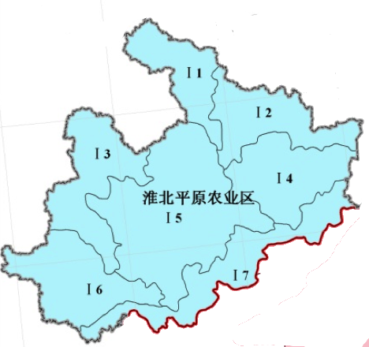
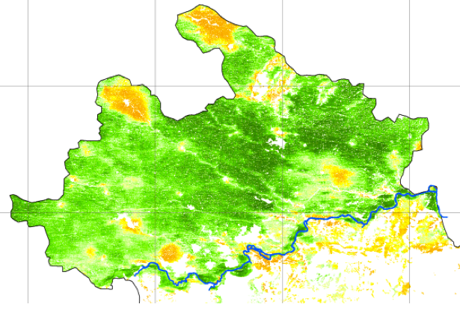
Crop Area Estimation in Huaibei, China
Crop Monitoring as an E-agricutural tool in Developping Countries
Institute of Agriculture Resources and Regional Planning, CAAS
2011-11-23

Slide 2
Work package 5
WP51:Ground sampling and data collection (HUAIBEI Plain, China)
WP52:Crop area estimation (HUAIBEI Plain, China)
WP53:Ground sampling and data collection (Morocco)
WP54:Crop Area estimation (Morocco)
WP55:Accuracy and cost-efficiency assessment
WP56:Cost efficiency study for crop mapping in East Africa

Slide 3
WP51: Ground sampling and data collection (HUAIBEI Plain, China)
To Collect the background data including the statistical crop area of recent 10 years, crop phenology data and other ancillary geographic data (such as boundary of administrative units, road map, etc
To adapt and design segment sampling method
To collect the groundtruth samples based on the segment sampling method
Retrieval of crop phenology by remote sensing based on MODIS NDVI or EVI

Slide 4
1.1 Background Data Collection
Statistical crop data for recent 10 years
Crop phenology data
Geographic map
boundary of administrative units
road map
Agricultural zoning map
comprehensive agricultural zoning
Landuse zoning
Zoning of agricultural mechanization

Slide 5
(1) Statistical Crop Data for Recent 10 Years
Crop production and acreage in Anhui(county-level 2000-2009)
Crop-specific crop production and acreage in Anhui (prefecture 2000-2009)
Crop-specific crop production and acreage in Bozhou (county 1999-2009)
粮食(吨) Grain(ton) | 棉花(吨) Cotton(ton) | 油料(吨) Oil-bearing Crops(ton) | 耕地面积(公顷) Cultivated Area(hectares) | #水田PaddyField(hectares) | 播种面积(公顷) Total Sown Area(hectares) | 果园面积(公顷)Area of Orchards
农作物播种面积Total Sown Area | 粮食作物播种面积Sown Area of Grain Crops | #谷物Cereal | ##稻谷Rice | ##小麦Wheat | ##玉米Corn | #豆类Soybean | #薯类Tubers
油料Oil-bearingCrops | #花生Peanuts | #油菜籽Rapeseeds | #芝麻Sesame | 棉花Cotton | 麻类FiberCrops | 糖料SugarCrops | 烟叶Tobacco
药材MedicinalMaterials | 蔬菜Vegetables | 瓜果类Melon | 茶园面积Area of Tea Plantations at Year-end | 果园面积Area of Orchards at Year-end | 药材MedicinalMaterials | 蔬菜Vegetables | 瓜果类Melon
农作物播种面积Total Sown Area | 粮食作物播种面积Sown Area of Grain Crops | #谷物Cereal | ##稻谷Rice | ##小麦Wheat | ##玉米Corn | #豆类Soybean | #薯类Tubers
油料Oil-bearingCrops | #花生Peanuts | #油菜籽Rapeseeds | #芝麻Sesame | 棉花Cotton | 麻类FiberCrops | 糖料SugarCrops | 烟叶Tobacco
药材MedicinalMaterials | 蔬菜Vegetables | 瓜果类Melon | 茶园面积Area of Tea Plantations at Year-end | 果园面积Area of Orchards at Year-end | 药材MedicinalMaterials | 蔬菜Vegetables | 瓜果类Melon

Slide 6
Total grain crop area of Anhui province (ha)

Slide 7
(2) Crop phenology data
时间 Data | 作物 Crop | 生长阶段 Growth period
12月-2月 Dec.-Feb. | 冬小麦 Winter Wheat | Slow growth stage, ear differentiation
 | 油菜 Rapeseeds | Coming into leaf, budding, and bolting
3月 Mar. | 冬小麦 Winter Wheat | Jointing
 | 油菜 Rapeseeds | Budding, bloom
4月 Apr. | 冬小麦 Winter Wheat | Heading and bloom, grain filling and milk ripeness in the last decade
 | 油菜 Rapeseeds | Bloom, scab
 | 棉花 Cotton | Seeding
5月 May. | 冬小麦 Winter Wheat | Milk ripeness, ripeness, harvesting
 | 油菜 Rapeseeds | Ripeness, harvesting
 | 一季水稻 Season Rice | Seeding, raising rice seedlings
6月 June. | 冬小麦 Winter Wheat | Finishing harvesting within the first third of this month
 | 玉米 Maize | Seeding
 | 棉花 Cotton | Budding
 | 一季水稻 Season Rice | Transplant, reviving, tiller
7月 July. | 玉米 Maize | Tasseling, bloom
 | 棉花 Cotton | Bloom
 | 一季水稻 Season Rice | Jointing, heading, bloom
8月 Aug. | 玉米 Maize | Grain filling, milky ripeness
 | 棉花 Cotton | Bloom, splitting boll
 | 一季水稻 Season Rice | Bloom, milk ripeness
9月 Sept. | 油菜 Papeseeds | Seeding
 | 玉米 Maize | Ripeness, harvesting
 | 棉花 Cotton | Opening bolls, picking up cottons
 | 一季水稻 Season Rice | Milk ripeness, ripeness, harvesting
10月 Oct. | 冬小麦 Winter Wheat | Seeding
 | 油菜 Papeseeds | Emergency of seedlings
11月 Nov. | 冬小麦 Winter Wheat | Emergency of seedlings, tiller
 | 油菜 Rapeseeds | In the fifth euphylla, transplant

Slide 8
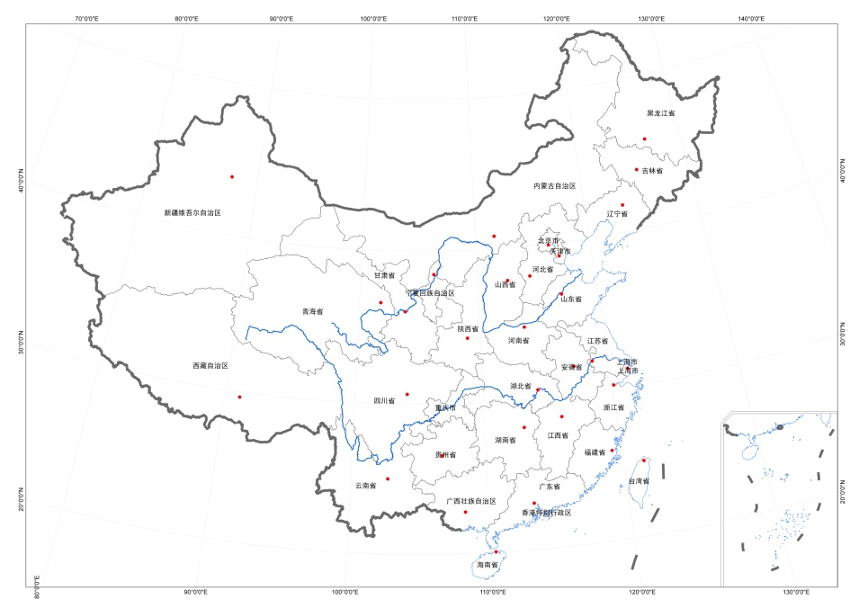
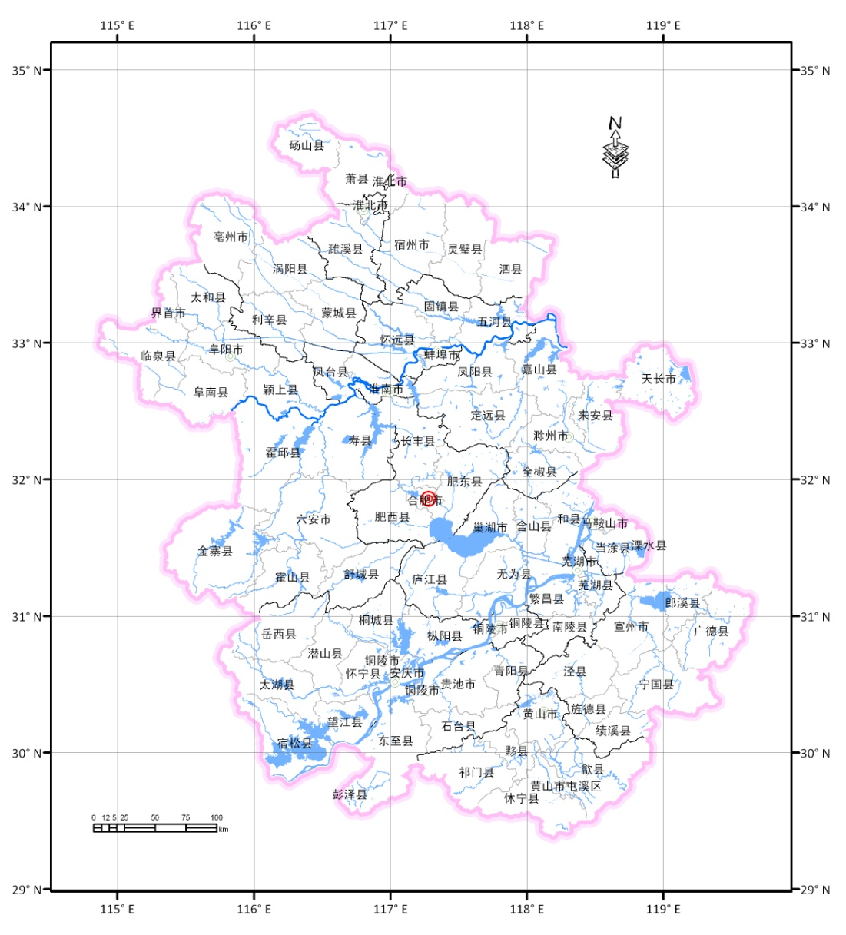
(3) Geographic map
Anhui Province

Slide 9
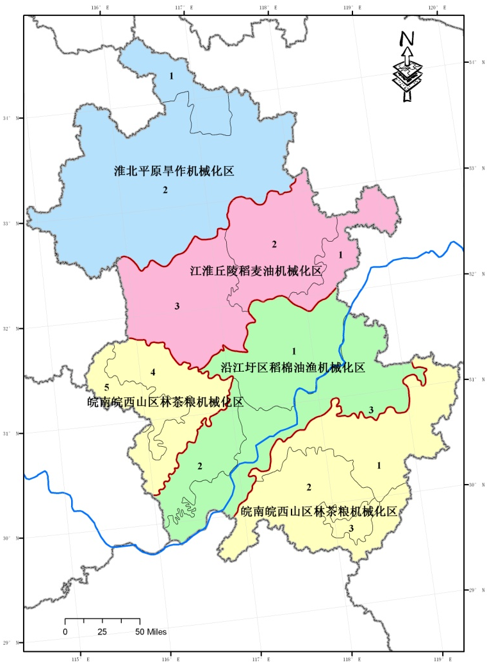
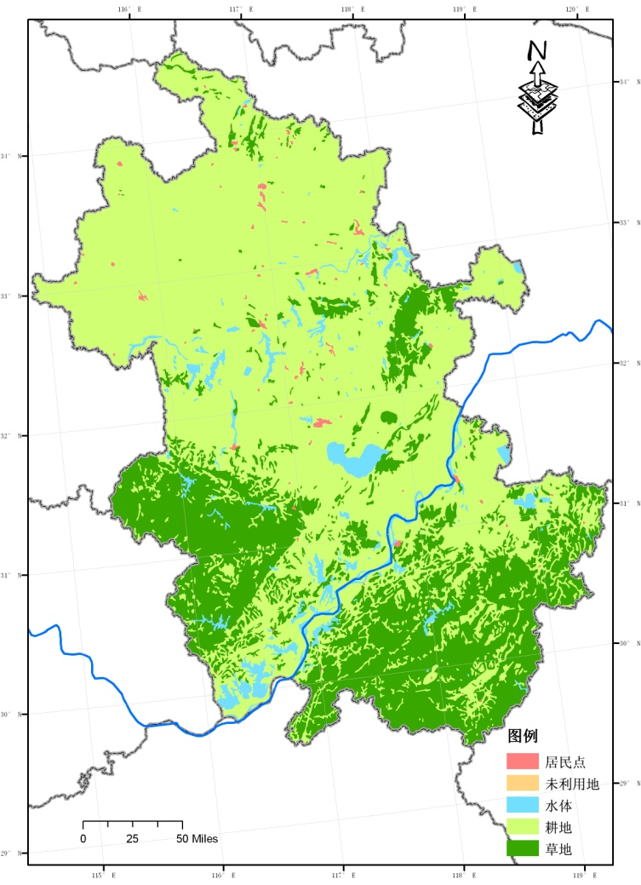
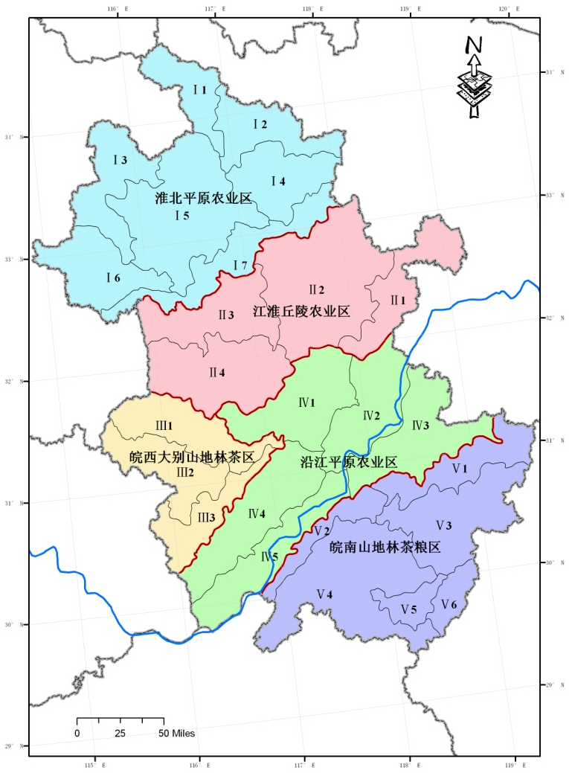
(4) Zoning Map
Zoning of agricultural
mechanization
Landuse zoning
Comprehensive agricultural zoning

Slide 10
1.2 Segment sampling method Design
Technical procedure
Construction of sampling frame
Inferences of population parameter and estimations of sampling error
Results and analysis
Conclusion

Slide 11
1.2.1 Technical procedure
Five spatial sampling methods were tested, sampling errors and sampling costs are selected as evaluation criteria for sampling efficiency.
Flow chart of spatial sampling survey for crop acreage estimation

Slide 12
1.2.2 Construction of sampling frame
The study area is clipped by the grids with a size of 5′×5′(that is sampling element units),and the sampling frame is set up.
Winter wheat area in each grid is calculated as sample observation, using the geographic information software- ArcGIS.
The sampling frame for estimating winter wheat area of Mengcheng County

Slide 13
1.2.3 Inferences of population parameter and estimations of sampling error
Simple random sampling
Spatial random sampling
Systematic sampling
Stratified sampling

Slide 14
(1) Simple random sampling
(1)
(2)
(3)
(4)

Slide 15
(2) Spatial random sampling
(5)
(6)
(7)
(8)

Slide 16
(3) Systematic sampling
(9)
(10)
(11)
(12)

Slide 17
(4) Stratified sampling
(13)
(14)
(15)
(16)
(17)

Slide 18
Results of relative error and sample size from 5 spatial sampling for winter wheat area estimation
1.2.4 Results and analysis
(1) Comparison of efficiencies among 5 spatial sampling methods
No | Name | Population size （N） | Sample size (n) | Fraction （％） | Relative error （％） | Coefficient of variation （％）
1 | Simple random sampling | 45 | 41 | 91.1 | 2.35 | 2.65
2 | Spatial random sampling | 45 | 25 | 55.6 | 6.53 | 4.54
3 | Systematic sampling（1） | 45 | 23 | 51.1 | 6.53 | 9.27
4 | Systematic sampling（2） | 45 | 22 | 48.9 | 6.83 | 6.83
5 | Systematic sampling（3） | 45 | 22 | 48.9 | 3.68 | 1.14
6 | Systematic sampling（4） | 45 | 22 | 48.9 | 4.22 | 1.21
7 | Spatial systematic sampling（1） | 45 | 14 | 31.1 | 19.44 | 17.07
8 | Spatial systematic sampling（2） | 45 | 12 | 26.7 | 16.64 | 13.66
9 | stratified sampling（1） | 45 | 33 | 73.3 | 3.03 | 3.50
10 | Stratified sampling（2） | 45 | 32 | 71.1 | 2.68 | 2.65
11 | Stratified sampling（3） | 45 | 17 | 37.8 | 1.57 | 2.42
12 | Sratified sampling（4） | 45 | 13 | 28.9 | 1.13 | 1.42
The sampling efficiency of stratified sampling is the highest in 5 kinds of sampling methods, comprehensively considering the relative error, stability and sample size.
18

Slide 19
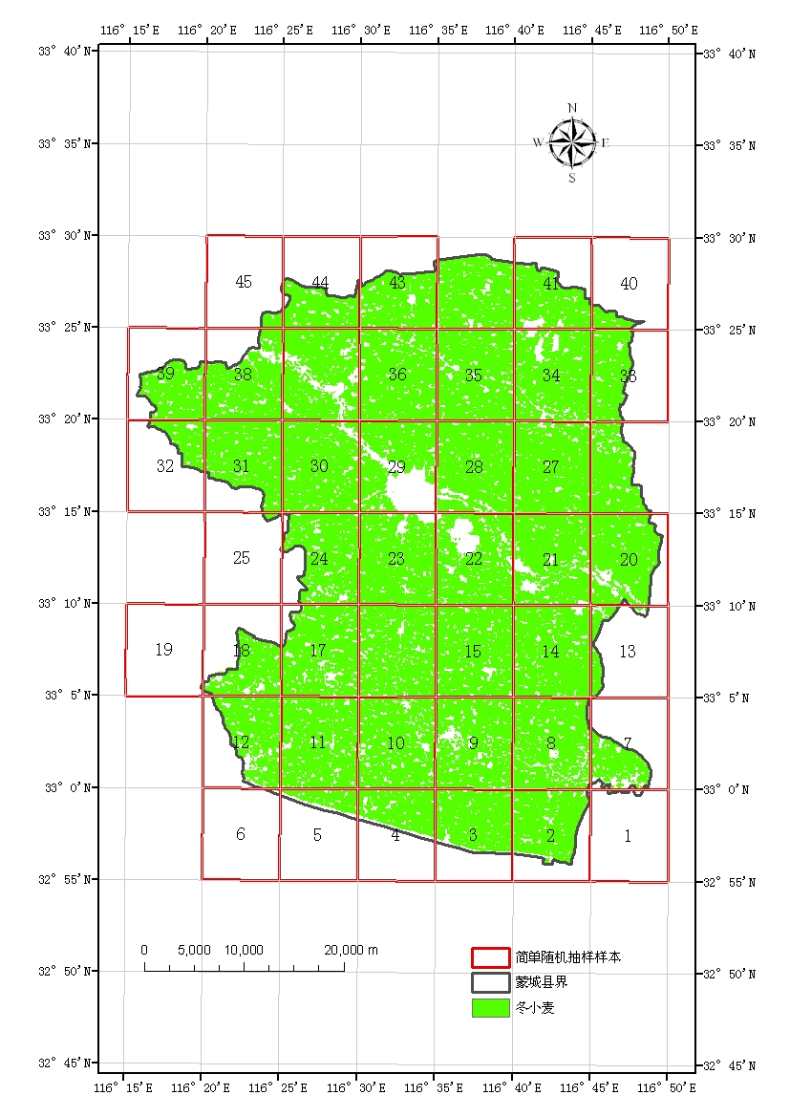
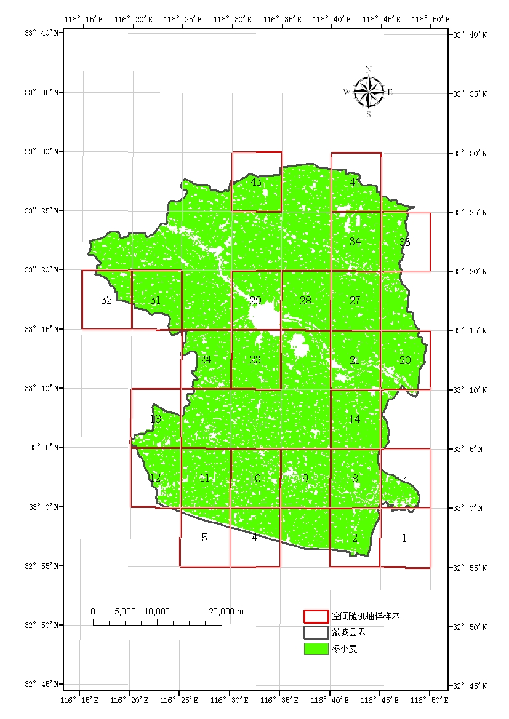
Samples spatial distributions of simple random sampling
Sample spatial distributions of spatial random sampling

Slide 20
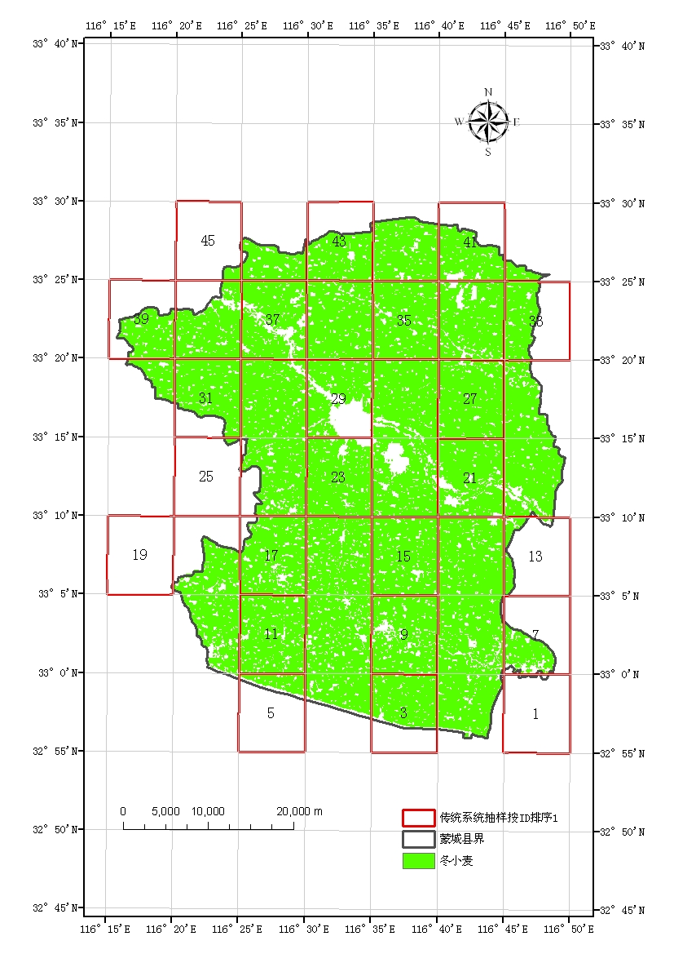
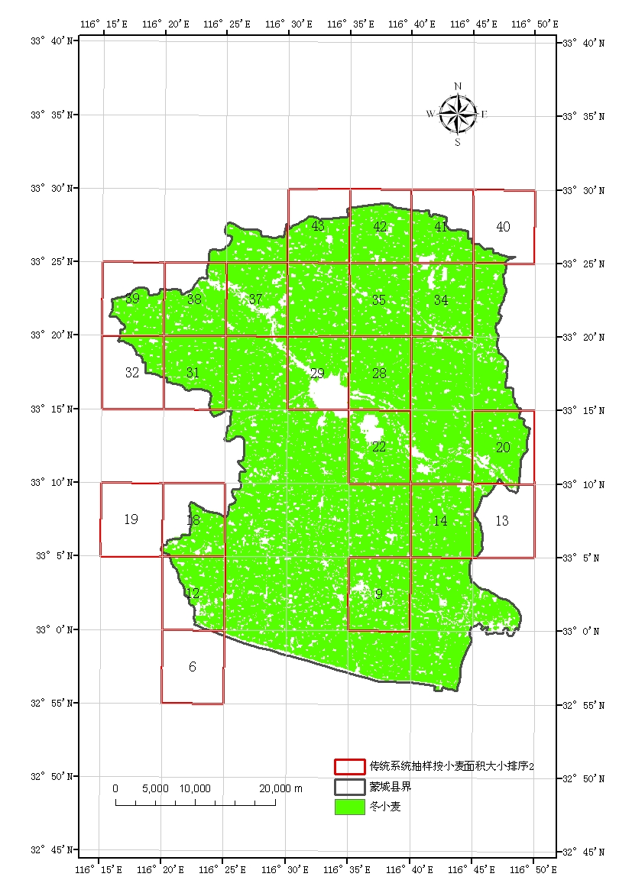
Sample spatial distributions of systematic sampling（sorted by the ID of population units）
Samples spatial distributions of systematic sampling（sorted by winter wheat area in population units）

Slide 21
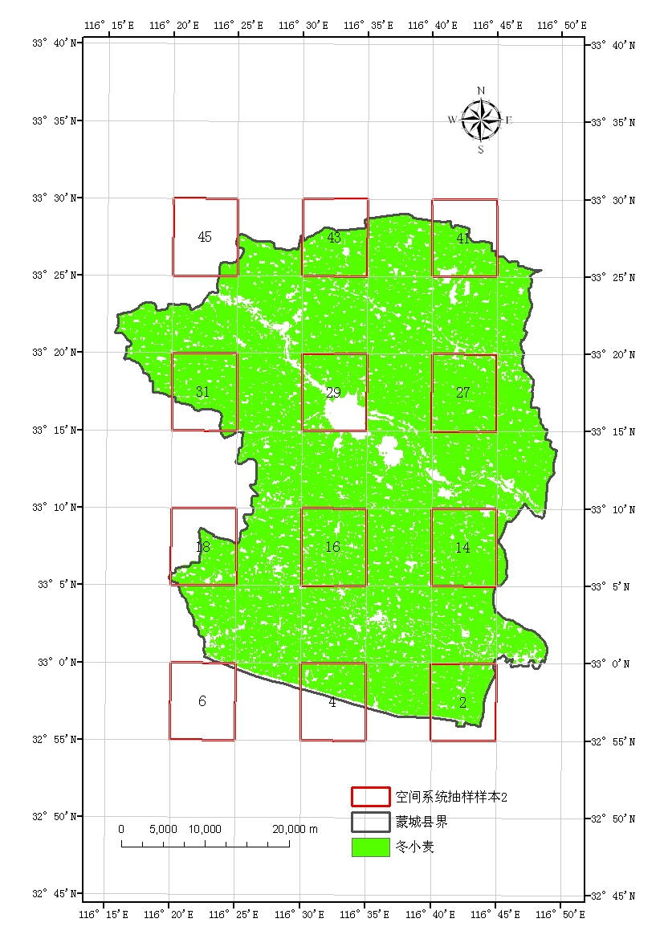
Samples spatial distributions of spatial systematic sampling
Samples spatial distributions of stratified sampling

Slide 22
Results of relative error and sample size using stratified sampling under 4 strata levels
(2) Impact of the numbers of stratum on stratified sampling efficiency
Numbers of strata | The ratio of winter wheat area accounting to population unit area
 | Stratum interval （％） | Sample size | Relative error （％） | Coefficient of variation （％）
2 | 41.04 | 33 | 3.03 | 3.50
3 | 27.36 | 32 | 2.68 | 2.65
4 | 20.52 | 17 | 1.57 | 2.42
5 | 16.42 | 13 | 1.13 | 1.42
The increasing of strata numbers can reduce the variance of population units in each stratum, consequently improve the precision of population inference and reduce sample costs.

Slide 23
1.2.5 Conclusion
The sampling efficiency of stratified sampling (the numbers of strata are 5) that the stratification sign is the ratio of winter wheat area accounting to population unit area is the highest in 5 kinds of sampling methods, comprehensively considering the relative error, stability and sample size.
The increasing of strata numbers can reduce the variance of population units in each stratum, consequently improve the precision of population inference and reduce sample costs.

Slide 24
1.3 Groundtruth samples collected based on the segment sampling method
First : To collect groundtruth samples for winter wheat
Spots: 1411
Plots: 12, the average area of plot 25ha (500m*500m)
Second: To collect groundtruth samples for maize
Plots: 31, the average area of plot 25ha (500m*500m)
Third: To collect groundtruth samples for maize
Plots: 30, the average area of plot 25ha (500m*500m)

Slide 25
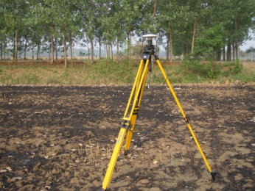
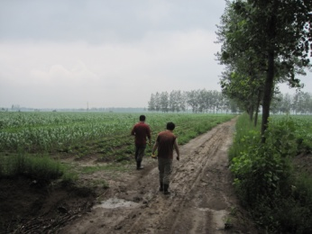
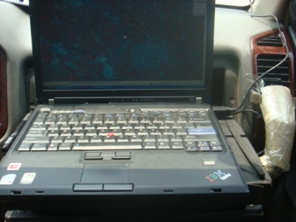
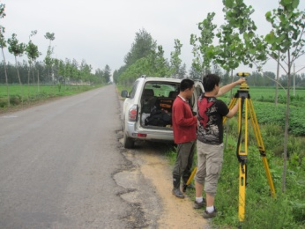
In-situ samples for winter wheat in North Anhui, 2010-2011
Samples：1411

Slide 26
500*500m maize quadrats in Mengcheng （31）

Slide 27
500*500m winter wheat quadrats in
Mengcheng, 2010-2011 （12）

Slide 28
1.4 Retrieval of crop phenology by remote sensing based on MODIS NDVI or EVI
Processing MODIS data (NDVI,EVI) in the research region（2010.11.1-2011.10.31）
Data smoothing of NDVI, EVI by Savitzky-Golay filter
Winter wheat phenology retrieval from remote sensing data by Logistic Model
Anhui Province

Slide 29
Original NDVI
Filtered NDVI
Mengcheng

Slide 30
Data smoothing for EVI by Savitzky-Golay Filter
Filtered EVI
Mengcheng

Slide 31
Regrowth (10th Decade)
（2月1日开始的那旬，从2010年11月1日开始计算）
抽穗：第17旬（
Heading （17th Decade)
Original NDVI
Filtered NDVI
Simulated Curve by Logistic Model
Derivative of Simulated Curve

Slide 32
WP52: Crop area estimation (HUAIBEI Plain, China)
Winter wheat acreage monitoring by single Landsat TM
Winter wheat acreage monitoring by multi-date HJ-1 imagery
Winter wheat acreage monitoring by pixel unmixing of EOS-MODIS data

Slide 33
1. Winter wheat acreage monitoring by single Landsat TM
Data：Landsat TM, 2011-3-29
Classification algorithms：
Neural Network (NN)
Object-oriented (OO)
SVM
Maximum likelihood classifier (MLC)
Decision tree (DT)

Slide 34
. Winter wheat acreage monitoring by single Landsat TM
TM12237-20110329
Winter wheat area extraction

Slide 35
Winter wheat/cash crop rotation region
Herbal Medicine planting
Winter wheat / rice rotation

Slide 36
NN
OO
SVM
MLC
DT-2
DT-3
Winter Wheat / Cash Crop Planting Region

Slide 37
NN
OO
SVM
MLC
DT-2
DT-3
Herbal Medicine Planting Region

Slide 38
NN
OO
SVM
MLC
DT-2
DT-3
Winter Wheat / Rice Planting Region

Slide 39
样方内不同分类方法冬小麦面积统计
Class | Area in the Qudrats_ha | Classification Accuracy for Winter Wheat
 |  | NN |  | OO |  | SVM |  | MLC |  | DT-1 |  | DT-2 |  | DT-3
Winter Wheat | 417.18 | 406.53 | 97.4% | 415.9 | 99.7% | 409.50 | 98% | 415.98 | 99.7% | 390.87 | 93.7% | 411.21 | 98.6% | 409.23 | 98%
Non WW | 28.73 | 19.44 | 30.1% | 26.2 | 9.9% | 20.97 | 28% | 22.32 | 21.3% | 16.11 | 45.1% | 22.05 | 24.4% | 21.42 | 27%
Fallow | 0.88 | 0.90 |  | 0.9 |  | 0.90 |  | 0.90 |  | 0.81 |  | 0.99 |  | 0.90
Greenhouse | 3.83 | 10.80 |  | 2.3 |  | 0.27 |  | 0.36 |  | 0.18 |  | 0.36 |  | 1.08
Water | 14.39 | 0.36 |  | 13.6 |  | 11.79 |  | 12.06 |  | 8.73 |  | 11.97 |  | 11.34
Forest | 0.31 | 0.00 |  | 0.3 |  | 0.36 |  | 0.27 |  | 0.36 |  | 0.36 |  | 0.36
Residential | 0.19 | 7.38 |  | 0.2 |  | 0.18 |  | 0.18 |  | 0.00 |  | 0.18 |  | 0.18
Traffic | 9.12 | 0.00 |  | 9.0 |  | 7.47 |  | 8.55 |  | 6.03 |  | 8.19 |  | 7.56
Overall | 445.91 | 425.97 | 93.1% | 442.1 | 93.9% | 430.47 | 93.7% | 438.30 | 94.7% | 406.98 | 90.6% | 433.26 | 93.8% | 430.65 | 93.5%

Slide 40
Winter wheat area estimation using different classification methods
县名城 | County | County Area | Monitoring Area | 2011年冬小麦种植面积 (ha)
 |  |  |  | NN | OO | SVM | MLC | DT-1 | DT-2 | DT-3
涡阳县 | Guoyang | 210862.1 | 210862.1 | 151885.4 | 173769.0 | 156877.0 | 169539.6 | 136275.3 | 161057.0 | 158268.2
颖上县 | Yingshang | 199158.4 | 199158.4 | 85073.6 | 122539.3 | 101742.0 | 119372.2 | 68356.8 | 103064.5 | 99396.5
宿州市 | Suzhou | 289090.9 | 158021.7 | 98369.4 | 112214.8 | 104787.6 | 110973.4 | 93253.77 | 108378.0 | 102646.2
亳州市 | Bozhou | 226067.5 | 212662.4 | 95608.1 | 111219.9 | 91914.7 | 105973.4 | 77096.52 | 101703.7 | 97278.4
濉溪县 | Suixi | 242205.9 | 204983.4 | 157064.0 | 168593.6 | 161023.8 | 165473.4 | 148575.15 | 161627.0 | 160241.2
界首市 | Jieshou | 67147.7 | 67147.7 | 41879.4 | 47142.1 | 42324.8 | 44771.6 | 36771.3 | 42721.3 | 43070.6
固镇县 | Guzhen | 145898.6 | 17490.1 | 8980.1 | 11990.5 | 10310.1 | 12088.1 | 8207.73 | 11565.2 | 9660.2
蒙城县 | Mengcheng | 214880.1 | 214880.1 | 160445.7 | 175930.8 | 165443.9 | 172268.6 | 148247.1 | 167060.0 | 164486.8
利辛县 | Lixin | 200148.6 | 200148.6 | 137890.9 | 157322.7 | 145293.1 | 154873.6 | 125440.74 | 146998.5 | 143660.3
怀远县 | Huaiyuan | 244159.4 | 155848.4 | 93663.6 | 118200.7 | 101569.9 | 119158.3 | 76310.19 | 112029.2 | 99901.8
阜阳市 | Fuyang | 182685.4 | 182685.4 | 98407.3 | 123049.3 | 106682.6 | 118141.3 | 82942.56 | 107467.7 | 107150.1
临泉县 | Linquan | 183974.0 | 151958.0 | 97201.9 | 109856.4 | 97612.7 | 106369.6 | 82709.73 | 99551.1 | 99152.6
凤台县 | Fengtai | 109495.3 | 109495.3 | 39994.9 | 68468.1 | 59509.4 | 67357.4 | 31459.5 | 54536.0 | 55603.0
淮南市 | Huainan | 102290.6 | 77178.6 | 18279.7 | 38292.6 | 30846.6 | 37194.8 | 14179.77 | 27753.5 | 27537.4
阜南县 | Funan | 192379.0 | 178819.8 | 103821.4 | 119805.5 | 99268.6 | 118718.0 | 78565.41 | 111037.9 | 104016.7
寿县 | Shouxian | 296397.0 | 102396.0 | 45185.0 | 71407.2 | 59560.7 | 69536.2 | 34128.72 | 59370.6 | 57387.2
长丰县 | Changfeng | 238913.1 | 12860.9 | 1057.2 | 5089.9 | 3045.2 | 4701.5 | 567.09 | 2568.5 | 2629.6
霍邱县 | Huoqiu | 379887.5 | 64710.1 | 28897.2 | 40665.3 | 33277.2 | 39741.4 | 21579.66 | 34766.3 | 32845.0
太和县 | Taihe | 186083.2 | 186083.2 | 106178.9 | 132939.3 | 112050.1 | 128137.8 | 85580.55 | 115349.9 | 115504.5
Total |  |  |  | 1569883.7 | 1908497.1 | 1683139.9 | 1864390.1 | 1350247.59 | 1728605.7 | 1680436.2

Slide 41
2. Winter wheat acreage monitoring by multi-date HJ-1 imagery
Data:
HJ-1 CCD Imagery
2011.2.6.、2011.3.7、2011.4.20、2011.4.29……
Winter wheat extraction methods:
Spectral analysis
Multi-date NDVI time series
Classification results:
NDVI time series decision tree决
other：ongoing……

Slide 42
3. Winter wheat acreage monitoring by pixel unmixing of EOS-MODIS data
Data:
Smoothed Modis-NDVI time series（2010.11.1-2011.5.31）
Landsat TM, 2011-3-29
Classifcation Methods:
MODIS: pixel unmixing by neural network
TM: MLC
Results:
2246030 ha
compared with statistical winter wheat acreage (2466017ha)，diff 219987ha，ca. 8.9%

Slide 43
Grazie Bedankt
Merci 谢 谢!
Thanks

