Slide 1




FP7 STREP Project (GA 270351)
Final Meeting (2014-01-20)
Crop monitoring as an E-agriculture tool in developing countries (E-AGRI)
Overview and Management

Slide 2
Objectives for this Final Meeting:
Finalizing the project by presenting the most relevant results with emphasis on activities during RP3
Summarizing the lessons learned during the E-AGRI implementation (positive & negative)
Establishing an action list for the last 10 days of the project and the next 60 days of reporting (RP3 & Final Report)
Discussing the wishful topics for a further collaboration

Slide 3
Structure of this presentation:
Achievement
Technological transfer
Capacity building
Finance
Payment
Cost claims
Deliverables
Due for Month30
Due for Month31-36
Networking
Policy making support
Liaising other EU projects
Scientific dissemination

Slide 4
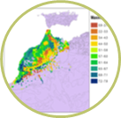
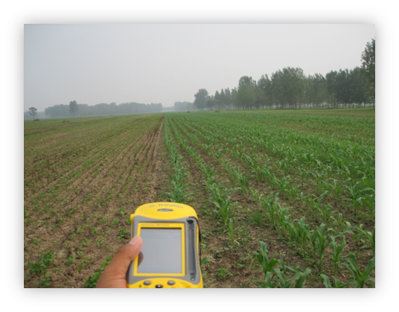
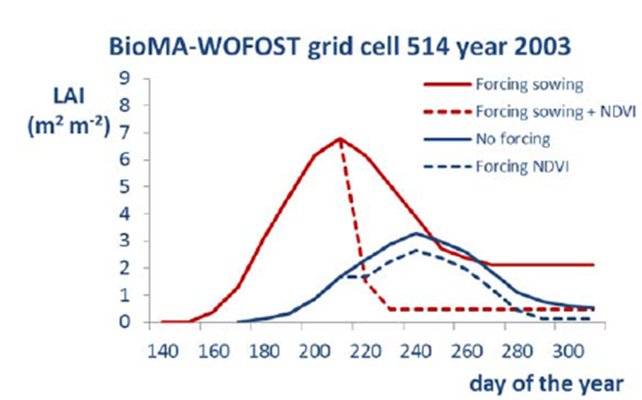
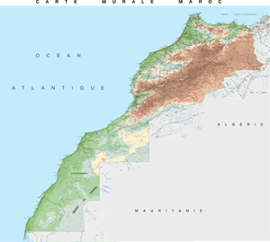
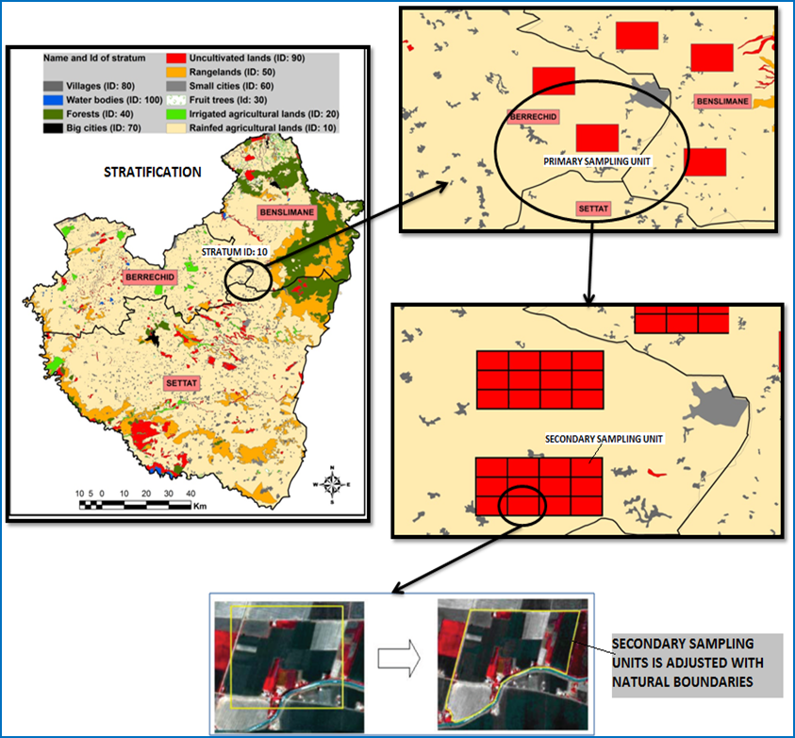
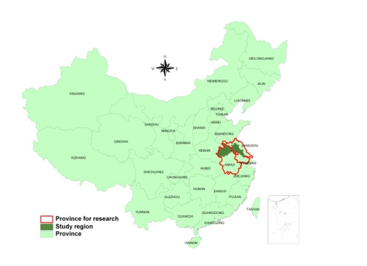
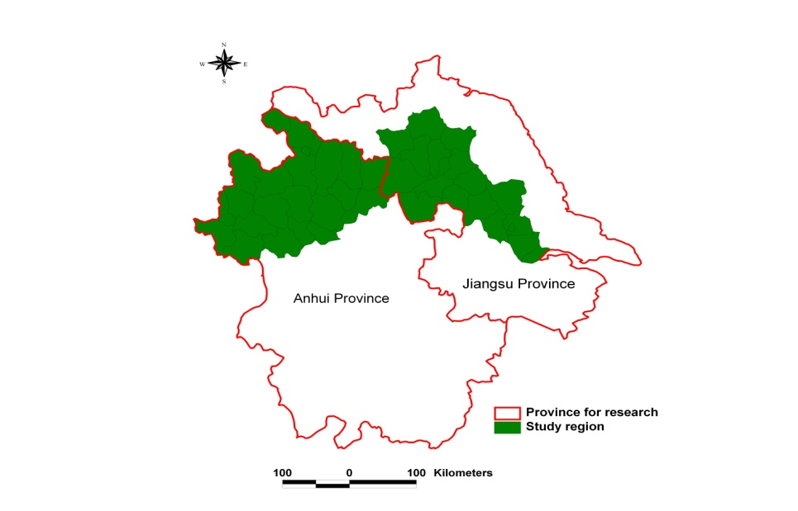
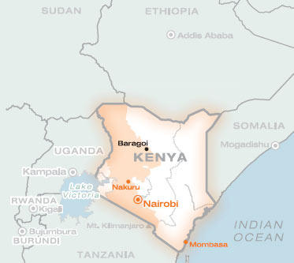
Summary of the study areas and the transferred methodologies
Jianghuai Plain
CGMS /
BioMA
Morocco
Huaibei Plain
Training on crop area estimation
China
Kenya

Slide 5
Achievement in: Scientific and technological transfer and its feedback in Morocco
established almost from scratch: CGMS Morocco and included BioMA approach in their panoply of monitoring tools;
In the area of acreage estimation, the methodology of image analysis and classification was strengthened and the activities of field sampling in two key producing regions were able to be put forward
Feedback for our work in Morocco was believed to be important: either for current MARS OP programme or future GLOBCAST.
CGMS set-up
BioMA set-up
Crop area estimation

Slide 6
Achievement in: Scientific and technological transfer and its feedback in China
BioMA setup
CGMS set up on Huaibei Plain had some difficulties with the availability of data. During the final period , the delay was be able to catch up and piloting exercise was accomplished;
BioMA platform for rice monitoring is an first concrete example of BioMA application for rice monitoring using the local field data.
The area estimation approach was deeply adapted and improved in terms of efficiency,
Feedback will be valuable in terms of BioMA further development for rice monitoring and the agricultural statistics at district level
CGMS set-up
Crop area estimation
Jianghuai Plain
Huaibei Plain

Slide 7
Achievements in: Capacity building in Kenya
The colleagues there were get informed and exposed to the available technologies applied for crop monitoring;,
In collaboration with AGRICAB project, they got trained on field sampling and image analysis (image classification).
They have clearer idea on which path they will to follow and which technology they wish to adopt
Training on crop area estimation

Slide 8
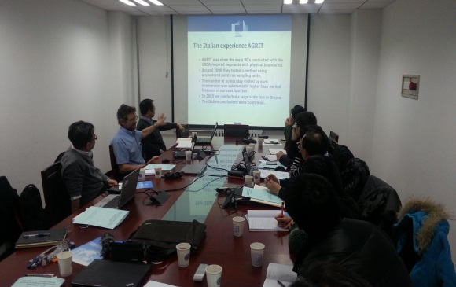
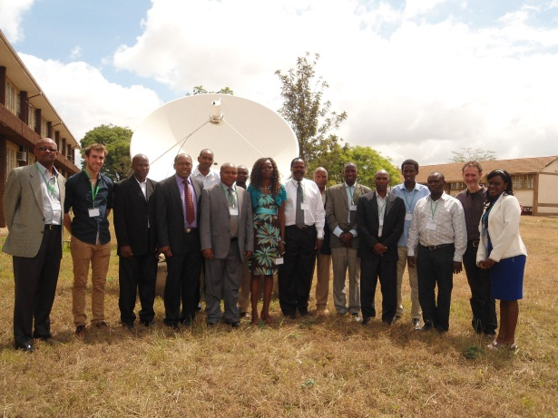
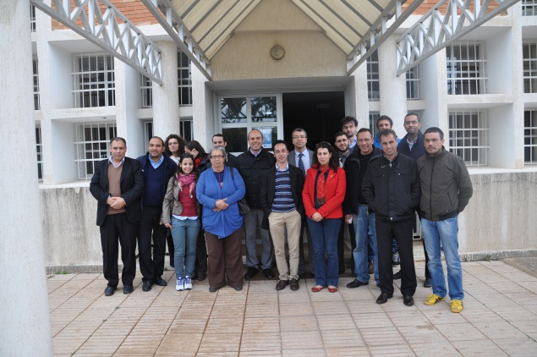
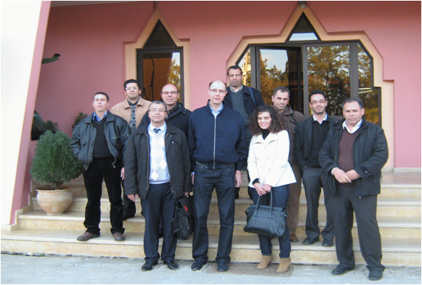
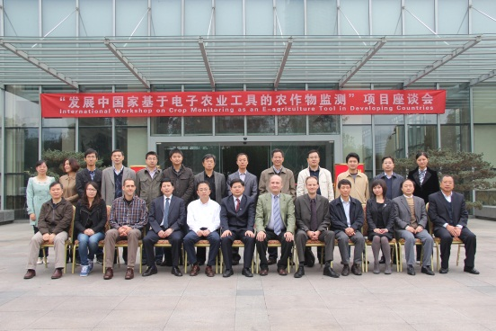
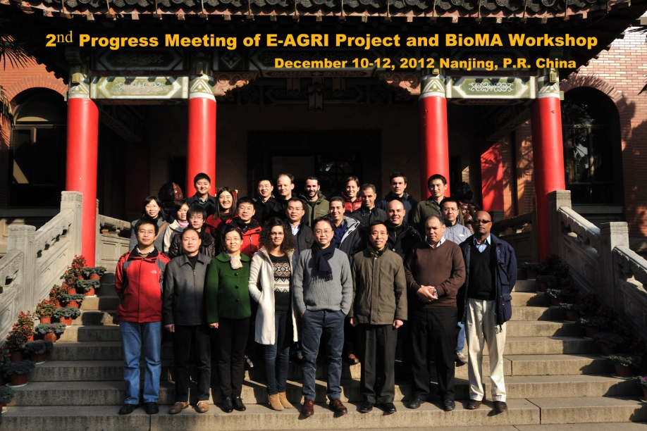
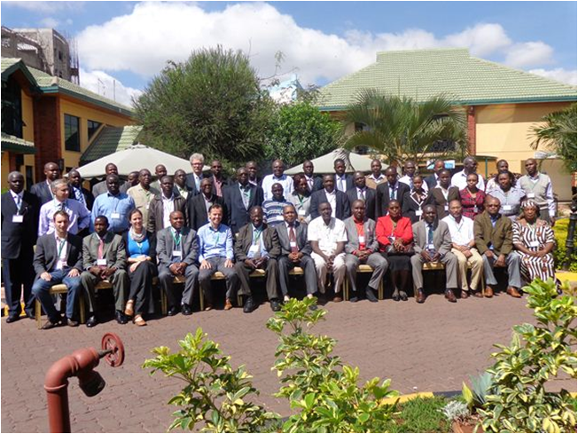
Achievements in capacity building : 8 thematic workshops / seminars

Slide 9
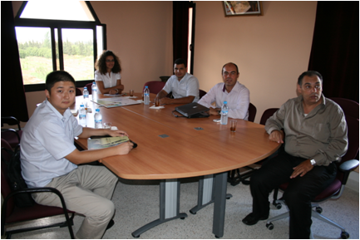
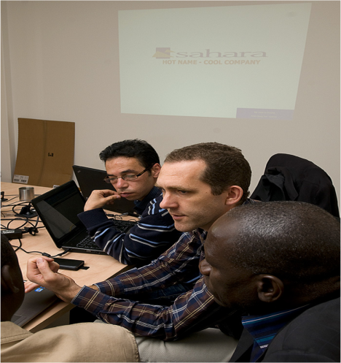
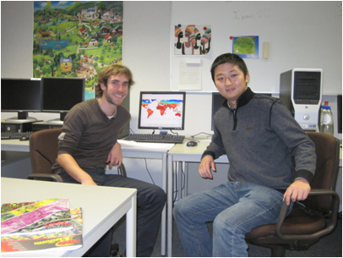
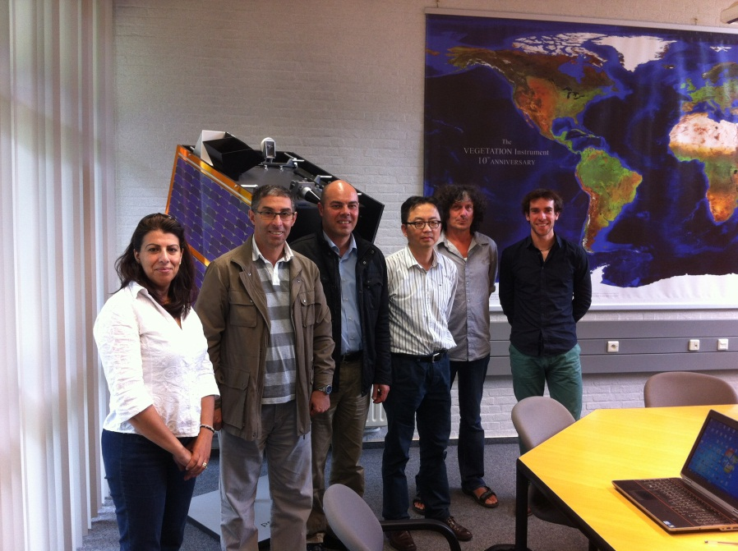
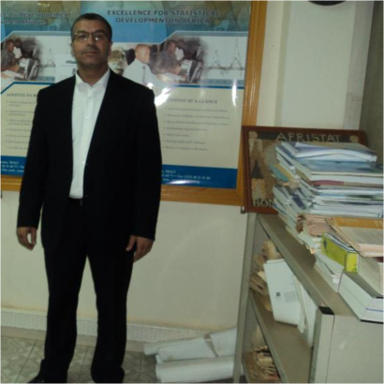
Achievements in capacity building : individual training sessions

Slide 10
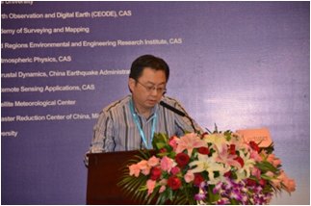
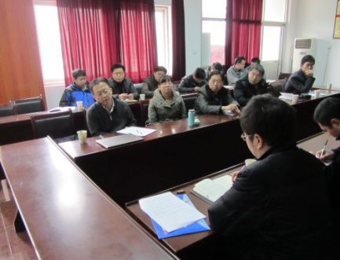
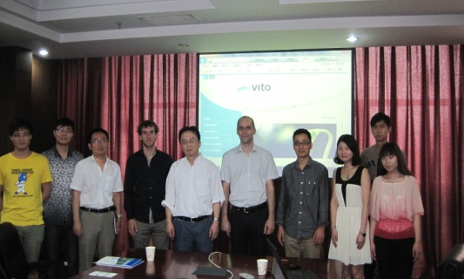
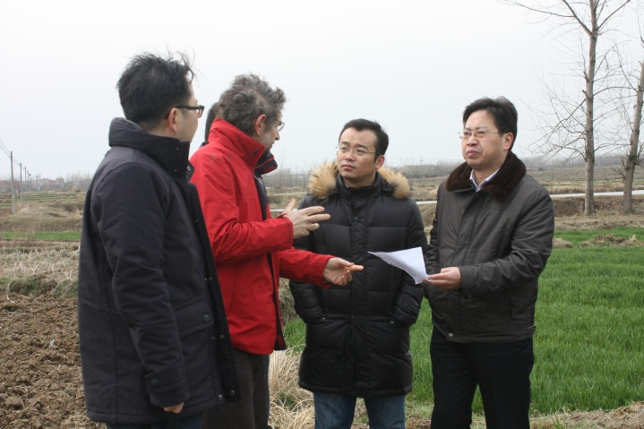


Achievements in dissemination: outreaches, networking and promoting

Slide 11
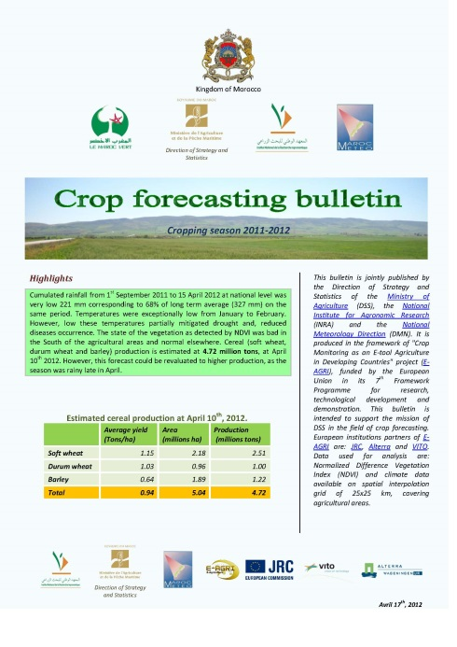

Achievement in : Policy Making Support
towards the Ministry of Agriculture by publishing forecasting bulletins

Slide 12
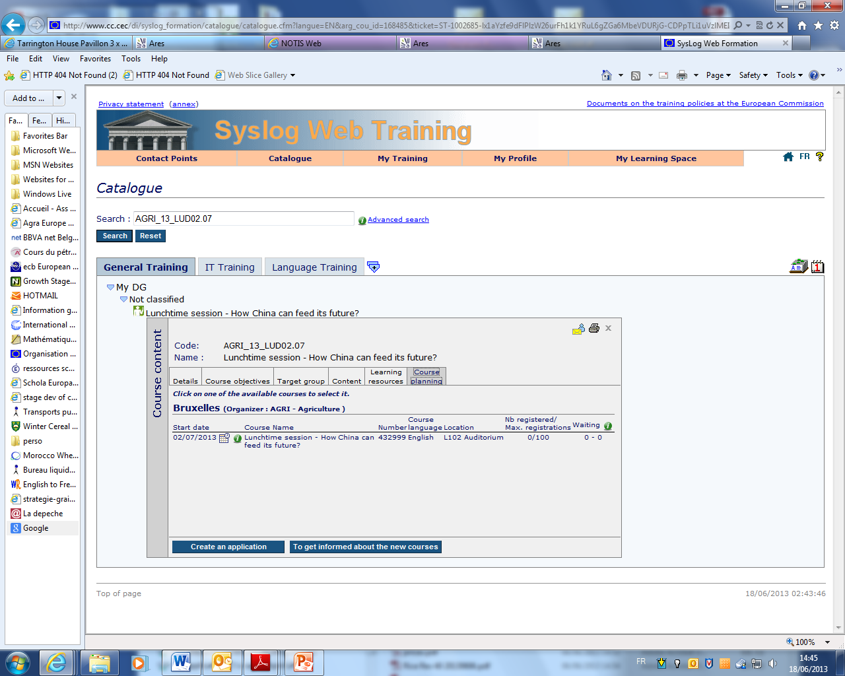
Achievement in : Policy Making Support
towards the Directorate General of EC by promoting the foreground

Slide 13
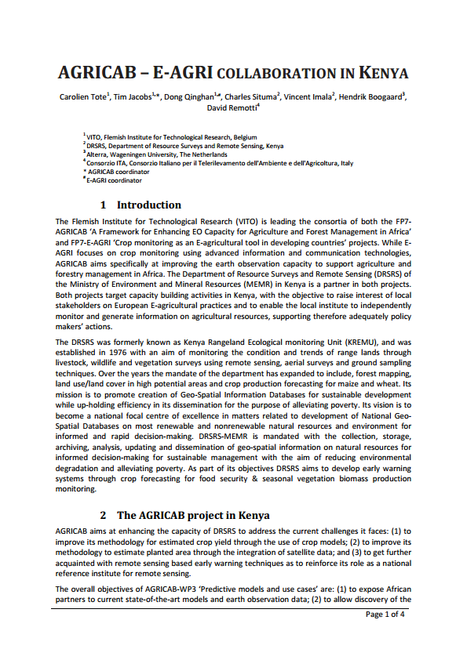
Achievement in : liaising with other European projects (example of AGRICAB)

Slide 14
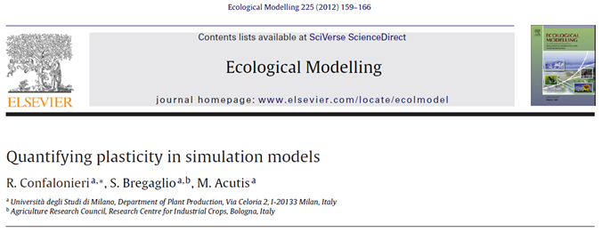
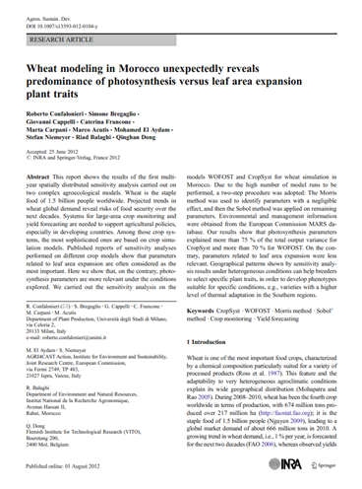


Achievement: Scientific dissemination

Slide 15
Financial aspects: financial rules in FP7 projects
The FP7 funding is composed of two procedures
The pre-finance, a sort of advance or credits with assumption for theoretical amount of 1,618,000 EUR
Cost claims per RP with a maximum funding ceiling
The claims need to be approved

Slide 16
Financial aspects: (pre-) payment status for E-AGRI
dd
 | Total budget | Pre- financing | 2nd payment | Payment (1+2) | last payment |  | Budget GA | Transfer during RP1⁽²⁾
VITO | 383.751,00 | 185.479,65 | 137651 | 323.130,65 |  |  | 383.751,00 | 2509,86
SDLO | 281.407,00 | 136.013,38 | 47171 | 183.184,38 |  |  | 281.407,00
UMIL | 209.920,00 | 101.461,33 | 54048 | 155.509,33 |  |  | 209.920,00
JRC⁽¹⁾ | 171.600,00 | 82.940,00 | 52401 | 135.341,00 |  |  | 171.600,00
INRA | 265.938,00 | 128.536,70 | 96428 | 224.964,70 |  |  | 265.938,00 | -678,25
CAAS | 129.158,00 | 62.426,37 | 77562 | 139.988,37 |  |  | 129.158,00
AIER | 54.319,00 | 26.254,18 | 26856 | 53.110,18 |  |  | 54.319,00
JAAS | 52.364,00 | 25.309,27 | 21777 | 47.086,27 |  |  | 52.364,00
KMD | 69.543,00 | 33.612,45 | 13784 | 47.396,45 |  |  | 69.543,00 | -1831,61
 | 1.618.000,00 | 782.033,33 | 527678 | 1.309.711,33 |  |  | 1.618.000,00
JRC, internal transfer within commission
Costs paid by VITO for partners during the KO meeting

Slide 17
Financial aspects: cost claims
status for E-AGRI
dd
Requested contributions | RP1 | RP2 | RP3 | Budget | Remaining
VITO | 137.841,00 | 147.328,00 |  | 383.751,00 | 98.582,00
SDLO | 47.171,00 | 88.037,00 |  | 281.407,00 | 146.199,00
UMIL ⁽²⁾ | 54.048,00 | 71.521,00 |  | 209.920,00 | 84.351,00
JRC ⁽²⁾ | 52.401,00 | 18.602,00 |  | 171.600,00 | 100.597,00
INRA | 96.428,00 | 119.259,00 |  | 265.938,00 | 50.251,00
CAAS ⁽¹⁾ | 77.562,00 | 51.596,00 |  | 129.158,00 | -
AIER | 26.857,00 | 27.450,00 |  | 54.319,00 | 12,00
JAAS | 21.777,00 | 21.244,00 |  | 52.364,00 | 9.343,00
KMD ⁽¹⁾ | 13.784,00 | 5.021,00 |  | 69.543,00 | 50.738,00
 | 527.869,00 | 550.058,00 |  | 1.618.000,00 | 540.073,00
⁽¹⁾ CAAS conducted the part of the activity in WP56 (1MM over 10MM),
⁽²⁾ JRC and UMIL shared most of the work(?)

Slide 18
Project deliverables: due for Month30
Deliverable Number | Deliverable Title | WP | Responsible | Nature | Dissemination level | Delivery date | Status
D21.1 | Experimental Database | 21 | AIFER / Alterra | R | PP | 30
D21.2 | Database Report | 21 | AIFER / Alterra | R | PU | 30 | ✔
D21.4 | Statistical Report | 21 | Alterra | R | PU | 30
D31.2 | Ground information database | 31 | JAAS/UMI | O | CO | 30 | ✔
D32.2 | Databases for model parameters | 32 | UMI | O | CO | 30 | ✔
D32.3 | Evaluation report on rice simulation at field level | 32 | UMI | R | PU | 30 | ✔
D32.4 | Evaluation report on rice simulation on large area | 32 | UMI | R | PU | 30 | ✔
D34.2 | Databases for parameterisation | 34 | JRC/UMI | O | CO | 30 | ✔
D34.3 | Evaluation Report on wheat simulation at field level in Morocco | 34 | JRC/UMI | R | PU | 30
D34.4 | Evaluation report on wheat simulation at regional level in Morocco | 34 | JRC/UMI | R | PU | 30
D51.1 | Segment sampling database (Huaibei) | 51 | CAAS | R | CO | 30 | ✔
D51.2 | Accuracy assessment report on the spatial extrapolation (Huaibei) | 51 | CAAS | R | PP | 30 | ✔
D52.1 | Databases on using different approaches (Huaibei) | 52 | CAAS | O | CO | 30 | ✔
D52.2 | Report on the best approach for crop acreage assessment (Huaibei) | 52 | CAAS | R | RE | 30
D53.1 | Segment sampling database for Morocco | 53 | INRA | O | CO | 30
D53.2 | Report on accuracy assessment for the spatial extrapolation for Morocco | 53 | INRA | R | PU | 30
D54.1 | Datasets on area estimates using different approaches (Morocco) | 54 | INRA | O | CO | 30
D54.2 | Report on best approach for crop acreage estimation in the region | 54 | INRA | R | RE | 30 | ✔
D55.1 | Accuracy and cost-efficiency report | 55 | VITO | R | PU | 30
D61.1 | Report on CGMS statistical toolbox | 61 | Alterra | R | PU | 30

Slide 19
Project deliverables: due for Month31-36
Deliverable | Title | Leader | Nat | Dissem level | Delivery | Status
D10.1 | Minutes of the project meetings/ teleconferences | 1 | R | PU | 36
D10.2 | Periodic activity reports and financial statements | 1 | R | PU | 36
D10.3 | Final activity report | 1 | R | PU | 36
D10.4 | Audit certificates(or Evaluation) | 1 | R | PU | 36
D22.3 | Adapted CGMS model for regional application in Morocco | 2 | P | PP | 33
D22.4 | Report of CGMS adaptation in Morocco | 2 | R | PU | 33
D23.3 | Adapted CGMS model for regional application in Anhui, China | 2 | P | PU | 33
D23.4 | Report for CGMS adaptation in Morocco | 2 | R | PU | 33
D24.1 | Piloting report for Anhui, China | 2 | R | PU | 36
D25.1 | Piloting report for Morocco | 5 | R | PU | 36
D33.1 | Assessment report on the BioMA platform for rice monitoring | 3 | R | PU | 33 | ✔
D33.2 | Assessment report on multi-model approach for rice monitoring | 3 | R | PU | 36
D33.3 | Evaluation report on integration of RS data | 3 | R | PU | 36
D33.4 | Guide of BioMA platform for local rice monitoring application | 1 3 | O | PP | 36
D35.1 | Assessment report on BioMA application in Morocco | 4 | R | PU | 36

Slide 20
Project deliverables: due for Month31-36
D35.2 | Assessment report on the multi-model approach for wheat monitoring and yield forecasting in Morocco | 4 | R | PU | 36
D35.3 | Evaluation Report on the integration of RS data in BioMA models | 4 | R | PU | 36
D35.4 | Guide of BioMA platform for local wheat monitoring application | 4 | O | PP | 36
D42.1 | Databases of bio-physical variables NDVI, fAPAR, DMP (optionally VPI) | 1 | O | CO | 34
D42.2 | RUM databases at county, district or province levels | 1 | O | CO | 34
D43.1 | Database containing NDVI or DMP and wheat statistics | 5 | R | RE | 36
D43.2 | Empirical models to forecast wheat yield from NDVI, at both national and provincial levels | 1 | P | RE | 36
D44.1 | Wheat yield prediction models for each of six districts on the HUAIBEI plain | 1 | P | RE | 36
D56.1 | Report on the best practice of crop area estimation in Kenya | 9 | R | PU | 36
D62.1 | Piloting and workshop report | 5 | R | PU | 36
D71.1 | Report on the CGMS workshop | 5 | R | PU | 36
D71.2 | Report on the BioMA workshop | 6 | R | PU | 36
D71.3 | Report on the workshop over yield prediction based on RS | 5 | R | PU | 36
D71.4 | Operational plans for two study regions | 1 | R | PU | 36
D72.1 | Report on E agriculture workshop and training on remote sensing | 1 | R | PU | 36

Slide 21
RP3 reporting: the scheme to be included

Slide 22
RP3 reporting: the UOR to be included
TABLE 4.1. PERSON-MONTH STATUS TABLE
GRANT AGREEMENT NO: 270351 |  | Partner - Person-months per Work-package
ACRONYM: E-AGRI
PERIOD: 1ST 2ND 3rd IMPLEMENTATION YEAR till 09-2013 |  | VITO | SDLO | UMIL | JRC | INRA | CAAS | AIFER | JAAS | MEMR | TOTALS
Total Project Person-months | Actual total: | 23.9 | 25.3 | 47.44 | 18.9 | 38.4 | 31.1 | 15.3 | 12.78 | 3.5 | 216.62
 | Planned total: | 22 | 35 | 21 | 24 | 33 | 20 | 13 | 11 | 13 | 192

Slide 23
Actions for last 10 days of the implementation and next 60 days of reporting
Actions:
Finalizing all WP activities and deliverables, for those in delay status ( due for 36 month), a justification letter is needed
Reporting activities including both RP3 and Final Reporting: deadline for RP3 report input – 28/02/2014 and for Final Report 15/03/2014,
Review Meeting and Dissemination event in Kenitra Morocco on 25 and 26 March 2014

Slide 24
Whish list for further collaboration
Some wishful topics:
Agricultural statistics (acreage) -- VITO
Agricultural insurance -- INRA
Yield modelling – (CAAS, Alterra, UMIL)
??????

Slide 25
E-AGRI: Final Meeting Agenda
Day 1 - January 20, 2014
Implementation of WPs: results, deliverables and final actions to comply with DoW
Day 2 - January 21, 2014 continued
8:30 |  | Pick-up from the hotel
9:00 – 9:30 | WP1 | Coordination issues and news from the project coordinator
9:30 – 11:00 | WP2 | CGMS implementation for Morocco/Anhui
 |  | Results for CGMS Morocco
 |  | Results for CGMS Anhui
11:00 – 12:30 | WP3 | BioMA implementations for Jiangsu/Morocco
 |  | Results for BioMA Jiangsu
 |  | Results for BioMA Morocco
12:30 – 13:30 |  | Lunch at the “Restaurant of the future”
13:30 – 15:00 | WP4 | Yield estimation with RS
 |  | Results for Morocco
 |  | Results for the Huaibei Plain
15:00 – 17:00 | WP5 | Crop acreage assessment
 |  | Results in Morocco
 |  | Results for the Huaibei Plain
 |  | Results for Kenya
19:00 |  | Joint dinner at a restaurant in the town centre of Wageningen
 |  | Pick up from the hotel
9:30 – 10:30 | WP6 | Statistical platform (CST)
 |  | 9:00
 |  | CST usage and results for Anhui
10:30 – 11:00 | WP7 | Wrap-up: achievement and shortcoming and
11:00 – 12:30 |  | lesson learned Issues for finalizing of the project and preparations for the Morocco event
13:00 – 17:00 |  | Excursion to the Dutch Flevopolder area and “Nieuwland museum”

Slide 26
A fruitful Collaboration
Grazie
Merci
Bedankt
شكرا
谢谢
asante

