Slide 1
E-Agri: Crop Database and Calibration of CGMS-Anhui
Li Jia, Allard de Wit, Beier Zhang, Raymond van der Wijngaart
(Alterra & AIFER)

Slide 2
Outline
Crop database from Fengqiu Comprehensive Agroecology Experiment Station and Anhui province
Anhui CGMS Calibration and Evaluation
Summary

Slide 3
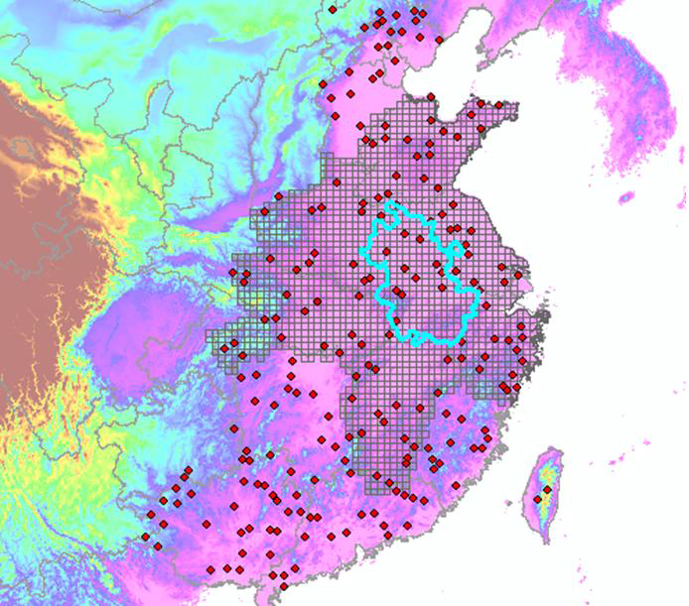
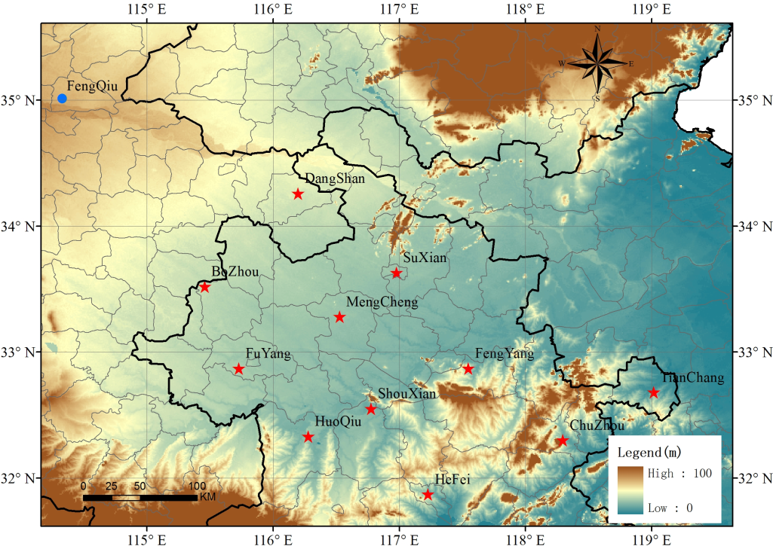

Crop Database
1. Intensive crop data from Comprehensive Agroecology Experiment Station - Fengqiu
2. Winter wheat crop calendar data from 11 counties in northern Anhui

Slide 4
Crop Experimental Database From Fengqiu
Fengqiu: Comprehensive Agroecology Experiment Station
Sub-humid climate (close to that in the northern Anhui):
  annual mean temperature of 14°C
  annual precipitation of 615 mm
Data period: 2003 – 2011

Slide 5
Crop Experimental Database From Fengqiu
Observations
Crop phenology
Emergence
Regreening
Tillering
Jointing
Heading
Anthesis
Milking
Dough
Grain filling
Maturity
Crop growth variables
Planting density (number of plants per square meter)
Mean crop height
Crop leaf area index
Number of tillers in each phonological stage
Total above ground fresh biomass weight
Stem dry biomass weight
Leaf dry weight
Total aboveground dry weight

Slide 6
Crop Experimental Database From Fengqiu
4 different cultivars of winter wheat each having 6 plots:
  Zhengmai9023
  Kenong199
  Xinmai19
  Zhengmai336
3 different practices in fertilization and water supply:
  optimized practice
  no fertilization
  water limited
Zhengmai9023 was used for calibration

Slide 7
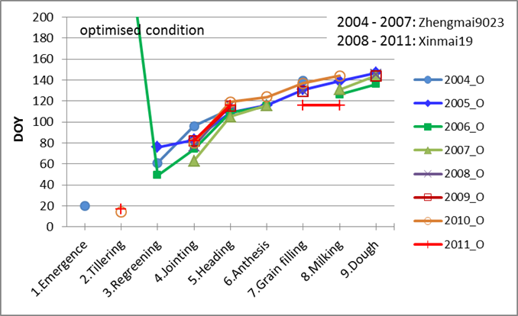
Crop Experimental Database From Fengqiu
Crop phenology
Differences in phenological stages under different treatments are found not obvious, both for Zhengmai9023 and Xinmai19.

Slide 8
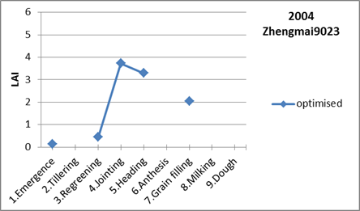
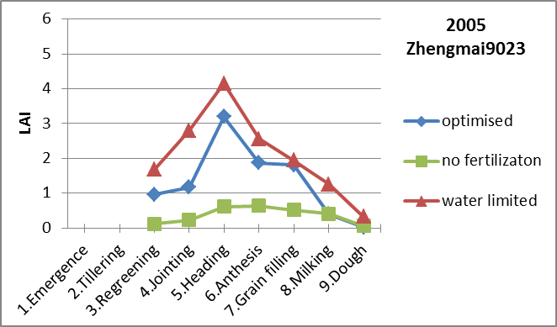
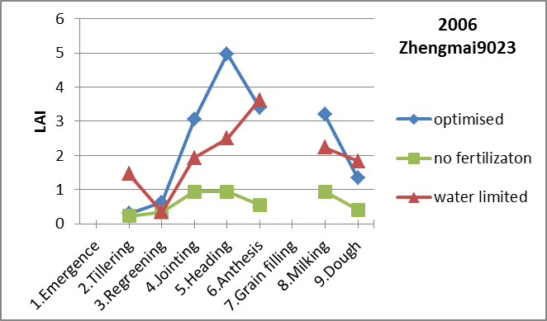
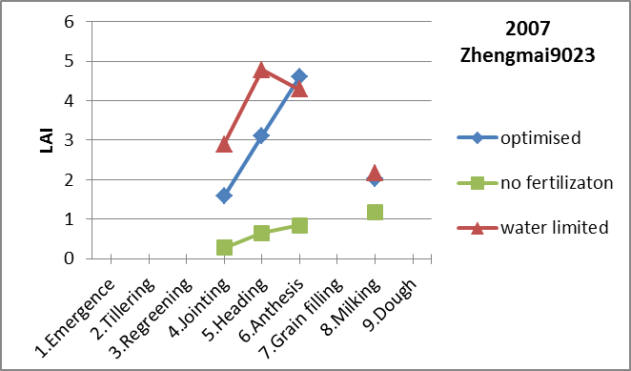
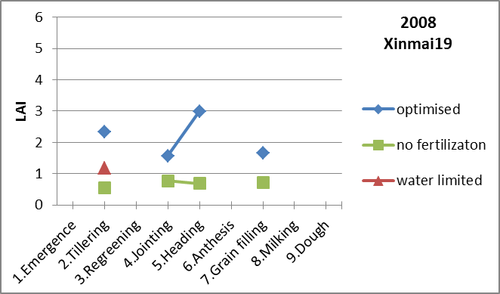
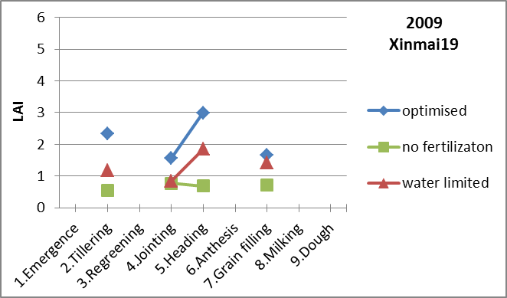
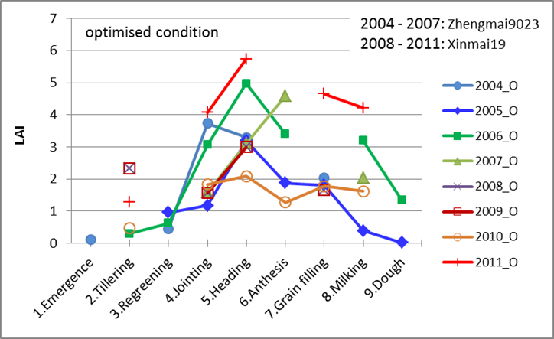
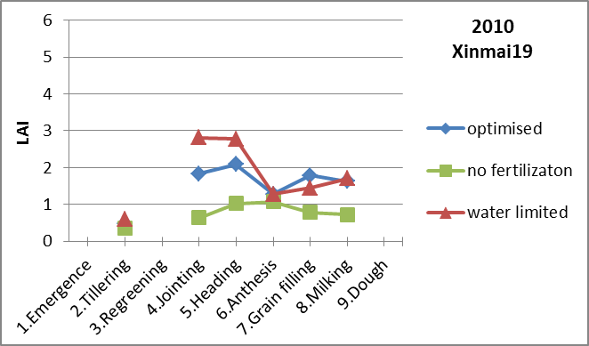
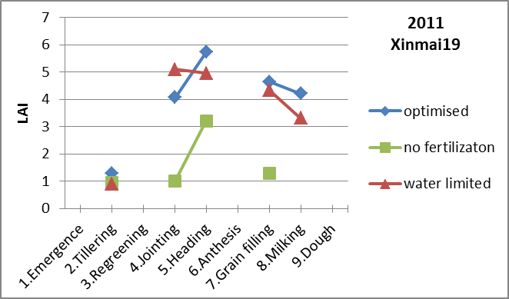
Crop Experimental Database From Fengqiu
Crop growth and yield
Impact on the LAI due to different treatments on the two cultivars of winter wheat are obvious.
In particular, large deviation under the “no fertilization” treatment from “optimised” condition were found.
LAI of winter wheat Zhengmai9023 and Xinmai19 under optimised condition

Slide 9
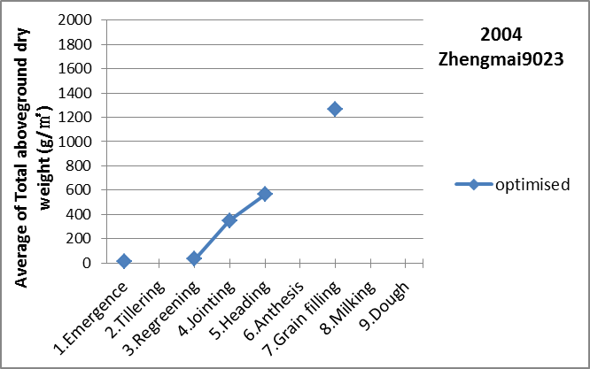
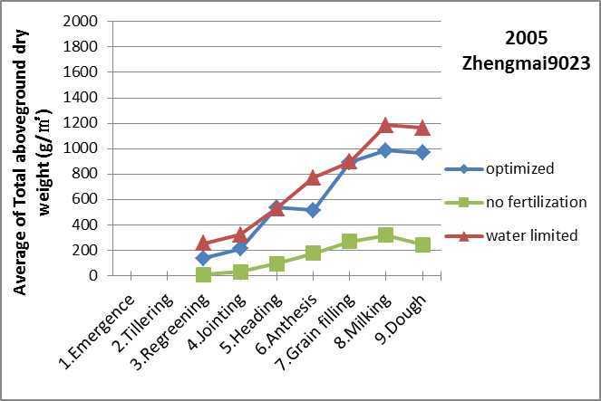
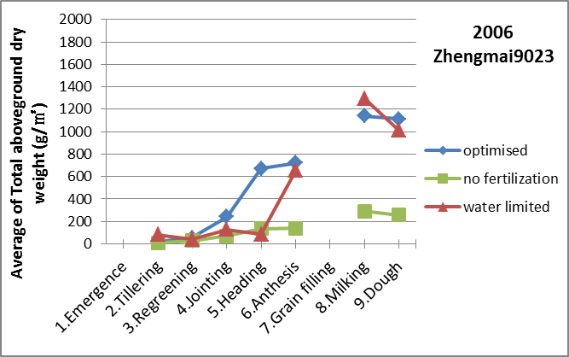
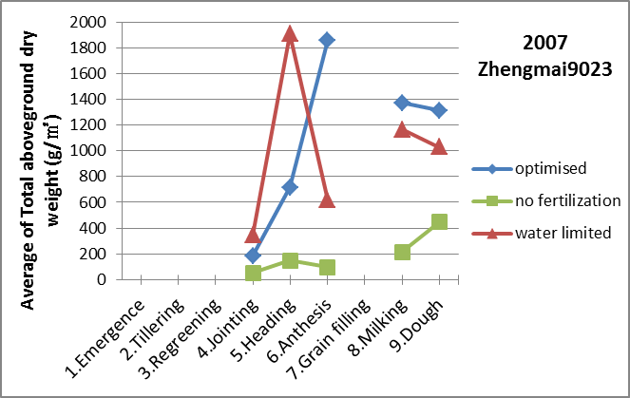
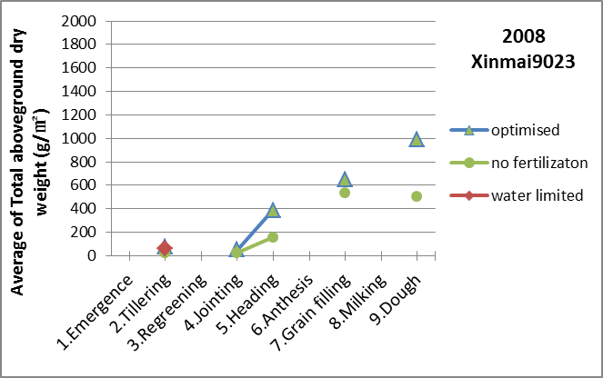
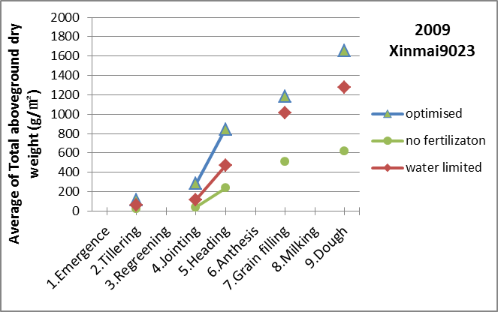
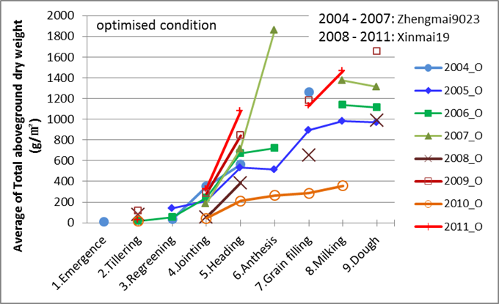
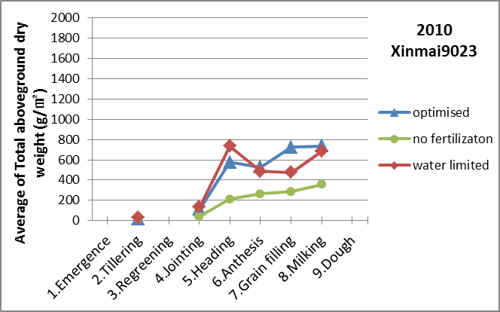
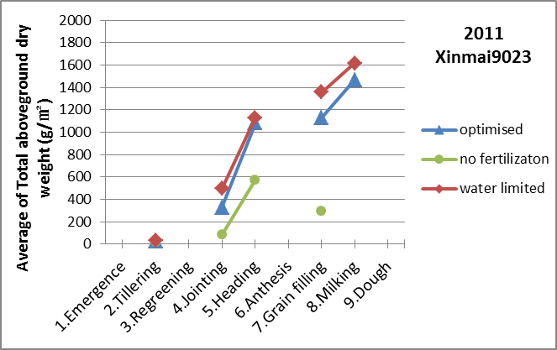
Crop Experimental Database From Fengqiu
Crop growth and yield
Difference in the “total aboveground dry weight” between the “water limited” and “optimised” conditions are not significant.
Yield under “no fertilization” condition are significantly deviated from the “optimised” condition
Total above ground dry weight of Zhengmai9023 and Xinmai19 under optimised condition

Slide 10
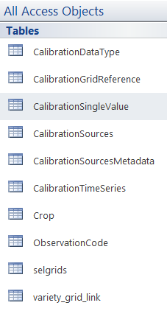
Crop Experimental Database From Fengqiu
Database for CGMS-Anhui
Table name | Function
CalibrationSources | listed all the calibration data sources available in the database (See Fig. 16 for snapshot of the Table). There are 208 sources in total.
CalibrationSourcesMetadata | the metadata for each calibration source, gives crop type, description, location and some additional information (See Fig. 17 for snapshot of the Table)
CalibrationDataType | gives definition for calibration data type, 3 types are defined: 1 = Observations from field experiment 2 = Regional observation 3 = Expert estimate
CalibrationGridReference | listed the CGMS grid numbers for which a given calibration source is assumed to be valid (See Fig. 18 for snapshot of the Table). All the 30 sources have the same grid number 89151
CalibrationSingleValues | actual calibration data that stores single value variables (i.e. crop phenology: DOP, DOE, DOA, DOM) (See Fig.19 for snapshot of the Table).
CalibrationTimeSeries | This table is empty since there was no temporal dependent variables were collected.
ObservationCode | stores observation codes and their descriptions and units (is the same as for Fengqiu database, see Fig.13 for snapshot of the Table).
Crop | gives crop type definition (is the same as for Fengqiu database, see Fig.14 for snapshot of the Table).

Slide 11
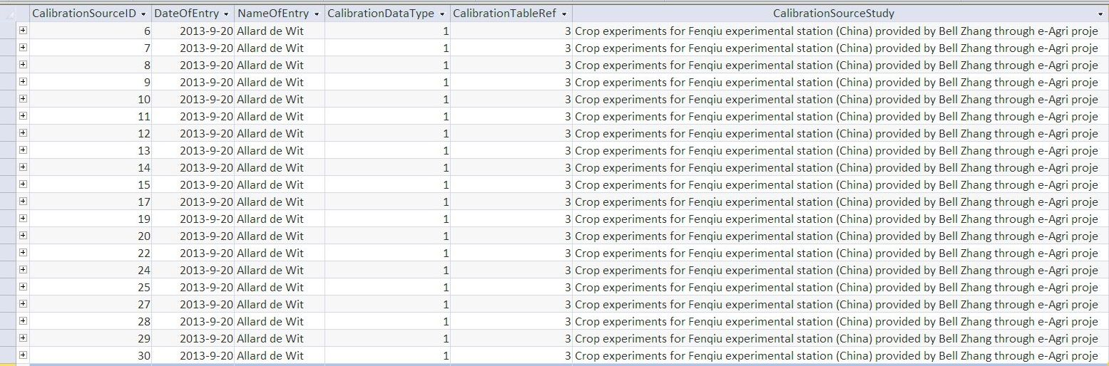
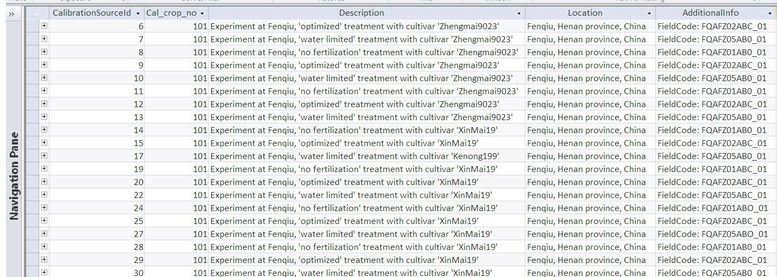
Crop Experimental Database From Fengqiu
Database for CGMS-Anhui
Source: winter wheat (ZhengMai9023), with different treatments (“optimised” , “no-fertilization” and “water limited conditions”.
Type of calibration data:
1 = Data from field experiments
2 = Regional values
3 = Expert estimate
Indicator in which table to find the data:
1 = CalibrationSingleValue
2 = CalibrationTimeSeries
3 = Both

Slide 12
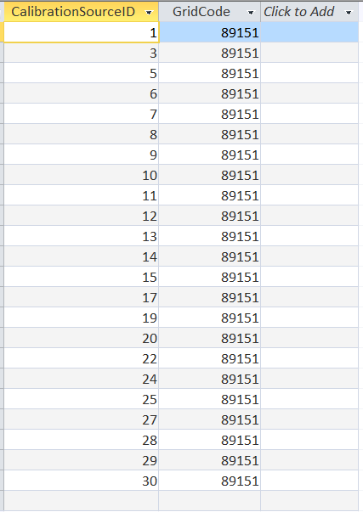
Crop Experimental Database From Fengqiu
Database for CGMS-Anhui
List of the CGMS grid numbers for which a given calibration source is assumed to be valid
All the 30 sources have the same grid number 89151

Slide 13
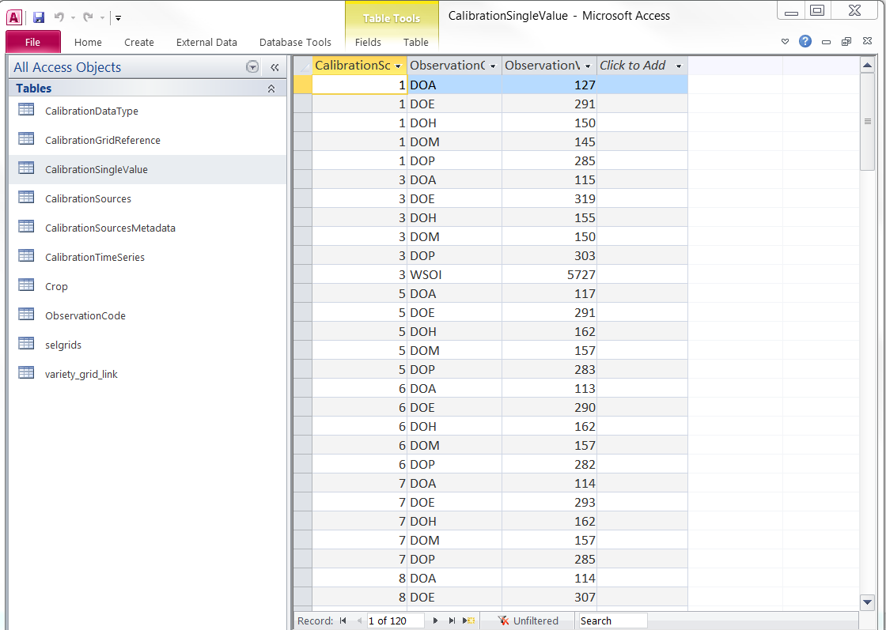
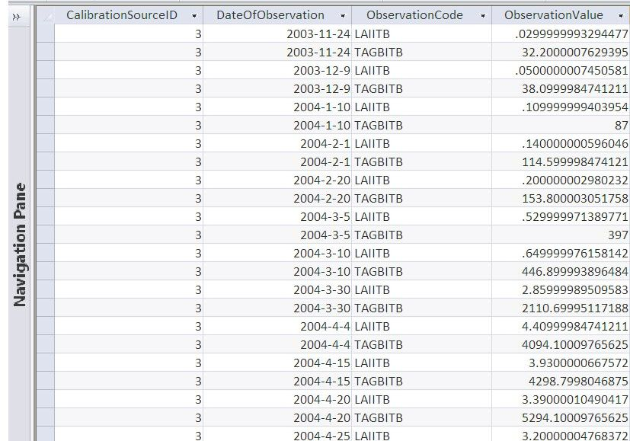
Crop Experimental Database From Fengqiu
Database for CGMS-Anhui
Actual calibration data that stores single value variables (i.e. crop phenology: DOP, DOE, DOA, DOM)
Actual calibration data that stores time series of crop growth conditions of key variables (LAI, Total above-ground biomass, etc)

Slide 14
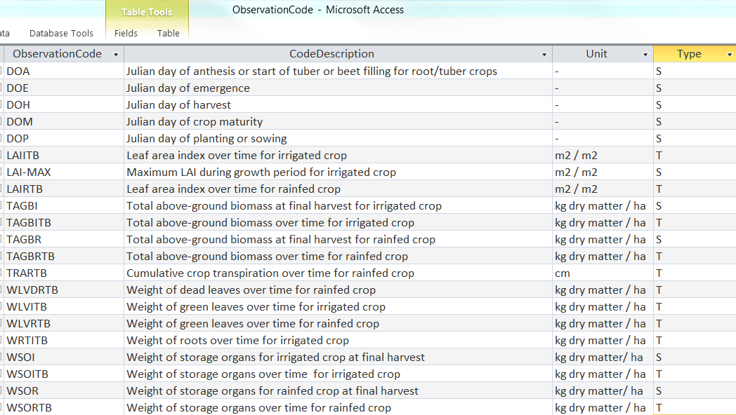
Crop Experimental Database From Fengqiu
Database for CGMS-Anhui
Observation codes and their descriptions and units

Slide 15
Crop Experimental Database From Fengqiu
Database for CGMS-Anhui – weather data
The Fengqiu Comprehensive Agroecology Experiment Station provides dedicated weather variables that were measured at the site itself including min/max temperature, rainfall and humidity. For the calibration of WOFOST the use of locally measured weather variables should preferred over the use of weather variables interpolated from weather stations in the surroundings. Therefore, the local weather data were processed to comply with the weather data needed by CGSM/WOFOST. Not all variables needed for CGMS/WOFOST are available therefore the complete set of variables was derived from the ERA-INTERIM weather archive that is available for China from the MARSOP3 project. Within this complete set the variables related to temperature, rainfall and humidity were updated from the measured values at Fengiu. This data is provided in a separate file ‘Fenqiu_GRID_WEATHER.mdb’.

Slide 16
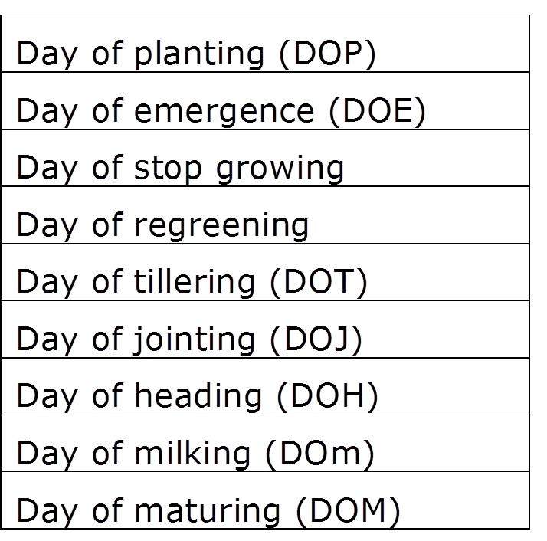
Crop Phenology Database From Anhui Province
Winter wheat crop calendar data from 11 counties in northern Anhui:
Day of Anthesis (DOA) was not measured, it was determined by adding 7 days to the heading date
Period: 1992 - 2012

Slide 17
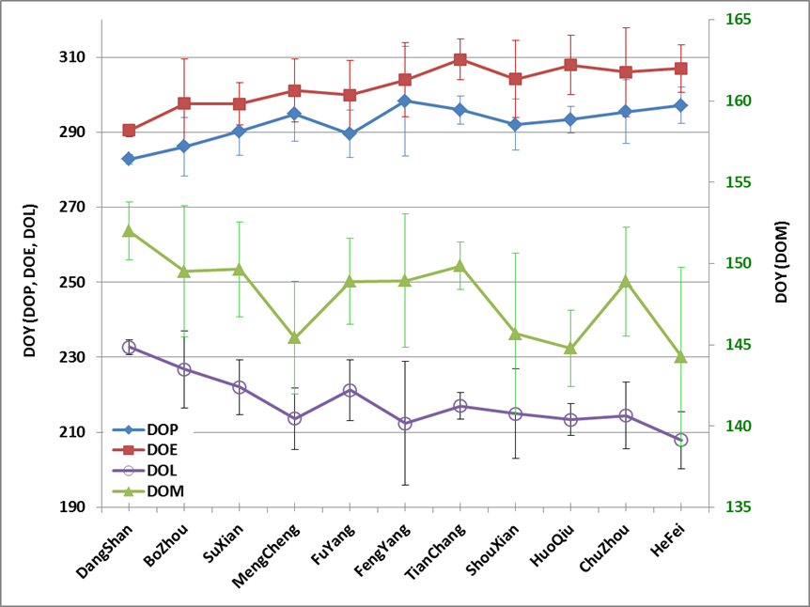
Crop Phenology Database From Anhui Province
Winter wheat crop calendar data from 11 counties in northern Anhui
DOP, DOE, DOM showed clear gradient:
DOP/DOE: earlier days in the north and later days in the south
DOM: earlier in the south than in the north
Length of growth (DOL= days between the planting day and the day of maturity):
decreasing gradient from the north to the south

Slide 18
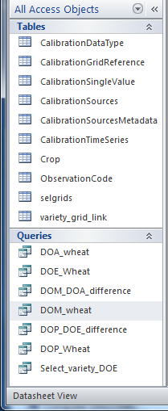
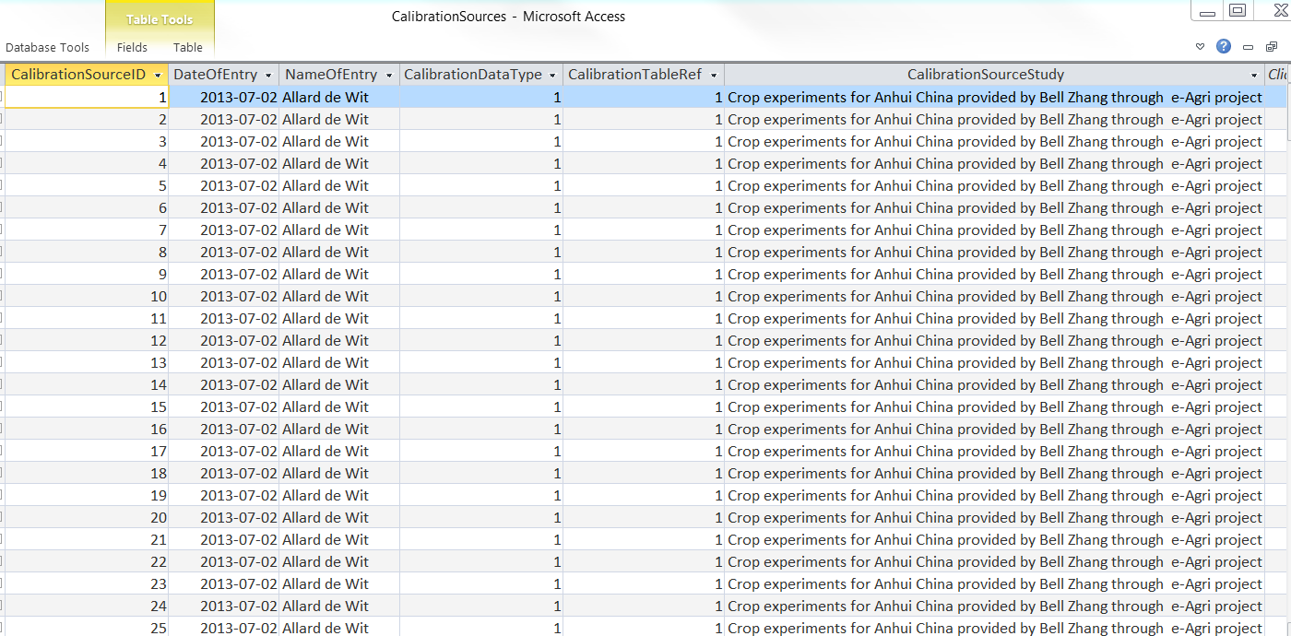
Crop Phenology Database from Anhui Province
Database for CGMS-Anhui
208

Slide 19
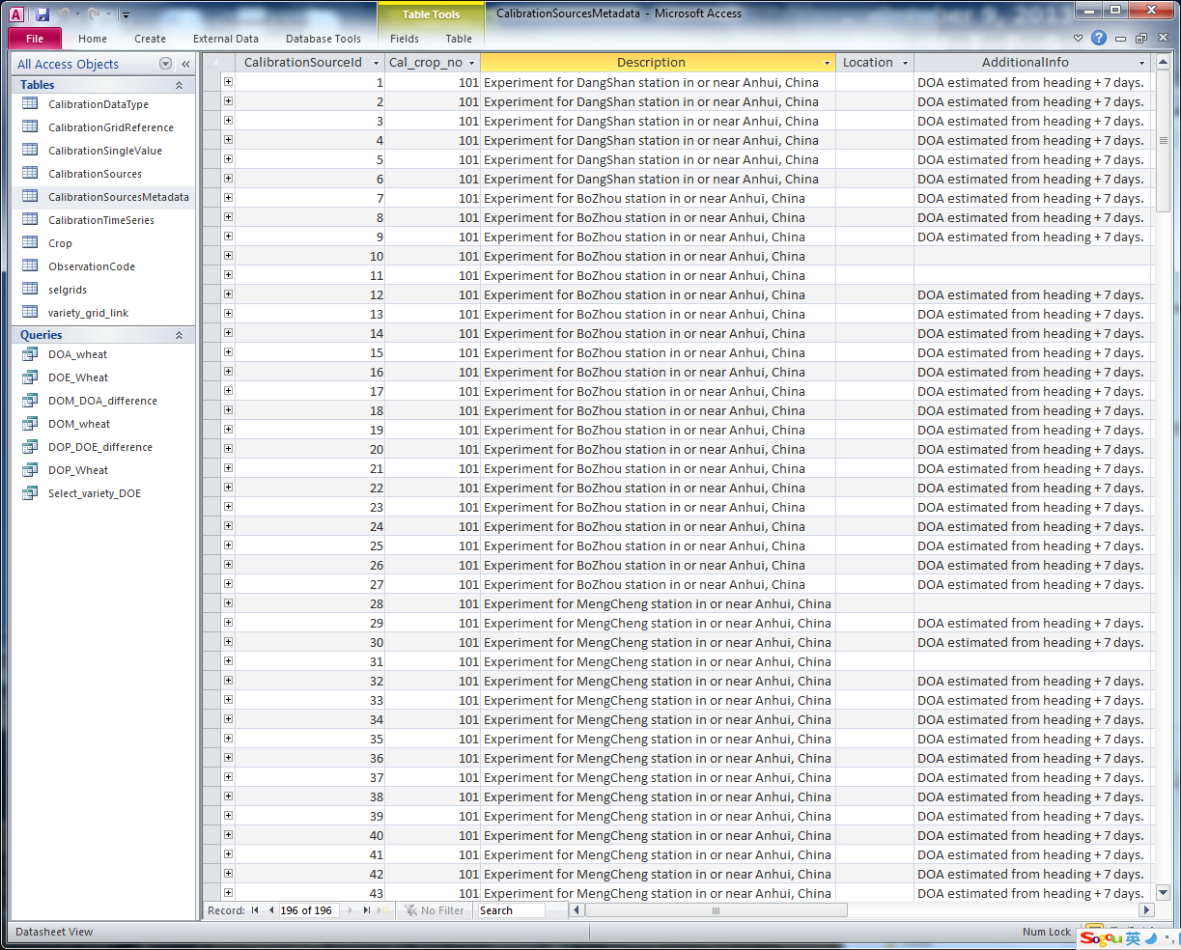
Crop Phenology Database from Anhui Province
Database for CGMS-Anhui
Additional information like growing conditions, crop management, fertilizer application and land and soil characteristics

Slide 20
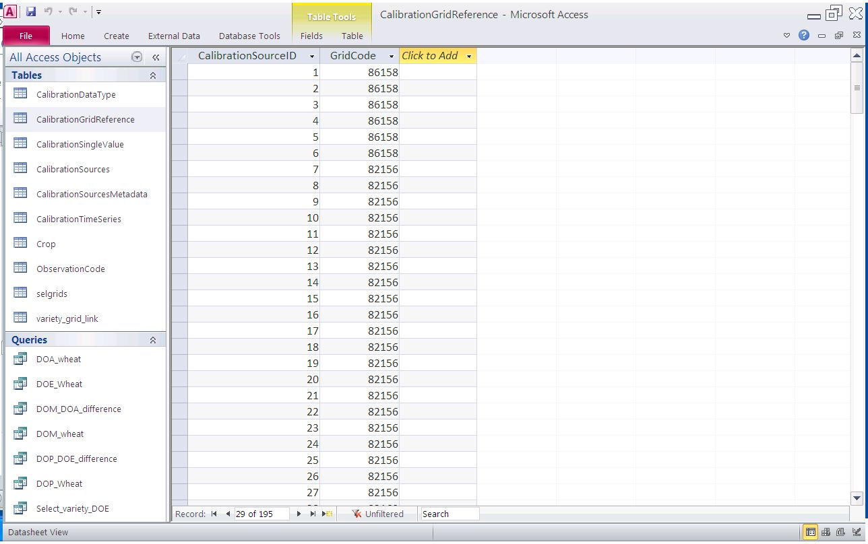
Crop Phenology Database from Anhui Province
Database for CGMS-Anhui
GridCode:
CGMS grid code which is linked with the calibration data, the 11 counties are corresponding to 11 GridCodes:
86158: DahngShan
82156: BoZhou
82160: MengCheng
83161: Suxian
79157: Fuyang
77159: Huoqiu
78161: ShouXian
80164: FengYang
78167: ChuZhou
80169: TianChang
76163: HeFei

Slide 21
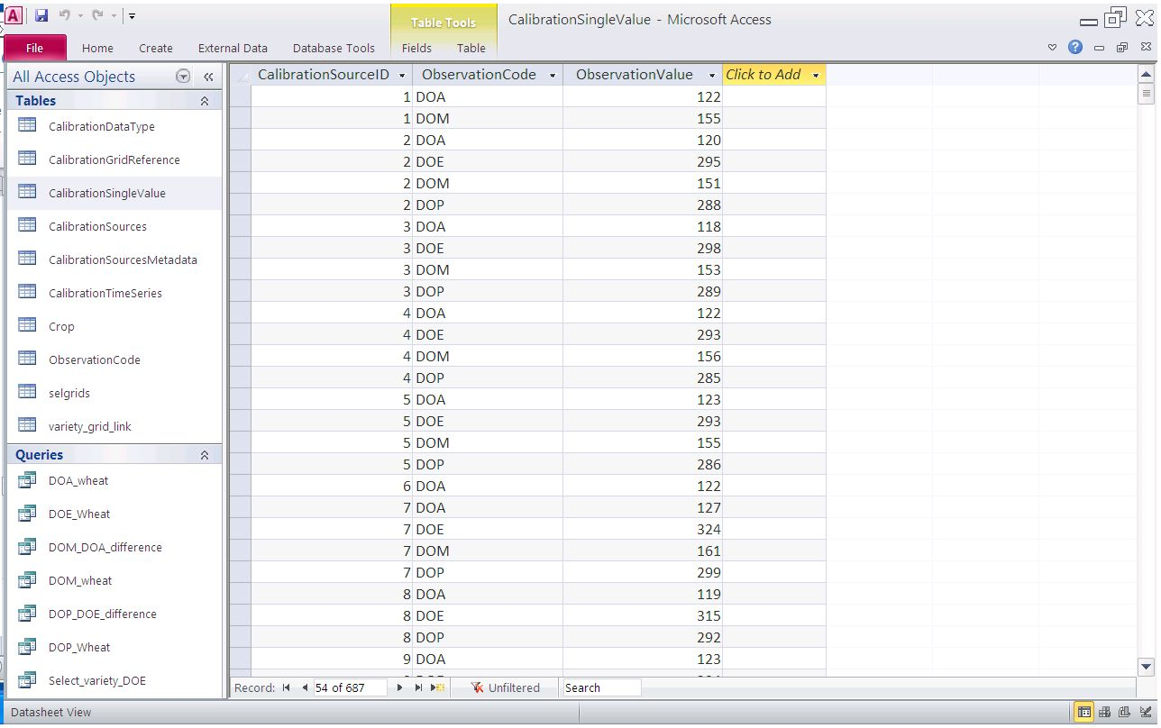
Crop Phenology Database from Anhui Province
Database for CGMS-Anhui

Slide 22
Anhui CGMS Calibration
Calibration at Fengqiu site - Approach
Selection of cultivar - Zhengmai9023:
  similar phenology with those collected from the 11 counties in Anhui;
  better quality;
  Xinmai19: rather different phenological characteristics.
CGMS calibration platform (CALPLAT): iteratively searches for the best solution by varying the values of selected parameters in the parameter space:
  objective function: Relative Root Mean Squared Error
A two-stage approach:
  1) calibrate the parameters related to phenology (TSUM1, TSUM2, DLC, DLO) using the observed phenological stages;
  2) calibrate the parameters related to photosynthesis and leaf area development (AMAXTB, SPAN and TDWI).
Tips: 1) the Specific Leaf Area (SLATB) was modified by directly calculating the SLATB values from measurements of crop leaf area and leaf biomass. 2) The final crop yield, was not directly used as target parameter in the calibration of the system due to problems with the adjusting the FOTB (partitioning to storage organs) in the CGMS Calibration Platform (CALPLAT).
Notes:
The optimization of parameters used in WOFOST model therefore was carried out using the data for cultivar Zhengmai9023.

Slide 23
Anhui CGMS Calibration
Calibration at Fengqiu site - Results
Calibration of Tsums:
  Tsum1 - the effective temperature sum from emergence to anthesis,
  Tsum2 - the effective temperature sum from anthesis to maturity.
The calibrated values of Tsums are very different form the default values, in particular for Tsum1
Notes:
The optimization of parameters used in WOFOST model therefore was carried out using the data for cultivar Zhengmai9023.

Slide 24
Anhui CGMS Calibration
Calibration at Fengqiu site – Parameter optimization
Full set of calibrated parameters in WOFOST model using data from Fengqiu site is achieved
Notes:
The optimization of parameters used in WOFOST model therefore was carried out using the data for cultivar Zhengmai9023.

Slide 25
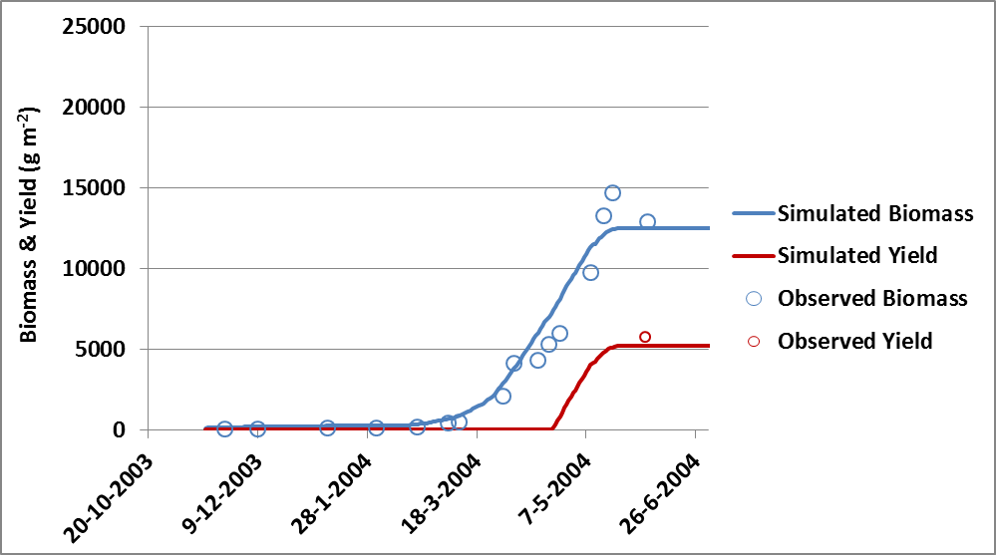
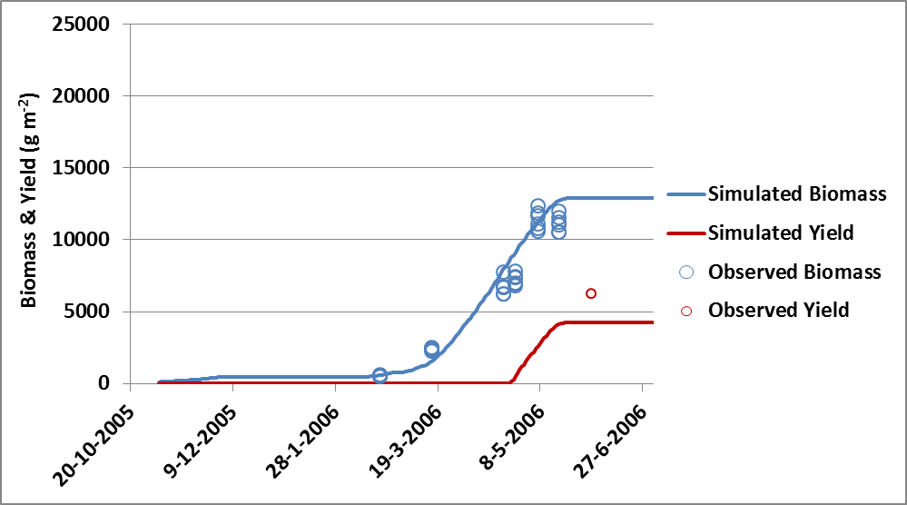
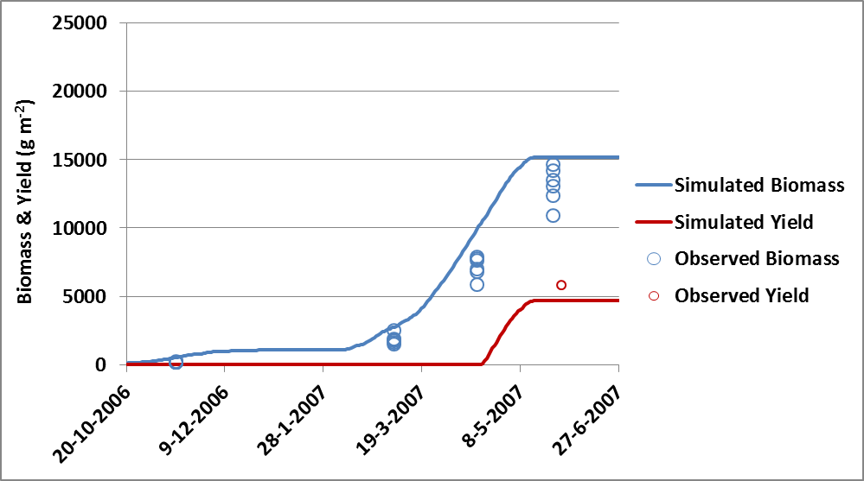
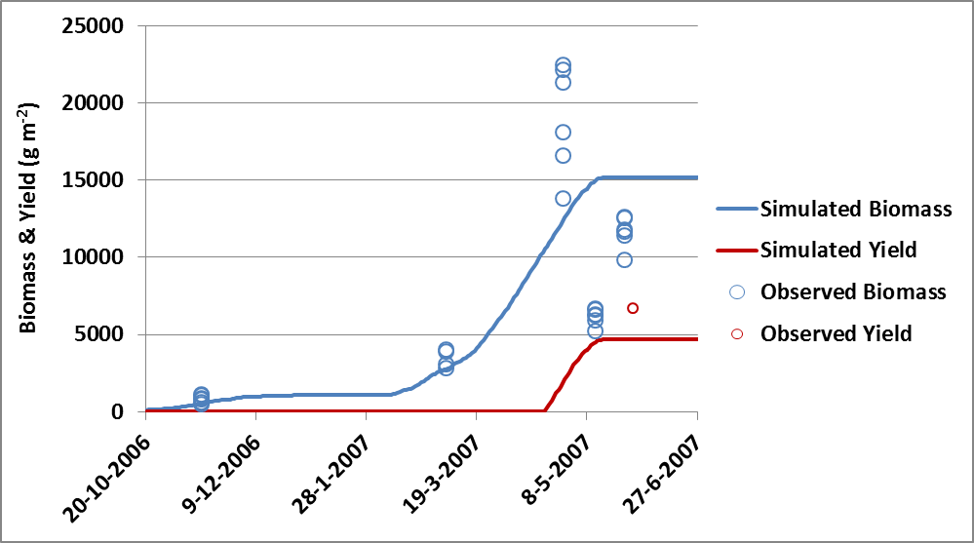
Anhui CGMS Calibration
Calibration at Fengqiu site – Prediction Results
Predicted biomass, yields
simulated curves in the two cases in 2003-2004 and 2005-2006 growing cycle followed well the observed values
the other two cases showed poorer simulation results
In general, the curves for the simulated crop yield tend to underestimate the final observed crop yield in all four cases.
Notes:
The optimization of parameters used in WOFOST model therefore was carried out using the data for cultivar Zhengmai9023.

Slide 26
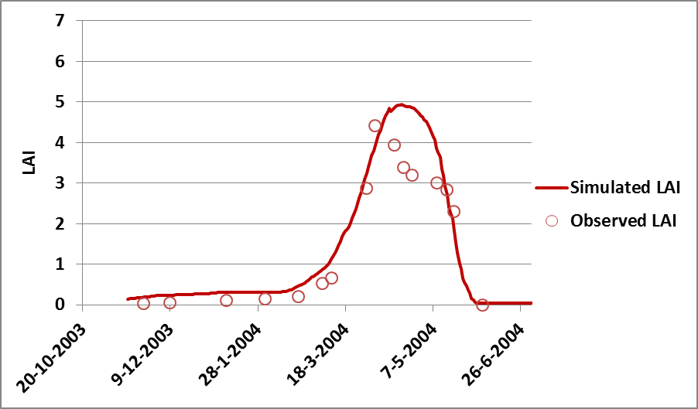
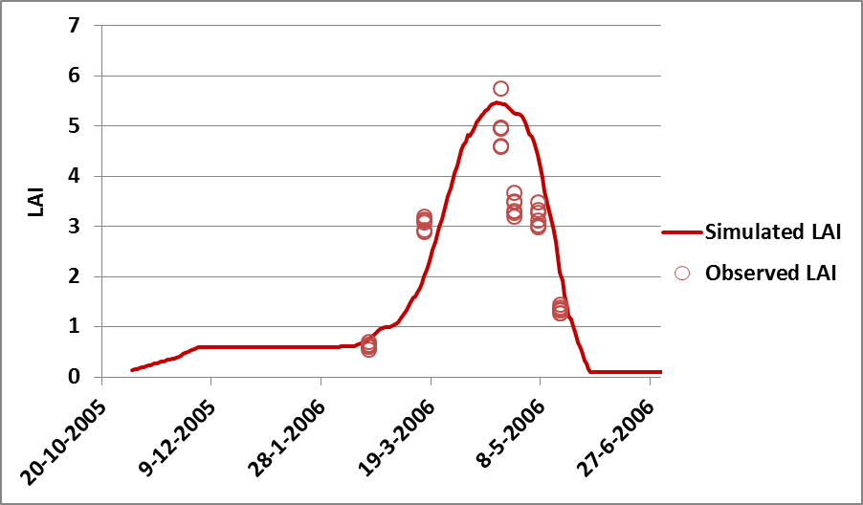
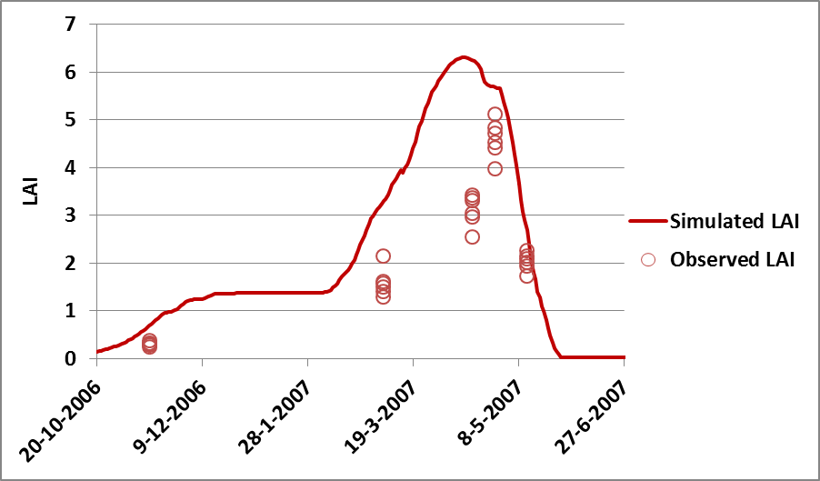
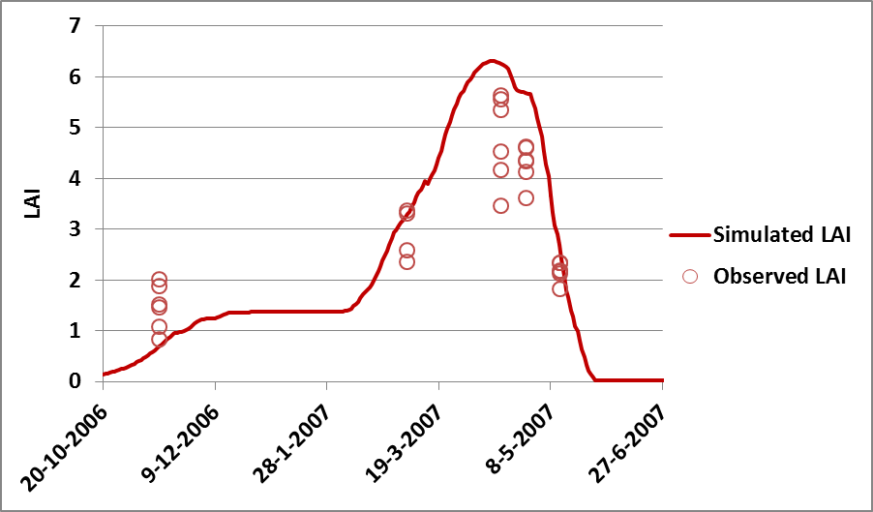
Anhui CGMS Calibration
Calibration at Fengqiu site – Prediction Results
Predicted LAI
simulated curves in the two cases in 2003-2004 and 2005-2006 growing cycle followed well the observed values
the other two cases showed poorer simulation results
Notes:
The optimization of parameters used in WOFOST model therefore was carried out using the data for cultivar Zhengmai9023.

Slide 27
Anhui CGMS Calibration
Calibration in northern Anhui - Approach
Only the data of crop phenological stages are available ➔ only major crop parameters that influence the phenological development stages were calibrated, Tsum1 and Tsum2.
All other parameters are taken from the calibration from Fengqiu site.
Crop calendar data used for calibration are:
  day of planting (DOP),
  day of emergence (DOE),
  day of anthesis (DOA),
  day of maturity (DOM),
  day of harvest (DOH)
DOA was not observed in the dataset, it is calculated by adding 7 days to the observed day of heading.
Day of harvest was also not observed: calculated by adding 7 days to the DOM.
For calibrating Tsum1, the observed DOP, DOE and DOA were used.
For calibrating Tsum2, observed DOA and DOM and/or DOH were used.
Notes:
The optimization of parameters used in WOFOST model therefore was carried out using the data for cultivar Zhengmai9023.

Slide 28
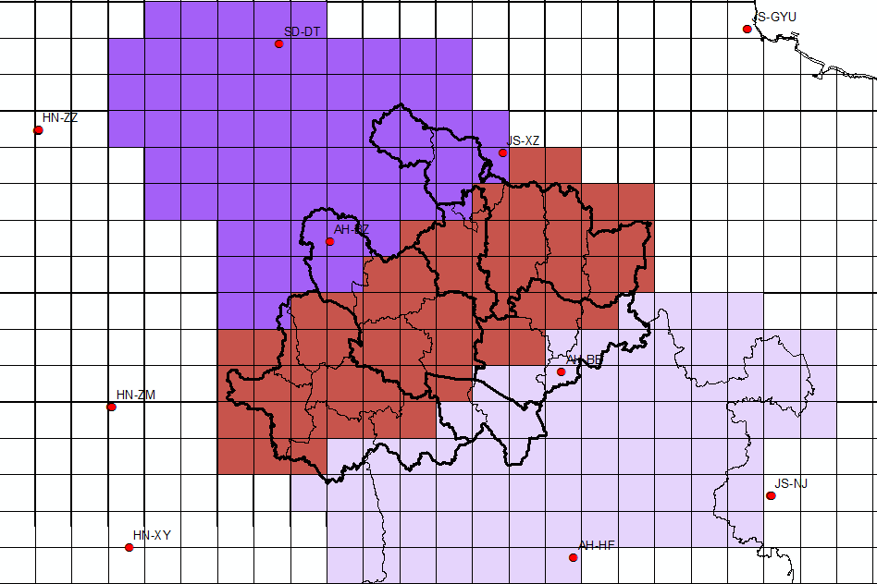
Anhui CGMS Calibration
Calibration in northern Anhui - Approach
gradient in phenology from north to the south
➔ study region in Anhui is divided into 3 zones for calibration
north
central
south

Slide 29
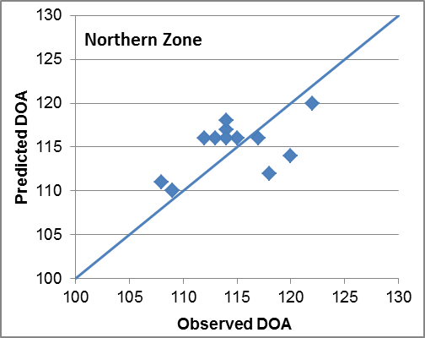
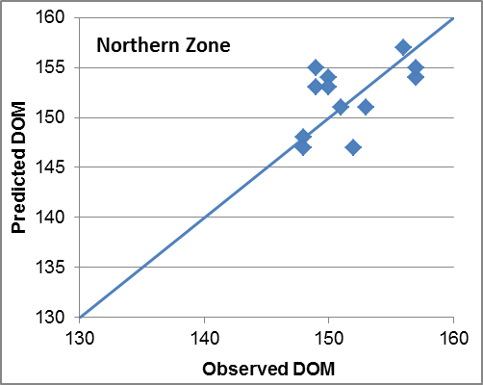
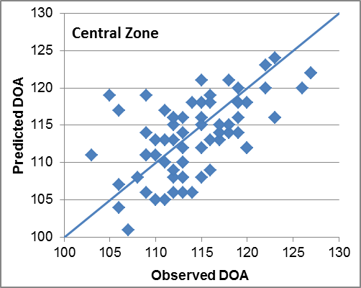
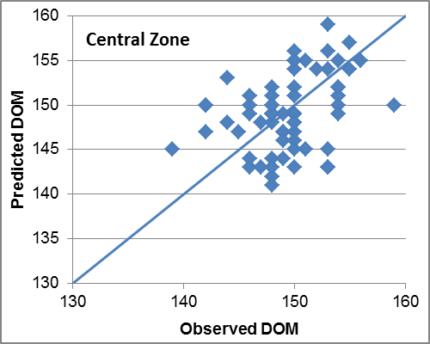
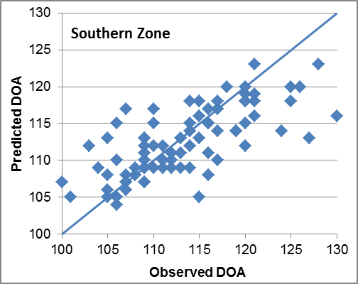
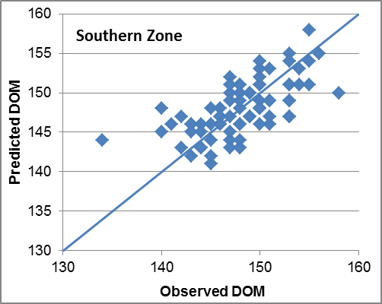
Anhui CGMS Calibration
Calibration in northern Anhui - Results
The calibrated values of Tsums are very different form the default values, in particular for Tsum1

Slide 30







Anhui CGMS Yield Prediction
Predicted Yields vs. Statistics Data
NUTS level 1

Slide 31
Summary
The detailed observations from the Fengqiu experimental site allow a very detailed calibration including complex parameters in the WOFOST model, though:
  the quality and number of observations is variable between years, cultivars and experiments
The results from the calibration of the phenology at Fengqiu demonstrate that the observed phenological stages can be reasonably reproduced by the model and that the values for TSUM1, TSUM2, DLC and DLO are considerable different from the default values.
The critical and optimal day length (DLC: 10.09 hour and DLO: 13.95 hour) are quite close to the shortest day length at the latitude of Anhui (10 hour) and the day length around flowering in Anhui (14 hours).
The regional phenological observations for each county allow making spatial adjustments to a limited number of parameters and allow defining the crop calendar (crop sowing) over the entire region which has to be implemented in CGMS.
The CGMS/WOFOST has now been set up well for Anhui and sufficient data could be used to calibrate the different parameters of the model and to make a spatial implementation of it.

Slide 32
Summary
For calibrating the final crop yield, we encountered a technical problem with CALPLAT which failed calibrating the relevant parameter (FOTB). The result is that the current calibration results underestimate the final crop yield. Calibration of this parameter may still be needed also given the short grain filling period in Anhui.

Slide 33
Thank you for your attention
© Wageningen UR

