Slide 1
E-AGRI Work Package 3
BioMA multi-model monitoring
Roberto Confalonieri¹, Simone Bregaglio¹, Caterina Francone¹, Valentina Pagani¹, Giovanni Cappelli¹, Tommaso Stella¹, Nicolò Frasso¹, Marco Acutis¹, Wang Zhiming², Li Bingbai², Qiu Lin², Fabien Ramos³, Stefan Niemeyer³, Riad Balaghi⁴, Hassan Ouabbou⁴, Tarik El Hairech⁴, Sliman Elhani⁴, Rachid Hadria⁴, Saadia Lhaloui⁴, Samira Ismaili⁴, Tarik Benabdelouahab⁴
¹ University of Milan, Department of Plant Production, CASSANDRA modelling team
² Jiangsu Academy of Agricultural Sciences
³ European Commission Joint Research Centre, IES, AGRI4CAST
⁴ INRA Morocco
roberto.confalonieri@unimi.it
E-AGRI - Final meeting, 20-21 January 2014, Alterra, Wageningen-UR, the Netherlands

Slide 2
WP3: scientific issues
Large area simulations targeting crop monitoring and yield forecasting are affected by many sources of uncertainty
Inputs reliability
Management practices (e.g., sowing dates)
Model suitability (are key processes formalized? How?)
Parameterization/calibration
Aggregation
…
This is why simulation results are usually post-processed (e.g., multiple regressions against historical time series of yield data)
E-AGRI WP3 faced some of these issues
E-AGRI - Final meeting, 20-21 January 2014, Alterra, Wageningen-UR, the Netherlands

Slide 3
WP3: scientific issues
Large area simulations targeting crop monitoring and yield forecasting are affected by many sources of uncertainty
Inputs reliability
Management practices (e.g., sowing dates)
Model suitability (are key processes formalized? How?)
Parameterization/calibration
Aggregation
…
[indirect] Integration of remote sensing data [D33.3, D35.3]:
LAI_{max} (~heading) from NDVI
E-AGRI - Final meeting, 20-21 January 2014, Alterra, Wageningen-UR, the Netherlands

Slide 4
WP3: scientific issues
Large area simulations targeting crop monitoring and yield forecasting are affected by many sources of uncertainty
Inputs reliability
Management practices (e.g., sowing dates)
Model suitability (are key processes formalized? How?)
Parameterization/calibration
Aggregation
…
Use of sowing dates derived from RS data (rice) [D33.3]
Implementation of automatic sowing rules [D35.1]
E-AGRI - Final meeting, 20-21 January 2014, Alterra, Wageningen-UR, the Netherlands

Slide 5
WP3: scientific issues
Large area simulations targeting crop monitoring and yield forecasting are affected by many sources of uncertainty
Inputs reliability
Management practices (e.g., sowing dates)
Model suitability (are key processes formalized? How?)
Parameterization/calibration
Aggregation
…
[key processes] Diseases [D33.1, D35.1]
[how formalized] Multi-model simulations [D33.2, D35.2]
E-AGRI - Final meeting, 20-21 January 2014, Alterra, Wageningen-UR, the Netherlands

Slide 6
WP3: scientific issues
Large area simulations targeting crop monitoring and yield forecasting are affected by many sources of uncertainty
Inputs reliability
Management practices (e.g., sowing dates)
Model suitability (are key processes formalized? How?)
Parameterization/calibration
Aggregation
…
Calibration/evaluation at field level [D32.3, D34.3]
E-AGRI - Final meeting, 20-21 January 2014, Alterra, Wageningen-UR, the Netherlands

Slide 7
WP3: tasks description
Task 3.1: Ground data collection for BioMA
Task 3.2: Adaptation of BioMA for multi-model rice monitoring in Jiangsu
Task 3.3: BioMA piloting for multi-model rice monitoring and yield forecasting in Jiangsu
Task 3.4: Adaptation of BioMA for multi-model wheat monitoring in Morocco
Task 3.5: BioMA piloting for multi-model wheat monitoring and yield forecasting in Morocco
E-AGRI - Final meeting, 20-21 January 2014, Alterra, Wageningen-UR, the Netherlands
Rice, Jiangsu
Wheat, Morocco
Task 3.1
BioMA adaptation
Task 3.2
Task 3.4
BioMA piloting
Task 3.3
Task 3.5

Slide 8
WP3: tasks description
E-AGRI - Final meeting, 20-21 January 2014, Alterra, Wageningen-UR, the Netherlands
Rice, Jiangsu
Wheat, Morocco
Task 3.1
BioMA adaptation
Task 3.2
Task 3.4
BioMA piloting
Task 3.3
Task 3.5

Slide 9
Task 3.1-description
Partners involved: JAAS, INRA, UMIL
E-AGRI - Final meeting, 20-21 January 2014, Alterra, Wageningen-UR, the Netherlands
D31.1
D31.1
D31.2
D31.2
MS1
MS1
MS1
Rice, China
Wheat, Morocco
Task 3.1
BioMA adaptation
Task 3.2
Task 3.4
BioMA piloting
Task 3.3
Task 3.5

Slide 10
Task 3.1-deliverables
Partners involved: JAAS, INRA, UMIL
E-AGRI - Final meeting, 20-21 January 2014, Alterra, Wageningen-UR, the Netherlands
Deliverable | (Short) Title | Nature | Delivery date | Status
D31.1 | Data collection | R | 6 | Delivered
D31.2 | Experiments database | O | 30 | Delivered

Slide 11
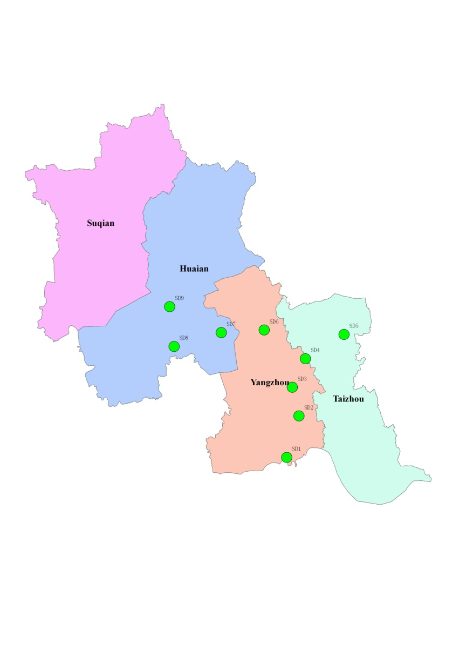
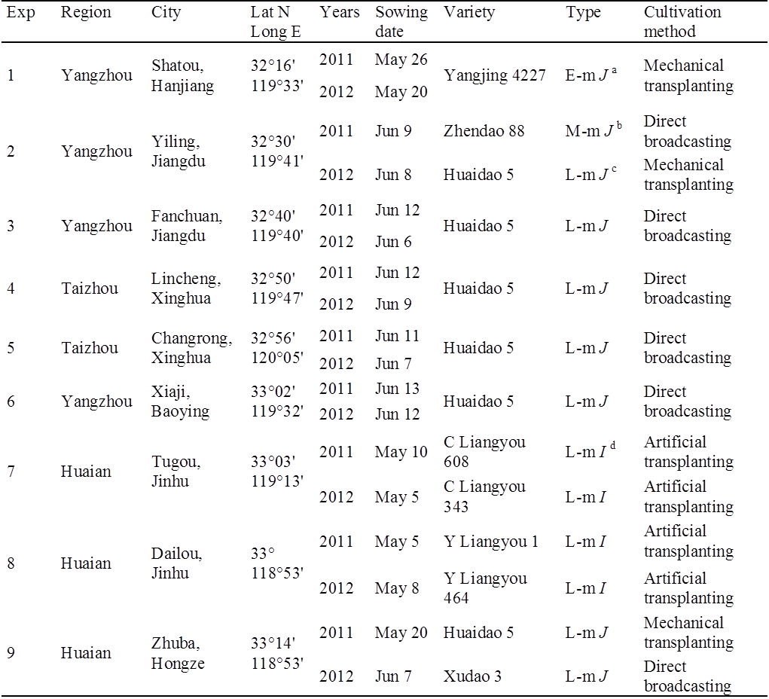
Task 3.1-deliverables
Partners involved: JAAS, INRA, UMIL
Rice – Jiangsu Experimental sites
E-AGRI - Final meeting, 20-21 January 2014, Alterra, Wageningen-UR, the Netherlands
Distribution of sample sites
3 years × 9 sites available

Slide 12
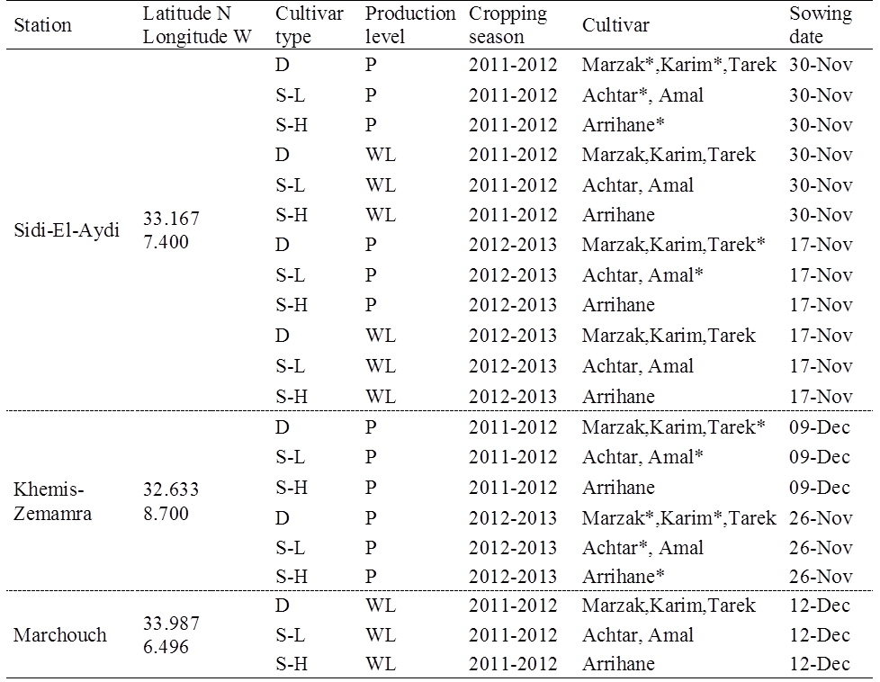
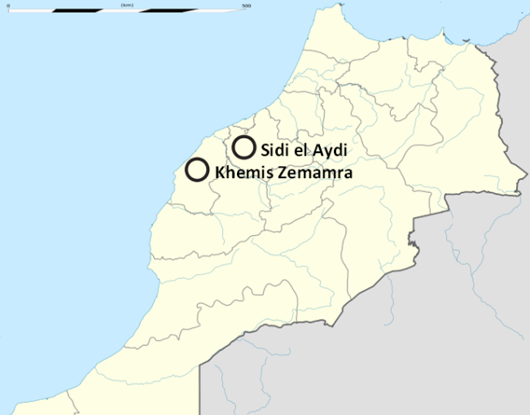
Task 3.1-deliverables
Partners involved: JAAS, INRA, UMIL
Wheat – Morocco Experimental data
E-AGRI - Final meeting, 20-21 January 2014, Alterra, Wageningen-UR, the Netherlands
Distribution of sample sites
2 years × 3 sites available (potential-water limited)

Slide 13
Task 3.2/4-description
Partners involved: UMIL, JRC (INRA, JAAS)
E-AGRI - Final meeting, 20-21 January 2014, Alterra, Wageningen-UR, the Netherlands
D32.1 – D34.1
D32.2 – D34.2
D32.3 – D34.3
D32.4
MS2
Rice, China
Wheat, Morocco
Task 3.1
BioMA adaptation
Task 3.2
Task 3.4
BioMA piloting
Task 3.3
Task 3.5

Slide 14
Task 3.2/4-deliverables
Partners involved: UMIL, JRC, INRA, JAAS
E-AGRI - Final meeting, 20-21 January 2014, Alterra, Wageningen-UR, the Netherlands
Deliverable | (Short) Title | Nature | Delivery date | Status
D32.1 | Sensitivity analysis (rice) | R | 12 | Delivered
D32.2 | Parameterization (rice) database | O | 30 | Delivered
D32.3 | Evaluation (rice) field level | R | 30 | Delivered (final ver.)
D32.4 | Evaluation (rice) large area | R | 30 | Delivered (final ver.)
D34.1 | Wheat var. classification and SA | R | 6 | Delivered
D34.2 | Parameterization (wheat) database | O | 30 | Delivered
D34.3 | Evaluation (wheat) field level | R | 30 | Delivered (final ver.)
D34.4 | Evaluation (wheat) large area | R | 30 | Delivered

Slide 15
Task 3.2-deliverables
Partners involved: UMIL, JRC (JAAS)
Last year we presented results of the calibration/evaluation at field level
Main problems seemed to be due to the transplanting algorithm
…especially for the high plant density in the seedbed for the mechanical transplanting
“There’s probably something to improve in the transplanting model (the same used by Oryza2000)”
The point was that nobody tested the same (or similar) cultivars WITH and WITHOUT transplanting
In some cases, something involved with transplanting was likely introduced in parameter values
We developed a new transplanting algorithm, by improving that implemented in Oryza2000
E-AGRI - Final meeting, 20-21 January 2014, Alterra, Wageningen-UR, the Netherlands

Slide 16
Task 3.2-deliverables
Partners involved: UMIL, JRC (JAAS)
Plant density in the seedbed affects:
Initial LAI (in Oryza is defined by the user)
The extinction coefficient for solar radiation
SLA at emergence (increases for high values)
Mortality
The other processes (magnitude and duration of transplanting shock, dilution of LAI units during transplanting) are simulated like in the original version of the algorithm.
E-AGRI - Final meeting, 20-21 January 2014, Alterra, Wageningen-UR, the Netherlands

Slide 17
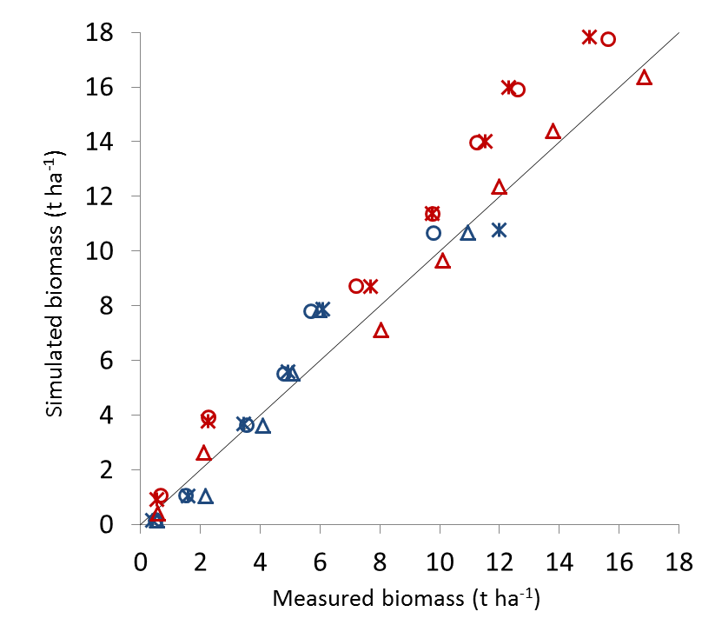
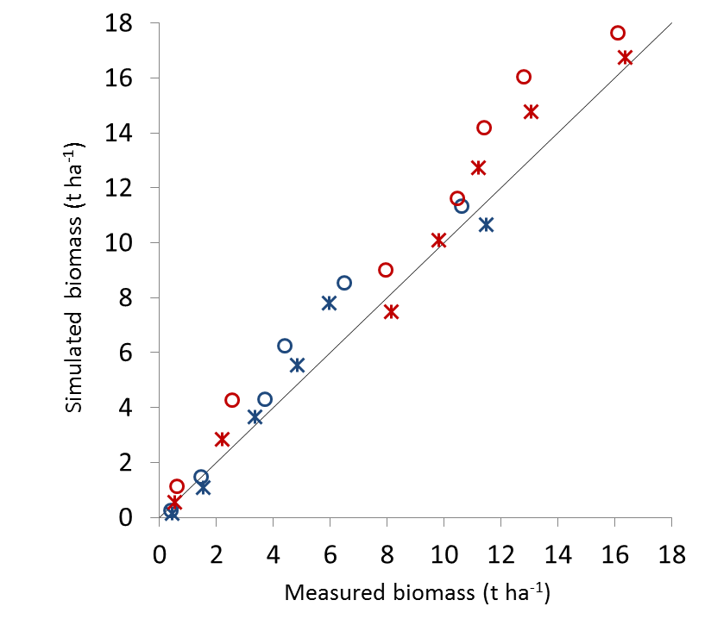
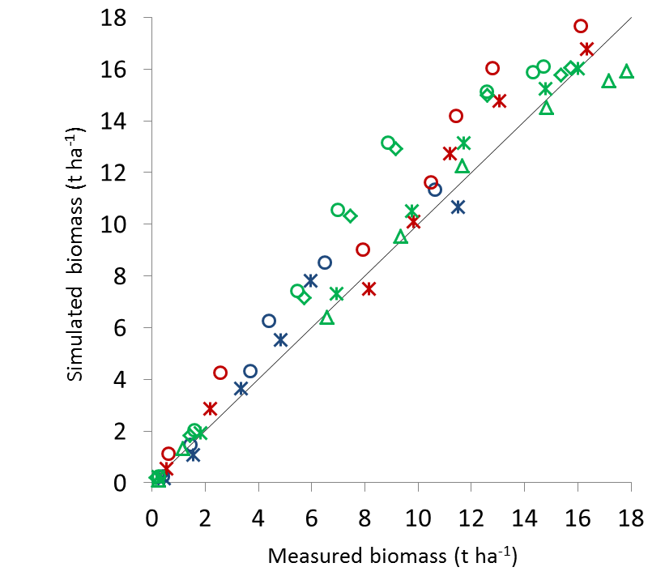
Task 3.2-deliverables
Partners involved: UMIL, JRC (JAAS)
E-AGRI - Final meeting, 20-21 January 2014, Alterra, Wageningen-UR, the Netherlands
RRMSE = 19.7%
RRMSE = 21.6%
Calibration
Validation
RRMSE = 19.5%

Slide 18
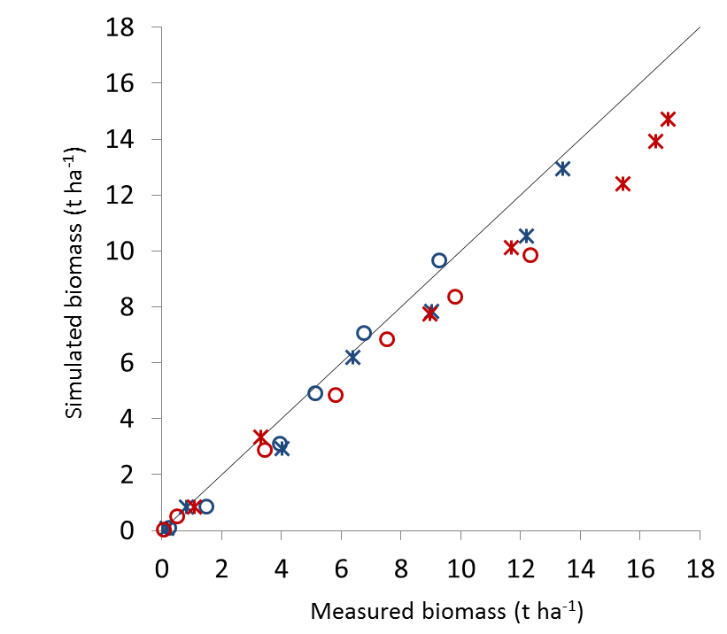
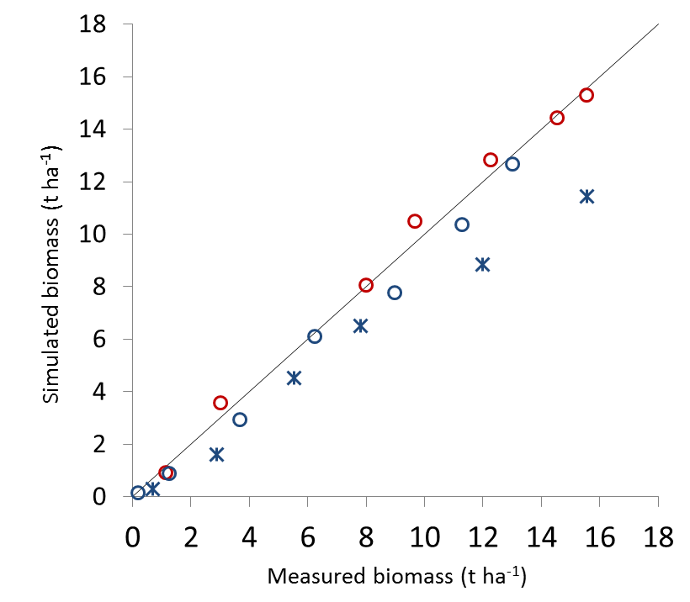
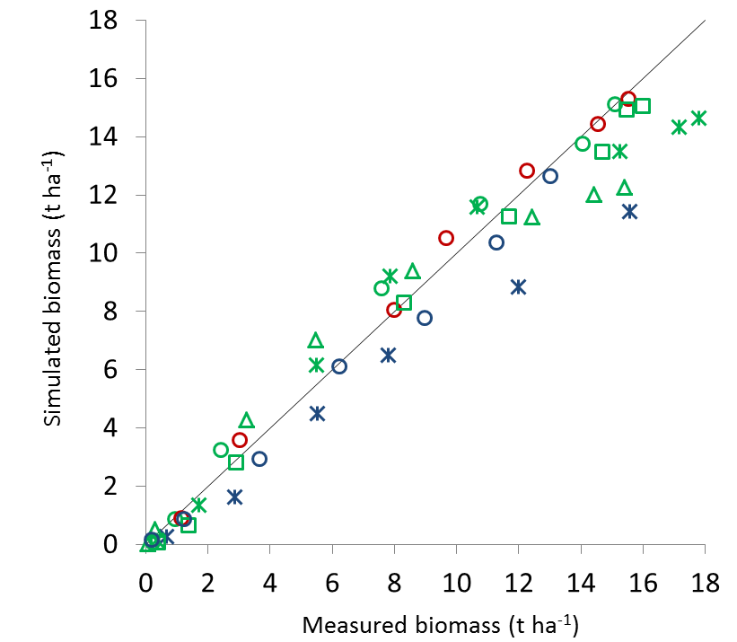
Task 3.2-deliverables
Partners involved: UMIL, JRC (JAAS)
E-AGRI - Final meeting, 20-21 January 2014, Alterra, Wageningen-UR, the Netherlands
RRMSE = 17.5%
RRMSE = 18.0%
Calibration
Validation
RRMSE = 16.3%

Slide 19
Task 3.4-deliverables
Partners involved: UMIL, JRC (INRA)
Calibration and evaluation of WOFOST and CropSyst at field level:
Soft wheat (high/low potential) and durum wheat
Potential and water limiting conditions
E-AGRI - Final meeting, 20-21 January 2014, Alterra, Wageningen-UR, the Netherlands

Slide 20
Task 3.4-deliverables
Partners involved: UMIL, JRC (INRA)
E-AGRI - Final meeting, 20-21 January 2014, Alterra, Wageningen-UR, the Netherlands
Potential conditions

Slide 21
Task 3.4-deliverables
Partners involved: UMIL, JRC (INRA)
E-AGRI - Final meeting, 20-21 January 2014, Alterra, Wageningen-UR, the Netherlands
WL conditions

Slide 22
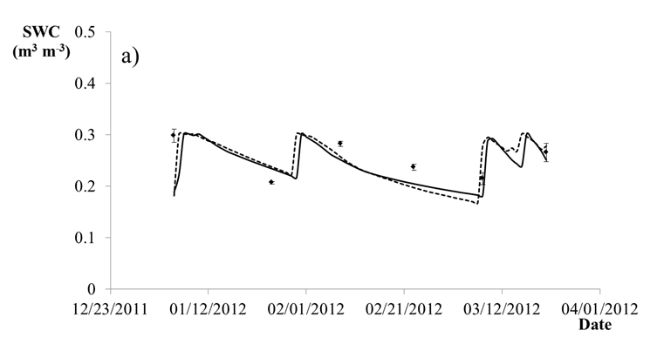
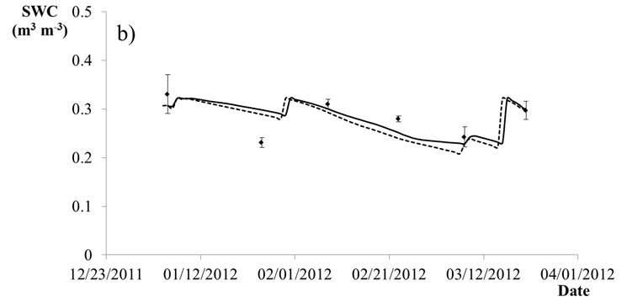
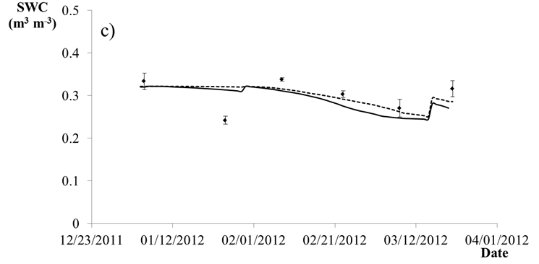
Task 3.4-deliverables
Partners involved: UMIL, JRC (INRA)
E-AGRI - Final meeting, 20-21 January 2014, Alterra, Wageningen-UR, the Netherlands
0-20 cm
20-40 cm
40-60 cm
Soil water content

Slide 23
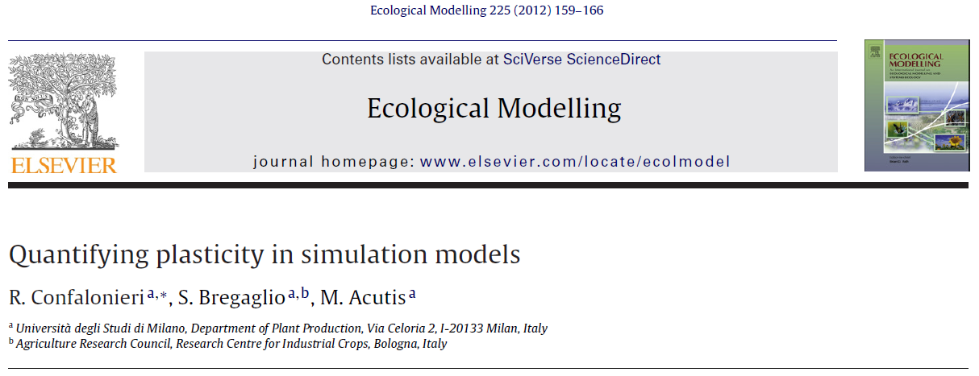
Task 3.2/4-ISI papers
Partners involved: UMIL
E-AGRI - Final meeting, 20-21 January 2014, Alterra, Wageningen-UR, the Netherlands

Slide 24
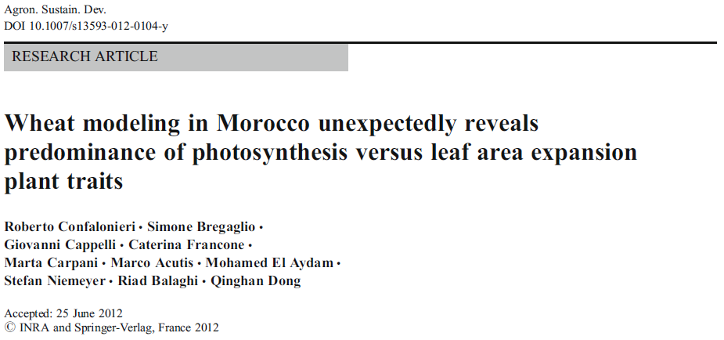
Task 3.2/4-ISI papers
Partners involved: UMIL, JRC, INRA
E-AGRI - Final meeting, 20-21 January 2014, Alterra, Wageningen-UR, the Netherlands

Slide 25
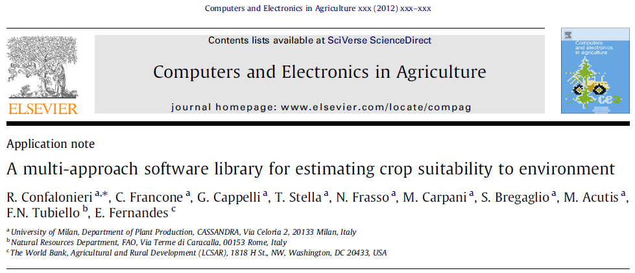
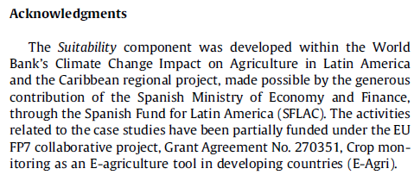
Task 3.2/4-ISI papers
Partners involved: UMIL
E-AGRI - Final meeting, 20-21 January 2014, Alterra, Wageningen-UR, the Netherlands

Slide 26
Task 3.2/4-ISI papers
Partners involved: UMIL, INRA, JAAS
Stella, T., Frasso, N., Negrini, G., Bregaglio, S., Cappelli, G., Acutis, M., Confalonieri, R., 2014. A new generation of SUCROS-type models. Environmental Modelling & Software, RE-submitted after revision.
Bregaglio, S., Frasso, N., Pagani, V., Stella, T., Francone, C., Cappelli, G., Acutis, M., Balaghi, R., Ouabbou, H., Confalonieri, R., 2014. Setting up a multi-model crop yield forecasting system in Morocco: field-level calibration and large-area simulation of wheat growth under severe water-limiting conditions. Agronomy for Sustainable Development, major revision received, to be RE-submitted before 15 February.
Pagani, V., Bregaglio, S., Francone, C., Zhiming, W., Confalonieri, R., 2014. Evaluation of WARM for rice growth and development under different sowing conditions in Jiangsu (China). European Journal of Agronomy, to be submitted before the end of January.
E-AGRI - Final meeting, 20-21 January 2014, Alterra, Wageningen-UR, the Netherlands

Slide 27
Task 3.3/5-description
Partners involved: UMIL, JRC, INRA, JAAS
E-AGRI - Final meeting, 20-21 January 2014, Alterra, Wageningen-UR, the Netherlands
D33.1 – D35.1 – D33.4 – D35.4
D33.2 – D35.2
D33.3 – D35.3
MS3
Rice, China
Wheat, Morocco
Task 3.1
BioMA adaptation
Task 3.2
Task 3.4
BioMA piloting
Task 3.3
Task 3.5

Slide 28
Task 3.3/5-deliverables
Partners involved: UMIL, JRC, INRA, JAAS
E-AGRI - Final meeting, 20-21 January 2014, Alterra, Wageningen-UR, the Netherlands
Deliverable | (Short) Title | Nature | Delivery date | Status
D33.1 | BioMA platform assessment (rice) | R | 33 | Delivered
D33.2 | Multi-model monitoring (rice) | R | 36 | Delivered
D33.3 | RS integration (rice) | R | 36 | Delivered
D33.4 | BioMA guide (rice) | O | 36 | Delivered
D35.1 | BioMA platform assessment (wheat) | R | 36 | Delivered
D35.2 | Multi-model monitoring (wheat) | R | 36 | Delivered
D35.3 | RS integration (wheat) | R | 36 | Delivered
D35.4 | BioMA guide (wheat) | O | 36 | Delivered

Slide 29
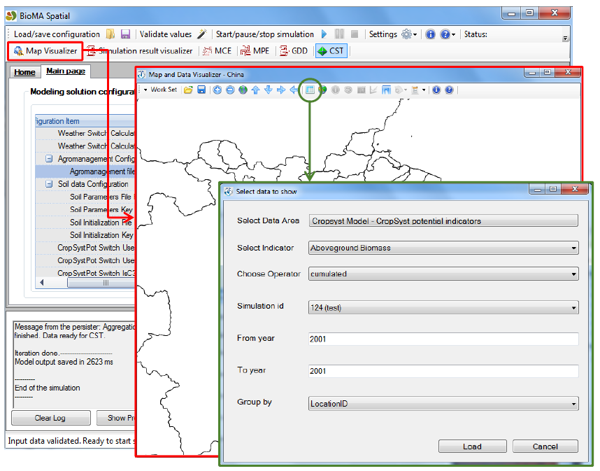
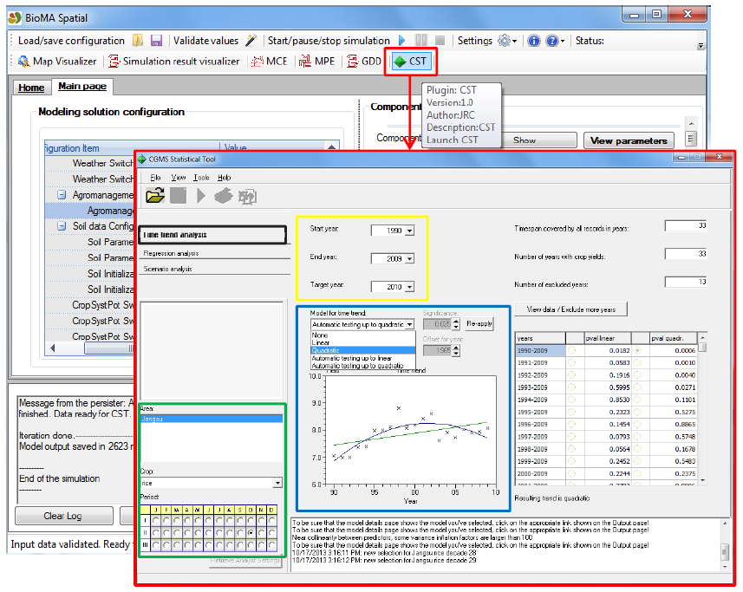
Task 3.3/5-deliverables
Partners involved: UMIL, JRC, INRA, JAAS
Production levels considered:
potential
water limited
disease limited
abiotic factor-limited
E-AGRI - Final meeting, 20-21 January 2014, Alterra, Wageningen-UR, the Netherlands
D33.1 BioMA for rice (Jiangsu)
D35.1 BioMA for wheat (Morocco)

Slide 30
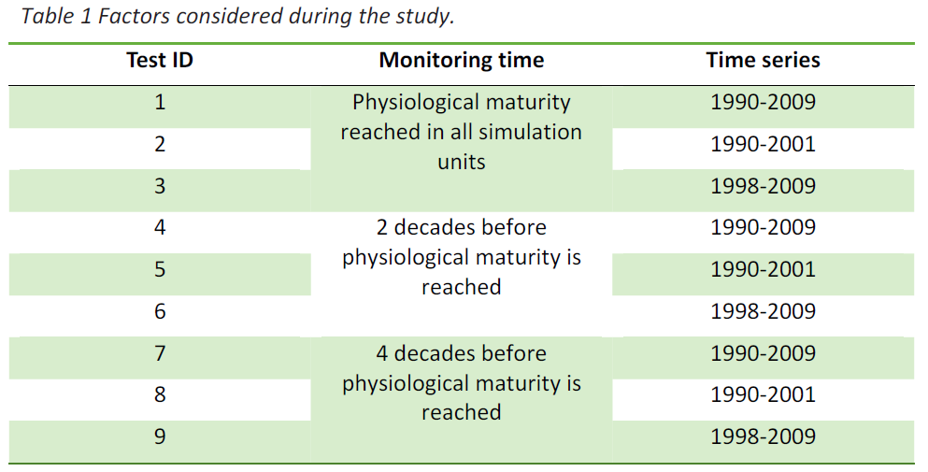
Task 3.3-deliverables
Partners involved: UMIL, JRC, JAAS
E-AGRI - Final meeting, 20-21 January 2014, Alterra, Wageningen-UR, the Netherlands
D33.2 Multi-model - rice

Slide 31
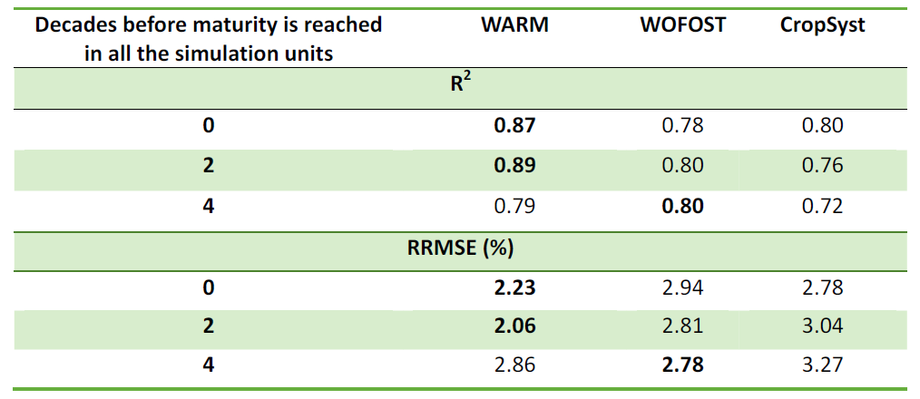
Task 3.3-deliverables
Partners involved: UMIL, JRC, JAAS
E-AGRI - Final meeting, 20-21 January 2014, Alterra, Wageningen-UR, the Netherlands
D33.2 Results
Whole series

Slide 32
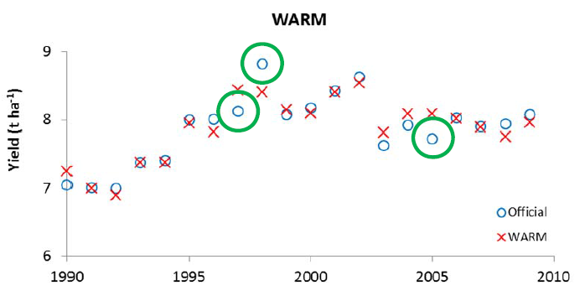
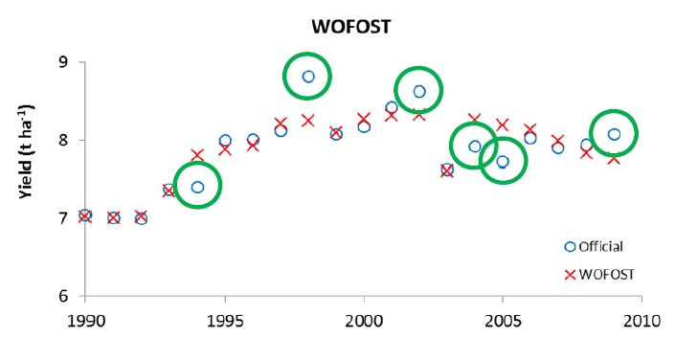
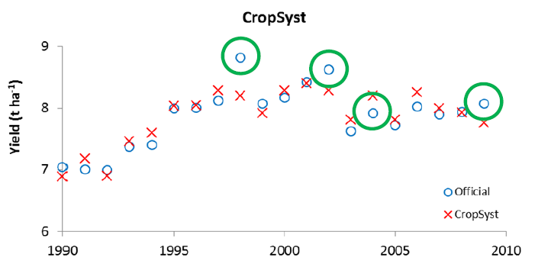
Task 3.3-deliverables
Partners involved: UMIL, JRC, JAAS
E-AGRI - Final meeting, 20-21 January 2014, Alterra, Wageningen-UR, the Netherlands
Whole series
Maturity decade

Slide 33
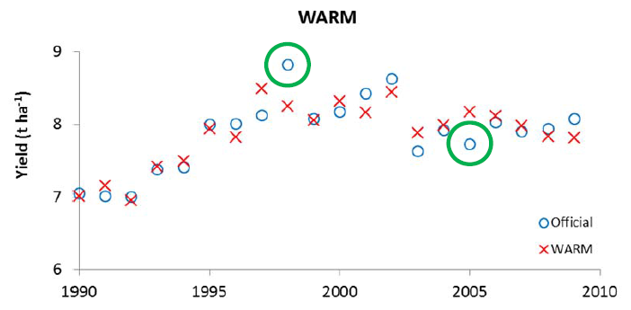
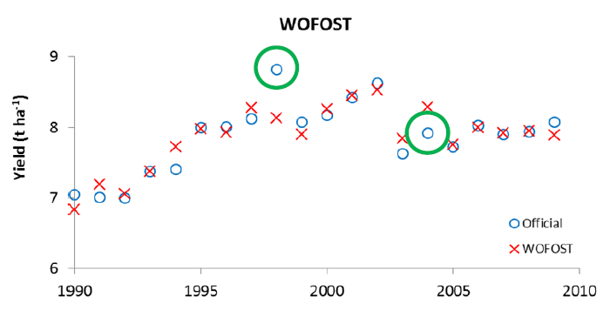
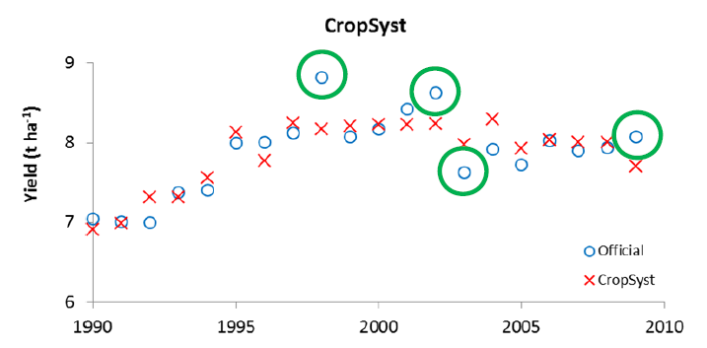
Task 3.3-deliverables
Partners involved: UMIL, JRC, JAAS
E-AGRI - Final meeting, 20-21 January 2014, Alterra, Wageningen-UR, the Netherlands
Whole series
4 decades before maturity

Slide 34
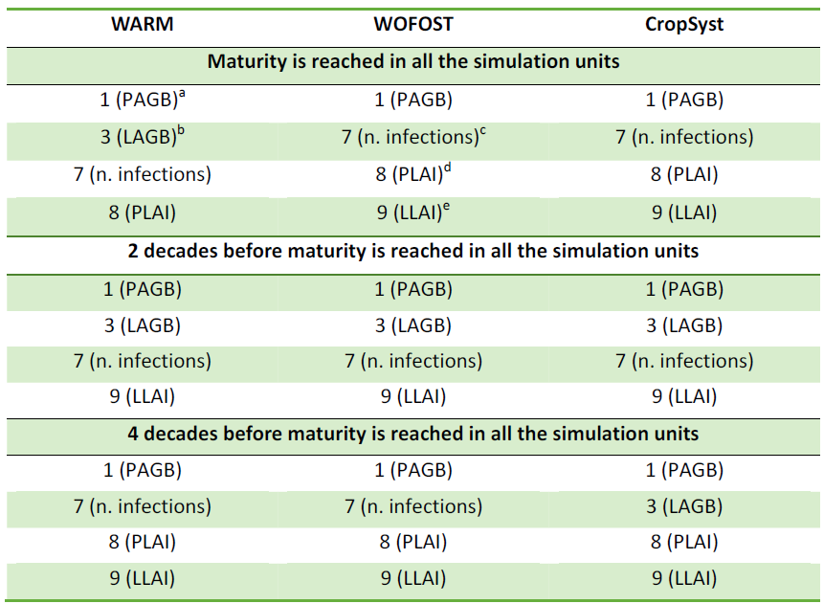
Task 3.3-deliverables
Partners involved: UMIL, JRC, JAAS
E-AGRI - Final meeting, 20-21 January 2014, Alterra, Wageningen-UR, the Netherlands

Slide 35
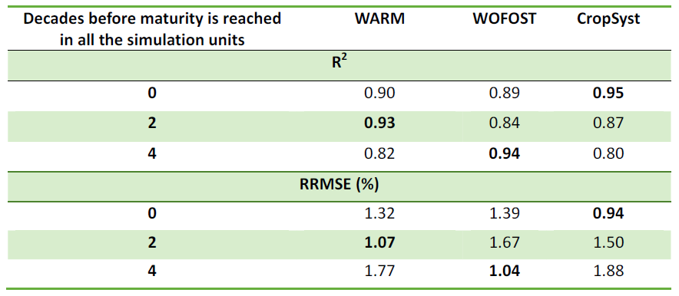
Task 3.3-deliverables
Partners involved: UMIL, JRC, JAAS
Varieties (and agro-management practices) more similar to the current ones?
E-AGRI - Final meeting, 20-21 January 2014, Alterra, Wageningen-UR, the Netherlands
D33.2 Results
Second part of the series

Slide 36
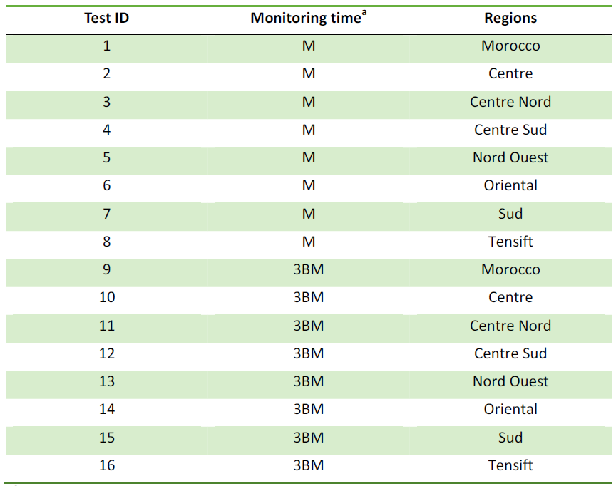
Task 3.5-deliverables
Partners involved: UMIL, JRC, INRA
E-AGRI - Final meeting, 20-21 January 2014, Alterra, Wageningen-UR, the Netherlands
D35.2 Multi-model
Durum wheat
Soft wheat

Slide 37
Task 3.5-deliverables
Partners involved: UMIL, JRC, INRA
E-AGRI - Final meeting, 20-21 January 2014, Alterra, Wageningen-UR, the Netherlands
Maturity decade
Durum wheat

Slide 38
Task 3.5-deliverables
Partners involved: UMIL, JRC, INRA
E-AGRI - Final meeting, 20-21 January 2014, Alterra, Wageningen-UR, the Netherlands
Maturity decade
Durum wheat
Morocco

Slide 39
Task 3.5-deliverables
Partners involved: UMIL, JRC, INRA
E-AGRI - Final meeting, 20-21 January 2014, Alterra, Wageningen-UR, the Netherlands
Maturity decade
Durum wheat
Nord Ouest region

Slide 40
Task 3.5-deliverables
Partners involved: UMIL, JRC, INRA
E-AGRI - Final meeting, 20-21 January 2014, Alterra, Wageningen-UR, the Netherlands
Maturity decade
Durum wheat
Centre Nord region

Slide 41
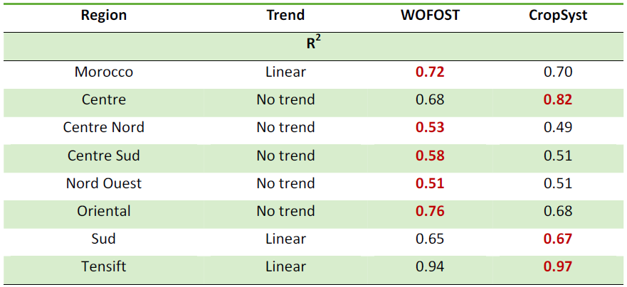
Task 3.5-deliverables
Partners involved: UMIL, JRC, INRA
E-AGRI - Final meeting, 20-21 January 2014, Alterra, Wageningen-UR, the Netherlands
3 decades before maturity
Durum wheat

Slide 42
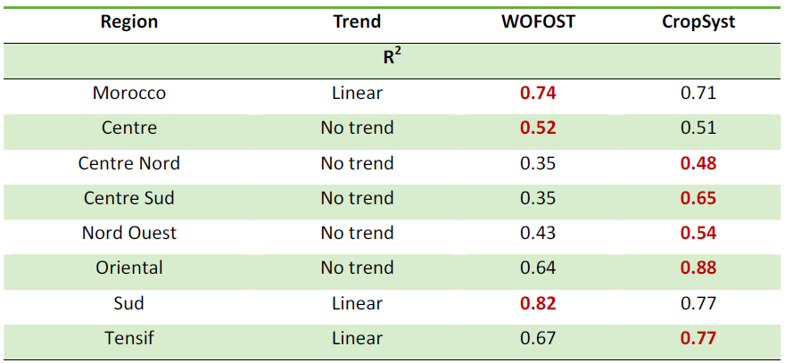
Task 3.5-deliverables
Partners involved: UMIL, JRC, INRA
E-AGRI - Final meeting, 20-21 January 2014, Alterra, Wageningen-UR, the Netherlands
Maturity decade
Soft wheat

Slide 43
Task 3.5-deliverables
Partners involved: UMIL, JRC, INRA
E-AGRI - Final meeting, 20-21 January 2014, Alterra, Wageningen-UR, the Netherlands
Maturity decade
Soft wheat
Morocco

Slide 44
Task 3.5-deliverables
Partners involved: UMIL, JRC, INRA
E-AGRI - Final meeting, 20-21 January 2014, Alterra, Wageningen-UR, the Netherlands
Maturity decade
Soft wheat
Sud region

Slide 45
Task 3.5-deliverables
Partners involved: UMIL, JRC, INRA
E-AGRI - Final meeting, 20-21 January 2014, Alterra, Wageningen-UR, the Netherlands
Maturity decade
Soft wheat
Nord Ouest

Slide 46
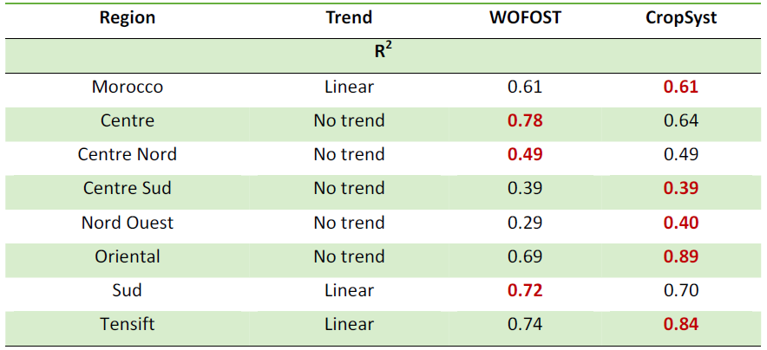
Task 3.5-deliverables
Partners involved: UMIL, JRC, INRA
E-AGRI - Final meeting, 20-21 January 2014, Alterra, Wageningen-UR, the Netherlands
3 decades before maturity
Soft wheat

Slide 47
Task 3.3/5-deliverables
Partners involved: UMIL, JRC, INRA, JAAS
Conclusions on the multi-model approach
Different models led to the best performances
Regardless from the accuracy (similar) at field level
Under different conditions
For different species (soft wheat, durum wheat, rice)
For forecasting events triggered in different moments during the crop cycle
The multi-model approach demonstrated better forecasting capability compared to those shown by single models for all combinations forecasting moment × conditions explored
This conclusions partly disagree with one of the main AgMIP outcomes
E-AGRI - Final meeting, 20-21 January 2014, Alterra, Wageningen-UR, the Netherlands

Slide 48
Task 3.3/5-deliverables
Partners involved: UMIL, JRC, INRA, JAAS
Three main strategies for integrating RS data into crop models (Dorigo et al., 2007):
Recalibration
Dangerous (i) when exogenous data are uncertain and (ii) after calibrations performed using many field observations
Risk of loosing coherence
Forcing (continuous, often input or intermediate variables)
Updating (periodic, state variables, does not consider soil states)
+ Reducing uncertainty in management data [only for rice; not in the DOW]
E-AGRI - Final meeting, 20-21 January 2014, Alterra, Wageningen-UR, the Netherlands
D33.3 RS integration, rice (Jiangsu)
D35.3 RS integration, wheat (Morocco)

Slide 49
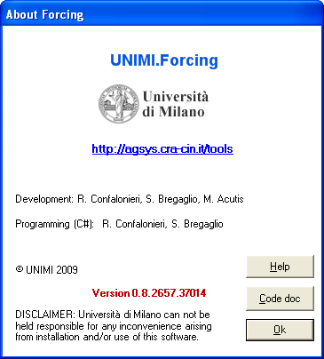
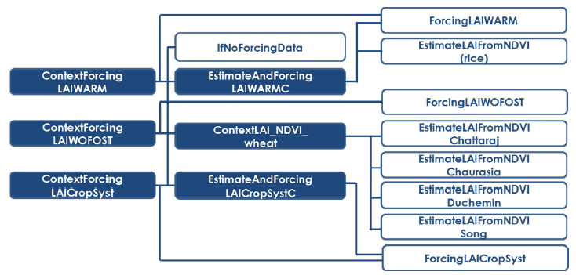
Task 3.3/5-deliverables
Partners involved: UMIL, JRC, INRA, JAAS
CropSyst does not implement a dynamic partitioning of assimilates
Although we developed an approach to force it with exogenous LAI data, we preferred to avoid using CropSyst within D33.3 and D35.3 activities
E-AGRI - Final meeting, 20-21 January 2014, Alterra, Wageningen-UR, the Netherlands

Slide 50
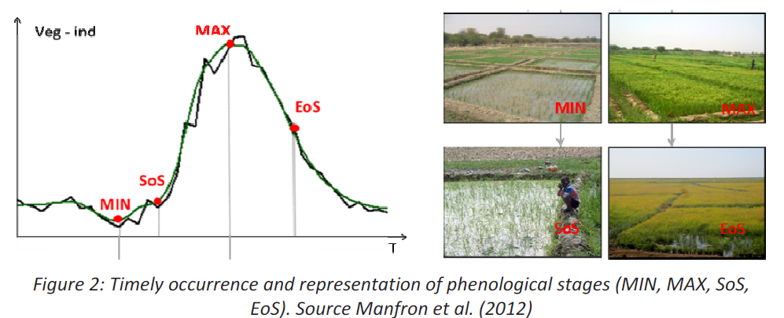
Task 3.3-deliverables
Partners involved: UMIL, JRC, JAAS
E-AGRI - Final meeting, 20-21 January 2014, Alterra, Wageningen-UR, the Netherlands
D33.3 RS integration, rice (Jiangsu)

Slide 51
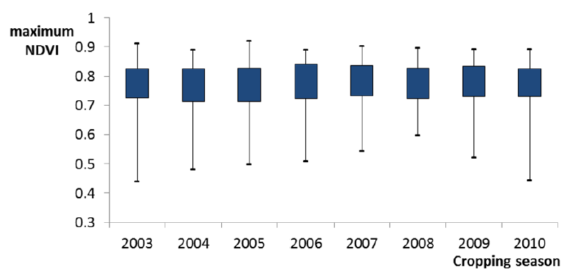
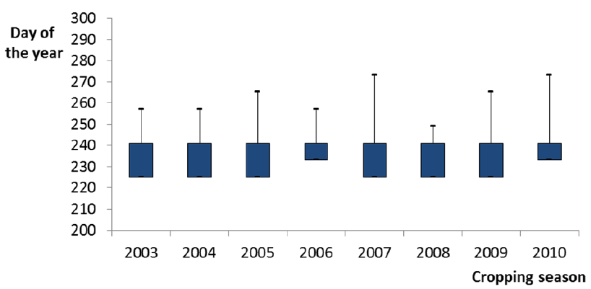
Task 3.3-deliverables
Partners involved: UMIL, JRC, JAAS
E-AGRI - Final meeting, 20-21 January 2014, Alterra, Wageningen-UR, the Netherlands
NDVI_{max} ~ 1 week before flowering

Slide 52
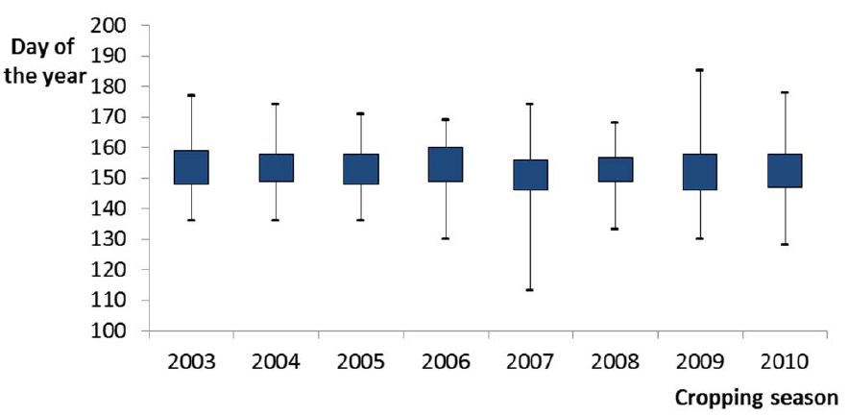
Task 3.3-deliverables
Partners involved: UMIL, JRC, JAAS
E-AGRI - Final meeting, 20-21 January 2014, Alterra, Wageningen-UR, the Netherlands
Sowing date

Slide 53
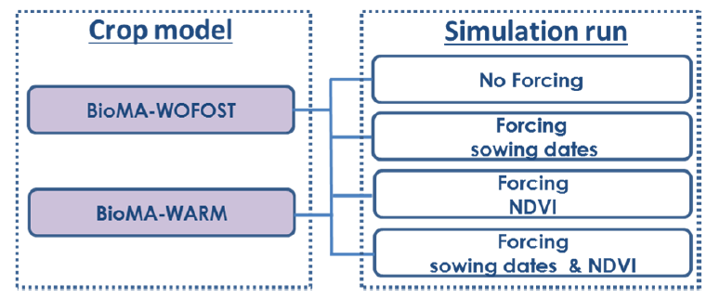
Task 3.3-deliverables
Partners involved: UMIL, JRC, JAAS
Forecasting events triggered in 5 different moments during the crop cycle (each 20 days from DOY 240 [flowering] to DOY 320 [after maturity])
E-AGRI - Final meeting, 20-21 January 2014, Alterra, Wageningen-UR, the Netherlands
Simulation experiment design

Slide 54
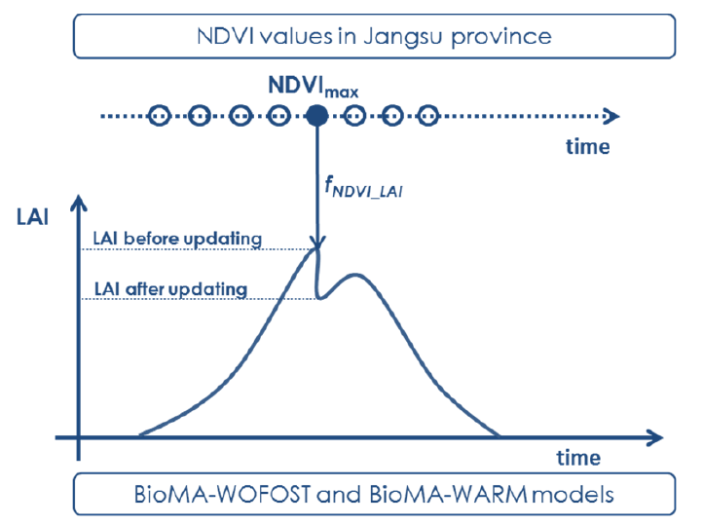
Task 3.3-deliverables
Partners involved: UMIL, JRC, JAAS
E-AGRI - Final meeting, 20-21 January 2014, Alterra, Wageningen-UR, the Netherlands
Wang et al. (2007)
Similar conditions to those explored by rice in Jiangsu

Slide 55
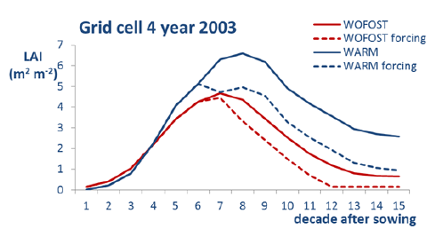
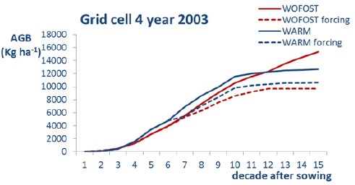
Task 3.3-deliverables
Partners involved: UMIL, JRC, JAAS
E-AGRI - Final meeting, 20-21 January 2014, Alterra, Wageningen-UR, the Netherlands
Forcing LAI

Slide 56
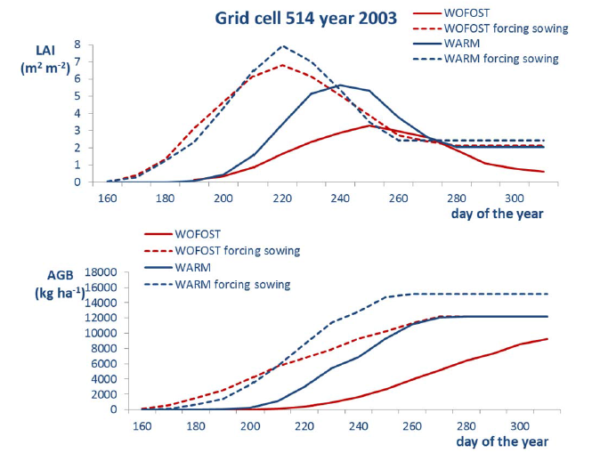
Task 3.3-deliverables
Partners involved: UMIL, JRC, JAAS
E-AGRI - Final meeting, 20-21 January 2014, Alterra, Wageningen-UR, the Netherlands
Forcing sowing date

Slide 57
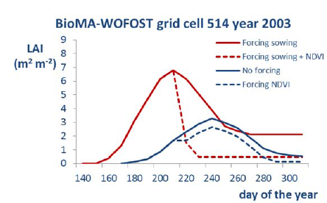
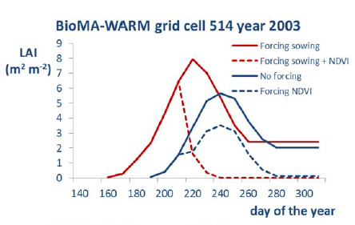
Task 3.3-deliverables
Partners involved: UMIL, JRC, JAAS
E-AGRI - Final meeting, 20-21 January 2014, Alterra, Wageningen-UR, the Netherlands
Forcing LAI & sowing date
LAI_{max} (heading)
calendar sowing
RS sowing
detected with RS

Slide 58
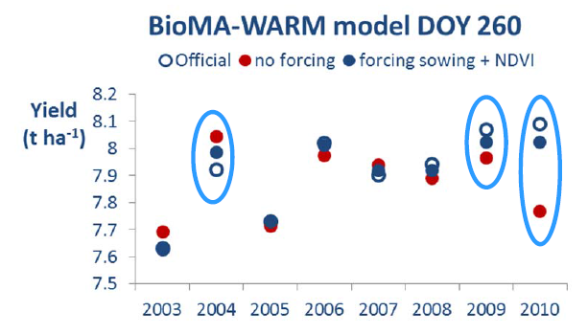
Task 3.3-deliverables
Partners involved: UMIL, JRC, JAAS
E-AGRI - Final meeting, 20-21 January 2014, Alterra, Wageningen-UR, the Netherlands
D33.3 - Results

Slide 59
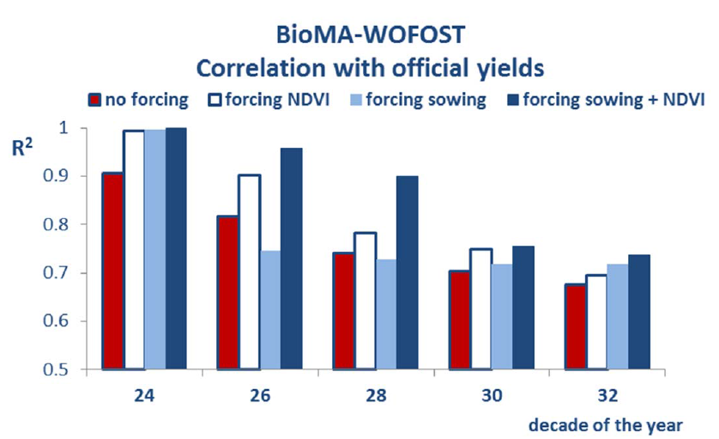
Task 3.3-deliverables
Partners involved: UMIL, JRC, JAAS
E-AGRI - Final meeting, 20-21 January 2014, Alterra, Wageningen-UR, the Netherlands
D33.3 - Results
Senescence is likely the problem
Maturity

Slide 60
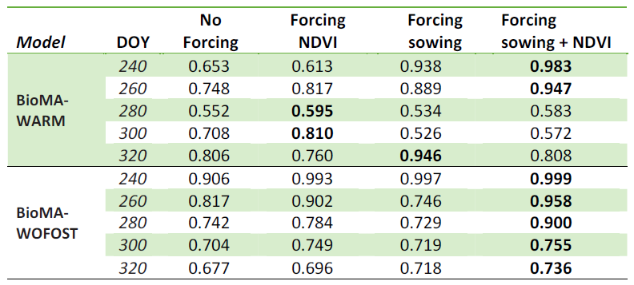
Task 3.3-deliverables
Partners involved: UMIL, JRC, JAAS
E-AGRI - Final meeting, 20-21 January 2014, Alterra, Wageningen-UR, the Netherlands
D33.3 - Results

Slide 61
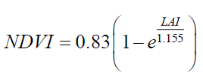
Task 3.5-deliverables
Partners involved: UMIL, JRC, INRA
Four empirical relationships were tested to derive LAI from NDVI
E-AGRI - Final meeting, 20-21 January 2014, Alterra, Wageningen-UR, the Netherlands
D35.3 RS integration, wheat (Morocco)
Duchemin et al. (2006) [Morocco]
Song et al. (2008) [China]
Chaurasia Sasmita et al. (2011) [India]
Chattaraj et al. (2013) [many sites in the Indo-Gangetic plain]

Slide 62
Task 3.5-deliverables
Partners involved: UMIL, JRC, INRA
E-AGRI - Final meeting, 20-21 January 2014, Alterra, Wageningen-UR, the Netherlands

Slide 63
Task 3.5-deliverables
Partners involved: UMIL, JRC, INRA
E-AGRI - Final meeting, 20-21 January 2014, Alterra, Wageningen-UR, the Netherlands

Slide 64
Task 3.5-deliverables
Partners involved: UMIL, JRC, INRA
E-AGRI - Final meeting, 20-21 January 2014, Alterra, Wageningen-UR, the Netherlands
Simulation experiment design
Forecasting events triggered in 4 different moments during the crop cycle (each 30 days from DOY 60 [flowering] to DOY 150 [after maturity])

Slide 65
Task 3.5-deliverables
Partners involved: UMIL, JRC, INRA
E-AGRI - Final meeting, 20-21 January 2014, Alterra, Wageningen-UR, the Netherlands

Slide 66
Task 3.5-deliverables
Partners involved: UMIL, JRC, INRA
E-AGRI - Final meeting, 20-21 January 2014, Alterra, Wageningen-UR, the Netherlands

Slide 67
Task 3.5-deliverables
Partners involved: UMIL, JRC, INRA
E-AGRI - Final meeting, 20-21 January 2014, Alterra, Wageningen-UR, the Netherlands

Slide 68
Task 3.5-deliverables
Partners involved: UMIL, JRC, INRA
E-AGRI - Final meeting, 20-21 January 2014, Alterra, Wageningen-UR, the Netherlands

Slide 69
Task 3.3/5-deliverables
Partners involved: UMIL, JRC, INRA, JAAS
Conclusions on the integration of RS
Better results achieved when both sowing dates and LAI are forced (rice)
Transfer to operational chains
Feasible for rice in Jiangsu
Results encouraging for wheat in Morocco, although further studies are needed
Large variability across regions
Sometimes RS integration had a negative impact
…soil states are not updated… (water…)
E-AGRI - Final meeting, 20-21 January 2014, Alterra, Wageningen-UR, the Netherlands

Slide 70
Task 3.3/5-deliverables
Partners involved: JRC, UMIL
E-AGRI - Final meeting, 20-21 January 2014, Alterra, Wageningen-UR, the Netherlands

Slide 71
Task 3.3/5-ISI papers
Partners involved: UMIL, JRC, INRA, JAAS
Pagani, V., Francone, C., Balaghi, R., El Hairech, T., Ismaili, S., Ramos, F., Fumagalli, Confalonieri, R., 2014. Multi-model wheat monitoring and yield forecasting in Morocco. Agronomy for Sustainable Development, in preparation.
Bregaglio, S., Pagani, V., Francone, C., Zhiming, W., Confalonieri, R., 2014. Combining remote sensing and multi-model simulations for rice monitoring and forecasting in Jiangsu (China). European Journal of Agronomy, in preparation.
E-AGRI - Final meeting, 20-21 January 2014, Alterra, Wageningen-UR, the Netherlands

Slide 72
Many thanks for your attention
The E-AGRI WP3 team

