Slide 1
Yield forecasting with remote sensing
using CGMS-MAROC
Balaghi R., Eerens H., Dong Q.

Slide 2
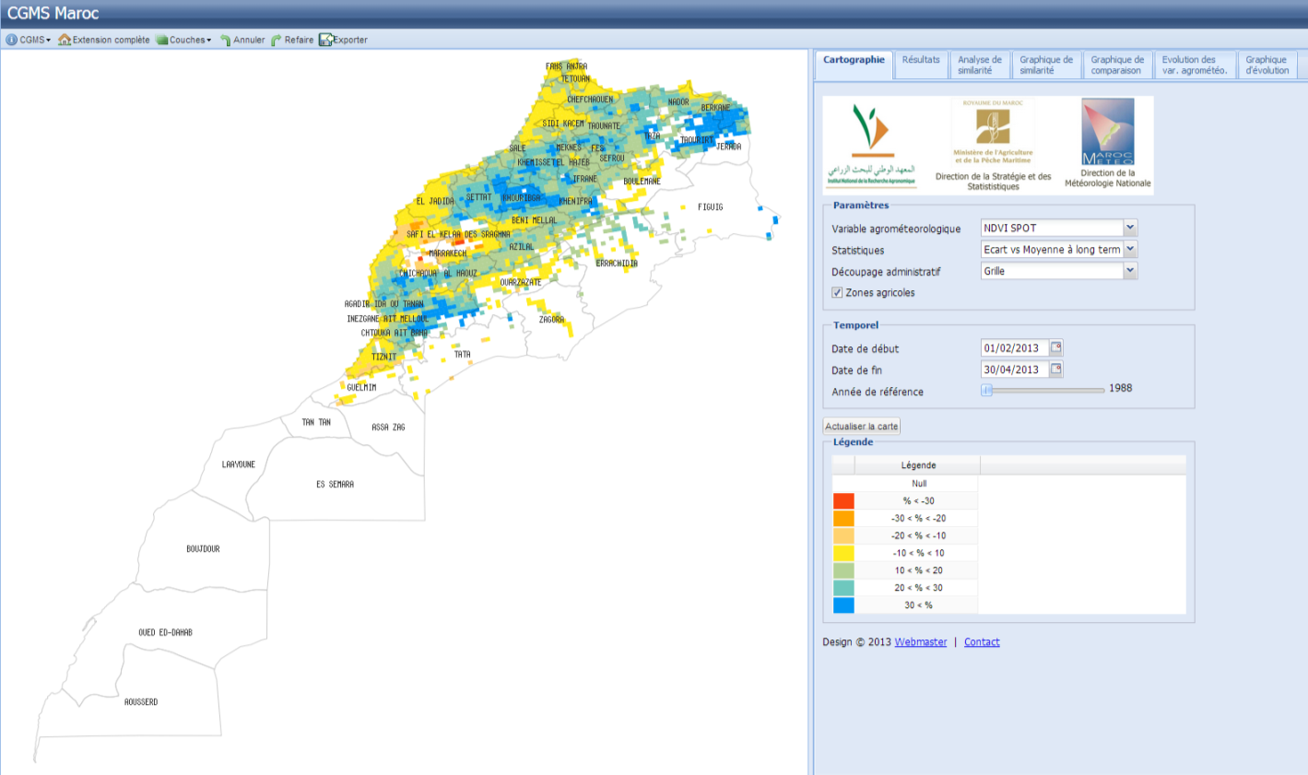
Normalized Difference vegetation Index (NDVI) during the 2012-2013 cropping season, from February 1st 2013 to the second dekad of April 30th 2013, as compared (%) to long term average (only agricultural areas are displayed).

Slide 3
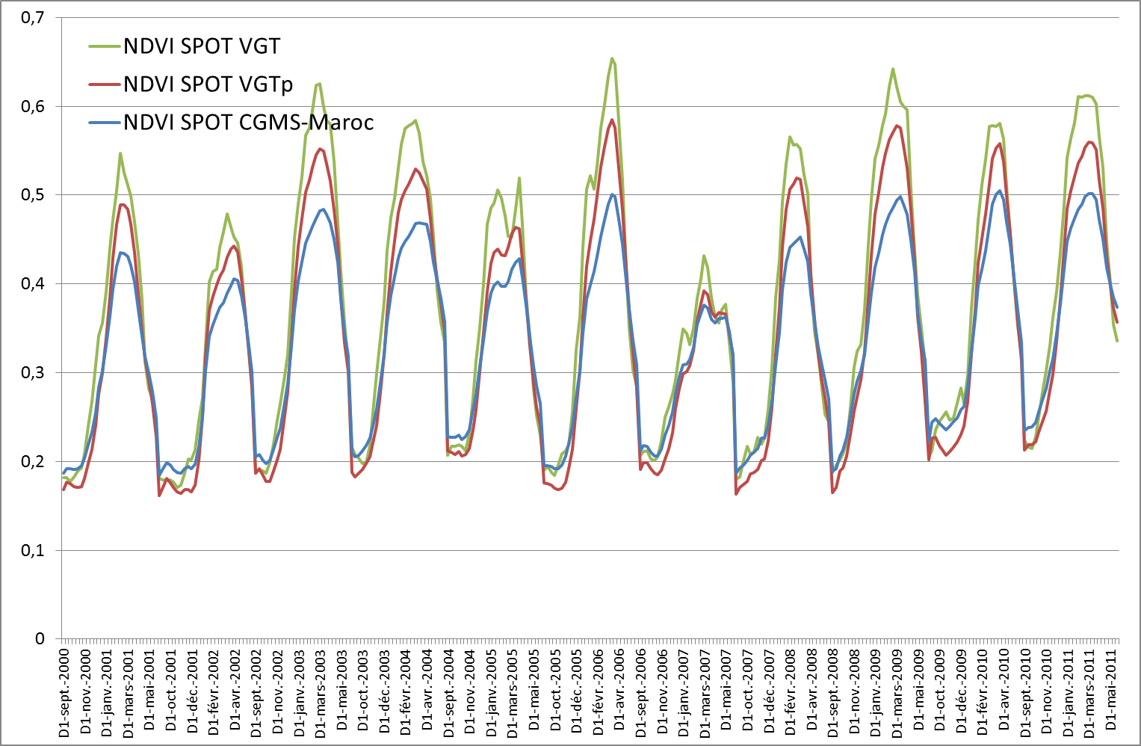
Comparison between NDVI extracted from CGMS-MAROC and sent by VITO as RUM files.

Slide 4
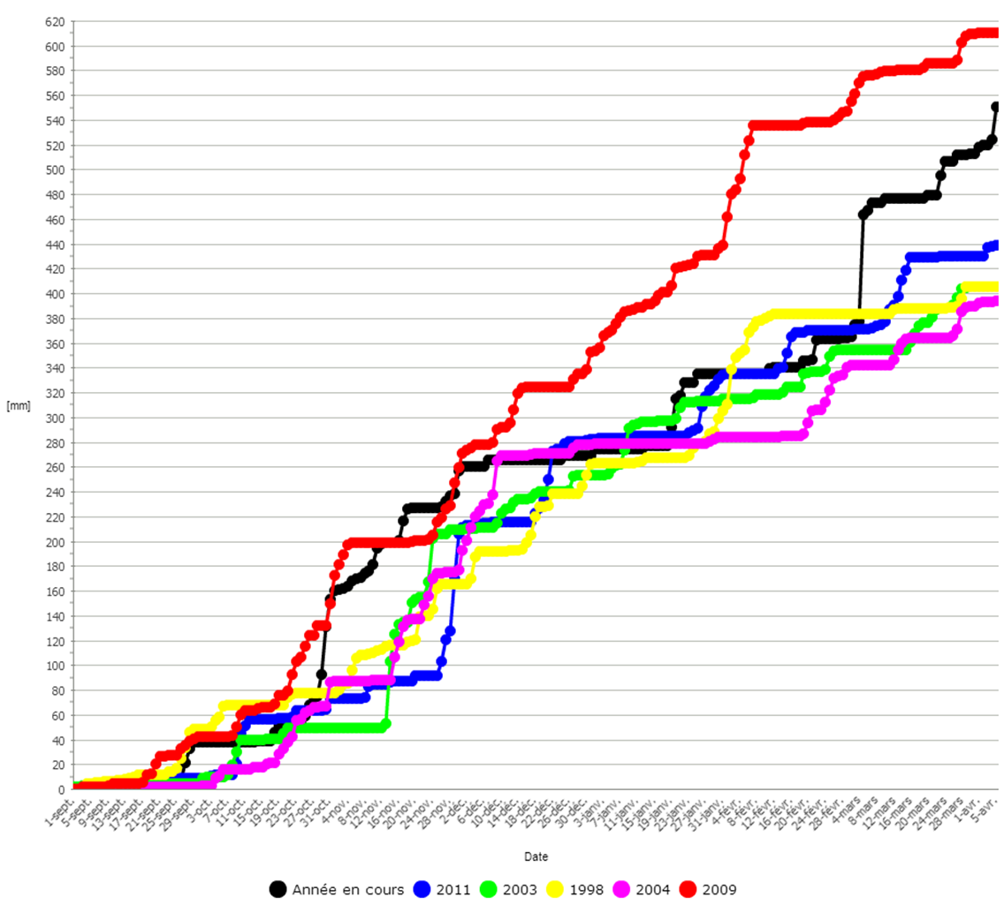
Production in 2011 = 83.6 million Quintal
Similarity analysis of the 2012-2013 cropping season, in terms of the distribution of daily rainfall (from CGMS-MAROC), from early October 2012 to the 5th of April 2013, at the national level over the agricultural areas

Slide 5
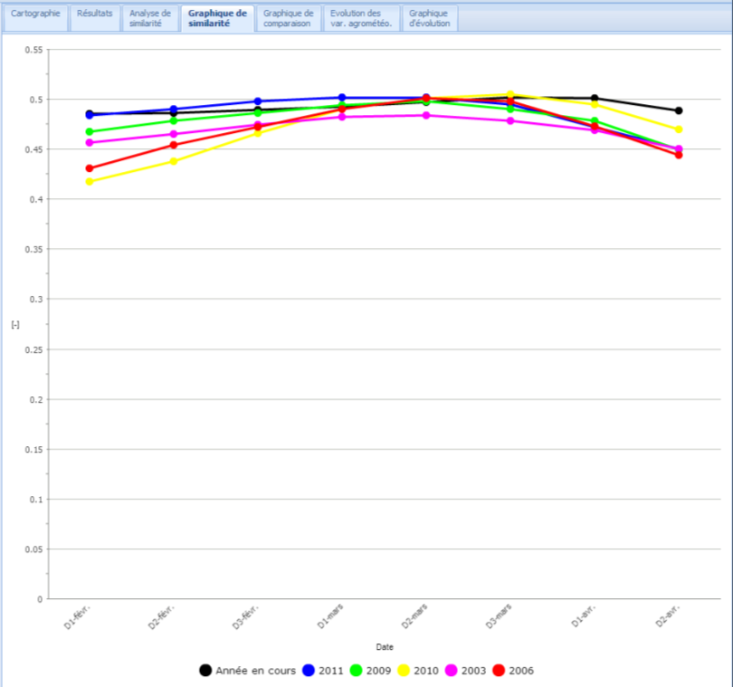
Production in 2011 = 83.6 million Quintal
Similarity analysis of the 2012-2013 cropping season, in terms of the distribution of dekadal NDVI (SPOT-VEGETATION), from early February to the second dekad of April 2013, at the national level over the agricultural areas

Slide 6
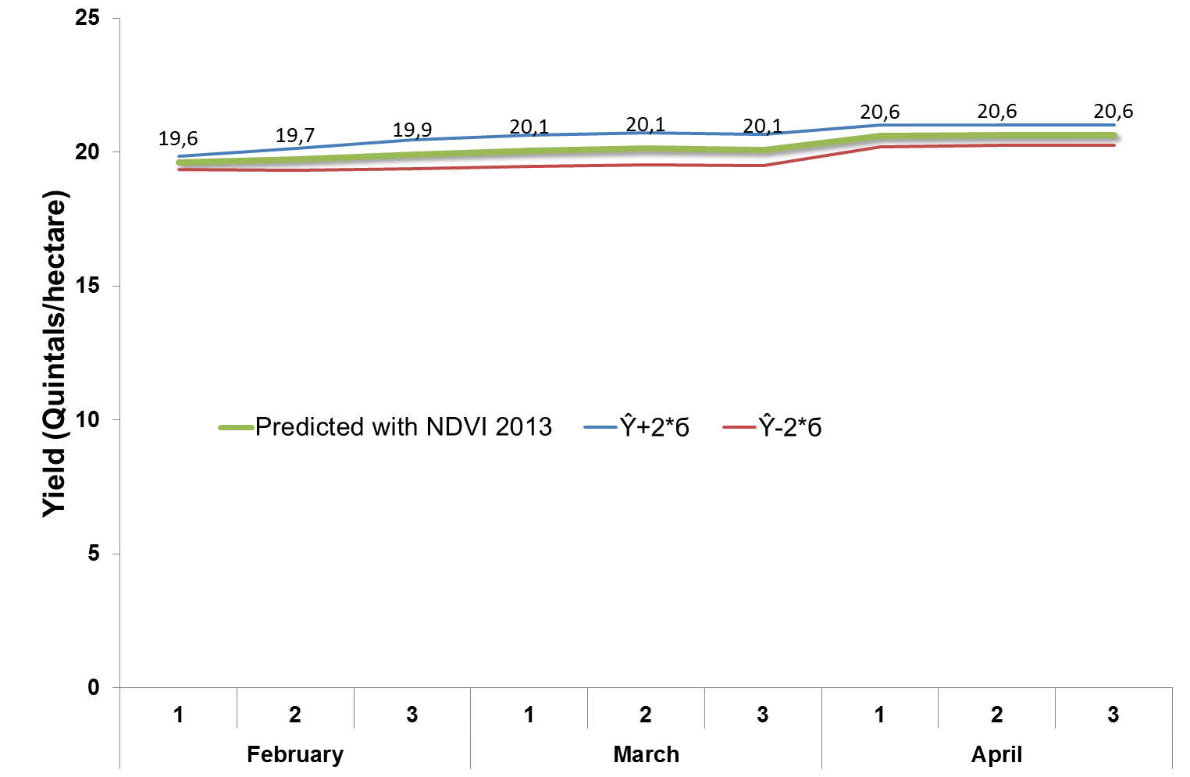
Soft wheat forecast based on similarity analysis for the season of 2012-2013, in terms of the distribution of dekadal SPOT-NDVI (from CGMS-MAROC), from 1st dekad of February to the 3rd dekad of April 2013, at the national level over the agricultural areas

Slide 7
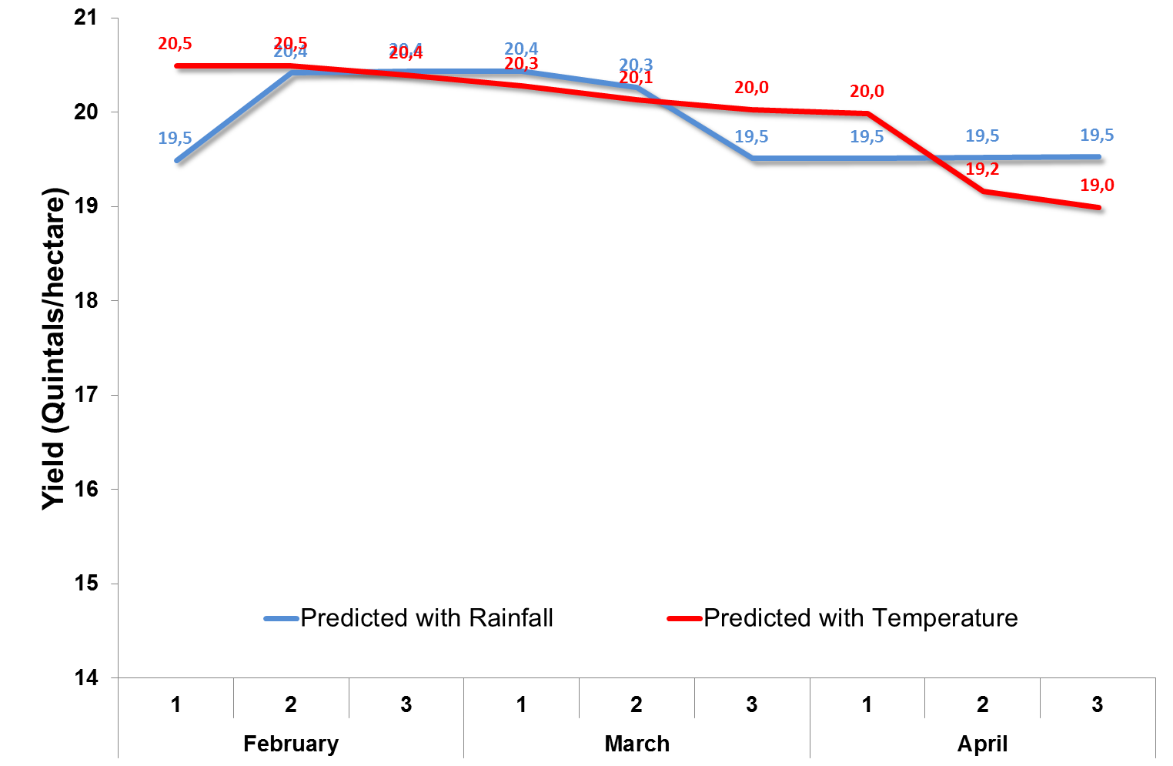
Soft wheat forecast based on similarity analysis for the season of 2012-2013, in terms of the distribution of rainfall (from CGMS-MAROC), from 1st dekad of October 2012 to the 3rd dekad of April 2013, at the national level over the agricultural areas

Slide 8
Cereals forecasts for the season of 2012-2013 in Morocco
 | Grain yield (Q/ha) | Area (million ha) | Production (million Q)
Soft wheat | 19,3 | 2,167 | 41,8
Durum wheat | 19,2 | 0,974 | 18,7
Barley | 14,0 | 1,988 | 27,8
Total |  | 5,129 | 88,3
* Production = 97 million Q (from preliminary official statistics in April)

Slide 9
 | Aagrometeorological index
 | NDVI | Rainfall | Rain/ETo | P-0.5*ETo | Nb Years
Durum wheat
Ouled Zidane | 0,46 | 0,84 | 0,77 | 0,81 | 9
Mzoura | 0,74 | 0,57 | 0,77 | 0,71 | 12
Ouled Sebbah | 0,66 | 0,65 | 0,66 | 0,67 | 8
Ras El Ain | 0,42 | 0,61 | 0,70 | 0,67 | 8
Sidi El Aidi | 0,45 | 0,27 | 0,35 | 0,33 | 7
Soft wheat
Ain Nzagh | 0,79 | 0,19 | 0,21 | 0,22 | 7
Deroua | 0,12 | 0,15 | 0,17 | 0,16 | 7
Gdana | 0,04 | 0,29 | 0,30 | 0,30 | 7
Mzoura | 0,67 | 0,47 | 0,61 | 0,58 | 7
Ouled Sebbah | 0,63 | 0,89 | 0,79 | 0,84 | 7
Sidi Boumahdi | 0,92 | 0,47 | 0,72 | 0,64 | 8
Barley
Ain Nzagh | 0,48 | 0,70 | 0,87 | 0,82 | 8
Dar Chafai | 0,74 | 0,23 | 0,47 | 0,38 | 8
Mgarto | 0,62 | 0,85 | 0,93 | 0,93 | 8
Ras El Ain | 0,47 | 0,64 | 0,83 | 0,78 | 8
Sidi Boumahdi | 0,60 | 0,57 | 0,80 | 0,73 | 9
Correlation (R2) between cereal yields (soft wheat, durum wheat and barley) and agrometeorological indices derived from CGMS-MAROC

Slide 10
شكرا
謝謝您
Thank you

