Slide 1
Crop Classification with Remote Sensing in Kenya
-- Based on EOS/MODIS and LANDSAT-8/OLI Images
Institute of Agricultural Resources and Regional Planning, Chinese Academy of Agricultural Sciences
2014-01-20

Slide 2
Outline
Objective
Basic Data and Background
Remote Sensing Data
Research Scheme
Research Process and Results
Problems and Further Work
Conclusions
Notes:
This report consists of 7 parts: the objectives of the crop area extraction in Kenya, basic background data for the establishment of crop area classification system in Kenya, remote sensing data used for crop area identification process, overall research route, research process and results, discussion of existing problems, next step jobs, and finally major conclusions based on current research.

Slide 3
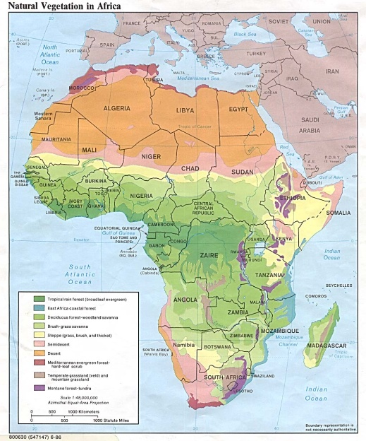
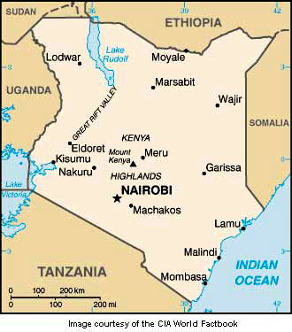
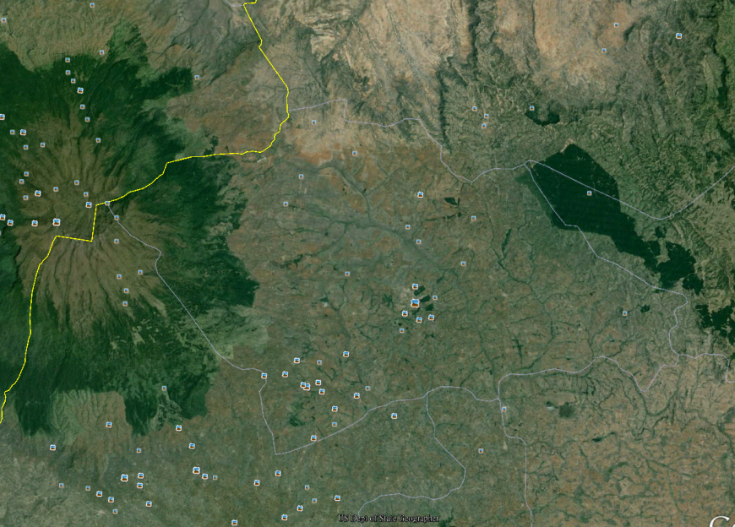
1. Objective
The main objective of the study is to obtain spatial distribution map of various crops and their acreage in Kenya. Using two resolutions of remote sensing data and with the analysis of the vegetation distribution and growth characteristics in this country, we try to demonstrate the possible crop acreage monitoring scheme by remote sensing in Kenya. It is part of the research tasks in EC FP7 E-Agri Project.
Notes:
The objective of this research is to establish a national level business operation system for the supervision of the crop areas in Kenya. The slide shows the geographical locations and maps of African continent and Kenya, as well as the GooleEarth image of Trans Nzoia region of Kenya. The purpose of this slide is to demonstrate that the established business supervision system covers the total areas of Kenya, and that it mainly uses remote sensing data.

Slide 4
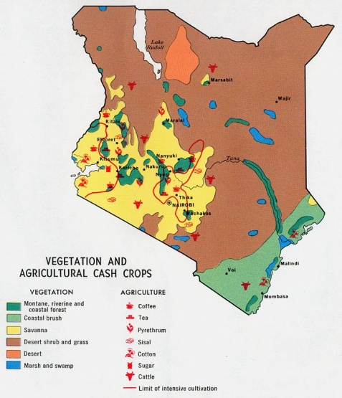
2. Basic Data and Background-(2)
Distribution of precipitation
Natural vegetation in Kenya
Vegetation and economic
crops in Kenya
Distribution of agriculture crops in Kenya
Rainy season and its maximum month
April-July, Maximum in May
March-May and October-December, Maximums in April and November
March-May and October-November, Maximums in April and October
December-May, Maximum in March
December-May, Maximum in April
March-May, Maximum in May
March-October, Maximum in May
March-September, Maximums in May and August
January-December, Maximums in April and December
Notes:
Data such as precipitation, natural vegetation, crop distribution of Kenya are collected. Preliminary results indicates that, the natural vegetation distribution in Kenya shows a regional regularity according to the volume of precipitation. From northeast to southwest, along with the precipitation decrease from below 250mm to above 1,700mm, the vegetation distribution of this country shows are change pattern from desert, to grassland, and then to forest. Crops are mainly distributed in the regions with the precipitation above 500mm, while the arable lands sporadically distributed in the regions with less precipitation are mainly the irrigation agriculture; In addition, the south-eastern costal areas with good sea water conditions are also distributed with some arable lands. In general, the arable lands in Kenya are mainly established based on forest regions.

Slide 5
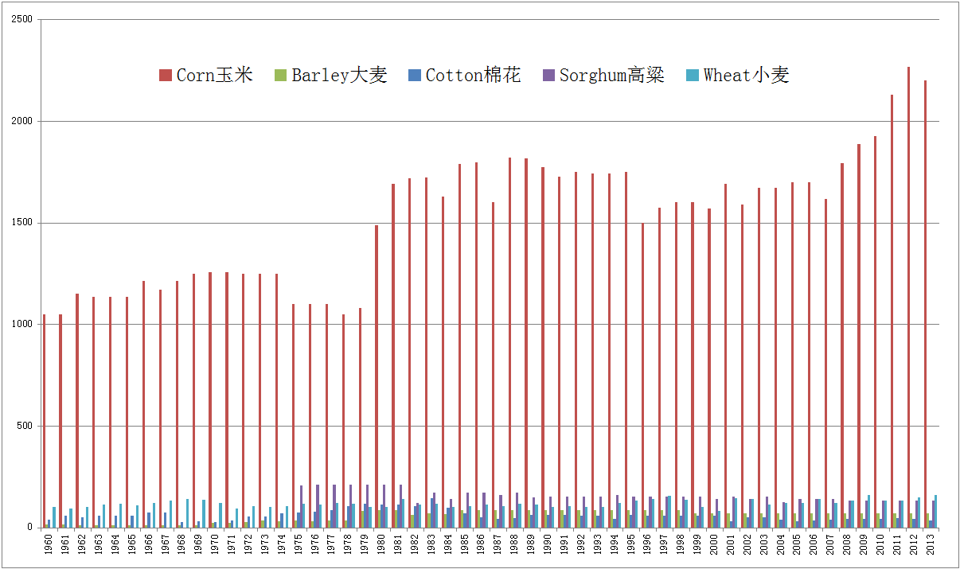
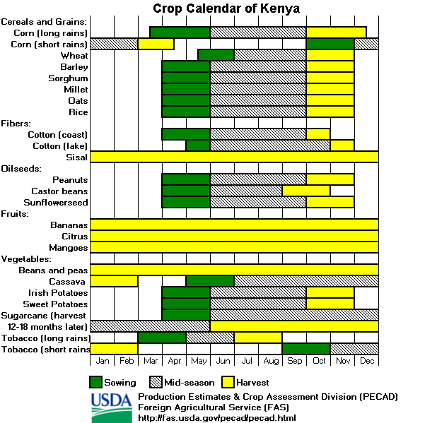
2. Basic Data and Background-(2)
Administrative division
Rivers
Cities and towns
Elevation
Agriculture statistics
Crop phenology
Notes:
This slide shows the administrative boundaries of the “regions” of Kenya before change of its zoning, as well as some vector data such as agricultural statistics, bioclimatology, elevation, water systems, urban areas, etc., which could help researchers to conduct the statistics of crop classification result, and help them to validate the types of crops.

Slide 6
3. Remote Sensing Data-(1)
LandSat-8/OLI and EOS/MODIS data are taken as the remote sensing data for crop classification in this study. The spatial resolution of OLI data is 30m, and the spatial resolution of MODIS NDVI data is 250m.
LandSat-8/OLI：April-September 2013，138 images in total。
April: 18 images;
May: 34 images;
June: 42 images;
July: 62 images;
August: 68 images;
September: 8 images。
EOS/MODIS/NDVI：January-December 2012, maximum composited in 16 days, 23 images.
Notes:
The slide shows the remote sensing data currently used in this research project and its quantity.

Slide 7
3. Remote Sensing Data-(2)
LandSat-8/OLI data have 8 bands, all of which have been used in classification process. DN value is used directly for classification, and it is also used for the calculation of NDVI value. The total territory of Kenya are covered by the 138 images, even though the coverage of each month varies.
Total coverage of 138 images from April to September
Coverage of 18 images in April
Coverage of 42 images in June
Notes:
The slide illustrates the Kenya regional coverage of obtained OLI data. It is difficult to obtain total coverage of crop areas with the different development stages in the regions of Kenya.

Slide 8
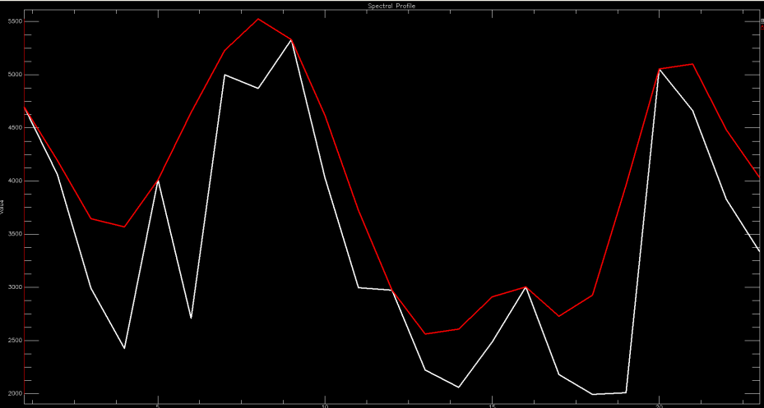
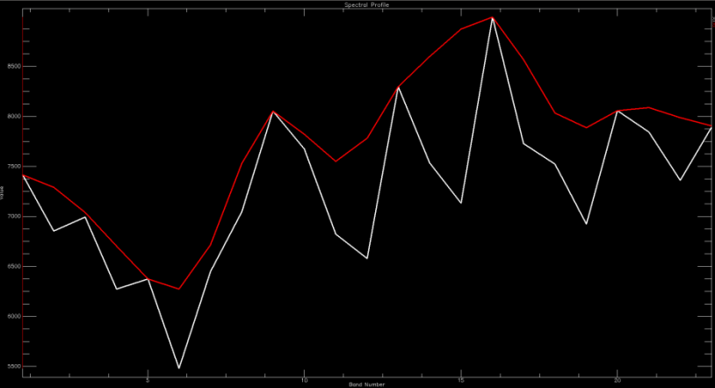
3. Remote Sensing Data-(3)
The 16-day maximum-value composite EOS/MODIS/NDVI data was used in this study. Data smoothing is conducted by using Savitzky-Golay filter.
A comparison is conducted on the effect before and after conducting Savitzky-Golay filtering (before filtering is white, and after filtering is red)
Notes:
The slide shows the Kenya MODIS/NDVI information, and the data come from website of NASA of USA. The image on the right is the NDVI data after S-G filtering.

Slide 9
4. Research Scheme-(2)
Technical Route of Crop Area Identification in Kenya
Background Data/Analysis
EOES/MODIS Data
LandSat-8/OLI data
Vegetation/crop classification system
Time Series S-G Filtering
Cloud Mask/data Interpolation
Typical Ground Object Visual Identification based on Googl Earth/QuickBird Data
MODIS/NDVI Spectrum
OLI Reflectivity/NDVI Spectrum
OLI Interpretation Mark
S-G Smoothed MODIS/NDVI Data
OLI Multi-temporal Data
OLI Multi-temporal Data
250m Vegetation/crop Spatial Distribution Mask
ISODATA Unsupervised Classifier
ISODATA Unsupervised Classifier
ISODATA Unsupervised Classifier
50-100 Types to Be Identified
50-100 Types to Be Identified
150-200 Types to Be Identified
Acquisition of Spectrum Curve of the Type to Be Identified
Acquisition of Reflectivity/NDVI Spectrum of Type to Be Identified
Interpretation Features of Types to Be Identified
Comparison of Spectral Shape
Comparison of Spectral Shape
Visual Comparison
250m Vegetation/crop Spatial Distribution
30m Vegetation/crop Spatial Distribution
30m Vegetation/crop Spatial Distribution
Different Supervision Method Efficiency/Precision Comparison/Process Solidification
Notes:
This slide could be divided into three levels and three major routes. Horizontal routes include data preparation, research method, and result summarization, and longitudinal routes take three research methods as their major technical routes.

Slide 10
5. Research Process and Results-(1)
Vegetation/crop classification system
MODIS/NDVI spectra of the typical vegetation
Maize OLI interpretation features
OLI spectral features of some crops in Trans Nzoia region
250m vegetation/crop spatial distribution in Kenya
30m maize spatial distribution in Kenya
Corp spatial distribution in Trans Nzoia region
Notes:
This slide illustrates the specific process of current research, including classification system, data and method used in this research, as well as the results（resolution of 250m and 30m ）of Trans Nzoia region of Kenya.

Slide 11
5. Research Process and Results-(2)
Vegetation classification system
Desert
Shrub Brush Vegetation
Woody Brush Vegetation
Prairie
Savannah
Forest
Mangroves
Wetlands
Cropland
Bare areas
Urban areas
Notes:
Preliminarily established vegetation classification system.

Slide 12
5. Research Process and Results-(3)
Crop Classification System
Tree crop
Coconut/Lemon and lime/Apple/Pear/Orange/Avocado
Shrub crop
Coffee/Tea/Cassava/Pigeon pea/Oil palm
Herbaceous crop
Maize(Corn)/Sugarcane/Wheat/Sorghum/Barley/Oats/Millet/Teff/Sunflower/Cotton/Seed Cotton/Sweet potatoes/Irish potatoes/Bean,green/Pea,green/Soybean/Cowpea/Sisal/Cabbage /Cucumber,gherkin/Tomatoe/Watermelon/Spinach/Lettuce/Onions/Garlic/Chillie,pepper,green/Banana/Pineapples/Okra/Sisim/Yam/Cocoyam/Groundnut/Rice/Pyrethrum,dried
Notes:
Preliminarily established crop classification system is a two layer classification system.

Slide 13
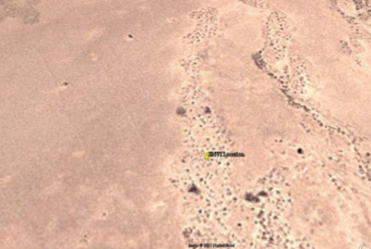
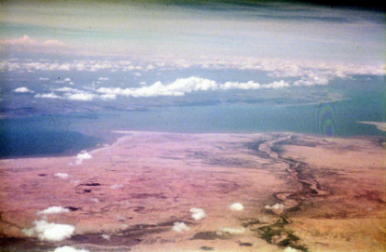
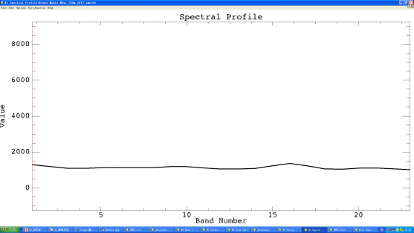
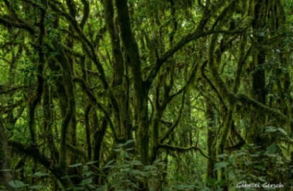
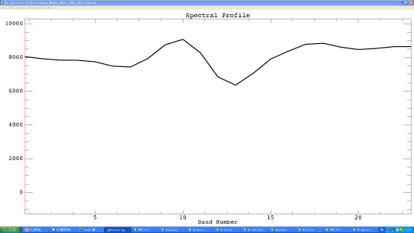
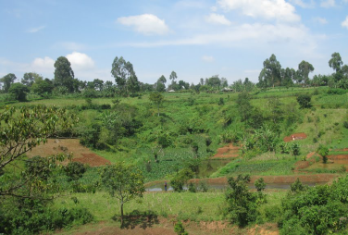
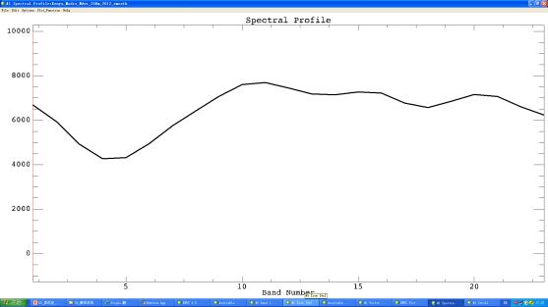
5. Research Process and Results-(4)
Contrast between Typical Vegetation MODIS/NDVI Spectrum and Actual Ground Objects
Desert
Desert
Desert
Forest
Forest
Forest
Arable land
Arable land
Arable land
Notes:
The slide shows the NDVI spectrum of three vegetation types of desert, forest, and arable land.

Slide 14
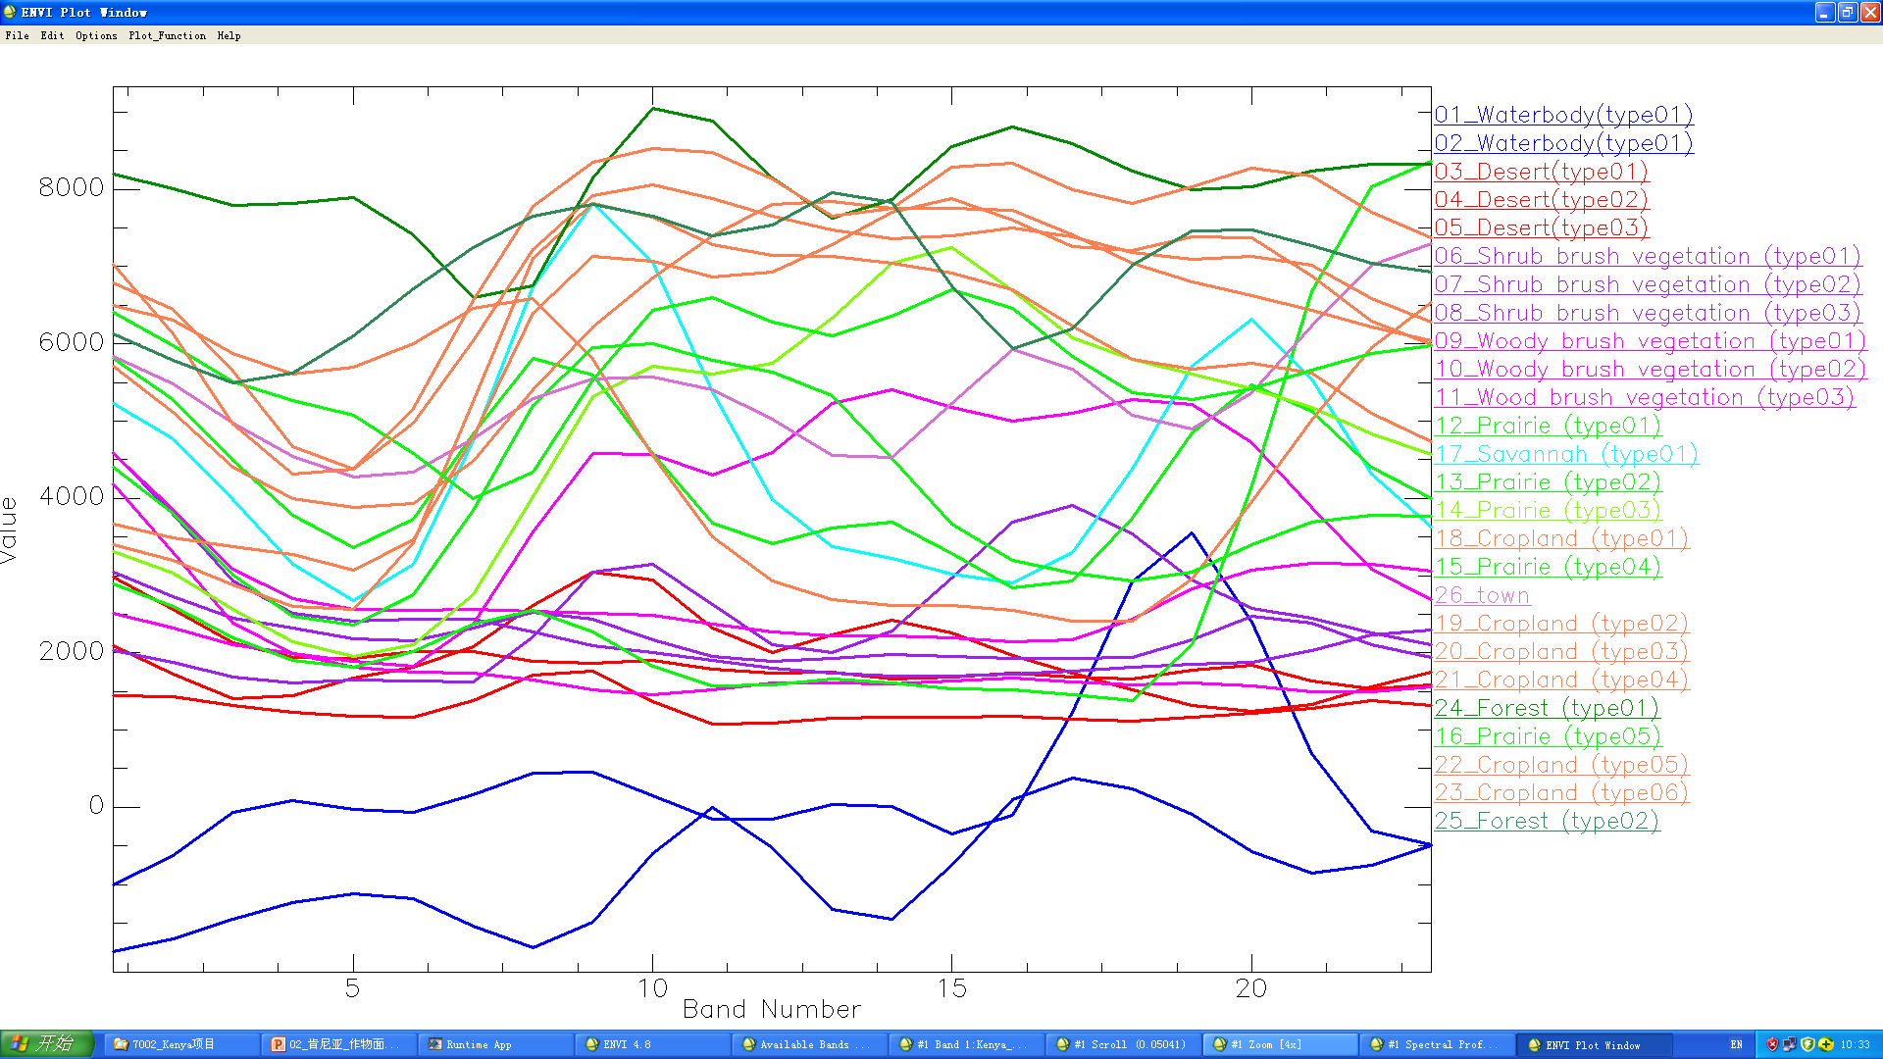
5. Research Process and Results-(5)
MODIS/NDVI Spectrum of Typical Vegetation
Notes:
A total of 100 types of ground objects to be classified are obtained through unsupervised classification method and a total of 26 ground object types are obtained through merging of similar NDVI spectrum curves. The slide shows the MODIS/NDVI spectrum curves of 26 types of ground objects.

Slide 15
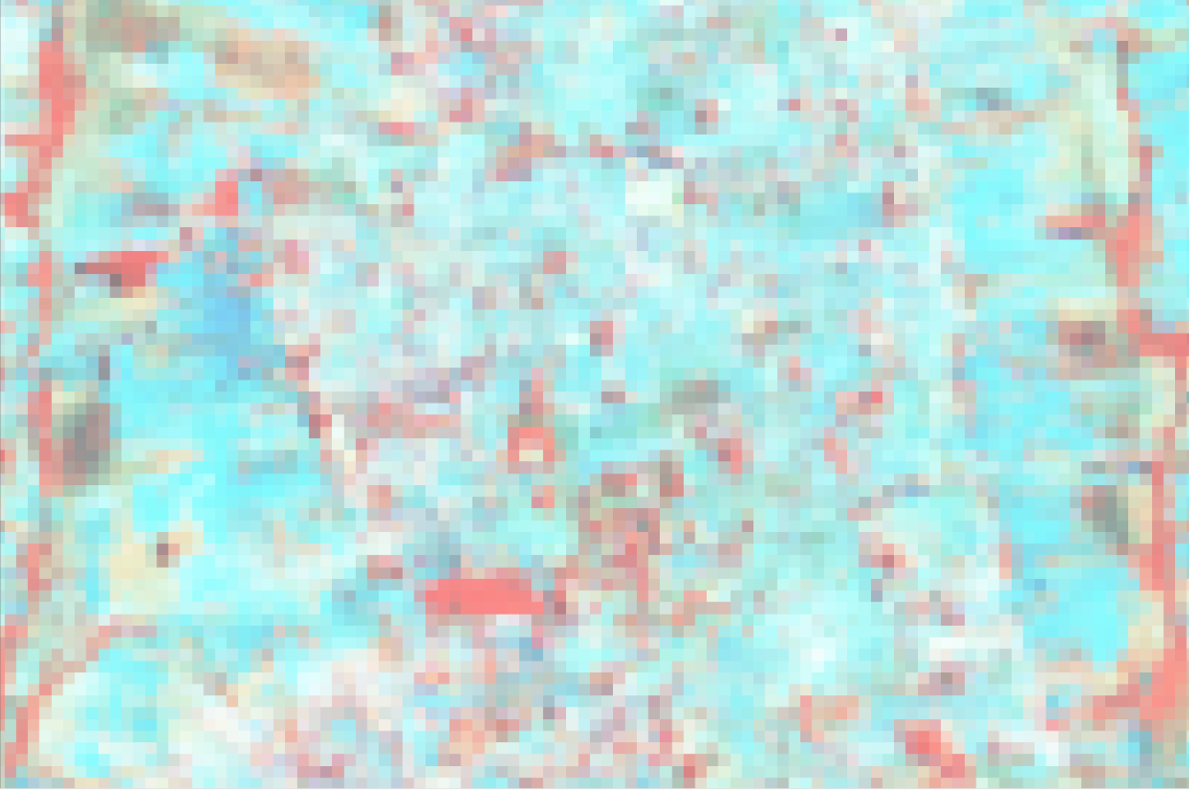
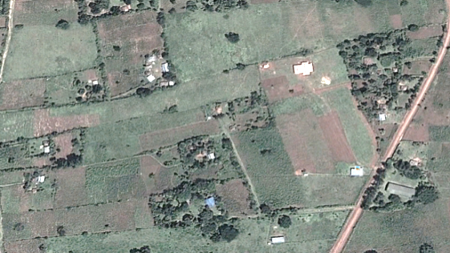
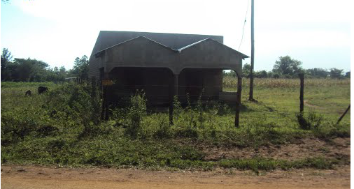
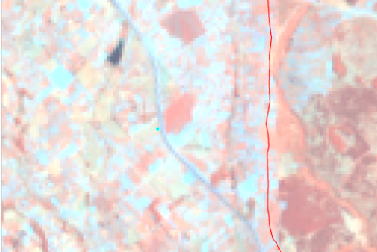
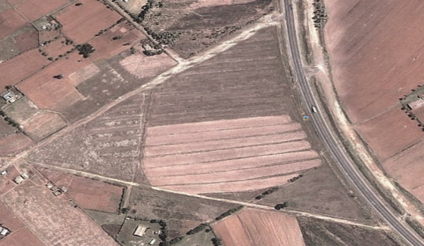
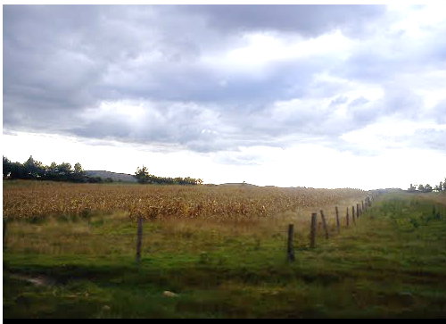
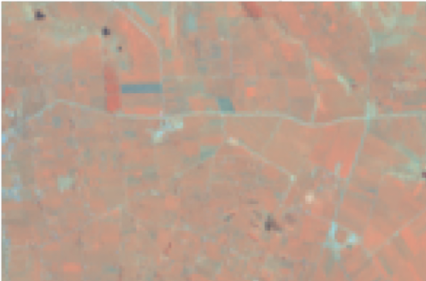
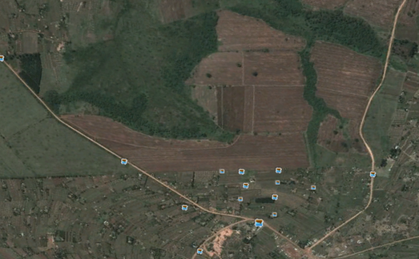
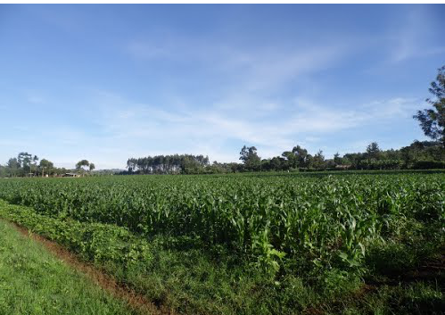
5. Research Process and Results-(6)
Establishment of Interpretation Characteristics of 30m Spatial Resolution OLI.
BUSIA（0°26′56.37″N，34°12′26.75″E）
NAKURU（0°11′17.56″ N，35°42′47.13″E）
TRANS NZOIA（0°53′57.61″N，34°51′23.47″E）
Notes:
The maize OLI identification features are established based on the Kenya 30m spatial resolution OLI data, and the identification of similar features of pre-classified 150-200 types to be further classified is conducted. Above slide shows the visual observation characteristics of different types of maize in different regions.

Slide 16
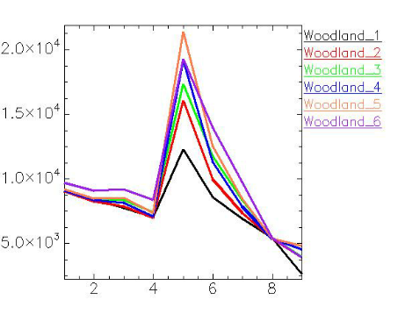
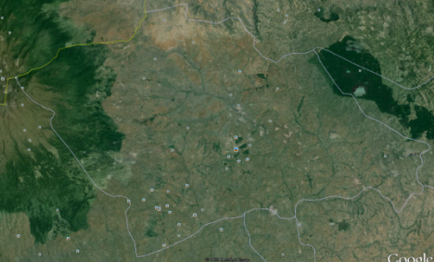
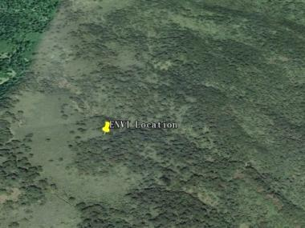
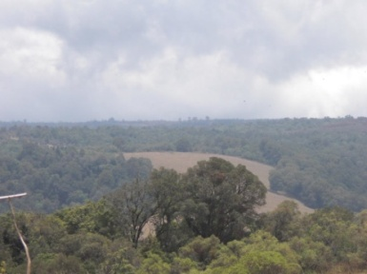
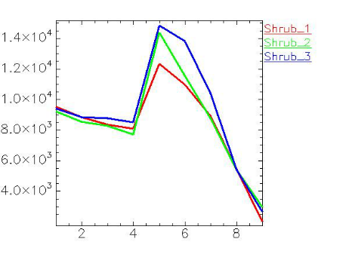
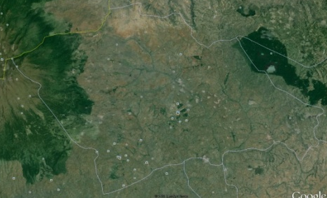
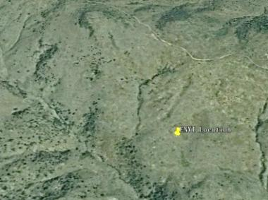
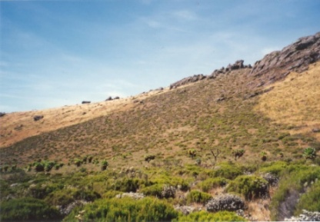
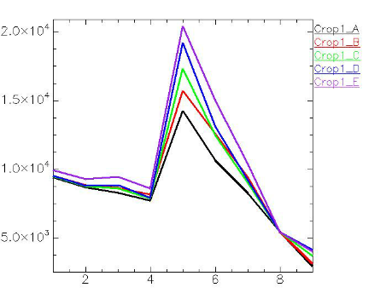
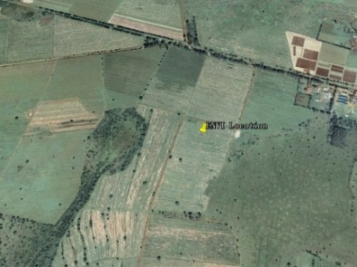
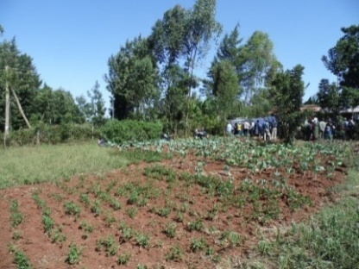
5. Research Process and Results-(7)
Contrast between OLI spectra of some crops of Trans Nzoia region of April 19th 2013 and actual ground object
Forest
Forest
Forest
Shrub brush
Shrub brush
Shrub brush
Arable land
Arable land
Arable land
Notes:
In the third research method, the OLI/DN value spectrum features of different periods are established; then crop characteristics obtained through MODIS/NDVI are taken as the background, to conduct the unsupervised classification of OLI images. The OLI/DN values of images to be classified are contrasted with the pre-established standard spectrum, to obtain 3 types of crops.
The above slide shows the classified results of 3 types of crops in Trans Nzoia region. The specific crop names need to be identified in the follow up jobs, and the current technical process has been established.

Slide 17
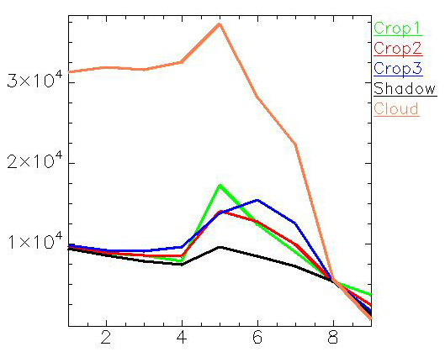
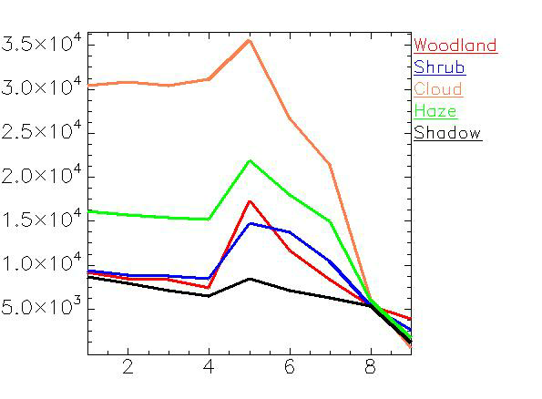
5. Research Process and Results-(8)
OLI spectra of some vegetation/crop in Trans Nzoia region in April 19th 2013
Three different crop types
Two different vegetation types
Notes:
The slide shows the amplified curve of OLI/DN values of 3 types of crops in Trans Nzoia region.

Slide 18
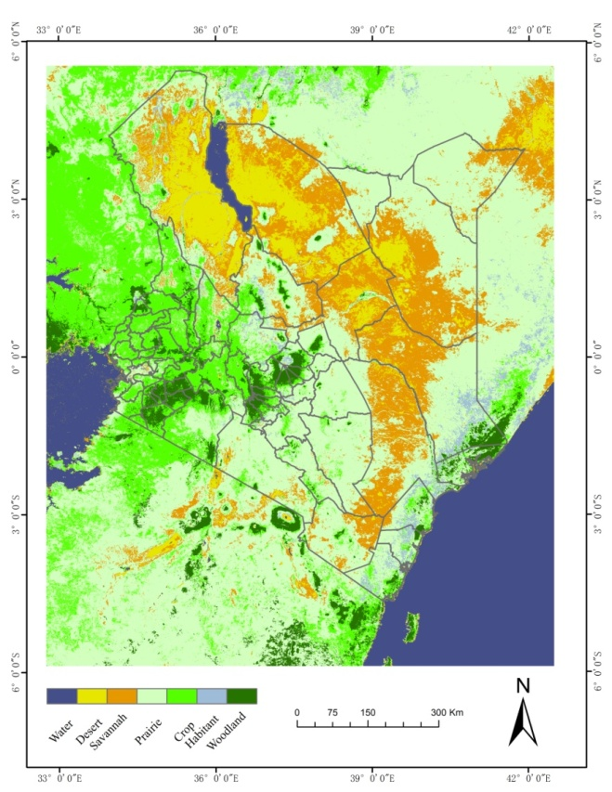
5. Research Process and Results-(9)
Kenya vegetation/crop spatial distribution based on MODIS/NDVI
ISOData method is used to classify the MODIS/NDVI time series data in Keyna in 2013, and they are classified into 100 types. By combing with GooglEarth, the types with similar spectrum are classified, to obtain two results of 26 types and 7 types. The statistics of the results of the 7 types is conducted. The desert, shrub and arber brush, grassland, savannah, crop, forest, water body, and urban areas account for 11.8%，11.4%，11.5%，15.6%，28.7%，13.4%，5.1%，0.1%, and 2.3% respectively.
100 types
26 types
7 types
Notes:
This slide show the vegetation classification result of Kenya based on MODIS/NDVI spectrum, the from left to the right of the slide are the 100types of crops to be validated, 26 types of merger results, and 7 types of merger results respectively. The image in the right is the merger result to show the regional distribution feature of vegetation of Kenya, and it can be seen that the spatial distribution of desert, grassland, forest, and arable land is basically consistent with the vegetation feature of the country. The name of vegetation may not be consistent with the common names used in Kenya, which needs to be unified in the follow up jobs.

Slide 19
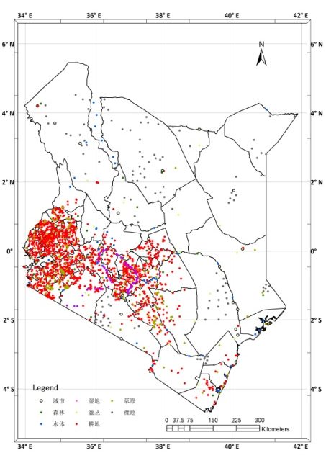
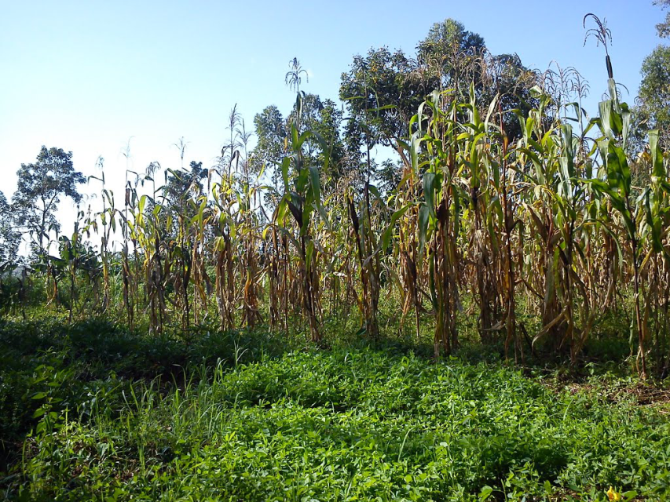
5. Research Process and Results-(10)
Kenya maize spatial distribution process based on LandSat-8/OLI
The unsupervised classification is conducted by taking a region as a unit, and by combing interpretation mark. 2570 verification sites were collected on GoogleEarth, and 63 verification sites were obtained through field study in 2012. For the use of multi-temporal data, classification is conducted firstly by using one image, and the regions which is mixed with other crops or vegetation are differentiated by gradually using other temporal phase data. By using above method, the cloud impact could also be eliminated, so that the maize distribution map of Kenya could be obtained.
GoogleEarth
Maize verification sites
Malanga village（0°07′27.55″N，34°26′02.01″E）
Notes:
This slide shows the selected identification sites in Kenya through Google Earth, which mainly include maize, but also include other types of crops. The image on the right is the image of maize obtained from GoogleEarth, and the purpose of this image is to strengthen the perceptual knowledge of viewers.

Slide 20
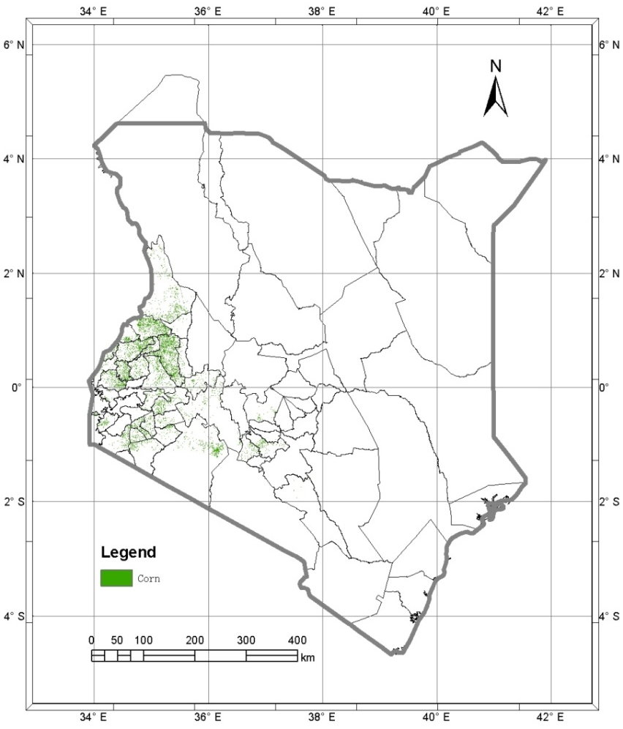
5. Research Process and Results-(11)
Kenya maize spatial distribution and quantity statistics based on LandSat-8/OLI
The maize area in Kenya is 9619,000 hectares, which are distributed in 47 regions of the country. There are 21 regions with their maize area exceeding 150,000 hectares, accounting for 90% of the total maize areas of the country.
Distribution of maize in Kenya
Distribution of major maize production areas in Kenya
Sn.: | DISTNAME | 1,000Hectares | Percentage
1 | UASIN GISHU | 1631.9 | 17.0
2 | TRANS NZOIA | 980.0 | 10.2
3 | WEST POKOT | 758.2 | 7.9
4 | BUNGOMA | 660.1 | 6.9
5 | NAROK | 568.3 | 5.9
6 | SIAYA | 491.2 | 5.1
7 | NANDI | 453.3 | 4.7
8 | BUTERE/MUMIAS | 393.1 | 4.1
9 | KERICHO | 321.5 | 3.3
10 | NAKURU | 261.7 | 2.7
11 | KAKAMEGA | 257.7 | 2.7
12 | MIGORI | 239.6 | 2.5
13 | CENTRAL KISII | 213.6 | 2.2
14 | NYANDO | 203.4 | 2.1
15 | KOIBATEK | 201.7 | 2.1
16 | TRANS MARA | 184.6 | 1.9
17 | TESO | 182.7 | 1.9
18 | LUGARI | 177.2 | 1.8
19 | THIKA | 171.0 | 1.8
20 | SUBA | 152.9 | 1.6
21 | NYAMIRA | 152.2 | 1.6
22 | OTHER PRODUCTION AREAS | 963.1 | 10.0
23 | MAJOR PRODUCTION AREA | 8655.9 | 90.0
24 | THE WHOLE COUNTRY | 9619.0 | 100.0
Notes:
Above slide shows the Kenya maize spatial distribution based on the resolution of 30m and a statistical table.

Slide 21
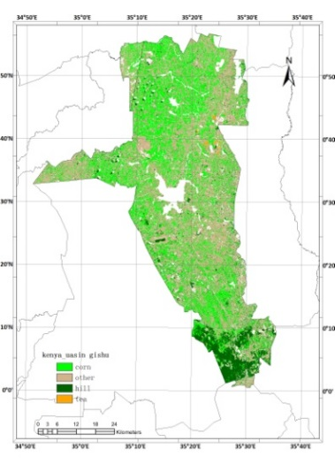
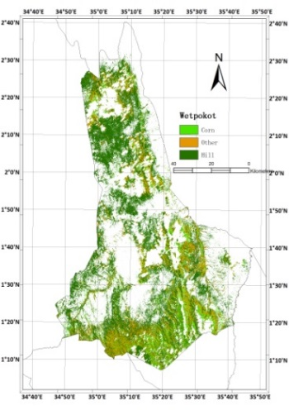
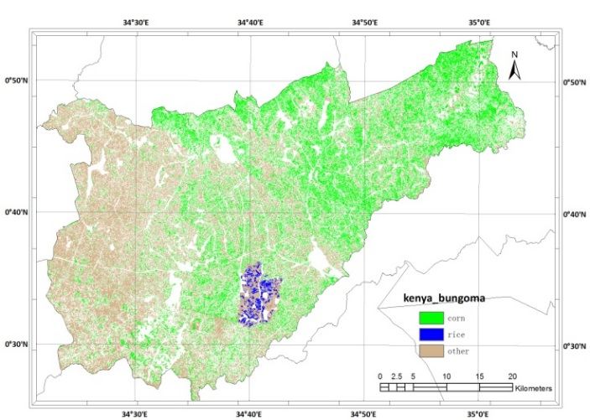
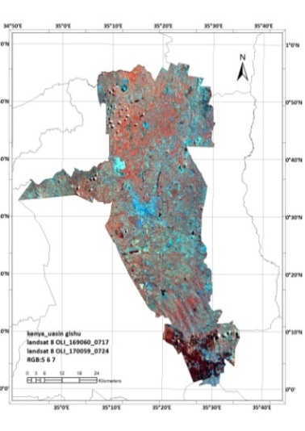
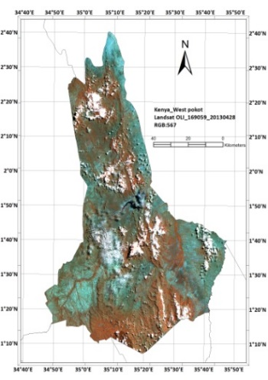
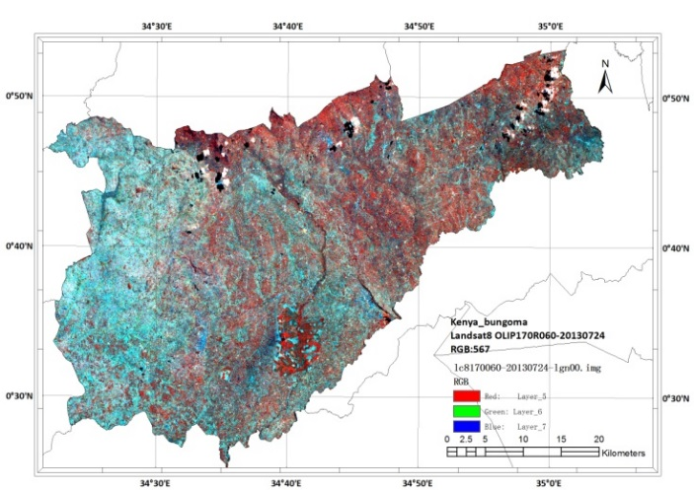
5. Research Process and Results-(12)
Maize spatial distribution of major production areas of Kenya based on LandSat-8/OLI(Example)
Uasin Gishu, Trans Nzoia, West Pokot, and Bungoma are top 4 maize production areas, and their maize planting areas were 1631,900, 980,900, 758,200 and 660,100 hectares，accounting for 17.0%，10.2%，7.9% and 6.9% of the total maize areas of Kenya.
Uasin Gishu
Trans Nzoia
West Pokot
Bungoma
Notes:
Above slide shows the maize spatial distribution of major maize production areas of Kenya and the original OLI image, which mainly demonstrates the amplified effect of the interpretation result.

Slide 22
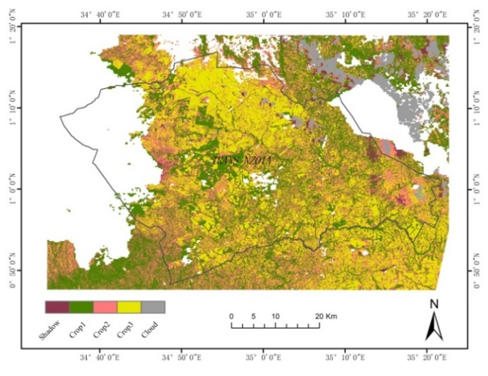
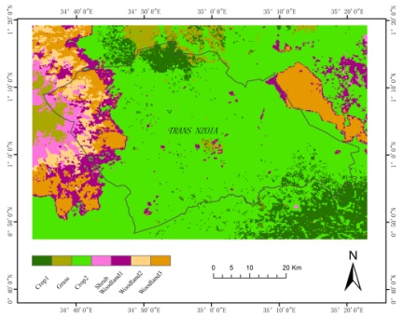
5. Research Process and Results-(13)
Trans Nzoia region crop spatial distribution of April 19th 2013 based on MODIS/NDVI and OLI
30m classification results combined with 250m information
250m background map
250m vegetation classification result obtained by using MODIS/NDVI is taken as background map, and the OLI data of April 19th 2013 is used to conduct re-classification. Under each background, ISODATA is used to classify the crops into 20 types, and then by comparing spectral characteristics they were merged into 3 crop types. The higher precision crop identification needs to use different temporal OLI data. Combination of 250m method and 30m method is essentially to extract crops in a small area and spectrum range, which could reduce the confusion degree of crop spectrum, and may improve the monitoring precision.
30m 20 types results under 250m crop mask
30m classification results combined with 250m information
30m 20 types results under 250m forest mask
Notes:
The above slide shows that specific implementation process of the second method. The first image on the upper left of the slide shows the NODIS/NDVI vegetation extraction result, and the second and the third image on the left shows the results of crops and forests. The first image on the right is the 30m result of 3 crops extracted under the background of 250m arable land, and the second image on the left is the forest result extracted under the background of 250m forest; the two images on the right are the synthetic result of crops and forests.

Slide 23
5. Research Process and Results-(14)
Trans Nzoia region crop spatial distribution of April 19th 2013 based on MODIS/NDVI and OLI
Trans Nzoia region crop spatial distribution of April 19th 2013 based on MODIS/NDVI and OLI
Initial result showed that, Trans Nzoia forest, shrub, type1 crop, type2 crop, type3 crop,and other ground objects accounted for 252.4, 85.2, 692.2, 591.8, 742.9, 111.9km²，accounting for 10.2%，3.4%，28.0%，23.9%，30.0% and 4.5% respectively.
Crop_01
Crop_02
Crop_03

Slide 24
6. Existing Problems and Further Work-(1)
To further clearly define the classification system: current classification system has clear definitions on desert, forest, and arable land, but its definitions on Grassland, Shrub brush vegetation, Woody brush vegetation and Savannah are not clear, which may affect the accurate classification of vegetation types, and may affect the precision of crop area identification under these backgrounds. 。
To further improve the construction of crop OLI spectral library: only single phase data of OLI based typical vegetation/crop spectrum is obtained, but the further improvement should be made on multi temporal data.
To further improve the crop identification process under the condition of cloud pollution: under cloud condition, joint classification of multi temporal data is infeasible, while classification could only be achieved by single phase data successive classification. A more clearly defined process is required to ensure the high work efficiency.。
To further refine the classification result: wet land and mangrove forest are classified into the types of Grassland, Forest, etc. They are not reflected in the current results and need to be further refined in the later researches.。
To further study the manual modification method of OLI based data: study should be mainly focused on the efficiency and precision of staple crops unsupervised classification + manual visual modification method. This method is a effective method for the operation.。
To strengthen the comprehensive study on multiple methods: comparison of the precision and efficiency of the 3 methods used in this study should be made, and the target of the follow-up study is to improve the precision of staple crop classification to 85-95%.。
Notes:
This slide summarizes the existing problems and the goal of the next step jobs. It mainly includes three aspects: one is the modification of the classification system; the second is the further study of the 3 research methods; the third is the further solution for the problems such as cloud pollution.

Slide 25
6. Existing Problems and Further Work-(2)
Spectral curve in Northeast of Trans Nzoia region is affected by cloud. How to effectively make use of clear sky area will be the focus of the next step research, and it is also an issued which must be dealt with in operation process.
April 19th 2013
May 5th 2013
May 21st 2013
June 22nd 2013
July 27th 2013
July 08th 201
Notes:
The slide shows the DN value abnormal under the condition of OLI data cloud pollution, and the cloud pollution characteristics, namely, increased reflectivity and decreased NDVI value.

Slide 26
6. Existing Problems and Further Work -(3)
Yala Swamp OLI Image on April 19th 2013
Yala Swamp GooglEarth Image
Yala Swamp Landscape
Wetland
Wetland
Rice
Rice
Meru Central OLI Image on May 23rd 2013
Meru Central GooglEarth Image
Meru Central Cropland
Notes:
This slide shows the confusion among different ground objects, and confusion among different crops. It illustrates the confusion between wet land and paddy field; it also illustrates the different types of arable lands. It is difficult to achieve automatic differentiation by only relying on few OLI time phase data, and subsidiary classification under the support of 250m spatial data is required. However, on the basis of crop identification, by using unsupervised classification, and modified by visual observation, the spatial distribution of staple crops could be obtained.

Slide 27
7. Conclusions
The research presented here is just a preliminary result to use remote sensing data for crop classification in Kenya. All the auxiliary data are from internet, including Google-Earth images and photos. The in-situ ground-truthing data is lack.
The crop planting pattern in Kenya is very complicated, which made the crop classification with remote sensing very difficult.
It is possible to use medium and low resolution remote sensing data for staple crops (such as maize) monitoring in Kenya, with integrating time-series MODIS and Landsat8 OLI images.
A lot of further work to be done to improve the classification result and put it into application.
Notes:
From the analysis of the progress of the current study, the semi-automated crop extraction in Kenya is likely to be achieved.

Slide 28
Thanks!
谢 谢!
Bedankt!
Grazie!
Merci !

